Slide 1
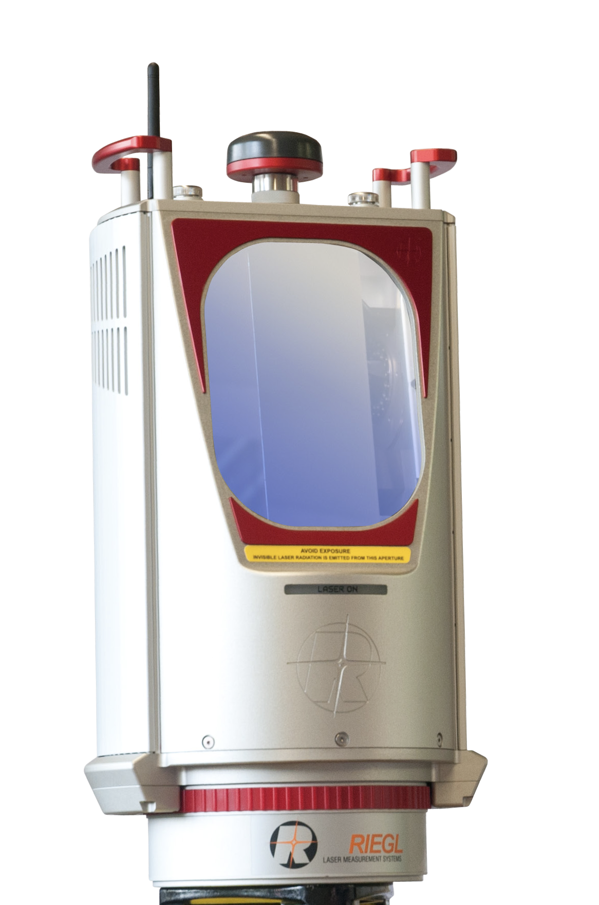




.las/.laz
.csv
…
PyMultiLidar
Import
Analysis and visualization
Recording
.bag
Frame
= single point cloud
Dataset
= multiple point clouds
Frame
Export
.csv
…
Import
Frame
…

