Slide 1
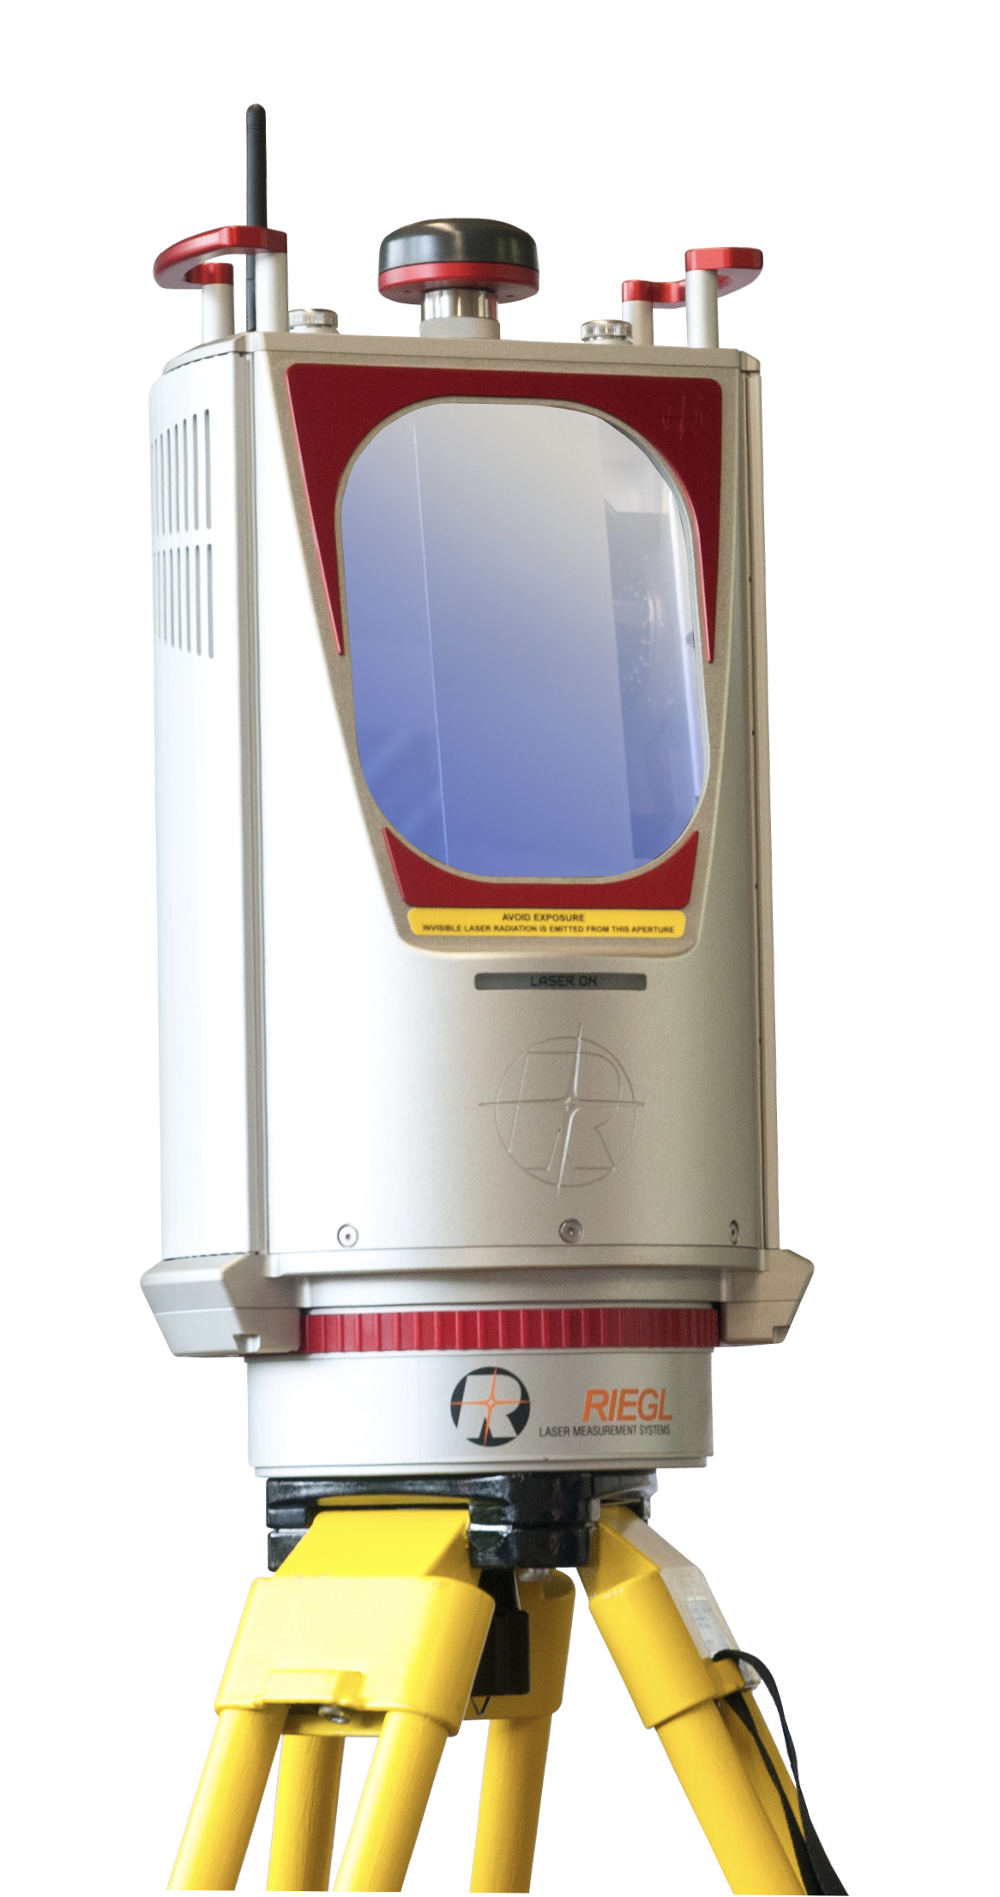




.las/.laz
.csv
…
pointcloudset
Import
Analysis and visualization
Recording
.bag
PointCloud
= single point cloud
Dataset
= multiple point clouds
PointCloud
Export
.csv
…
Import
PointCloud
…

Slide 2

stored Dataset
Dataset.from_file()
pointcloudset.Dataset
ROS
.bag
stored Dataset
Point Cloud
Point Cloud
Point Cloud
bag2dataset
CLI tool
data
stored Dataset
timestamps
[datetime.datetime(2020, 12, 2, 10, 23, 48, 995642), datetime.datetime(2020, 12, 2, 10, 23, 49, 154242), datetime.datetime(2020, 12, 2, 10, 23, 49, 238166)]
[datetime]
ROS
.bag
Dataset.from_file()
[ ]
meta
{'orig_file': 'vib2_2020-12-02-11-22-46.bag', 'topic': '/os1_cloud_node/points'}
dict
Point Cloud
Point Cloud
Dataset.from_instance()
List of PointClouds

Slide 3

pointcloudset.PointCloud
.las
.csv
And more
data
.las
.csv
And more
PointCloud.from_file()
points
pyntcloud
timestamp
datetime
orig_file
str

