Slide 1
Group 5
SQUAWK
CHUN HE
RUI ZHAO
ZONGRU LI
JUYIN TANG

Slide 2
Project Overview
The project is a simplified, functional clone of Twitter designed to capture its core social media loop.
The main purpose is to allow users to post short messages and interact with each other in a public forum.
Target Users
Stakeholders
Primary Users ("Squawkers"): General web users interested in a micro-blogging experience.
Group Members :
The stakeholders responsible for building, testing, and deploying the application.

Slide 3
Main Functionalities
User Account Management: Secure sign-up, login, and logout functionality.
Content Creation: Users can create and publish short text posts called "Squawks".
Social Graph: Users can follow and unfollow other users to customize their content experience.
Personalized Feed: A chronological homepage feed that displays Squawks from all followed users.
User Profiles: Every user has a public profile page displaying their information and a timeline of their Squawks and interactions.
Core Engagement: Users can interact with Squawks by Liking, Replying, and Resquawking (the equivalent of a retweet).

Slide 4
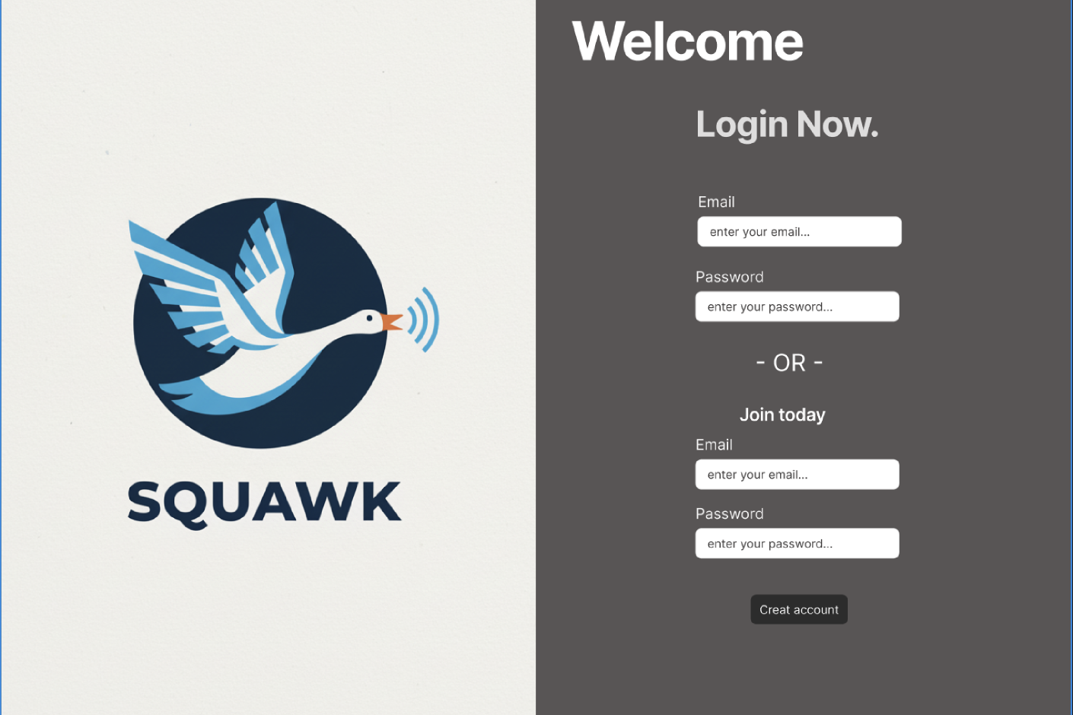
Prototype UI Design

Slide 5
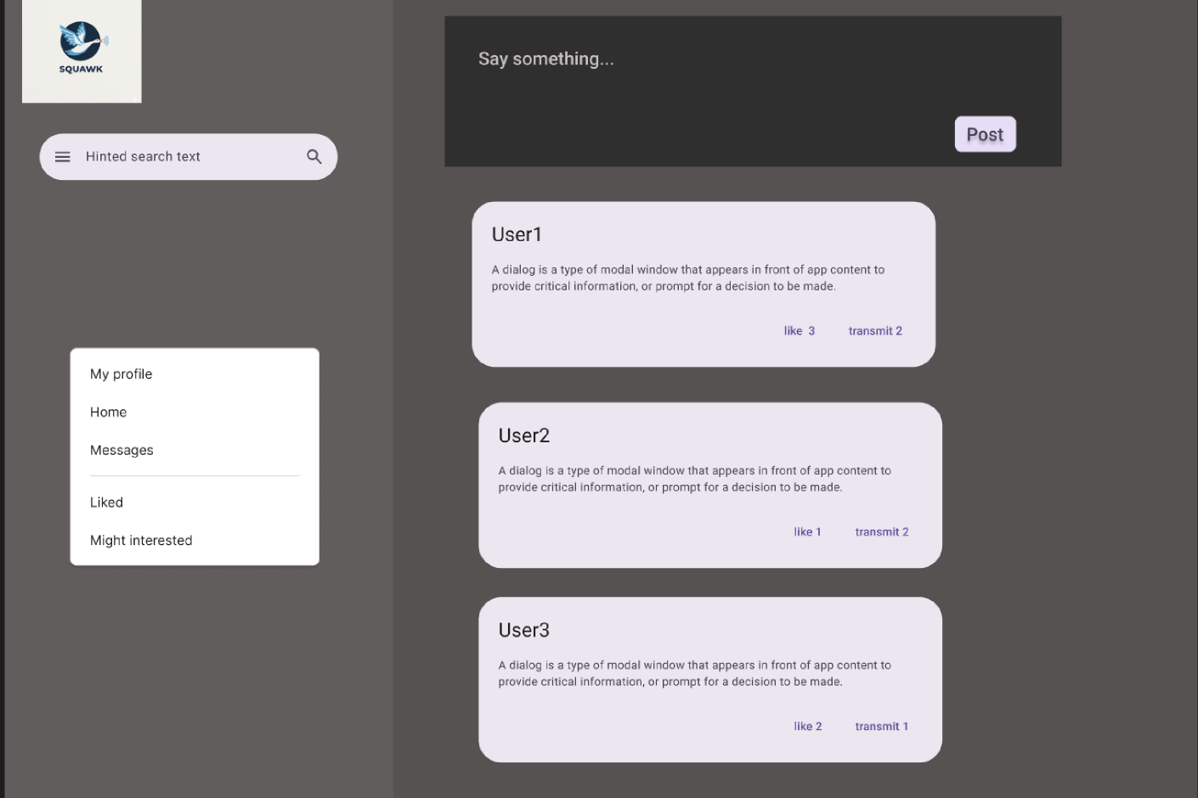
Prototype UI Design

Slide 6
User Stories
Account & Profile
The Social Graph
As a new user, I want to sign up with a unique username, email, and password on Squawk.
As a registered user, I want to log in with my registered account on Squawk.
As a logged-in user, I want to view profile page of mine, so that I can see my bio and a list of all my past Squawks.
As a user on someone else's profile, I want a "Follow" button, so that I can subscribe to their content.
As a user on the profile of someone I follow, I want an "Unfollow" button, so that I can stop seeing their content in my feed.
Content Creation & Interaction
Content Consumption
As a logged-in user, I want to publish a short text message (a "Squawk"), so that I can share my thoughts with my followers.
As a user viewing a Squawk, I want to "Like" it, so that I can show appreciation and the author can see it.
As a user viewing a Squawk, I want to Resquawk it, so that I can share it with my own followers.
As a user viewing a Squawk, I want to post a reply to it, so that I can engage in a public conversation.
As a logged-in user, I want to view a chronological feed on my homepage containing Squawks and Resquawks from users I follow, so that I can see the latest content.
As a user, I want to click on any Squawk in my feed to view it as a standalone page with its full conversation thread (replies), so that I can understand the context of the discussion.
(Crafted with INVEST Principles)

Slide 7
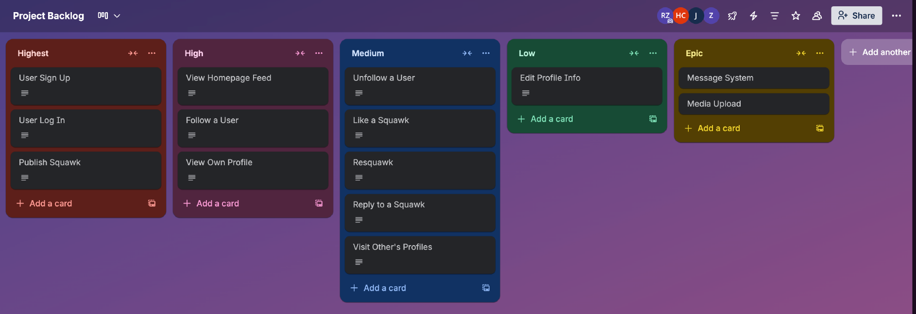
Product Backlog
Based on DEEP principle: Detailed Appropriately / Emergent / Estimated /Prioritized

Slide 8
Sprint Ceremonies & Insights
1
Daily Scrum: Daily online meeting to discuss everyday process or difficulties if any for at least 15 minutes.
Sprint Review:
During the review of the UI, we realized our initial design was too complicated to complete on time, leading to a simplified UI prototype.
While reviewing the backlog, we found some of them may be too complicated to achieve, so we decided to break them down further to make the backlog more manageable. e.g. Account system.
2

Slide 9
Sprint Retrospective
Liked
Our collaboration was a big success. Everyone contributed equally, and brainstorming sessions were creative and open.
1
Lacked
Our initial brainstorming sessions could have been more structured with the help of some useful tools such as Miro.
2

Slide 10
Sprint Retrospective
Learned
The Power of a Shared Vision: Before this sprint, "Squawk" was just an idea. Now, it's a concrete plan. We are no longer working on four different versions of the project in our heads; we are all working towards one.
3
Longed for
We are looking forward to optimize the UI design by making it more easy to use and beautiful to watch. The elaboration on the more detailed and achievable functionalities design is another goal.
4

Slide 11




Main Team Contributions
Chun He
Product Owner
Rui Zhao
Scrum Master
Zongru Li
Product Owner
Juyin Tang
UX/UI Design Lead
Group 5

Slide 12
Collaboration Highlights
Our most successful collaboration was the User Story Workshop. Our Product Owners would propose a story, and other group members would estimate the availability to convert it to a achievable function, then our UI Lead would immediately mock up a rough visual.
1
2
Furthermore, the UI Prototype Design wasn't a solo effort. The entire team provided continuous feedback to the logo design and so on.

Slide 13
THANK YOU
ANY QUESTION?

