Slide 1

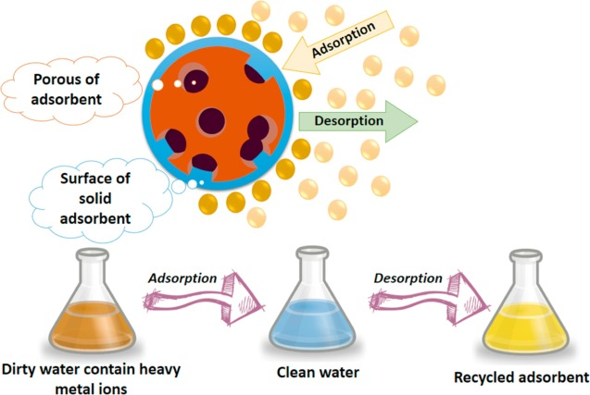
PUNJAB ENGINEERING COLLEGE | MMED
Machine Learning-Assisted Prediction and Interpretation of Adsorption Capacity
Water pollutant removal: Pb(II), Cd(II), methylene blue and Congo red
Aditya Agrawal • Sarthak Srivastava
SIDs :- 24108036 • 24108047
Mentor :- Dr. Vishwendra Pratap Singh | MMED | PEC
Mid-semester minor project progress evaluation

Slide 2
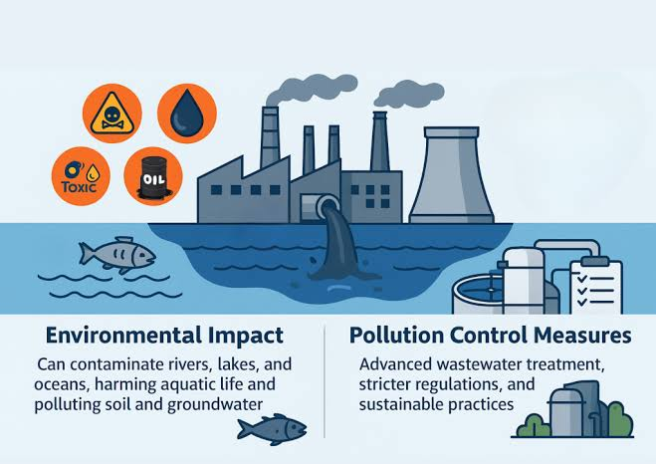
1. The engineering problem: polluted water, variable adsorption performance
Why industry needs a predictive and interpretable approach ?
• Industrial effluents may contain toxic metal ions (Pb²⁺, Cd²⁺) and coloured organic dyes (methylene blue, Congo red).
• Sources include metal finishing/battery-related streams and dyeing/textile processes; actual effluent composition varies by industry.
• Adsorption transfers pollutants from water to a solid adsorbent; performance depends on both the material and operating conditions.
• Trial-and-error experiments consume time, chemicals and analytical effort. A reliable predictor could screen conditions and prioritize experiments.
• Engineering challenge: predict equilibrium adsorption capacity (qₑ, mg/g) while understanding the limits of the prediction.
Industrial relevance: process screening • adsorbent selection • reduced experimental burden
2

Slide 3
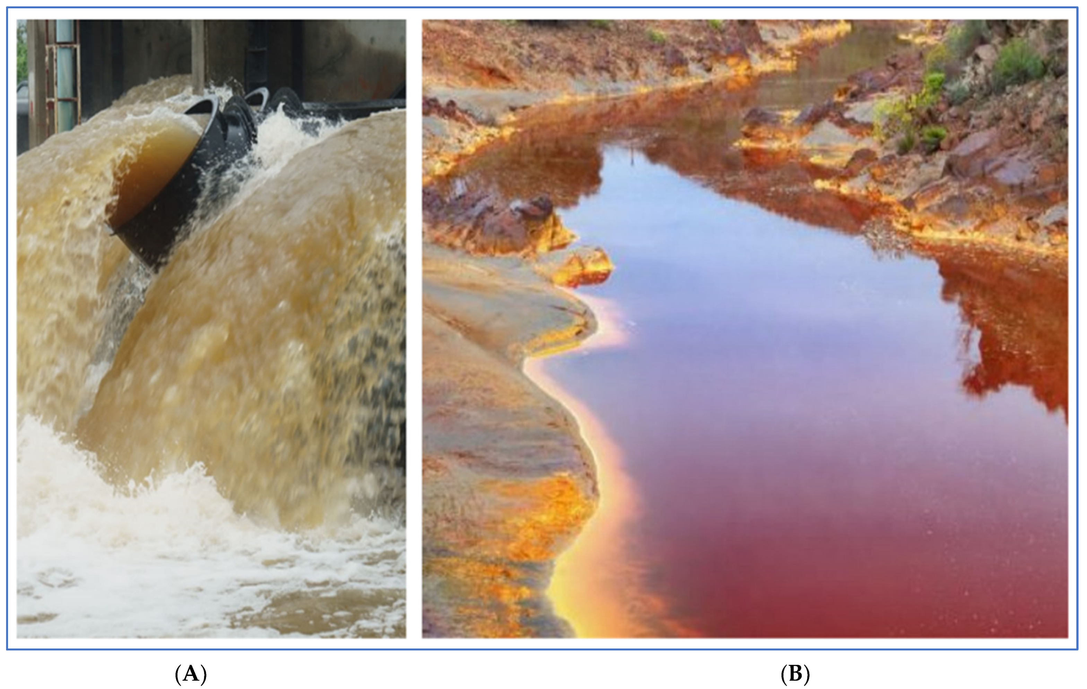
2. Aim, objectives and pollutant scope
Progress is staged: first establish a traceable literature baseline, then extend and validate
AIM
POLLUTANTS
TARGET
Build an interpretable ML workflow to estimate adsorption capacity from material properties and experimental conditions.
Metals: Pb(II), Cd(II) | Dyes: methylene blue (MB), Congo red (CR).
Equilibrium adsorption capacity, qₑ (mg/g), as reported or derived in the source literature.
• Collect comparable experiments from peer-reviewed literature and retain paper IDs and extraction notes.
• Clean numeric fields, audit ambiguity and missingness, and document all transformations.
• Train a first Linear Regression baseline; evaluate error and interpret coefficients cautiously.
• Extend to non-linear models and source/material-aware validation before claiming generalization.
Polluted Water Bodies due to dyes and heavy metals
Scope note: the current compiled sheet is an activated-carbon literature dataset; it is not yet a separately identified dataset of metallurgical-waste-derived adsorbents.
3

Slide 4
3. Variables and their expected influence on qₑ
Expected mechanisms guide feature selection; effects are conditional, not universal
Solutions / operating conditions
Material descriptors
Kinetics / thermodynamics
BET surface area (m²/g): accessible area often increases available sites.
Pore volume (cm³/g): pore accessibility and size distribution matter.
pHₚzc / elemental composition: surface charge and functional groups.
Initial concentration C₀ (mg/L): changes driving force and site saturation.
pH: changes pollutant speciation and adsorbent surface charge.
Dosage (g/L): more mass may raise removal %, but qₑ per gram may fall.
Contact time (min): uptake rises until equilibrium is approached.
Temperature (K): effect depends on adsorption thermodynamics.
Pollutant identity: metal ions and dyes have different interaction mechanisms.
Target: qₑ = (C₀ − Cₑ)V / m = (C₀ − Cₑ) / dose [mg/g when concentrations are mg/L and dose is g/L]
Cₑ is post-adsorption information: kept for mass-balance QC, excluded from pre-experiment predictors to avoid target leakage.
4

Slide 5
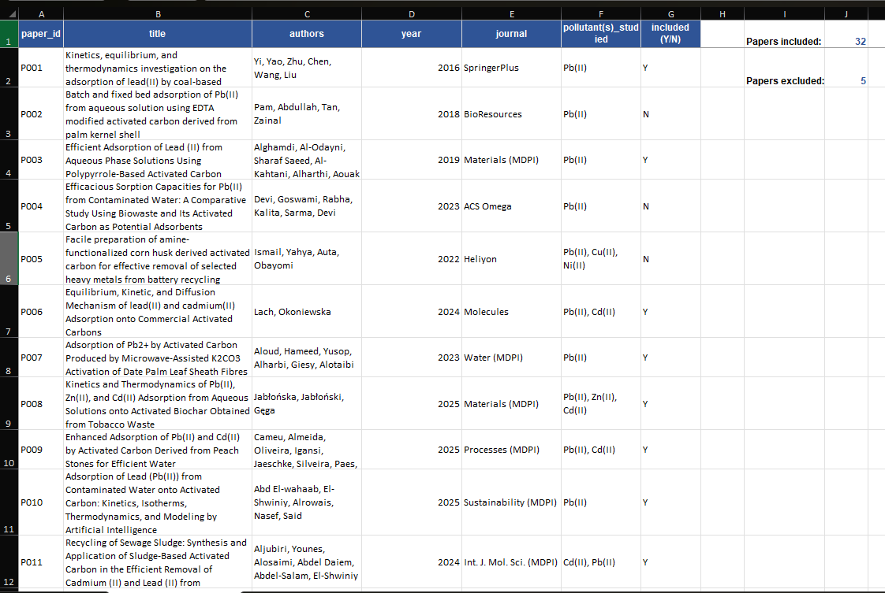
4. Literature review: evidence base and research gap
Master list records 32 included papers and 7 excluded papers; inclusion depends on usable material-property data
32 INCLUDED
7 EXCLUDED
32 SOURCE IDs
488 ROWS
Papers with data accepted under current extraction criteria.
Main reasons include missing/unusable BET or pore-volume data.
Across current compiled observations; 74 precursor labels.
Literature observations in CompilationData.xlsx before cleaning.
KEY IMPORTANT PAPERS
• Lead: Yi et al. (2016), coal-based activated carbon; Pam et al. (2018), modified palm-kernel-shell activated carbon.
• Metals / AI: 2024 sewage-sludge-based activated carbon for Cd/Pb; 2025 Pb adsorption study including AI modelling.
• Dyes: comparative methylene-blue adsorption on activated carbons (2011); activated-carbon studies for MB and Congo red (2020–2025).
Gap motivating this work: results are reported across different materials, concentrations, pH, units and extraction formats; cross-study comparison needs harmonization and transparent QC.
List of All the Papers and its Details (Excel File Present)
5

Slide 6
5. Data collection and cleaning workflow
Use the source workbook as the audit trail; never silently convert uncertainty into certainty
1 Search & screen
2 Extract
3 Harmonize
4 Flag uncertainty
5 Audit & model
39 papers listed
32 included; 7 excluded
→
paper_id • pollutant • precursor
properties • conditions • qₑ
→
units to m²/g, cm³/g, mg/L,
g/L, min and K
→
graph/table/text/calculated
notes + ambiguous values
→
missingness • duplicates
mass balance • feature selection
CURRENT RAW COMPILATION • 488 ROWS • 19 COLUMNS
• Missing: C/H/O/N are absent in about 66–70% of rows; pHₚzc 28.7%; C₀ 27.9%; contact time 23.2%.
• Source method: 314 graph, 49 table, 9 text, 116 calculated entries.
• Exact duplicates in the full 19-column compilation: 0. Earlier 14-column export had 44 duplicate copies after IDs/metadata were dropped.
MB
Pb
Cd
CR
212 rows
103 rows
91 rows
82 rows
Do not call the raw workbook “clean”: final cleaning and pollutant/source-aware modelling remain a work package.
6

Slide 7
6. First model: what Linear Regression does
A transparent baseline tests whether a simple additive relationship has predictive signal or not
q̂ₑ = β₀ + β₁x₁ + β₂x₂ + … + βₚxₚ
SPLIT
VALIDATION
80% train (355)
20% test (89)
random_state = 42
5-fold CV on training data; random row split only.
• Fit coefficients by ordinary least squares: minimize the sum of squared residuals on training data.
• Preprocessing: parse numeric fields; midpoint-approximate pH intervals; median-impute missing predictor values inside the pipeline.
• Features: BET, pore volume, pHₚzc, C₀, pH, dosage, contact time and temperature.
• Excluded: Cₑ because it is measured after adsorption and can reveal target information; high-missingness C/H/O/N excluded from this first baseline.
IMPORTANT DATA-VERSION NOTE
These metrics came from the earlier 14-column ExpData(1).xlsx export after 44 duplicate rows were removed. The full 19-column CompilationData.xlsx preserves paper_id, pollutant and precursor and has 488 unique full rows.
Next correction: retrain with pollutant identity and preserve paper/material groups; use GroupKFold or source-held-out evaluation.
7

Slide 8
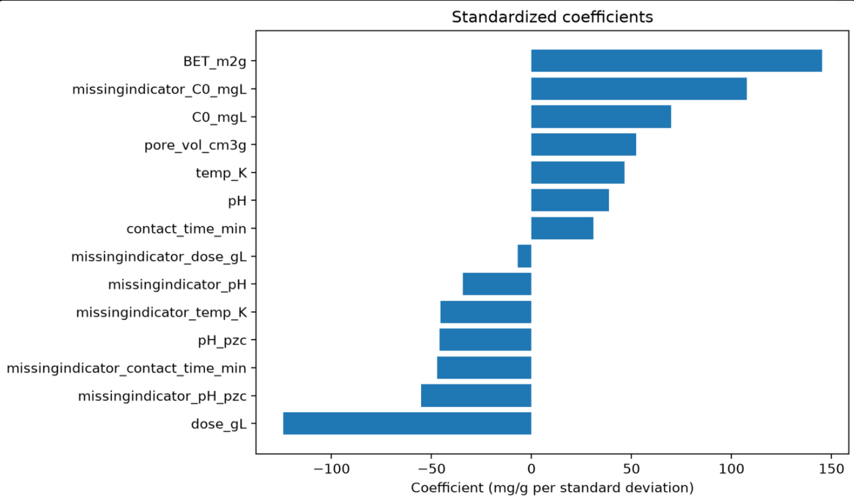
7. Preliminary results — useful signal, not yet generalization proof
Reported on the earlier cleaned dataset exported from the papers
TEST R²
TEST MAE
TEST RMSE
5-FOLD CV R²
0.718
Linear Regression
166.24 mg/g
Average absolute error
226.43 mg/g
Penalizes large errors
0.542 ± 0.130
Training-fold validation
• Test MAE is lower than the median baseline (204.60 mg/g); RMSE also improves versus 445.28 mg/g.
• CV R² is lower than the single test R²; variability and skewed qₑ values matter.
• Negative predictions occur; ordinary Linear Regression does not enforce qₑ ≥ 0.
• Coefficients are associations under this model, not causal effects; missingness indicators also carry signal.
Do not claim “71.8% accuracy”: R² is not classification accuracy, and the random split may be optimistic.
8

Slide 9
8. Remaining-semester roadmap & timeline
Timeline is tentative; weeks adjust to the official semester calendar and our mentor feedback
Now → Week 1
Audit source papers, pollutant labels (Pb, Cd, MB, CR), units and ambiguous values; freeze the cleaned master dataset and data dictionary.
Weeks 1–2
Retrain Linear Regression; establish a reproducible preprocessing pipeline and evaluate using source/material-grouped validation where identifiers permit.
Weeks 2-3
Compare Linear Regression, Ridge and Random Forest; attempt XGBoost and other non linear models of ML. Analyse feature effects, residuals and errors across pollutants.
Weeks 3-4
Validate against available literature/experimental evidence; finalise the Streamlit UI, results, report, reproducible code and final presentation.
Final phase
Validate against available experiments/literature if feasible under semester constraints ; prepare report, reproducible code and final presentation.
9

Slide 10
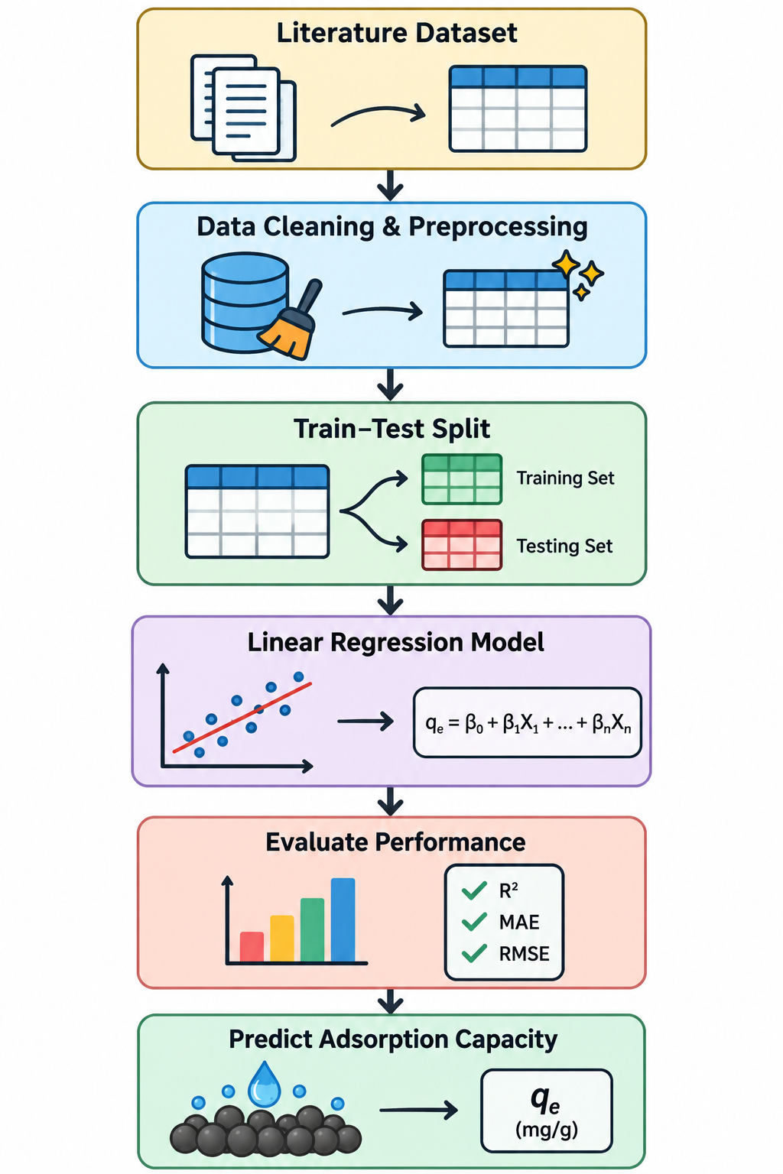
Thank you | Questions & Discussions
TEAM
Aditya Agrawal • Sarthak Srivastava
Mentor: Dr. Vishwendra Pratap Singh
KEY PAPERS FROM THE INCLUDED MASTER LIST
• Yi et al. (2016) — Lead(II) adsorption by coal-based activated carbon. SpringerPlus.
• Pam et al. (2018) — Pb(II) adsorption using EDTA-modified palm-kernel-shell activated carbon. BioResources.
• P020 (2011) — Comparative adsorption isotherms/modeling of methylene blue onto activated carbons. Applied Water Science.
• P011 (2024) — Sludge-based activated carbon for Cd(II) and Pb(II). International Journal of Molecular Sciences.
• P034 (2025) — Congo red removal using flower-derived activated carbon. Scientific Reports.
• P035 (2020) — Activated carbons for methylene blue and Congo red removal. Scientific Reports.
10

