Slide 1
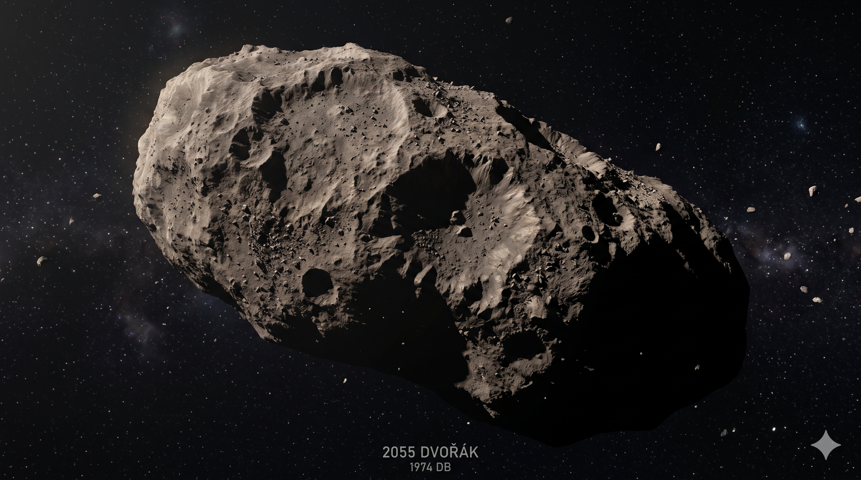
Project C.E.N.T.R.I.F.U.G.E
Centrifugal Extraction, Magnetic Sorting & Steam-Propelled In-Situ Utilization
“Mining the Outer Rim without drills, without fuel, and without going broke.”

Slide 2
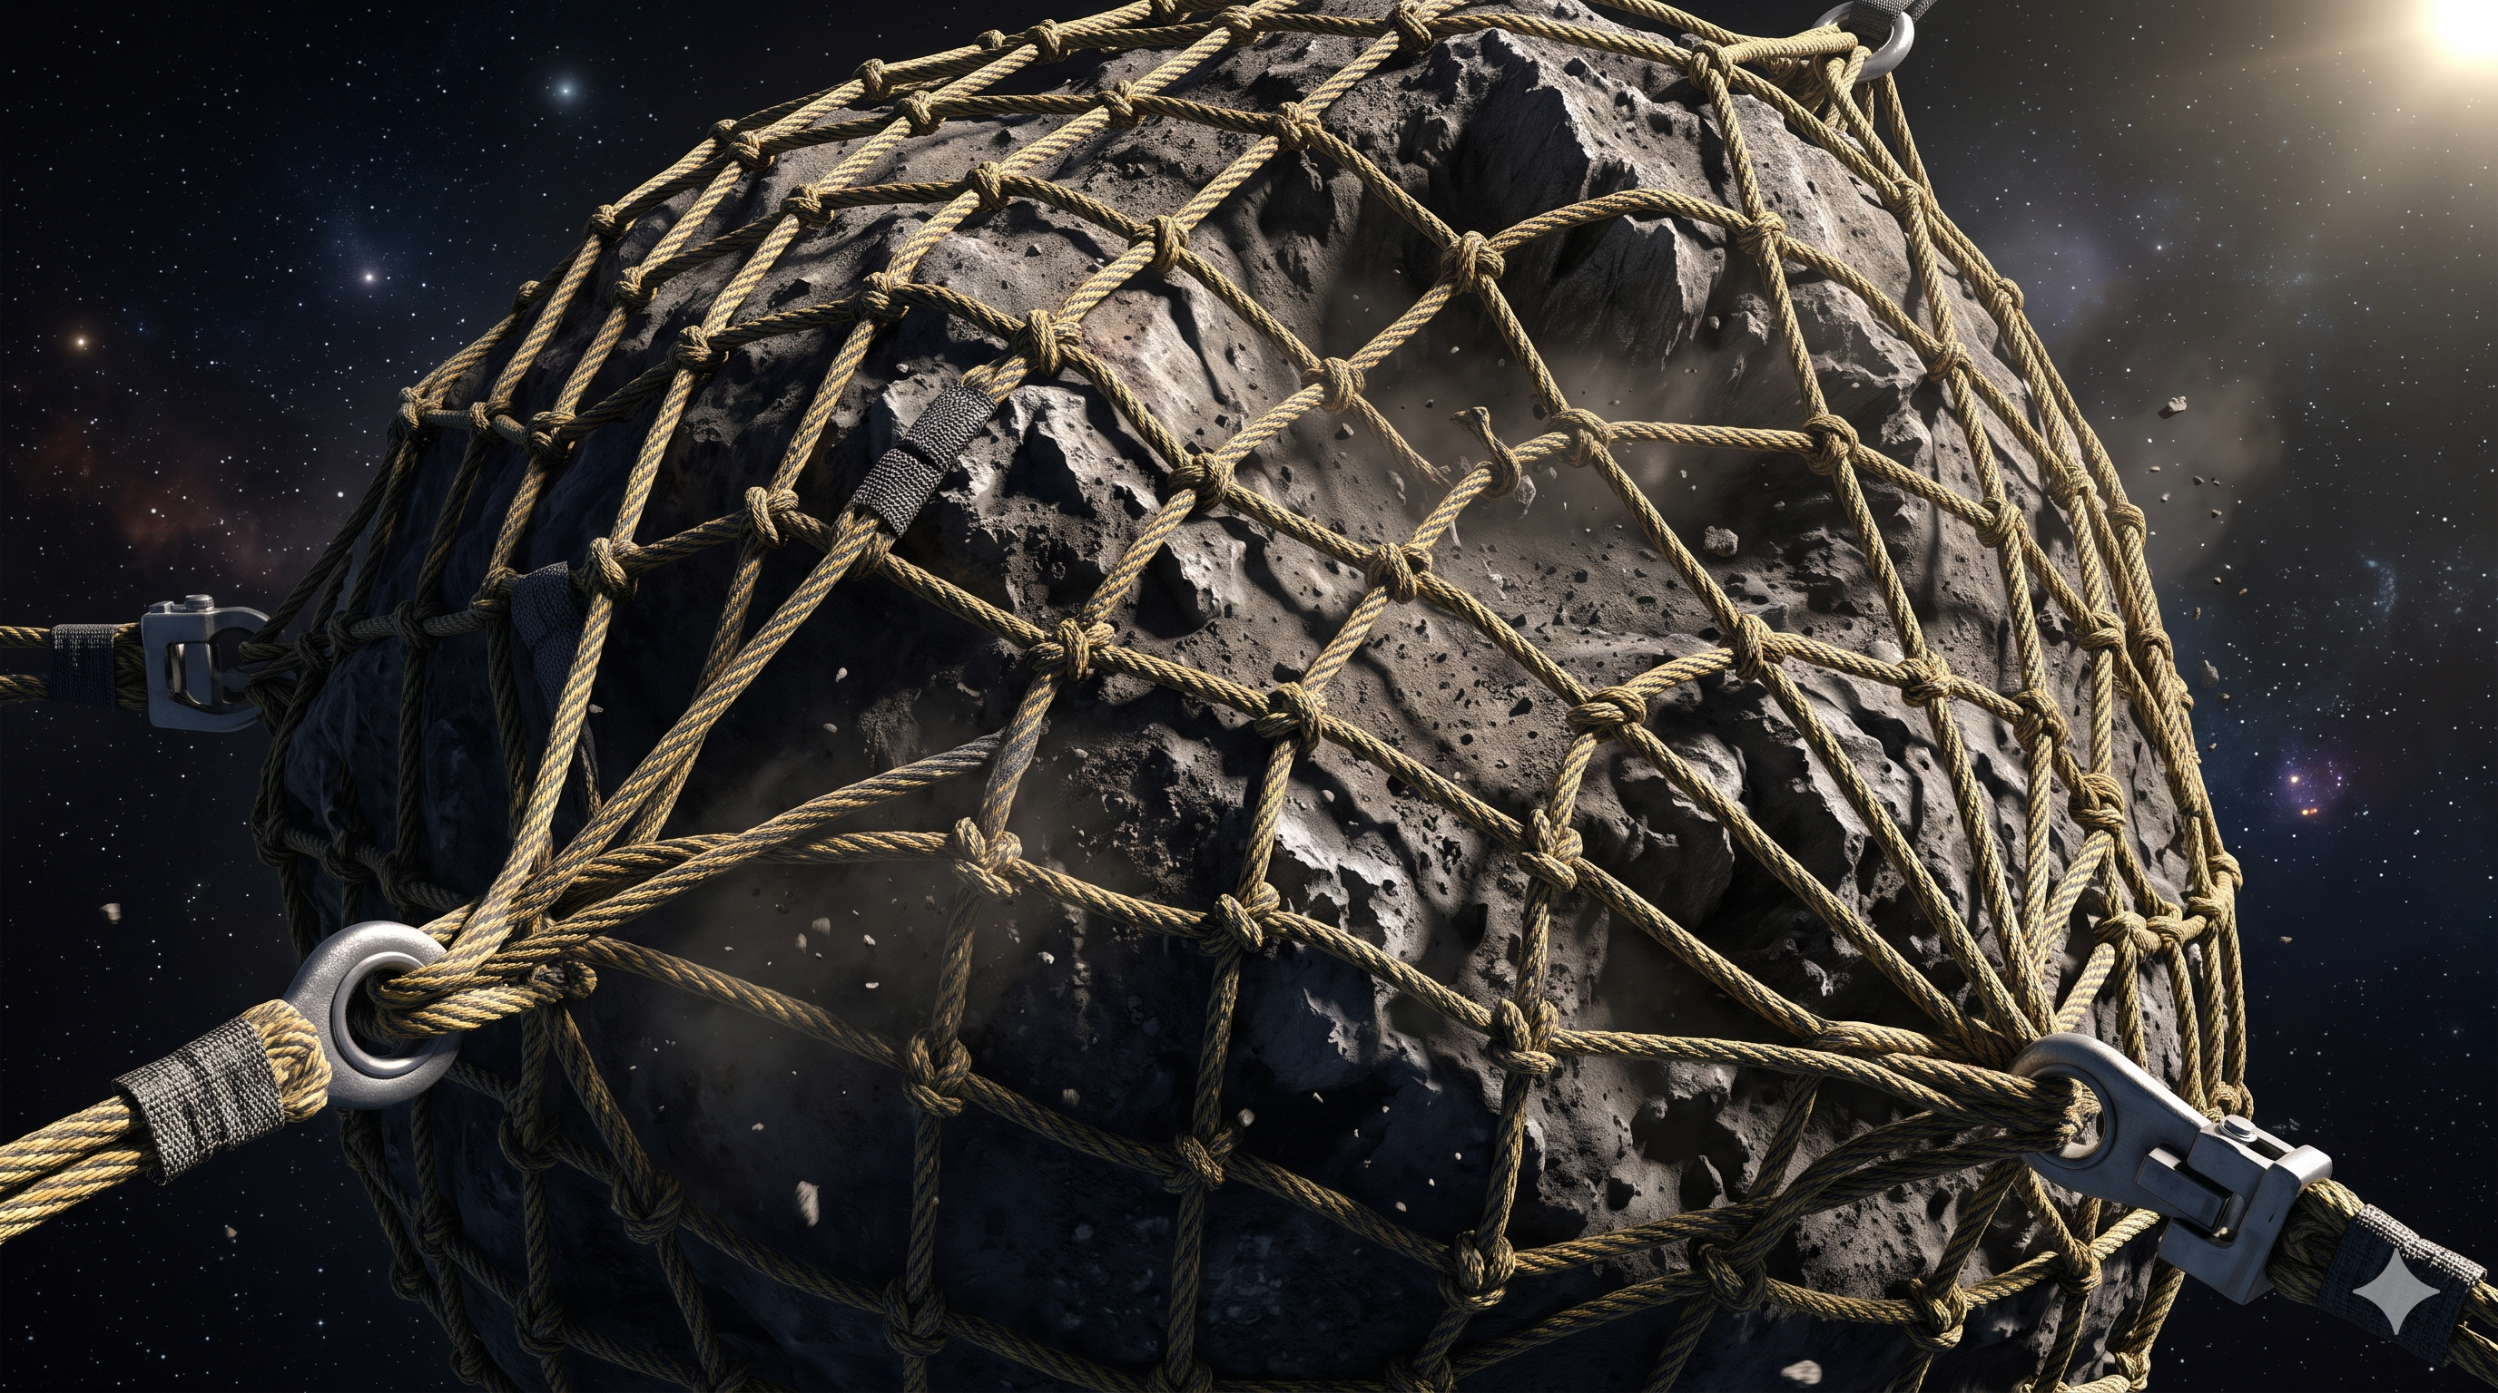
Rethinking Asteroid Extraction
Physics over brute force
• A custom Kevlar 'Bola-Net' wraps the asteroid entirely without relying on invasive harpoons.
• Inflatable Fresnel lenses completely replace heavy, cost-prohibitive nuclear thermal architectures.(breaks into smaller pieces.)
• Our Mothership/Spaceship operates around the asteroid by hovering over and enclosing it by a few Hundred meters away.
• We can also get help from our small , expendable and autonomous drones near the Spaceship.
• The floating mixture is then kept in the cooling chamber by which hot water quickly cools down into liquid water, then the liquid water is splitted using electricity into liquid hydrogen and oxygen, i.e. High Grade Rocket Fuel
• Vapour metallurgy can help us to get pure iron, platinum and nickel

Slide 3
The 4-Stage Contactless Sorter
Fluidic & Electromagnetic Separation Flow
Stage 1
150°C Solar Bake-Off
Sunlight turns ice to steam, piped directly to cold-traps.
Stage 2
DC Electromagnet
Separates and pulls loose Iron/Nickel into targeted Bin A.
Stage 3
Eddy Current Sorter
Lenz's Law kicks Platinum into Bin B; waste rocks drop away.
Stage 4
Solar Sintering
Sunlight 3D-prints refined structure in active orbit.

Slide 4
h
Breaking the Bottleneck & Slaying Costs
Eliminating moving parts subject to vacuum jamming
Process | Conventional Architecture | C.E.N.T.R.I.F.U.G.E. System
Digging | Mechanical Drills (High Wear) | Centrifugal Net (Contactless)
Refining | 1500°C Carbon Arc Furnaces | Passive Magnetic & Eddy Sorter
Earth Return | Expensive Manufactured Heatshields | Free Sintered Pykrete Pods
• For profit and cost efficiency we can use pure iron and nickel to build space stations, satellite frames and spaceship fuels

Slide 5
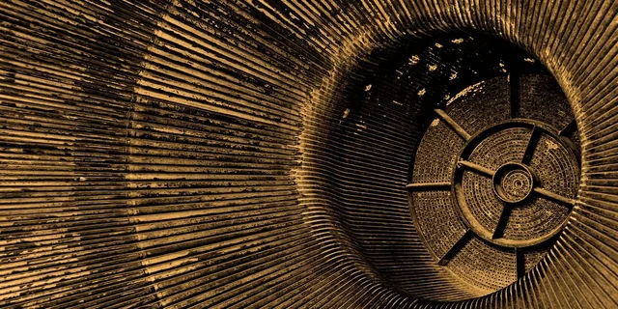
Slashing the 3 Major Cost Drivers
Optimized mass and materials utilization workflow
• Launch Mass Reduction: Drops instantly with 50kg inflatable Fresnel lenses instead of multi-ton traditional smelting furnaces.
• In-Situ Return Propellant: Powered cleanly by a solar-thermal steam rocket boiling the asteroid's harvested water reserves.
• Zero-Cost Re-entry Vehicles: Utilizes Pykrete built from local rock dust and water as a free, expendable shield for precious cargo return.
Risk Mitigation Framework
• 'Dry Rock' Scenario: Sinter silicates directly into heavy-duty 'Orbital Armor Tiles' to monetize as high-demand debris shielding.
• Market Price Collapses: Leverage Orbital Vaulting mechanics to store up to 80% of asset volume at L1, releasing carefully timed supply batches.
Solar-Thermal Steam Propulsion Engine

Slide 6
The 'Split-Market' Business Strategy
Strategic logistical arbitrage between orbit and Earth return
• Target Commodities: Highly focused extraction of Water Ice, Iron/Nickel structural ore, and Platinum-Group Metals.
• Primary Customer Base: Orbital space stations, deep-space satellite operators, green-tech companies, and advanced manufacturing.
• In-Space Arbitrage (L1): Water and iron supply undercuts baseline Earth-launch prices ($2,000/kg) by a massive 50%.
• Terrestrial Return Model: Only hyper-valuable Platinum ($50,000/kg) is transferred directly to Earth using low-cost Pykrete drop pods.
• Orbital Petrol Pump: Allows strategic satellite networks to pre-purchase standardized water and steam refill tokens.
• Platinum Batch Auctions: Generates strong recurring cash flow via bi-annual auctioning of returned cargo pods to land-based refiners.

Slide 7
“Never tell us the odds.”
Ready for the Falcon's first profitable run.
Team Jugaad.exe
Thank You

