Slide 1
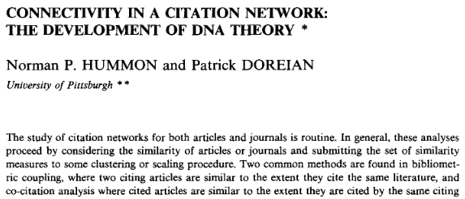
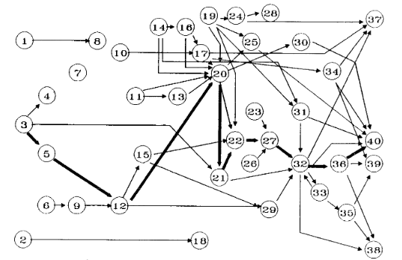
Main Path Analysis
Historical background:
Finding the most important citation paths in publication networks.
cites
P1
P2
information flow
Hummon, N. P., & Dereian, P. (1989). Connectivity in a citation network: The development of DNA theory. Social networks, 11(1), 39-63.
Notes:
The question was what was the main line of development in the field of DNA research.
If you want to learn how a field has developed there are 100dreds or 1000dreds papers you could read on the topic.
You cannot read them all so you need a good selection strategy.
The basis were citation networks of publications on the topic.
Is there a chian of citations that reflect the emergence of a field best.

Slide 2

Main Path Analysis
Directed acyclic graphs (DAGs)
2015
2016
2017
2018

Slide 3
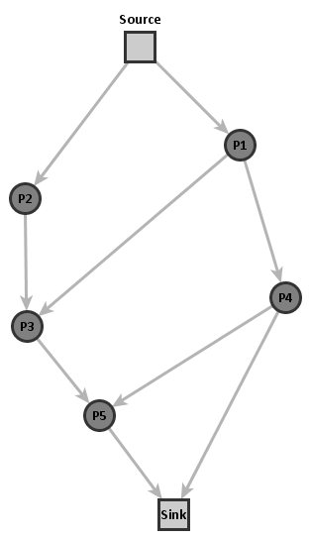
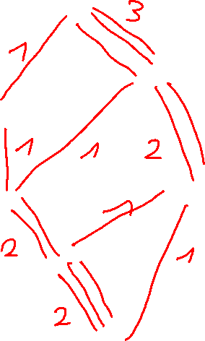
Main Path Analysis
Step 1: Weight links according to their occurrences on source-sink paths.

Slide 4

Main Path Analysis
Step 1: Weight links according to their occurrences on source-sink paths.
Step 2: Traverse graph from source to sink taking the most important links.
3
1
2
1
1
2
1
1
3

Slide 5
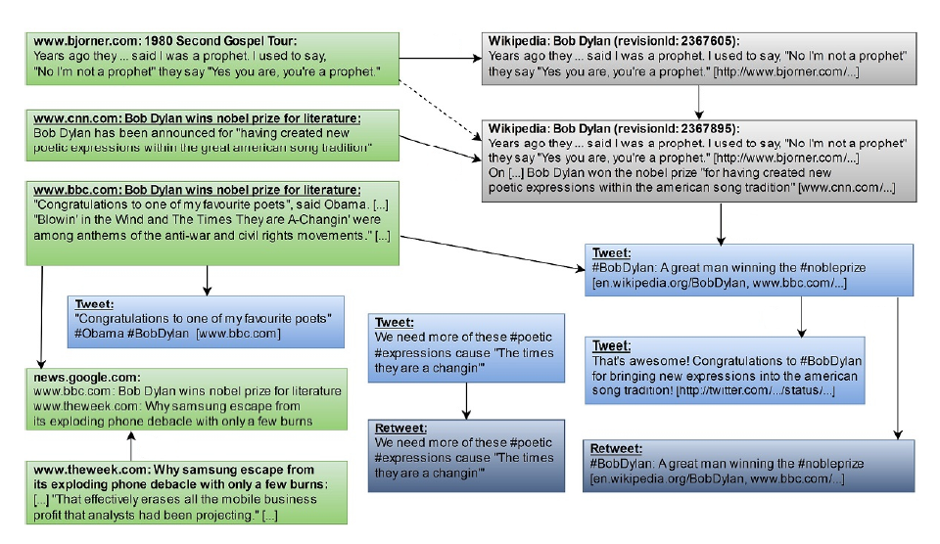
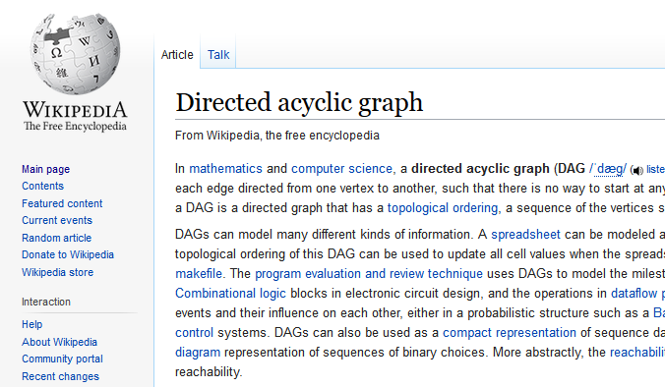
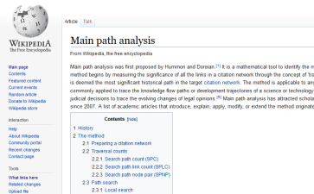
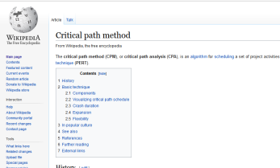
MPA for Analysing Online Media
Hyperlinks, mentions on Twitter, etc. can be considered as a certain type of citation.

Slide 6
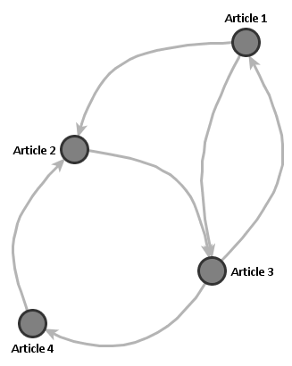
Main Path Analysis
Problem: Network has to be a DAG

Slide 7
Main Path Analysis
Problem: Network has to be a DAG
Solution: Use article versions
Article 1
Article 2
Article 3
Article 4
version/time

Slide 8
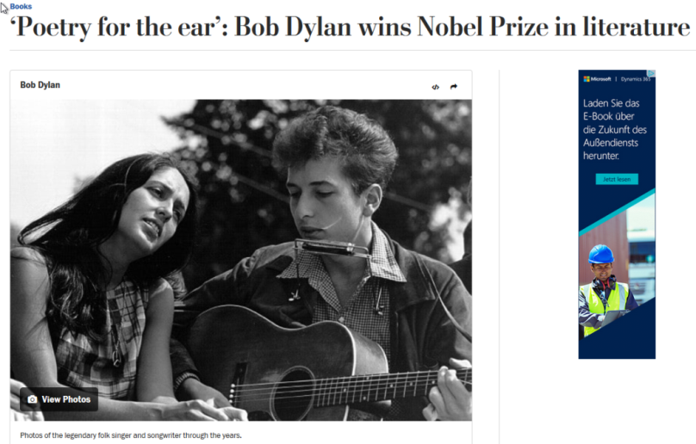

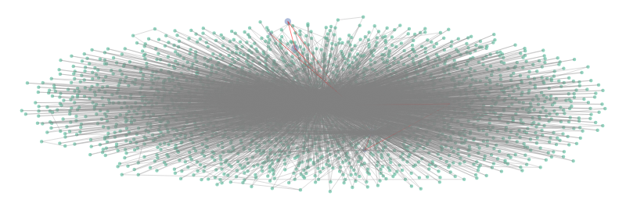
Main Path Analysis Example
Identification of important pathways of news spreading in online media
Web content
Information diffusion network

Slide 9
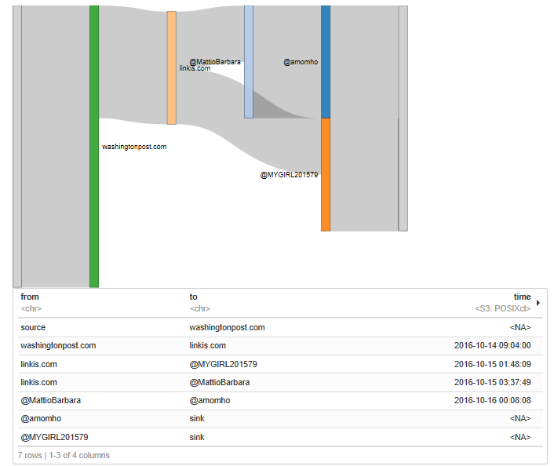
Main Path Analysis Example

Slide 10
Themen für Ausarbeitungen
Jupyter Notebooks mit Erläuterungen
Implementierung des Main Path Analysis Algorithmus zur Identifikation der wichtigsten Publikationen in einem Zitationsnetzwerk und Anwendung auf einen gegebenen Datensatz
Implementierung des Link Community Algorithmus zur Detektion von überlappenden Gruppen in sozialen Netzwerken Datensatz
Vergleich verschiedener Link Prediction Algorithmen in der Python Bibliothek NetworkX anhand gegebener Datensätze.
Bei Interesse: tobias.hecking@dlr.de

