Slide 1
MongoDB for developers

Slide 2
Part I: Introduction to NoSQL
Estimated time: 1.5 hours

Slide 3
What is NoSQL?
NoSQL is a document oriented database
NoSQL is a graph DB
NoSQL is a high performance data store
NoSQL is a high availability database
NoSQL is a distributed database
NoSQL implementations usually does not expose SQL interface.

Slide 4
What is MongoDB?
MongoDB is an open source document data store with great performance.

Slide 5
MongoDB Features
Document oriented.
High performance
High availability
Easy scalability

Slide 6
JSON
JavaScript Object Notation
Lightweight data-interchange format
Easy to read and write
Based on an standard ECMA-262 – 1999
Text format language independent

Slide 7
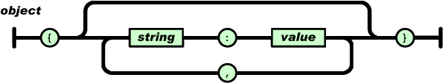
JSON
Name/value pair
{ name: ”John”, lastName: ”Smith”, phone: ”555-555555” }
{ ”name”: ”John”, ”lastName”: ”Smith” }

Slide 8
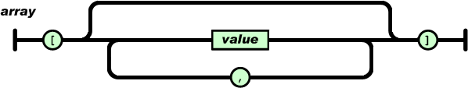
JSON Arrays
[ 1, 2, 3]
[”Mary”, ”Joe”, ”Paul”]
[
{ name: ”John”, lastName: ”Smith” },
{ name: ”Mary”, lastName: ”Swan” },
{ name: ”Joe”, lastName: ”Black” }
]

Slide 9
Why and when NoSQL?
High Scalability
High Availability
Unstructured data
Flexibility

Slide 10
Excersises

