Slide 1
Jaguar BPM - Kick off
Juan Pablo Crossley
Architect - Developer

Slide 2
What is Jaguar BPM?
BPM Engine and modeler
SOA Tool
Development tool for business

Slide 3
Why Jaguar BPM?
Easy to use
The fastest engine at the market
Tools to increase productivity
Focused on Business Analyst and Developers
Multiplatform (*nix, Windows, Mac, etc)
Well documented processes.

Slide 4
Features
BPMN 2.0 Modeler / XPDL
Powerful engine
Integrated data management
Rules based on policies, with zero code
Code library
SOA Server
Integration and Query tools

Slide 5
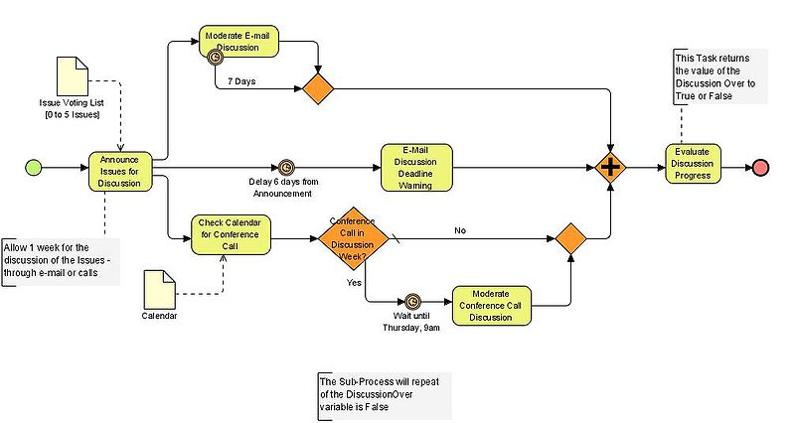
BPMN 2.0 Modeler

Slide 6
Powerful Engine
The fastest engine in the market
Fully implemented by our team, which leads to an incredible flexibility and power
Supports BPMN 2.0

Slide 7
Integrated data management
The designer could use data to model his process using data mapped at the database level.
Every process owns their data.
Transactional workflow

Slide 8
Rules based on policies
A new semantic to define business policies
No CODE!
Could change at runtime

Slide 9
Code library
Complex rules created, precompiled and tested outside of the model.
Powerful business centric API to create rules from scratch.
  Finantial
  Math libraries

Slide 10
SOA Server
SOA Bus implementation
Provides transparent communication betwen applications.
Supports WS-I
ACID transactions between applications
Compensation activities.

Slide 11
Integration and Query tools
Tools for Webservice discovery
Create queries from workflow or process data

Slide 12
Versions
Pre-alpha
Alpha
Beta
Release Candidate
Final Product

Slide 13
Pre-alpha
This version will be able to create a simple workflow, manage simple data associated with it, a preliminar rule management and renders user interface at runtime. Could be considered as a probe of concept.
Estimated release date: March 2009

Slide 14
Alpha
This version will complete the features created at the alpha version, completing the BPMN 2.0 Standard, all the Data Types and Complex forms.
Estimated Release Date: August 2009

Slide 15
Beta
At this series of versions the application will contains all the BPMN 2.0 Shapes, data types, forms, rules, code library. And it will introduce the SOA tools, developers, integration and Query tools. This version will contains all the features proposed and will be released to public testers.
Estimated Release date: December 2009

Slide 16
Release Candidate
This version will be a stable version with some bugs, could be used at production environment.
Estimated release date: March 2010

Slide 17
Final Product
This version is bug free, and ready to execute at production environments.
Estimated release date: June 2010

Slide 18
Risks and mitigation
The BPMN 2.0 is not available at the creation of this document.
New development language C++.
Some components of the designer will be a third party code.
The company does not have any methodology currently implemented.

Slide 19

Questions

