Slide 1

CUBE ORCHESTRA
Advanced Interface Design

Slide 2
Research Question
Can we take advantage from touch screen and gestures to develop an interactive musical application?
Take advantage of our natural visual capacities
We can distinguish and associated real objects easily
Use basic shapes: Polyhedra (3D figures)
Basic polyhedra represents basic sound feature
Complex polyhedra (combination of basic ones) represent complex sound features
Use movement, position and color

Slide 3
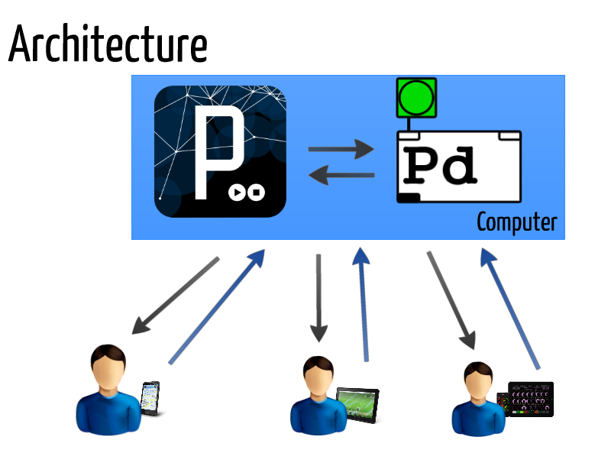
Cube Orchestra v1

Slide 4
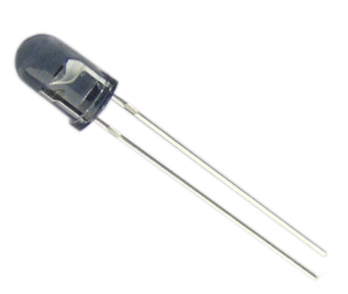
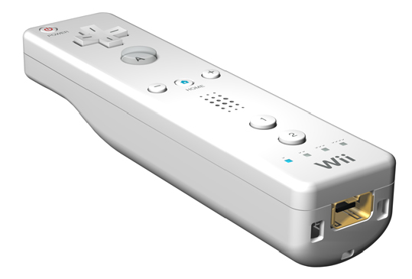

Cube Orchestra v2

Slide 5
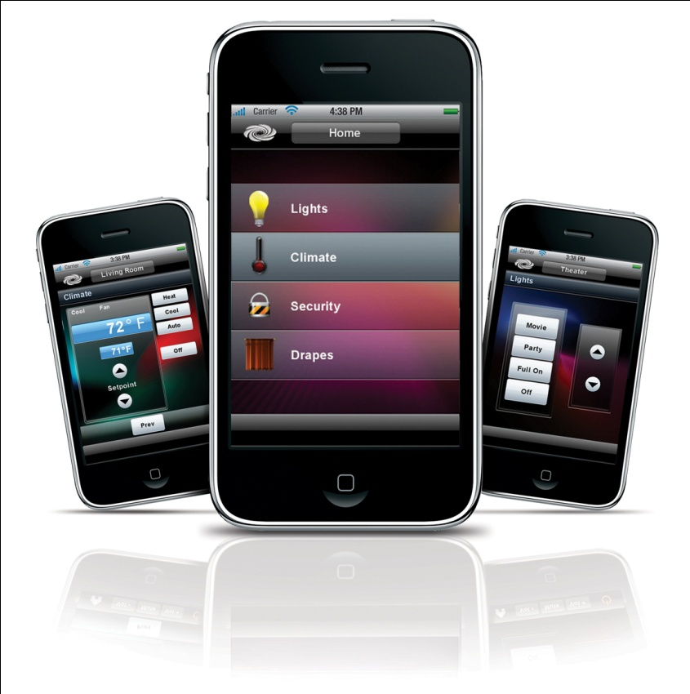
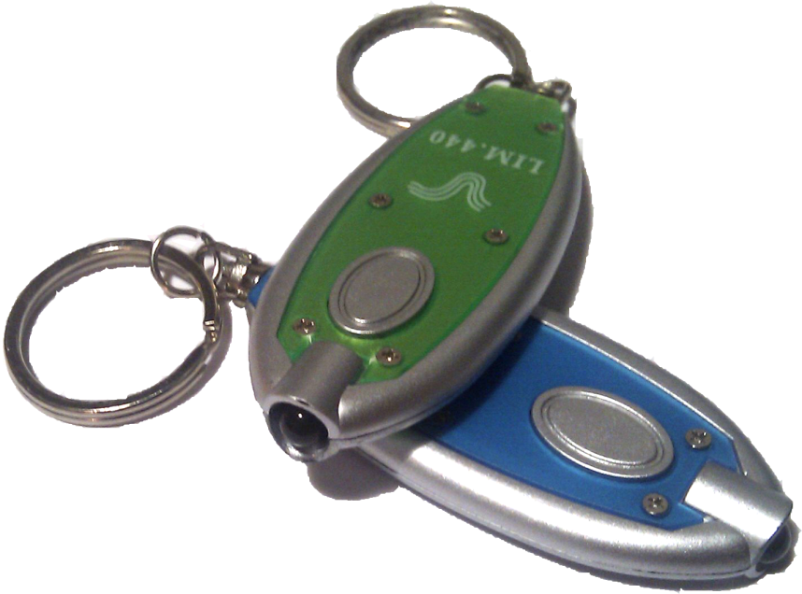
Sensors
Mobile Devices
Touch screen
Accelerometer
Wiimote
IR Camera
IR Emitters

Slide 6
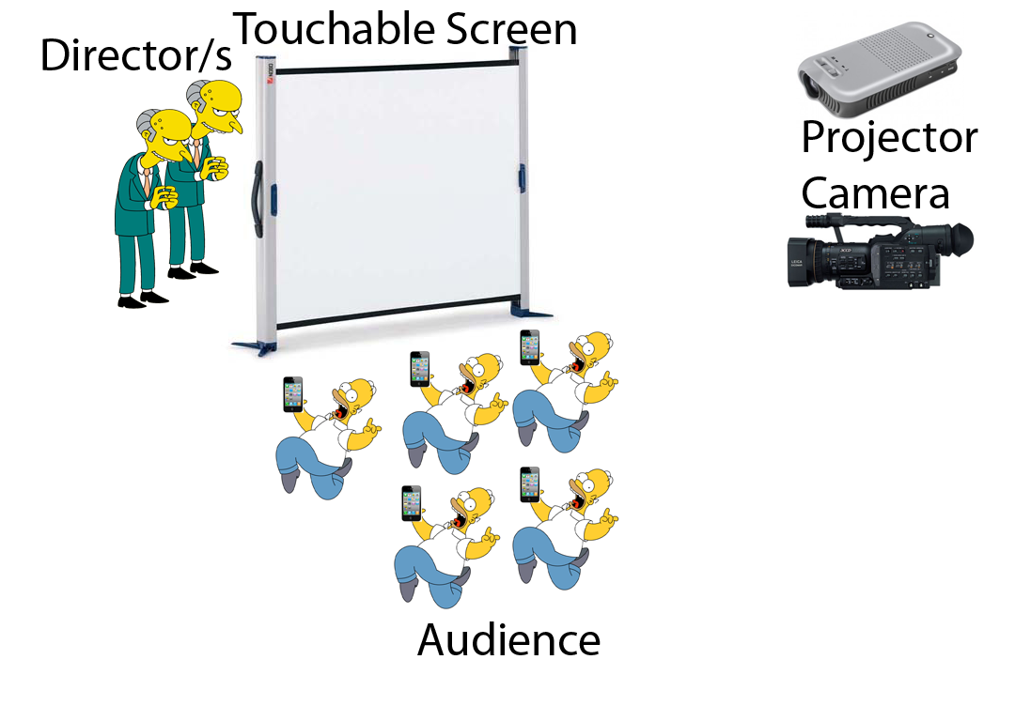
Sensors

Slide 7
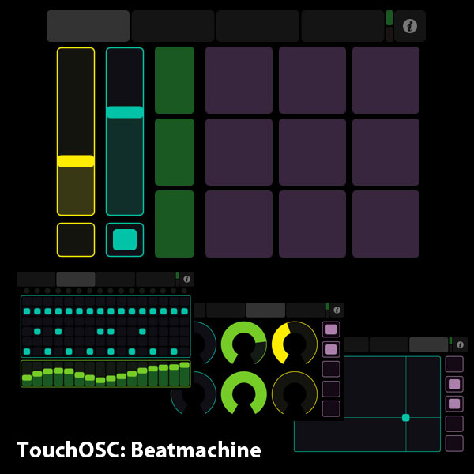
Mapping
Input Mapping
Touch OSC
Processing Visual Touch Objects
Output Mapping
Processing Visual Objects/Reactions
Virtual Synths & Drum Machines

Slide 8



Implementation
Software
Wiimote Whiteboard
TUIO
MT4J
Processing
Pure Data
Hardware
IR key chains

Slide 9
Conclusions
Cheap/easy touch screen solution
Find optimal calibration point/IR emitters
Touchable visual objects improve usability
Requires good accuracy for natural interaction

Slide 10

Questions?

