Slide 1
Mortality of Cancer by State (US)
Hector Santos

Slide 2
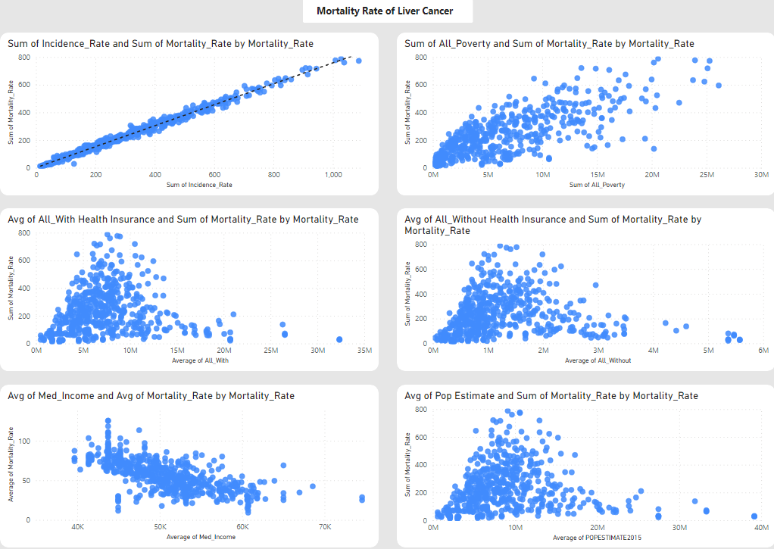
Why Linear Regression?
As we can see in the visualization, there is a linear relationship with the Mortality Rate (Cancer), so Linear Regression would be a great model to interpret the data.

Slide 3
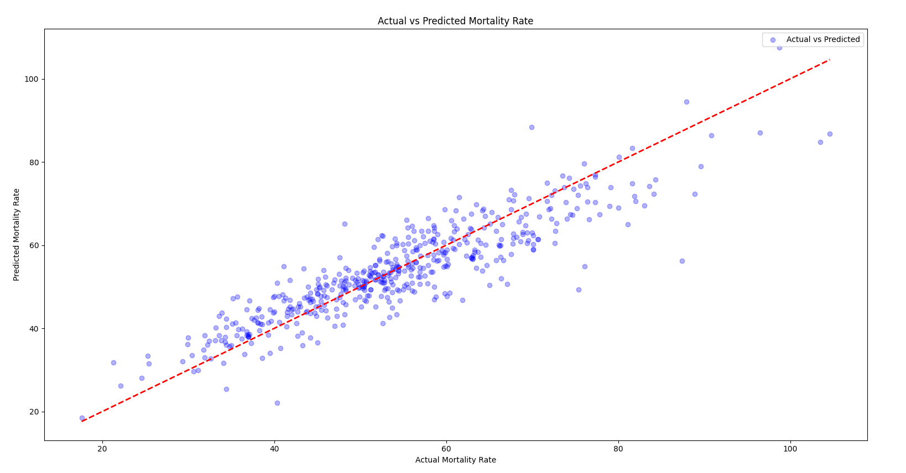
Model

Slide 4
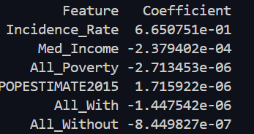
Conclusions
As we can see, the impact of our features in our model:
Incidence Rate of cancer boosts the probability of mortality rate.
Median Income lowers the mortality rates, the higher the income.
Poverty is the one that doesn’t make sense to me because the higher it is then it lowers the mortality rate.
Population the higher the it is, the higher the mortality rate.
Insurance (With and Without) lowers a lot more the mortality rate if they have it.

Slide 5
Recommendations
The most impactful way to lower the mortality rate will be analize data about what triggers the incidence rate to spike.
With this data I can recommend that if the person makes his income higher, chose a state with less population and has insurance, his mortality rate from cancer will be lower.

Slide 6
What can be done to have a better understanding.
In this data set, I used data from incidents and mortality from the counties of the United States. Still, regarding the other data, I used State data because counties were unavailable. If we could use counties for all the data, we would have a much clearer picture of the model. I made the project this way because I believe that we will not count on the perfect conditions to run the model in a real-world example.

