Slide 1
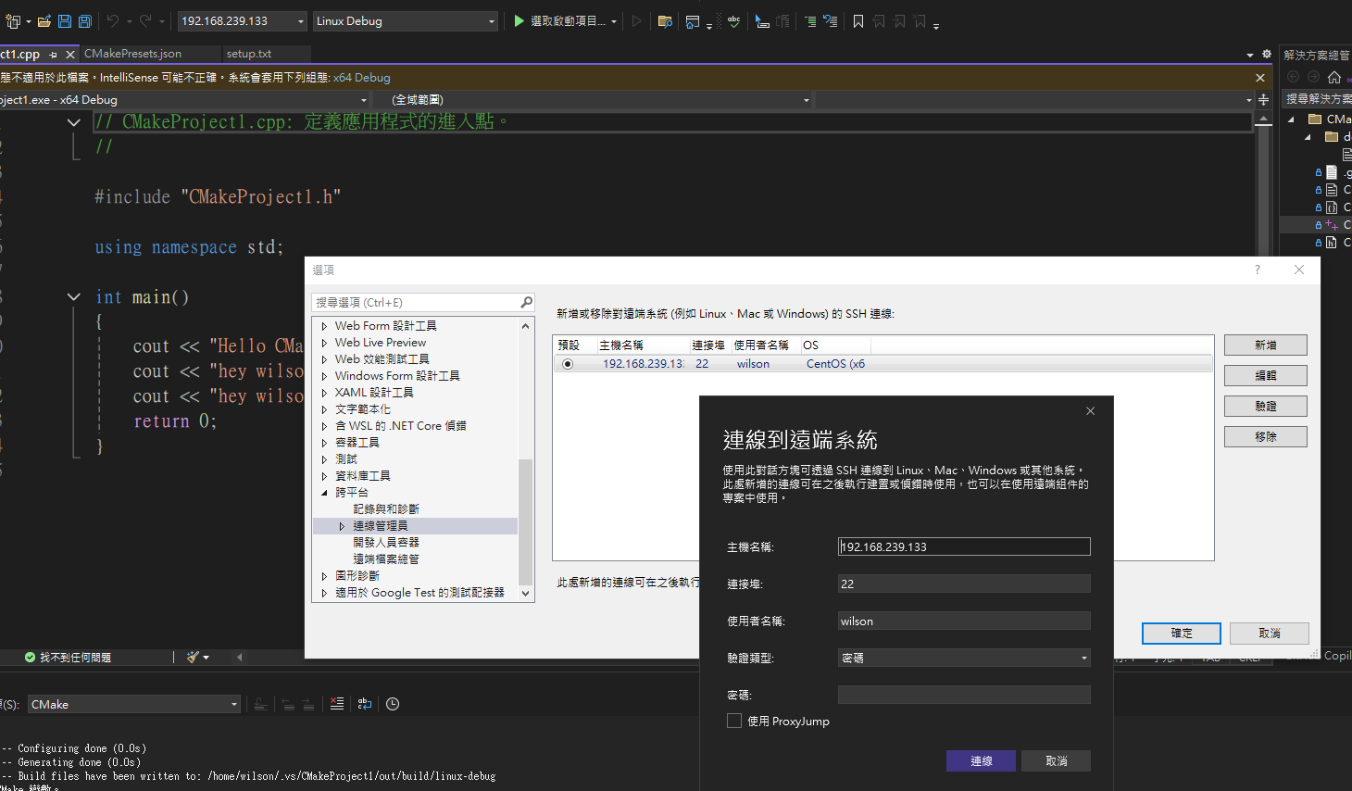
設定”遠端連線” : vs 2022 to remote server

