Slide 1

Altafulla Code Challenge

Slide 2
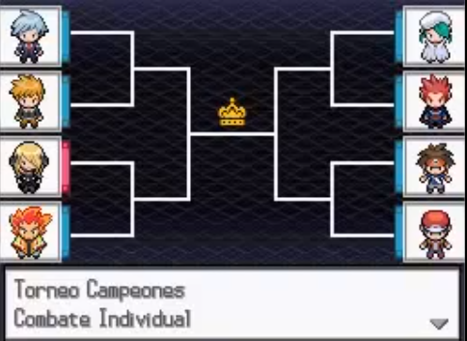
Welcome to the Altafulla Pokemon Tournament
Choose your Pokemons!
Teach them the best movements and train them how to fight

Slide 3
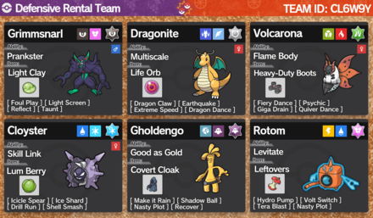
How to participate
Create a team with the available Pokemons (1st gen)
Select 4 movements for each pokemon
Create a PR to register your team
Extra: submit your code to choose the movement to use
Repo: https://github.com/hectormirete/Pokemon-tournament/

Slide 4
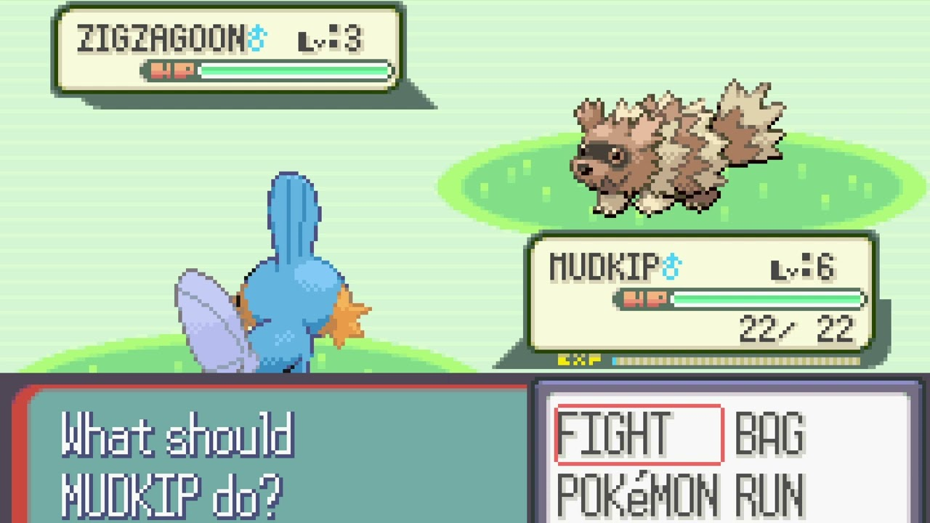
Tournament
All teams fights against all others to the best of 5 fights
If you win one fight, you get one point
The team that gets more points wins.
Contributions will be open until 9.00 – 20 Nov
The team with more points will receive something

Slide 5
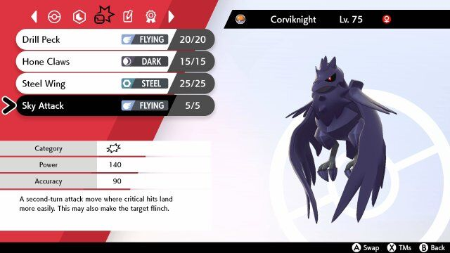
Fight
Attacks first the fastest pokemon
By default, each movement is selected randomly.
You can submit your own code to choose the movement priority
Then the second pokemon attacks

Slide 6
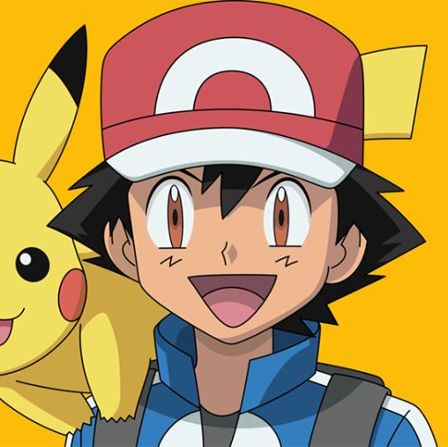
Considerations
There are damage movements + stats modifiers to increase or decrease
If you are run out of movement points (PP), there is a default movement that does damage to the openent + the user

Slide 7
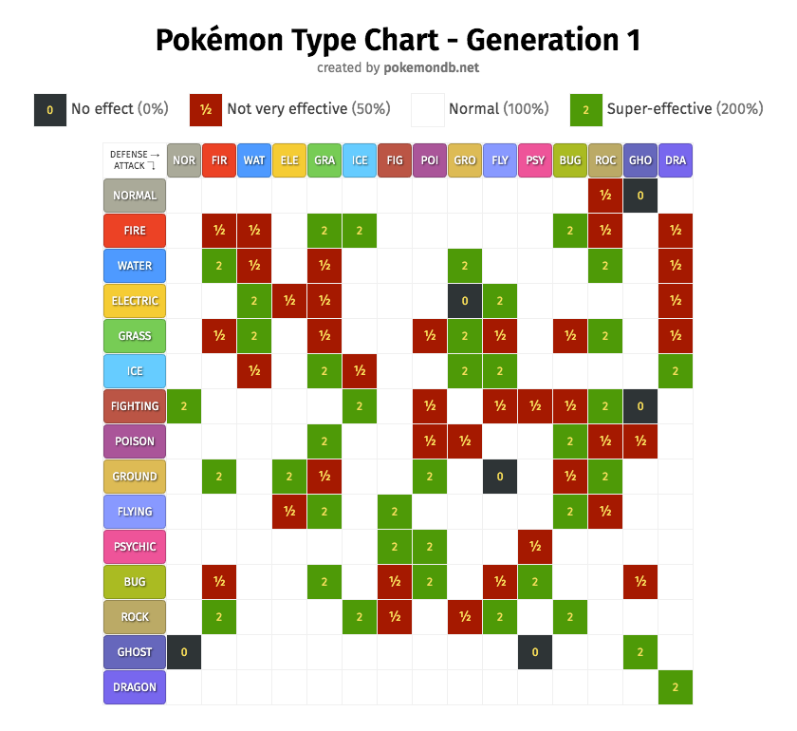
Considerations
Depending on the type of the movement + the type of the defender, the movement damage gets a modifier that increases or decreases the damage.
If the Attacker uses movements of his own type, movement damage is boosted
Physical movements use the Attk/Defense pokemon stats
Special movements use the Special Attk/ Special Defense pokemon stat

Slide 8
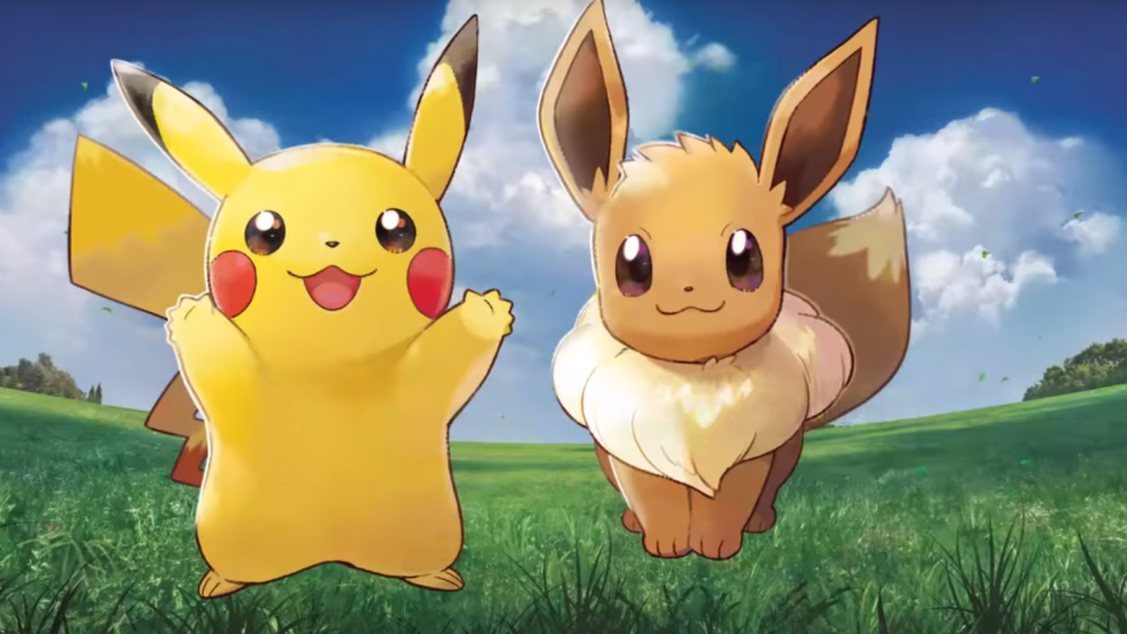
Have fun

