Slide 1
Java Transaction
Concept and Design Strategy

Slide 2
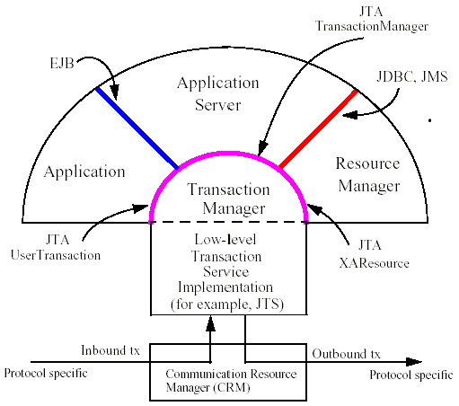
Java Transaction Model

Slide 3
ACID - The properties of the transaction
Atomicity
A transaction must either commit/rollback all of its updated in a single unit of work
Consistency
During the course of an active transaction the database will never be left in an inconsistent state
Isolation
Determine how protected my uncommitted updates from other transactions accessing the same information. Level of isolation Increase will cause consistency increase and concurrency decrease
Durability
When we successful commit the trans, we can guarantee our update are permanent and cannot be lost

Slide 4
JTA and JTS
JTA - Java Transaction API
The JTA is the interface developers use to manage transactions
JTS – Java Transaction Service
An underlying transaction service that implements JTA
Relationship between JTA and JTS
Like JDBC and the database driver
JBoss Transaction Service, JOTM
Common use methods in JTA
begin(); commit(); rollback(); getStatus();

Slide 5
Transaction Models
Local Transaction Model – Managing local resource manager but not transaction. The resource manager is the DB Driver, Connection factory for JMS….
Programmatic Transaction Model - Leverage JTA and underlying transaction service impl to provide transactional support. Developer to write code to begin(), commit() and rollback()
Declarative Transaction Model - Developer tell framework when to rollback for the app exceptions. Declarative but not programming to control.

Slide 6
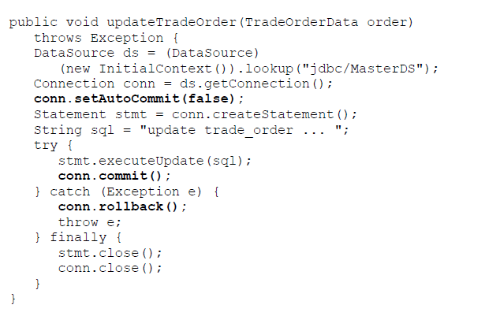
Local Transaction Mode Example
Not transactions, but connections.

Slide 7
Local Transaction Mode – Notices
setAutoCommit
Indicate whether commit the change for each update SQL statement
Connection management
For guarantee ACID, should use same connection for several DAOs which work together
Can’t work with multiple resource
For example, JMS and DB in same trans

Slide 8
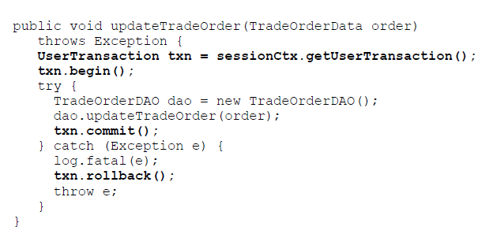
Programmatic Transaction Model Example
Manage transactions but not connections.

Slide 9
Programmatic Transaction Model
User responsible for starting and terminating
Notice Exception Handling, don’t miss anything to terminate the transaction
Transaction Context Problem
We can’t pass context for one bean to another which all use programmatic trans. But you can pass to another bean which using declarative trans.

Slide 10
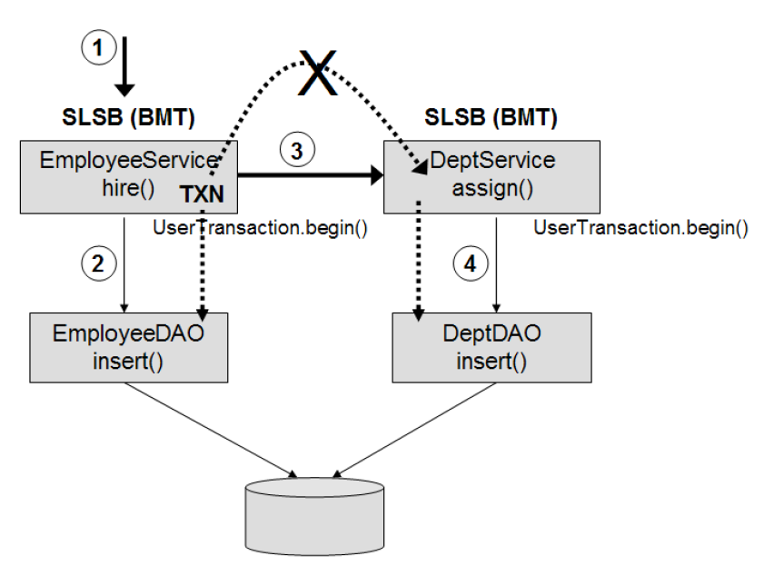
Programmatic Transaction Model

Slide 11
Declarative Transaction Model Example

Slide 12
Declarative Transaction Model Example
Transaction Attribute
Required
Mandatory
RequiresNew
Support
NotSupported
Never
Exception Handling and Rollback
@ApplicationException(rollback=true)
setRollBackOnly
javax.ejb.EJBException

Slide 13
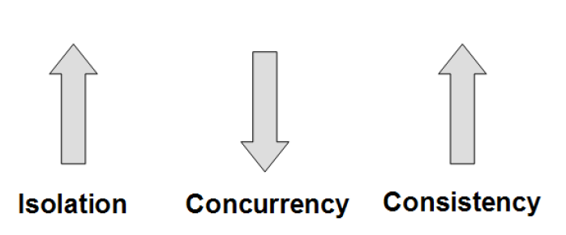
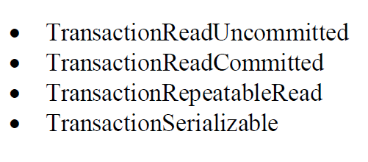
Declarative Transaction Model Example
Transaction Isolation Level

Slide 14
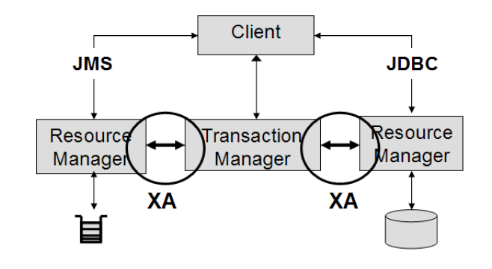
XA Transaction
The XA interface is a bi-directional system-level interface which forms the communication bridge between Transaction Manager and one
or more Resource Managers. So it’s support two phase commit.

Slide 15
XA Transaction
When should you use XA: It should only be used if you are coordinating multiple resources (i.e. databases and message queues or topics) with in the same transaction context.
Multiple resources would typically include accessing two or more databases (not tables, but separate database), a database and a message queue, or multiple message queues.
Two-Phase Commit
When commit() request is issued from the client to transaction manager.
Phase one: Prepare
1.All participants will be asked whether they are ready to commit their work
2.Respond with “Ready”, “Read-only”, “Not-Ready”
Phase two: Commit
Based on all response, determine commit or rollback.

Slide 16
Transaction Design Patterns
Client Owner Transaction Design Pattern
Domain Service Owner Transaction Design Pattern
Server Delegate Owner Transaction Design Pattern

Slide 17
Client Owner Transaction
When:
1. The client requires multiple (remote/local) calls to domain service objects to fulfill a single business request
2. ACID properties must be maintained
3. Domain service objects are fine-grained and no aggregate services exist to combine business request
4. It is not possible to re-architect or refactor the application to provide a single domain service method invocation for a single client request.

Slide 18
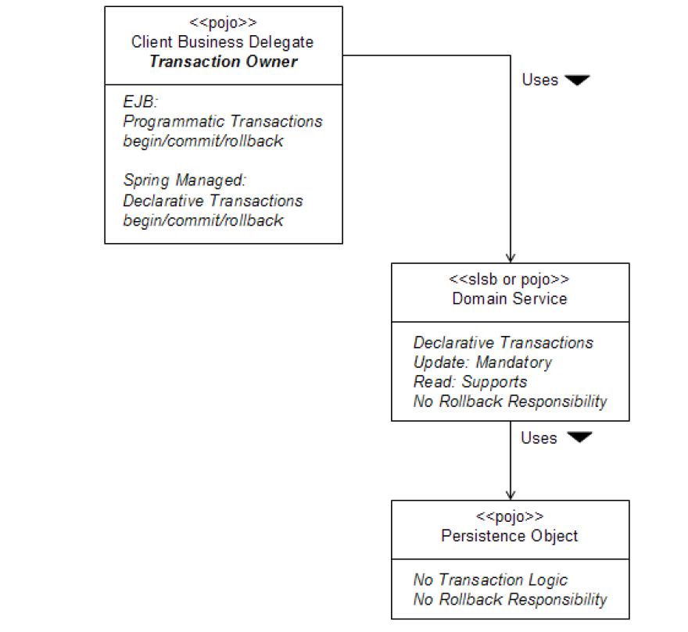
Client Owner Transaction Model

Slide 19
Domain Service Owner Transaction
When:
1. The client always makes a single request to domain service objects to fulfill a single client request
2. ACID properties must be maintained
3. Domain service objects are course-grained and/or use inter-service communication to perform aggregate service request

Slide 20
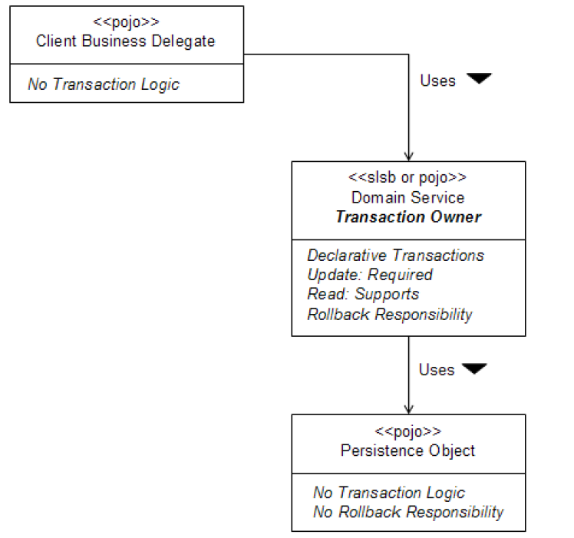
Domain Service Owner Transaction

Slide 21
Server Delegate Owner Transaction
When:
1. The Command Pattern or Server Delegate Design Pattern is used in the app architecture for client/server communication.
2. The client always makes a single request to a Server Delegate to fulfill a single client request
3. ACID properties must be maintained
4. Domain service objects are implemented as POJOs and may be remote or local
5. The Command Processor or Service Delegate is the only entry point to the domain services from the client.

Slide 22
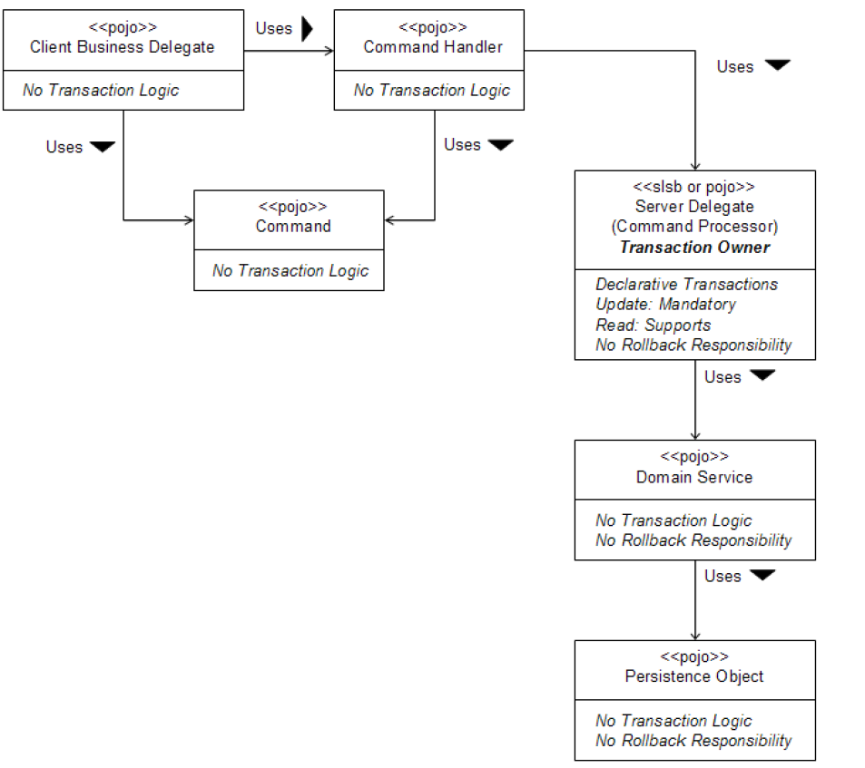
Server Delegate Owner Transaction

Slide 23
Resources/Reference
Java Transaction Design Strategies:
https://www.infoq.com/books/JTDS
https://www.infoq.cn/article/JTDS
JTA Specification: https://download.oracle.com/otn-pub/jcp/jta-1_2-mrel2-eval-spec/JTA1.2Specification.pdf
JTS Specification:
https://download.oracle.com/otn-pub/jcp/7309-jts-1.0-spec-oth-JSpec/jts1_0-spec.pdf
JBoss JPA:
https://access.redhat.com/documentation/en-us/jboss_enterprise_application_platform/6/html-single/development_guide/#chap-Java_Transaction_API_JTA
From IBM:
https://www.ibm.com/developerworks/cn/java/j-jtp0305.html
https://www.ibm.com/developerworks/cn/java/j-jtp/part2/index.html
https://www.ibm.com/developerworks/cn/java/j-jtp/part1/index.html

Slide 24
Resources/Reference
Transactions on JBoss：
https://docs.jboss.org/jbossas/jboss4guide/r5/html/ch4.chapt.html
Spring Transaction Management
https://docs.spring.io/spring/docs/2.5.x/reference/transaction.html
XA Transactions using Spring
https://www.javaworld.com/article/2077714/java-web-development/xa-transactions-using-spring.html
Example: How to - XA transactions using Spring
https://www.javaworld.com/article/2077714/java-web-development/xa-transactions-using-spring.html?page=2

