Slide 1
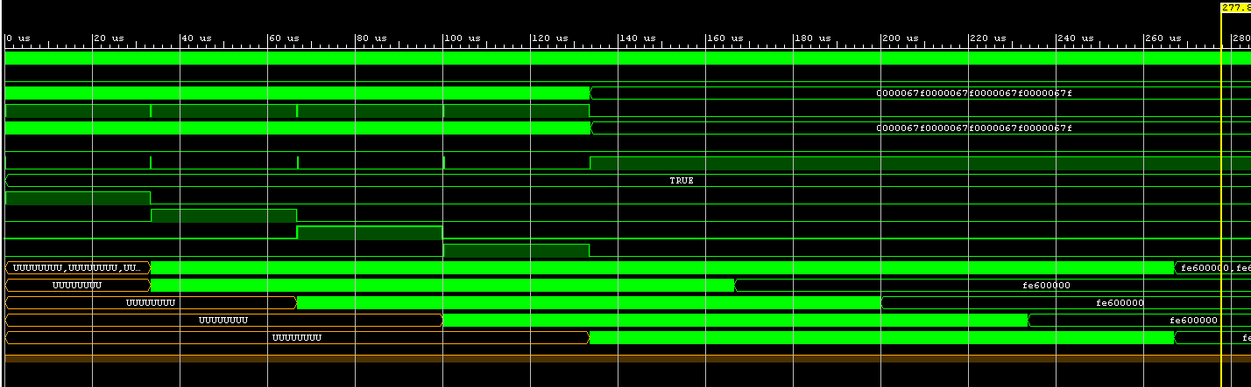
Fifo Package_0
208*1024Bit
Fifo Package_1
208*1024Bit
Fifo Package_2
208*1024Bit
Fifo Package_3
208*1024Bit
1664 Clock Cycles per Fifo Package_n
“¼ of Interleave data out block”
Low output rate !
Package_0
Interleave data
6566 samples(Clock Cycles)
Package_1
Interleave data
6566 samples(Clock Cycles)
Package_2
Interleave data
6566 samples(Clock Cycles)
Package_3
Interleave data
6566 samples(Clock Cycles)

Slide 2
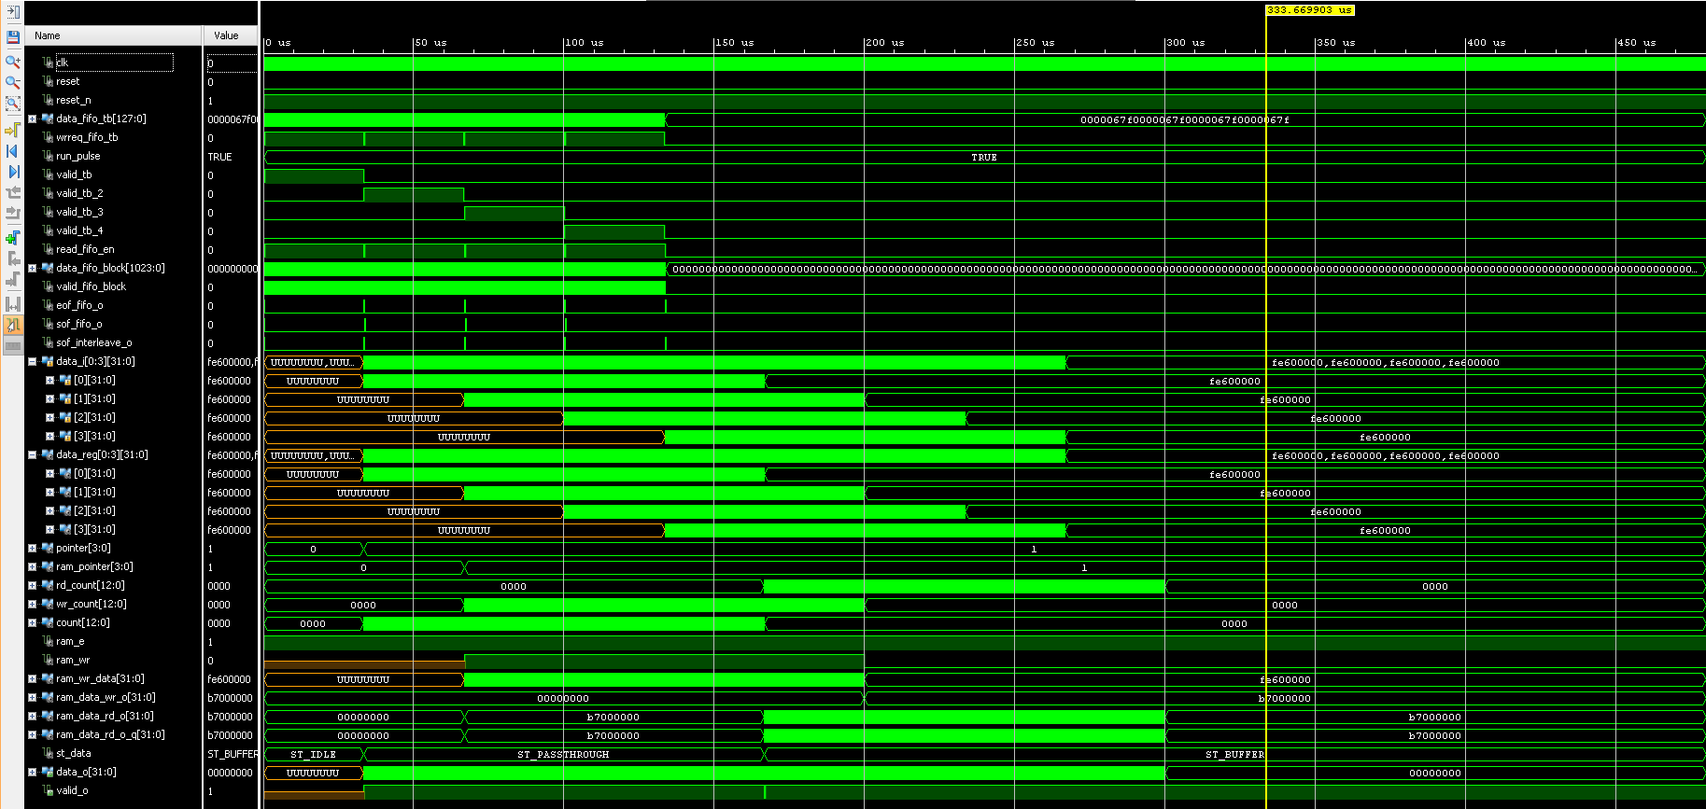
Fifo Package_0
Fifo Package_1
Fifo Package_2
Fifo Package_3
Package_n
Package_n+1
Package_n+2
Package_n+3
Interleave 0
Interleave 1
Output RAM
Interleave 2
?
Buffer during stream output
Interleave 3
?

