Slide 1
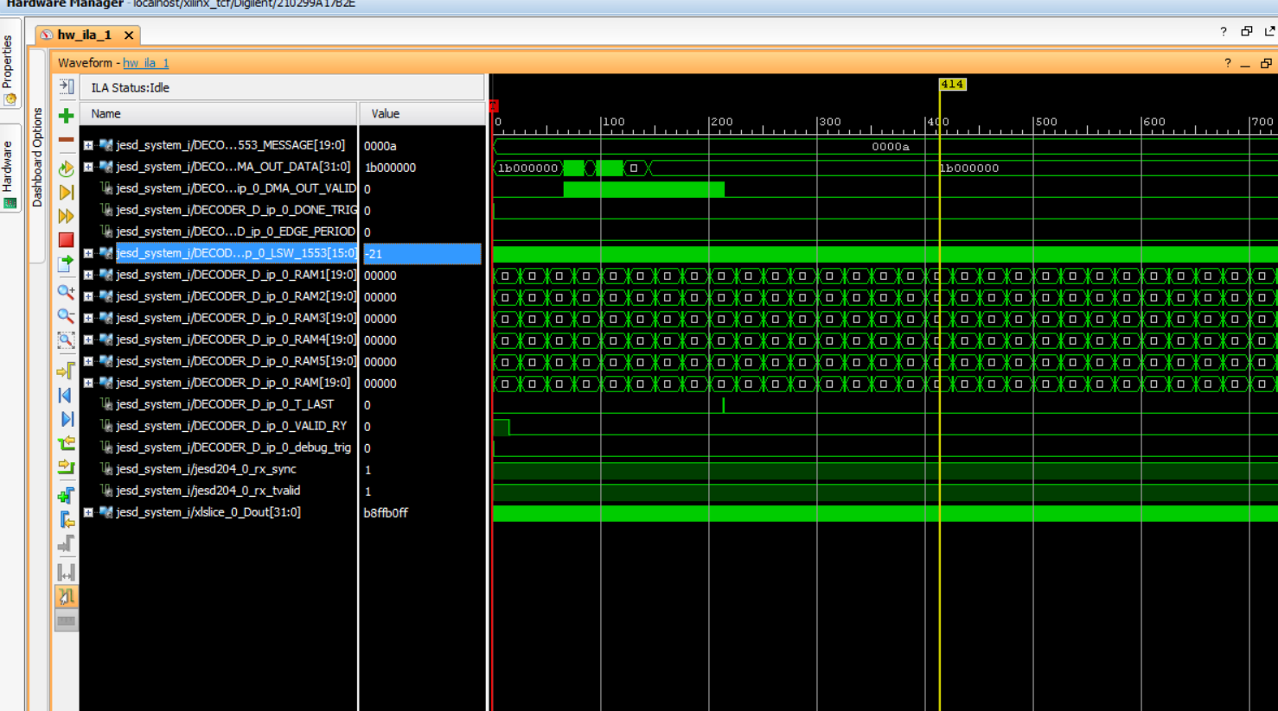
Notes:
Message info debug signals:
DMA_OUT_DATA[31:0] -> driving data from packager
DMA_VALID -> valid
T_LAST -> HW Int
debug_trig -> start packager

Slide 2
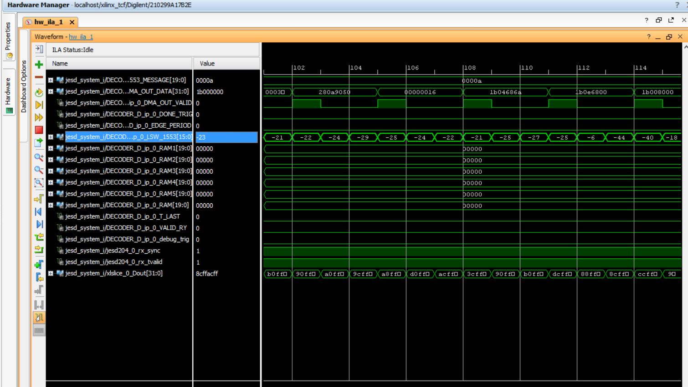
Notes:
Zoomed to decoded data window

Slide 3
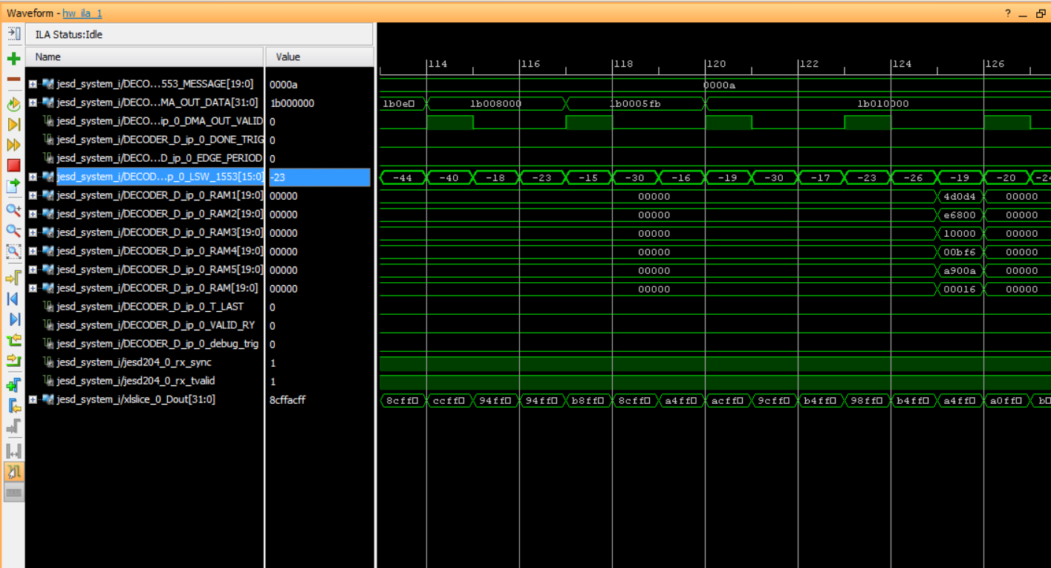
Notes:
Zoomed to decoded data window(continued)

Slide 4
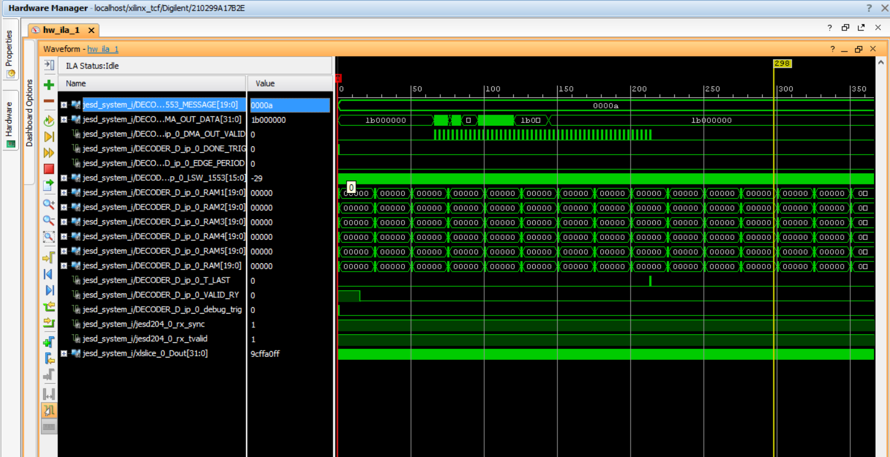
Notes:
Zoomed out to show complete decoded data window

Slide 5
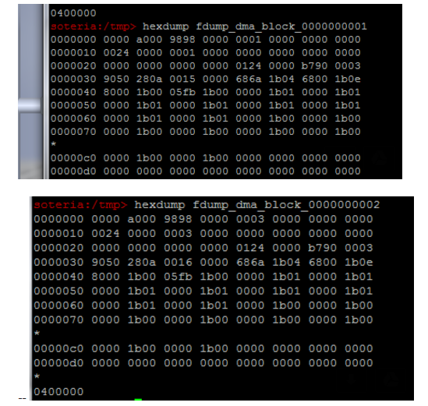
Error in message counter field. See the 5th byte for both dumps. The counter should incrementing to show the message count. That is the message count(in this case the number of packets read from DMA)
Kyle show be able to deduce the fields. The last message driven to the DMA is 0x1B000000

