Slide 1
GraphQL
He Dai

Slide 2
What is GraphQL?
Why GraphQL?
GraphQL vs REST
Summary

Slide 3
What is GraphQL?
{
person(ID: ...) {
name,
birthYear,
planet {
name
},
films {
title
}
}
}
Application-level query language
Created by Facebook in 2012
Provides a interface between the client and the server for data fetching and manipulations.
Notes:
It is not a query language for graph database, but the idea is based on that, so that's the reason it was called GraphQL.

Slide 4
Why we need GraphQL?
Declarative response format
If we use REST API
(REpresentational State Transfer)
{
"person": {
"name": "Darth Vader",
"birthYear": "41.9BBY",
"planet": {
"name": "Tatooine"
},
"films": [
{ "title": "A New Hope" },
{ "title": "The Empire Strikes Back" },
{ "title": "Return of the Jedi" },
{ "title": "Revenge of the Sith" }
]
}
}
1. GET - /person/{id}
{
"name": "Darth Vader",
"birthYear": "41.9BBY",
"planetId": 1
"filmIds": [1, 2, 3, 6],
*** other information we do not need ***
}
2. GET - /planets/1
3.
GET - /films/1
GET - /films/2
GET - /films/3
GET - /films/6

Slide 5
GraphQL VS RESTful API
{
person(ID: ...) {
name,
birthYear,
planet {
name
},
films {
title
}
}
}
GET - /person/{id}
GET - /planets/1
GET - /films/1
GET - /films/2
GET - /films/3
GET - /films/6

Slide 6
Flexible response format
get name of the person with id=1
get name and planet of the person with id=1
get name and films of the person with id=1
{
person(ID: 1) {
name,
planet {
name
},
}
}
{
person(ID: 1) {
name,
films {
title
}
}
}
{
person(ID: 1) {
name,
}
}

Slide 7
Drawback of RESTful API
HIGH Lantency!
Fetching data from server is costly
We always fetch more data than we need
More roundtrip
It's hard to specify and implement advanced requests with includes, excludes and especially with linked resources.
{
"name": "Darth Vader",
"birthYear": "41.9BBY",
"planetId": 1
"filmIds": [1, 2, 3, 6],
*** other information we do not need ***
}
GET - /person/{id}

Slide 8
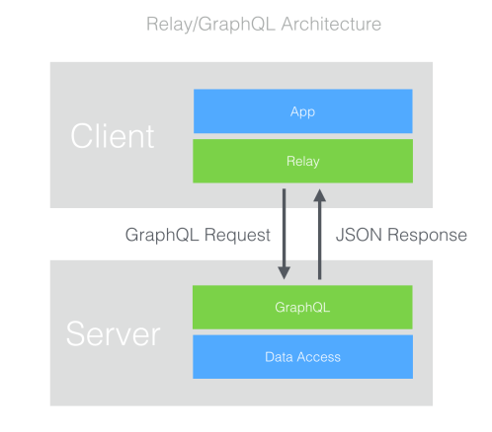
Summary of GraphQL
Application-level query language
Flexible response format
Single round-trip
Reference:
http://facebook.github.io/graphql/

Slide 9
Thanks!

