Slide 1
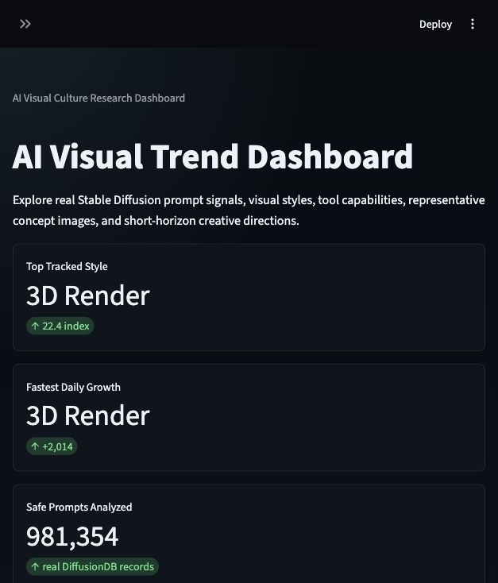
AI Visual Trend Dashboard
A data-driven research dashboard for AI-generated visual culture
- Prompt trend analytics, tool benchmarking, representative works, and creative strategy
- Designed as a Data Hub Dashboard with interactive exploration and visual evidence
- Built with Streamlit, Pandas, Plotly, scikit-learn-style forecasting, and local AI assets
Presentation focus: PRD alignment + full website walkthrough
AI Visual Trend Dashboard
01

Slide 2
PRD FRAMEWORK
5W1H defines the product direction
The project starts from a clear product requirement document and turns it into a working Streamlit dashboard.
Why
Who
What
Explore trends in AI-generated visual content, creative advertising styles, film production, and creative technology.
Students, creators, designers, marketers, and people interested in AI-generated visual content.
Trend charts, style comparison, keyword analysis, AI tool comparison, filters, data tables, metrics, and insights.
When
Where
How
Used for researching visual trends, finding creative inspiration, analyzing AI content, and comparing design directions.
A Streamlit web application prepared for GitHub and Streamlit Cloud deployment.
Python, Streamlit, Pandas, Plotly, AI-assisted coding, GitHub, and Streamlit Cloud.
AI Visual Trend Dashboard
02

Slide 3
PRD ALIGNMENT
Target users and jobs to be done
The website supports both analytical review and creative decision-making.
Design Students
Digital Creators
Art Directors
Evaluators
Need a clear explanation of AI visual trends, datasets, tools, and project methodology for learning and presentation.
Need style inspiration, prompt starters, moodboard directions, and representative images for faster concept exploration.
Need tool comparison, visual evidence, and use-case recommendations for production planning and team discussion.
Need to see data credibility, interaction depth, code organization, visual quality, and final delivery readiness.
Primary user journey
- Start with top metrics and the AI toolchain snapshot
- Filter by style, year, and tool to explore trend patterns
- Open representative works to understand the visual meaning behind the data
- Use recommendations, moodboard, and forecast to form a creative direction
AI Visual Trend Dashboard
03

Slide 4
PRD ALIGNMENT
Requirement coverage matrix
The deck maps the website directly against the requested project expectations.
Requirement Area
What the website includes
Evidence in the project
Data credibility
981,354 safe DiffusionDB prompts, source notes, transparent rules
Home metrics, README, data folder
Interaction depth
Sidebar filters, chart drill-down, selected-tool linking, random exploration
Trend Analytics, Tool Benchmarks
Visual evidence
Representative generated works, model labels, visual evidence captions, motion previews
Representative Works, Creative Strategy
Technical quality
Modular functions, cache, error handling, requirements file, deployment notes
app.py, README, requirements.txt
Presentation readiness
Screenshots, speaker notes, GitHub sync, PPT delivery
README, PPT deck, project repo
AI Visual Trend Dashboard
04

Slide 5
PRD FEATURE SCOPE
Main features translated into website modules
Each required feature from the PRD is represented by a concrete section or interaction in the final dashboard.
PRD Feature
Dashboard Implementation
Where It Appears
Visual Trend Analysis
Line and bar charts for AI visual style changes over time
Trend Analytics
AI Tool Comparison
Factual capability matrix for Midjourney, OpenAI Images, Stable Diffusion, Adobe Firefly, and Runway
Tool Benchmarks
Keyword Trend Dashboard
Frequency and growth from real DiffusionDB prompt matches
Keyword Insights
Interactive Filters
UTC date, style category, AI tool, and capability focus controls
Sidebar + chart drill-down
Dashboard Metrics
Top tracked style, fastest daily growth, safe prompts, and classified matches
Home hero metrics
Additional polish beyond the PRD
Representative works, creative direction generator, moodboard preview, motion preview, real-world references, and exploratory forecasting.
AI Visual Trend Dashboard
05

Slide 6
WEBSITE ARCHITECTURE
A full dashboard system with six content areas
The site structure was designed to move from overview, to evidence, to creative application.
Home
Trend Analytics
Representative Works
Tool Benchmarks
hero metrics, data volume, toolchain snapshot
daily style signals and click drill-down
AI image examples and visual evidence
official capability matrix and tool fit
Keyword Insights
Creative Strategy
Real References
real keyword frequency and growth signals
recommendations, moodboard, motion preview, forecast
official links and trend context
Design logic
The dashboard does not end at charts. It converts trend data into visual understanding, tool choice, and creative direction.
AI Visual Trend Dashboard
06

Slide 7
UI DESIGN DIRECTION
A modern dark dashboard with AI-themed visual cues
The visual system follows the PRD direction while keeping the interface readable for data exploration.
Dark UI
Neon accents
The background uses a deep dashboard theme to make charts, metrics, and images feel unified.
Cyan, gold, green, coral, and violet accents are used for emphasis, not decoration overload.
Sidebar navigation
Responsive layout
Filters and page navigation are grouped to support repeated exploration.
Wide chart areas, compact metrics, and local image assets help the dashboard adapt for presentation and review.
AI Visual Trend Dashboard
07

Slide 8
DATA FOUNDATION
The dashboard now uses real DiffusionDB metadata
The source is the official DiffusionDB 2M text-only metadata table, released under CC0 1.0.
981,354
Aug 06-20
10
26.85%
safe prompt records analyzed
real UTC collection window
tracked visual styles
tracked-style rule coverage
Real source
Cleaning and aggregation
Honest limitation
DiffusionDB 2M metadata.parquet
2,000,000 official metadata rows
CC0 1.0 license
Keep valid timestamps, image_nsfw < 0.1, prompt_nsfw < 0.1; assign documented keyword rules; aggregate by UTC date.
The source window is short. Tracked styles are a transparent analytical lens, not a complete ontology of every prompt.
AI Visual Trend Dashboard
08

Slide 9
TREND ANALYTICS
Real daily prompt matches reveal the leading tracked styles
On 2022-08-20 UTC, 3D Render leads the tracked style ranking, followed by Anime and Cyberpunk.
3D Render
2306
Main insight
Anime
1449
Rendering language is highly visible in the real prompt sample: 3D Render reaches 2,306 matched prompts on the latest date.
Cyberpunk
1207
Retro Futurism
602
How the insight was found
Surreal Editorial
387
Safety-filtered prompt matches were grouped by UTC date and tracked style, then normalized into a daily comparison index.
AI Cinematic Storyboard
386
AI Visual Trend Dashboard
09

Slide 10
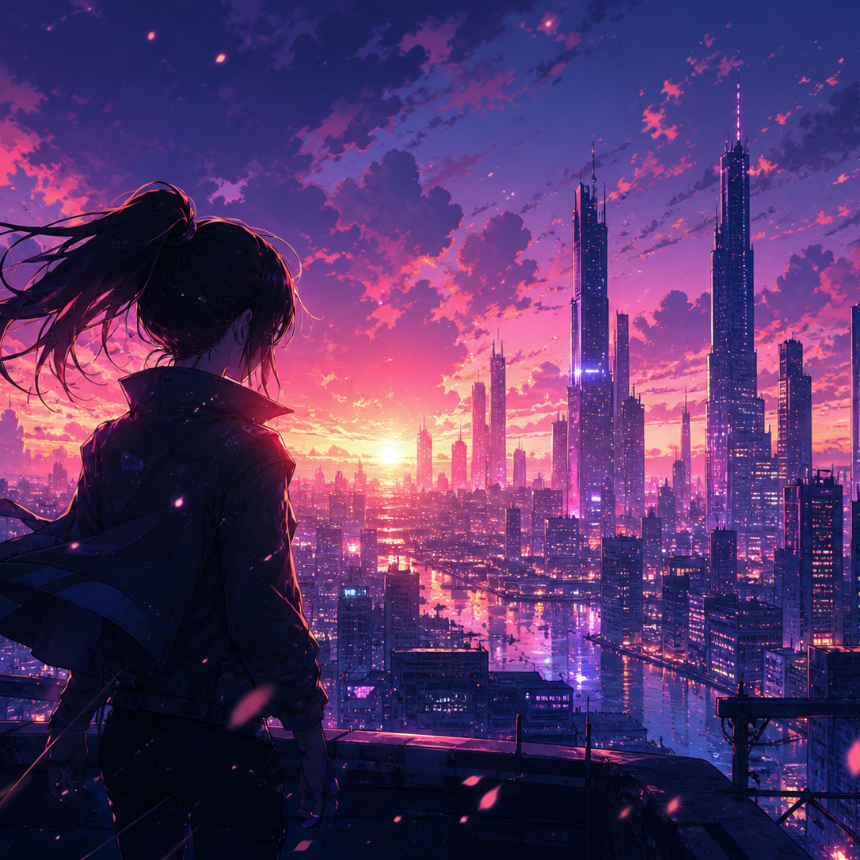
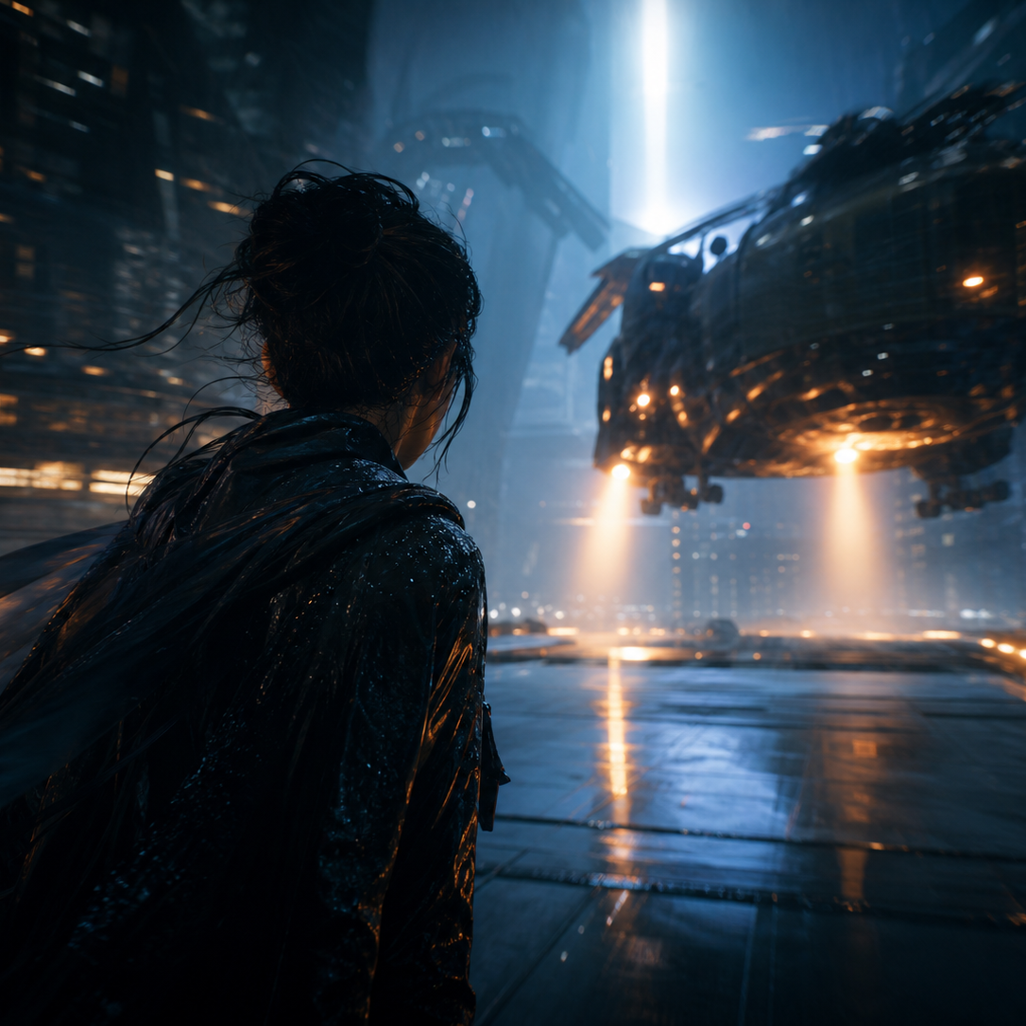


REPRESENTATIVE WORKS
Visual examples make the trend story understandable
Each style is supported by a generated work, model label, visual evidence, and prompt starter.
Anime
emotion, character, color intensity
AI Cinematic Storyboard
shot sequence and narrative pacing
Luxury Fashion
commercial editorial composition
Surreal Editorial
visual metaphor and impossible scenes
AI Visual Trend Dashboard
10

Slide 11
AI TOOLCHAIN BENCHMARK
The dashboard replaces invented scores with factual capabilities
Official source links support the comparison. The matrix is a workflow guide, not a universal quality ranking.
Tool
Best fit
Text-to-image
Image editing
Image-to-video
Midjourney
Visual ideation
Yes
Yes
Yes
OpenAI Images / DALL-E
Instruction following
Yes
Yes
No
Stable Diffusion
Open customization
Yes
Workflow
Ecosystem
Adobe Firefly
Commercial workflows
Yes
Yes
Yes
Runway
Motion/video
Yes
Yes
Yes
AI Visual Trend Dashboard
11

Slide 12
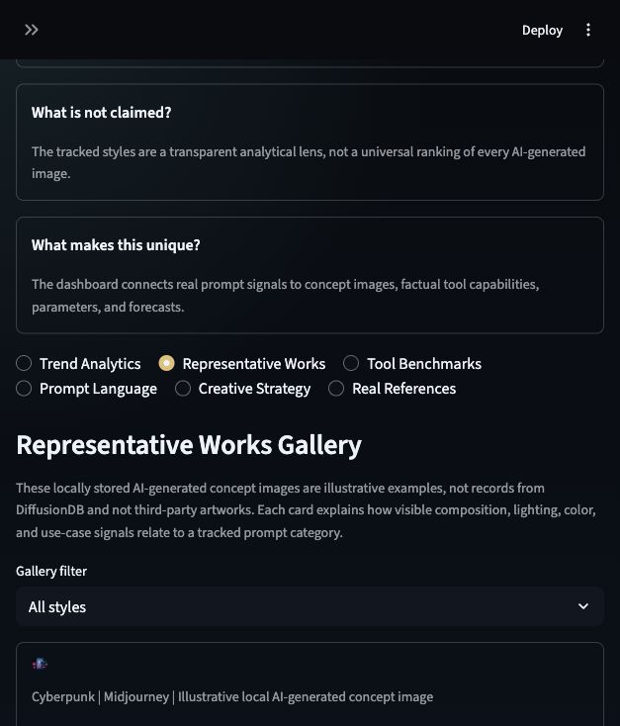
INTERACTION DESIGN
The dashboard is built to be explored live
Interactive controls make the project stronger for both demonstration and user learning.
Linked filters
Click drill-down
Style, year, and tool selections update charts, benchmark highlights, and keyword views.
Plotly selections reveal detailed keywords, style-year context, and representative image evidence.
Random exploration
Performance feedback
A demo-friendly button selects a style/date combination and generates an insight prompt.
st.cache_data and loading spinners reduce friction during repeated dashboard interaction.
AI Visual Trend Dashboard
12

Slide 13
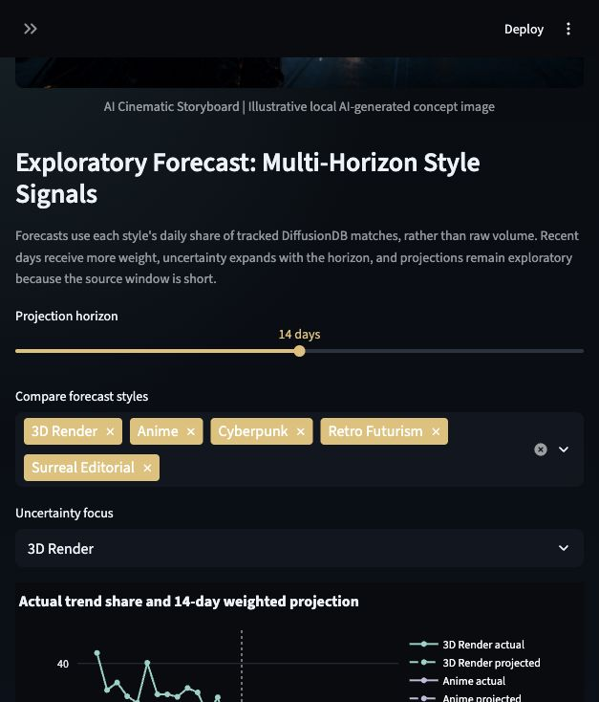
CREATIVE STRATEGY LAYER
The site turns analysis into actionable creative output
This is the main differentiator from a standard chart dashboard.
Use Case Recommendation
brand campaign, game concept, social visual, short film, product render
Creative Direction Generator
copy-ready direction based on selected visual style
Moodboard Preview
visual collage driven by mood, color, and theme choices
Motion Preview
GIF previews for cinematic, editorial, and luxury styles
Multi-Horizon Forecast
7-, 14-, and 21-day weighted projections with momentum and uncertainty
AI Visual Trend Dashboard
13

Slide 14
TECHNICAL IMPLEMENTATION
The source code is organized for review and deployment
The implementation addresses performance, maintainability, and delivery requirements.
Core functions
Quality controls
Delivery package
load_data(), render_sidebar(), render_hero(), tab_trends(), tab_gallery(), tab_tools(), tab_keywords(), tab_strategy(), tab_references()
st.cache_data for CSV loading; try/except for missing files; normalized Plotly dark theme; local assets to avoid broken external image links.
app.py, data/, assets/, requirements.txt, README.md, screenshots, presentation notes, and this PowerPoint deck are synced to GitHub.
Run command
Repository
streamlit run app.py
streamlit run app.py --server.port 8510
github.com/hedan-skku/ai-visual-trend-dashboard
AI Visual Trend Dashboard
14

Slide 15
PRD ROADMAP
Three-step development plan and final delivery status
The final website follows the PRD roadmap from prototype to polished portfolio-ready dashboard.
Step 1: Basic Layout + Sample Data
Step 2: Charts + Interactivity
Step 3: Polish + Data + Extras
Create Streamlit structure, sidebar, sample data, basic charts, title sections, and dark-theme layout.
Add advanced Plotly charts, filters, dropdowns, AI tool comparison, keyword trends, and improved UI layout.
Add richer datasets, responsiveness, animations, performance optimization, final screenshots, and presentation assets.
Final deliverables from PRD
- Streamlit web dashboard: completed locally and prepared for Streamlit Cloud
- GitHub repository: completed and synced
- GitHub Pages portfolio site: identified as an optional next publishing step
- PRD documentation: included in this presentation narrative
- Final presentation screenshots: included in README and presentation assets
AI Visual Trend Dashboard
15

Slide 16
CONCLUSION
The website presents AI visual trends as a complete research product
It connects PRD goals, data evidence, interface design, visual examples, and technical implementation.
Final argument
AI visual culture is moving from static style imitation toward creative direction: narrative image-making, tool-aware production, and visual strategy. The dashboard makes that shift visible through data, examples, and interaction.
Next steps
- extend the real-data pipeline with a longer timestamped prompt source
- deploy the app publicly on Streamlit Cloud
- record a 1-2 minute demo video for README and final presentation
Thank you
AI Visual Trend Dashboard
16

