Slide 1
Day 2
Session 10
5:00 – 6:00 PM
Closing &
Next Steps
Two days. Ten sessions. One career, starting now.
WHAT YOU
WILL LEARN
1. Consolidate the full 2-day journey
4. Leave with a clear and motivated next step
2. Commit to your 30-day action plan
5. Remember: the real work starts Monday
5 key outcomes
3. Celebrate what you've built this week
Campus to Corporate Ready · 2-Day Workshop
Notes:
Session 10: Closing & Next Steps Time: 5:00 – 6:00 PM Day 2

Slide 2
FULL JOURNEY
10 Sessions. 2 Days. One Transformation.
Day 1
S1
S2
S3
S4
S5
Corporate World
Etiquettes
Communication
Teamwork
Day 1 Recap
Day 2
S6
S7
S8
S9
S10
Personal Branding
Interview Skills
Ethics & Mindset
Mock Interviews
Closing

Slide 3
ACTION PLAN
Your 30-Day Campus to Corporate Sprint
Week 1
Week 2
Week 3
Week 4
Digital Presence
Communication Practice
Resume & Applications
Interview Readiness
✓ Update LinkedIn with new headline + skills + summary
✓ Join a debate club or Toastmasters group on campus
✓ Final resume — send to 3 people for review
✓ Do 3 mock interviews with different people
✓ Ask 2 seniors for a LinkedIn recommendation
✓ Record yourself answering 3 interview questions
✓ Tailor it for 3 different job descriptions
✓ Prepare 5 STAR stories — write them down
✓ Research 5 target companies in your domain
✓ Send 1 cold LinkedIn message to a professional you admire
✓ Apply to 5 companies / 2 internships
✓ Set your Day 1 intention for your first job

Slide 4
COMMITMENT
Sign Your Commitment Card
MY COMMITMENT
The ONE skill I will practice every day this month:
The FIRST person I will reach out to on LinkedIn this week:
The company I will research and apply to first:
The bad habit I will stop — starting today:
The thing I am most grateful for from this workshop:
Name: _________________________________ Date: ________________

Slide 5
Remember This.
The degree proves you can learn. The job proves you can deliver.
No one was 'ready' for their first job. Readiness is built on the job.
The person who gets promoted is not always the smartest — it's the most consistent.
Your first year is your most important impression — and your best opportunity.
Every senior you admire was once sitting exactly where you are right now.
Now go. You're ready.

Slide 6
YOUR PRIORITY LIST
Top 10 Actions — Start This Week
1
Update your LinkedIn headline today
Why: 6-second test. This is what recruiter's see first.
2
Write 5 STAR stories and save them in a doc
Why: You'll forget them. Having them written means instant access in any interview.
3
Record yourself answering 'Tell me about yourself'
Why: You'll hear your own filler words. Nothing fixes a habit faster than hearing it.
4
Ask 1 senior for a LinkedIn recommendation
Why: Most freshers don't. The ones who do stand out immediately.
5
Research 3 companies you'd actually want to work at
Why: Vague job hunting = vague results. Specific targets = tailored applications.

Slide 7
CLOSING THOUGHT
You Are Not Behind. You Are Beginning.
Every professional you admire was once exactly where you are. The gap between where you are and where you want to be is filled with consistent daily action — not talent.
🎯
The job isn't the destination — it's the beginning of a much longer and more interesting journey.
📈
Your first salary doesn't define your career. Your learning rate in Year 1 does.
🤝
The relationships you build in the first 5 years of your career will shape the next 30.
💪
The single most important skill in the next decade isn't AI literacy or coding — it's the ability to keep learning.
🌟
You just spent two days preparing. Most of your peers didn't. That is already a competitive edge.

Slide 8
Thank You.
You showed up for two full days. You did the activities. You stayed present.
That already puts you ahead of 80% of your peers.
Stay in touch — we mean it.
Workshop team
Add your trainer on LinkedIn today.
Share the workshop
Tag us @[handle] when you get your first job.
The group
Exchange WhatsApp numbers now. This network is worth more than a degree.
Come back
Have a question 6 months from now? Reach out. We genuinely want to hear how it went.
Campus to Corporate Ready — Workshop Complete

Slide 9
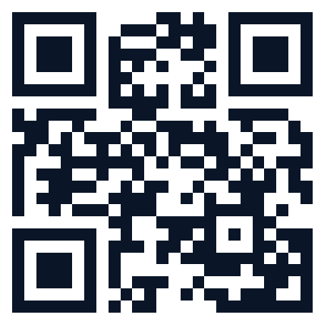
📱 BEFORE YOU GO
One Last Thing:
Your Feedback
90 seconds. Scan, rate, and tell us what landed. It shapes the next workshop — and it matters.
Scan to give feedback
Trainer: link this QR to your own feedback form.

Slide 10
“
The secret of getting ahead is getting started.
— Mark Twain

