Slide 1
Day 2
Session 7
10:45 AM – 12:30 PM
Interview Skills
& All Rounds
Interviews are performances. Rehearse, don't hope.
WHAT YOU
WILL LEARN
1. Navigate every interview round with confidence
4. Answer tough questions without fumbling
2. Master the STAR method for behavioural questions
5. Ask questions that leave a lasting impression
5 key outcomes
3. Handle aptitude, technical & HR rounds
Campus to Corporate Ready · 2-Day Workshop
Notes:
Session 7: Interview Skills & All Rounds Time: 10:45 AM – 12:30 PM Day 2

Slide 2
THE PROCESS
Every Round — What They Test & How to Win
R1
Resume Screen
ATS + recruiter: does this person fit the JD?
✓ Keywords, metrics, clean format
R2
Aptitude / Psychometric
Logical, numerical, verbal reasoning speed
✓ Practice daily; manage time, skip & return
R3
Technical Round
Domain knowledge, coding, problem-solving live
✓ Think aloud, admit gaps, show process
R4
Case / Task Round
How you handle real-world ambiguity
✓ Ask clarifying questions, structure clearly
R5
HR Round
Culture fit, values, salary expectations
✓ Honest, research the company, have a number
R6
Managerial / Final
Leadership potential, situational judgement
✓ STAR stories ready; show growth mindset
What they test
How to win

Slide 3
BEHAVIOURAL QUESTIONS
The STAR Method — Answer Every Behavioural Question
S
Situation
Set the context. One to two sentences maximum. What was happening?
T
Task
What was YOUR specific responsibility in that situation?
A
Action
What did YOU do? Use 'I', not 'we'. Steps taken, decisions made.
R
Result
What was the outcome? Quantify if possible. What did you learn?
Practice: "Tell me about a time you handled a difficult situation" — answer using STAR right now.

Slide 4
MOST ASKED
10 Questions You Will Be Asked — How to Answer
1. Tell me about yourself
Professional summary: education → key project → why this role. 90 seconds.
2. Why this company?
Specific answer: product, mission, recent news. Never 'good reputation.'
3. What's your weakness?
Real weakness + active steps you're taking to improve it.
4. Where do you see yourself in 5 years?
Growth within the field, aligned with the company's direction.
5. Why should we hire you?
3 specific skills + proof + what problem you solve for them.
→ Question (What they ask)
→ Answer framework

Slide 5
YOUR TURN
"Do You Have Any Questions For Us?" — Yes. Always.
Asking good questions signals preparation, curiosity, and seriousness.
About the role
"What does success look like in the first 90 days in this role?"
About growth
"What do your best performers have in common that I can learn from?"
About team
"How would you describe the team culture and how decisions are made?"
About challenges
"What's the biggest challenge the team is working through right now?"
About your work
"How does this role contribute to the company's larger goals?"
Never ask about salary, leave, or 'what does the company do' in early rounds.

Slide 6
✏ ACTIVITY
Hot Seat Interview Practice
01
Form groups of 3
One interviewer, one candidate, one observer.
02
3-minute interview
Interviewer asks: 'Tell me about yourself' + one STAR question. Candidate answers.
03
Observer gives feedback
Body language, eye contact, structure, filler words. Specific and kind.
04
Rotate twice
Everyone experiences all three roles. Debrief: what changed after feedback?

Slide 7
REAL-WORLD SCENARIO
Case Study: What Would You Do?
Scenario: 'What is Your Expected CTC?'
Karan is in his HR round. The recruiter asks: 'What salary are you expecting?' He hasn't researched market rates. His college placed students at 4–12 LPA for similar roles. He doesn't know if he should quote high or low — or ask them first.
❓ What's the best approach — and what should Karan have prepared before entering this room?
✅ Research-backed range answer
✅ Ask a clarifying question first
❌ Say 'I'm flexible, whatever you offer'
"Based on my research, similar roles at this level are typically in the 6–8 LPA range. I'm open to discussion based on your compensation structure and the full package." Then — be quiet.
"Could you share the budgeted range for this role? I want to make sure we're aligned before I give you a number."
States no expectation. Leaves it entirely to the company to decide.
Why this works:
Why this works:
Why this fails:
A range shows preparation. The upper end anchors the negotiation. Staying quiet after you name a number is a critical negotiation skill — the first one to speak after that often concedes.
This is a power move — gets their anchor first. Not always possible, but worth trying. If they deflect, use the research-backed range approach.
Signals low confidence and no market awareness. You'll get the bottom of their range. Companies don't respect candidates who don't value themselves.

Slide 8
DATA & RESEARCH
What Interviewers Actually Evaluate
33%
7x
65%
of hiring decisions are made in the first 90 seconds of the interview
more likely to be hired: candidates who ask 3+ thoughtful questions vs those who ask none
of interviewers say preparation (knowing the company, role, and department) is most differentiating
— Association for Psychological Science
— Glassdoor Hiring Study
— LinkedIn Talent Research 2023
💡 The interview starts before the room. How you walk in, how you shake hands, whether you know the company's last quarter result — interviewers notice all of it before you say a word.

Slide 9
DIFFICULT QUESTIONS
Questions That Throw Freshers Off — Answered
'Tell me about a failure.'
How to answer: Real failure → what you did → what you learned → how it changed you. End on growth, not regret.
Don't pick a fake failure. Pick a real one where you recovered.
'Why should we hire you over 200 other candidates?'
How to answer: 3 specific skills + 1 personal trait + 1 thing you've done that most freshers haven't. Evidence beats adjectives.
This is not the time for humility. It's the time to own your differentiators.
'Do you have any concerns about the role?'
How to answer: Acknowledge one legitimate question (growth path, tech stack, team size) — not a dealbreaker. Shows you've thought critically.
They're testing honesty and research quality, not fishing for problems to reject you.
'What will you do if a better offer comes along?'
How to answer: 'I'm committed to evaluating based on fit, growth, and culture — not just number. That's why I'm here today specifically.'
Be honest, not defensive. This is about character.

Slide 10
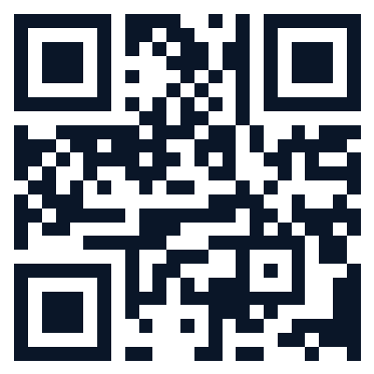
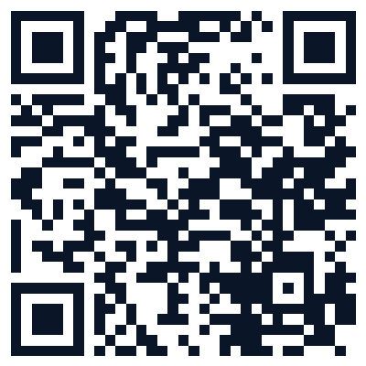
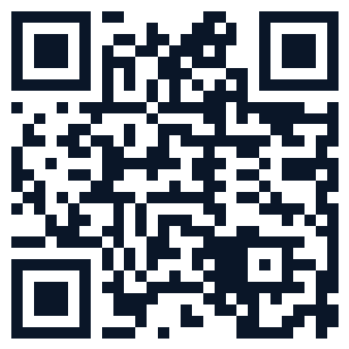
MODERN WORKPLACE
Scan These — Your Interview Prep Resources
Take a photo of this slide, or scan what's useful now. These are your homework for the next 30 days.
STAR Method Guide
Optimise LinkedIn
Practice Questions
Deep dive on behavioural answers
Profile checklist & examples
Common interview question bank
Trainer: swap these QR codes for your own curated links before delivery.

Slide 11
“
Before anything else, preparation is the key to success.
— Alexander Graham Bell

