Slide 1
2025 SUPPLEMENT
The Modern
Workplace
AI, remote work, and the tools that define work today.
Slot these slides into the relevant sessions to keep the workshop current. Each is tagged with its home session.
Campus to Corporate Ready · Modern Workplace Supplement

Slide 2
FITS: SESSION 1 / 8
AI Is Now Your Co-Worker, Not Your Competition
The professionals who thrive in 2025 aren't the ones who avoid AI — they're the ones who use it well and honestly.
⚡
🔍
🤝
Use It to Go Faster
Always Verify
Be Transparent
• Draft emails, summarise docs, brainstorm
• AI is confident even when wrong
• Don't pass AI work off as fully yours
• First drafts in seconds, not hours
• Check facts, figures, and code
• Know your company's AI policy
• More time for judgment and creativity
• You own the output — not the tool
• Disclosure builds trust, not weakness

Slide 3
FITS: SESSION 6
The Modern Fresher's Toolkit
You don't need all of these — but you should know they exist and what they're for.
AI Assistants
Job Search
ChatGPT, Claude, Gemini — drafting, learning, debugging
LinkedIn, Naukri, Instahyre, Wellfound (startups)
Resume & Portfolio
Collaboration
Canva, Novoresume, GitHub, personal site (Vercel)
Slack, Teams, Notion, Google Workspace
Project Tracking
Interview Prep
Jira, Trello, Asana, Linear
Pramp, interviewing.io, LeetCode, Glassdoor

Slide 4
FITS: SESSION 2 / 4
Winning at Remote & Hybrid Work
Your first job may be partly or fully remote. The rules of trust and visibility change when you're not in the room.
✅ DO
❌ DON'T
• Over-communicate — silence reads as absence
• Don't multitask visibly on calls
• Turn your camera on for the first 5 minutes
• Don't go dark when stuck — ask sooner, not later
• Reply to messages within a few hours
• Don't assume people know what you're doing
• Make your work visible: share updates proactively
• Don't skip virtual social moments entirely
• Have a clean, well-lit video setup
• Don't rely only on text — hop on a call when it's faster

Slide 5
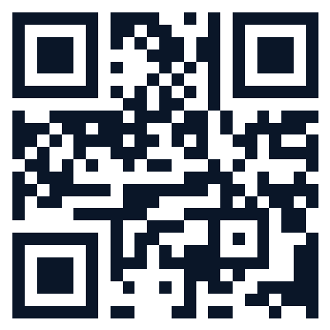
📱 INTERACTIVE MOMENT
Quick Poll:
Scan to Answer
Take out your phone. Point the camera at the QR code. Tap the link. Answer in 30 seconds.
Scan me
Trainer: replace this QR with your own Mentimeter / Slido / Google Form poll before delivery.

Slide 6
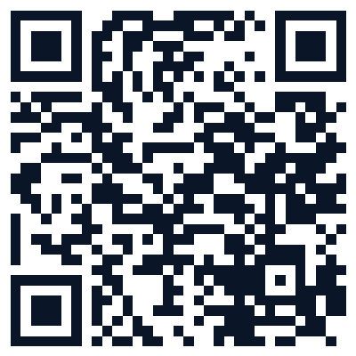
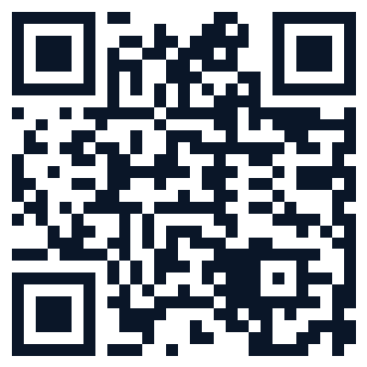
FITS: SESSION 7
Scan These — Your Interview Prep Resources
Take a photo of this slide, or scan what's useful now. These are your homework for the next 30 days.
STAR Method Guide
Optimise LinkedIn
Practice Questions
Deep dive on behavioural answers
Profile checklist & examples
Common interview question bank
Trainer: swap these QR codes for your own curated links before delivery.

Slide 7
FITS: SESSION 8
The Skills AI Can't Replace
As AI handles more routine work, these deeply human skills become your career moat.
🧭
Judgment
💬
Communication
🤝
Relationships
Knowing which problem to solve, and when the AI is wrong
Persuading, aligning, and moving people to action
Trust, empathy, and collaboration — built human to human
🎨
Creativity
🔄
Adaptability
⚖️
Ethics
Original ideas and taste that go beyond remixing what exists
Learning fast and thriving when everything keeps changing
Deciding what should be done, not just what can be done

Slide 8
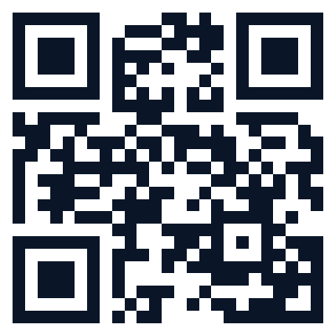
📱 BEFORE YOU GO
One Last Thing:
Your Feedback
90 seconds. Scan, rate, and tell us what landed. It shapes the next workshop — and it matters.
Scan to give feedback
Trainer: link this QR to your own feedback form.

Slide 9
TRAINER GUIDANCE
Adding Video for Better Delivery
Short, well-placed videos re-energise a room and show real-world examples. Here's where they work best.
Session 2
A 60-sec clip of a great vs poor handshake / introduction
Search: 'professional first impression' on YouTube
Session 3
A TED clip on body language (Amy Cuddy) or public speaking
Keep it under 3 minutes — clip, don't play whole talks
Session 7
A mock interview breakdown video — good and bad answers
Many recruiter channels have these; pick India-relevant ones
Session 8
Carol Dweck on growth mindset (2–3 min excerpt)
Reinforces the fixed vs growth content perfectly
Tip: In PowerPoint, Insert → Video → download the clip first (don't rely on venue Wi-Fi for streaming).

Slide 10
Keep It Current.
The world of work changes fast. Revisit these supplement slides every few months and swap in what's new — new tools, new norms, new examples. A workshop that feels current is a workshop people trust.
Campus to Corporate Ready · Modern Workplace Supplement · Update before every delivery

