Slide 1
Machine leaning

Slide 2
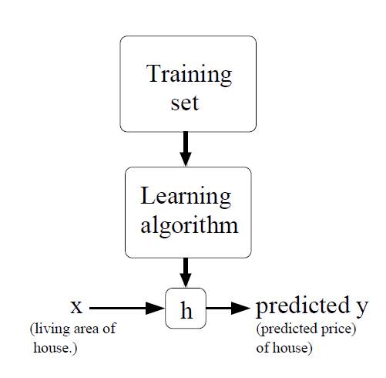
Notation
x^{(i)} : input variables or features
y^{(i)}: output or target variables
A pair (x^{(i)}, y^{(i)}) is called a training example
A list of m training examples {(x^{(i)}, y^{(i)}); i =1, . . . ,m}—is called a training set.
given a training set, to learn a function h : X → Y so that h(x) is a “good” predictor for the corresponding value of y. For historical reasons, this function h is called a hypothesis

Slide 3
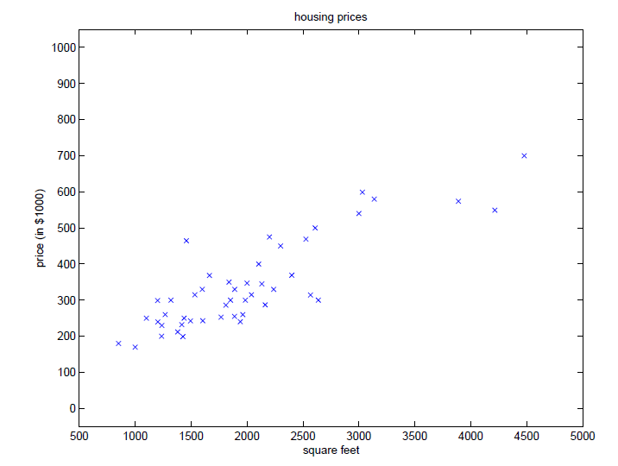
Supervised learning
Regression

Slide 4
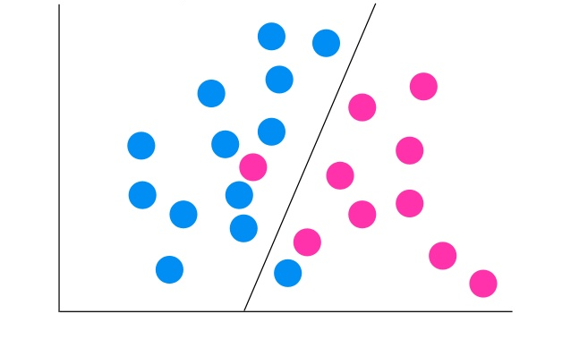
Supervised learning
Classification

Slide 5



Linear Regression
Here, the θi’s are the parameters (also called weights)
Letting x₀=1
We define the cost function:

Slide 6
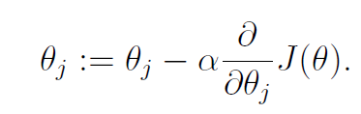
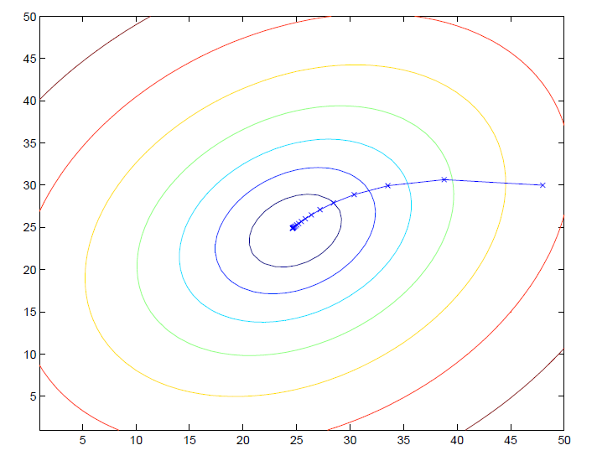
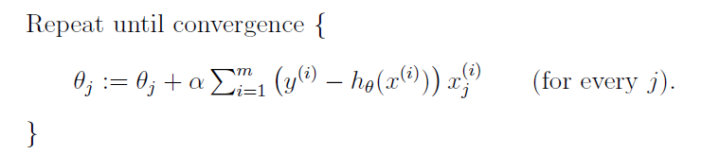
LMS algorithm
Gradient descent algorithm
α is called the learning rate.
update rule
The rule is called the LMS update rule (LMS stands for “least mean squares”), and is also known as the Widrow-Hoff learning rule.

Slide 7
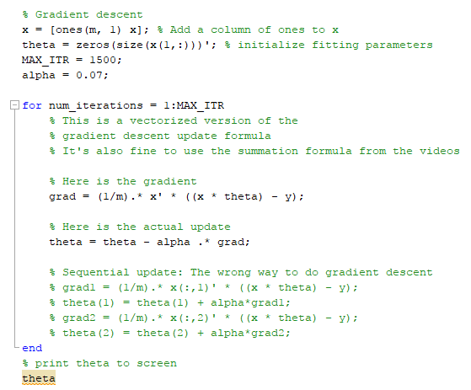
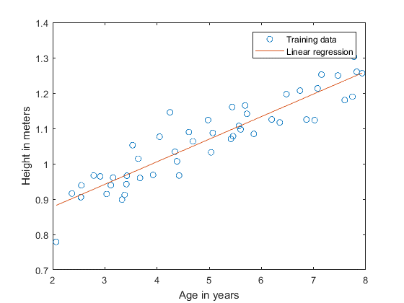
Application

Slide 8

Application

Slide 9
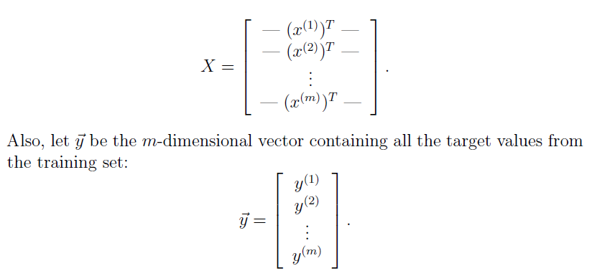
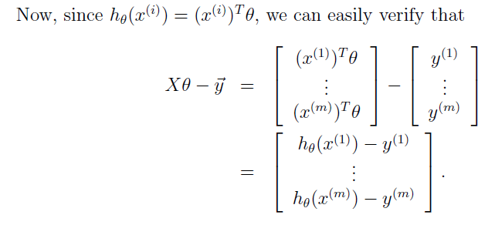
The normal equations

Slide 10
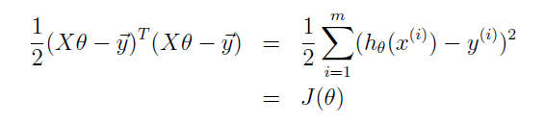
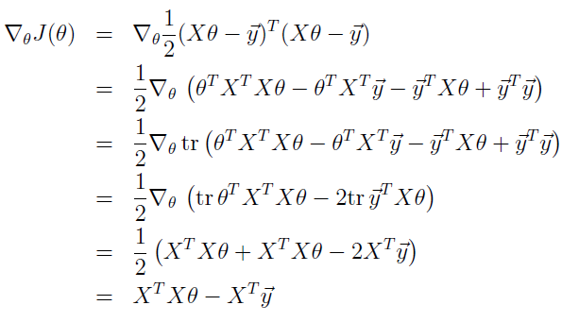



The normal equation
The cost function
Minimize J => $\frac{∂J}{∂θ}=0$
Normal equation

Slide 11
Feature Scaling
x2
Cost function
x1
X=x1/(max(x1) => 0=<X=<1
x1>>x2

Slide 12
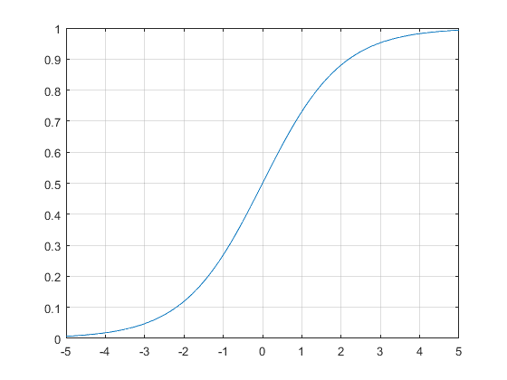

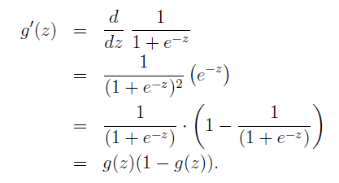
Logistic Regression
Logistic function or Sigmoid function
Derivative:

Slide 13
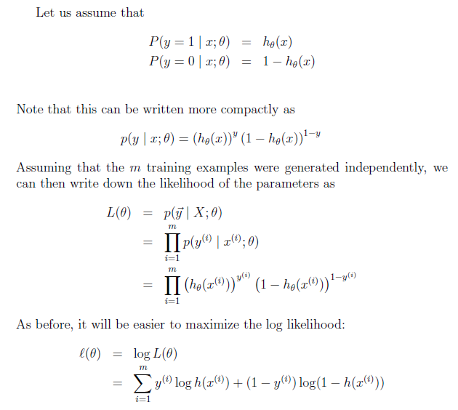

Logistic Regression
Update rule
L’=0

Slide 14

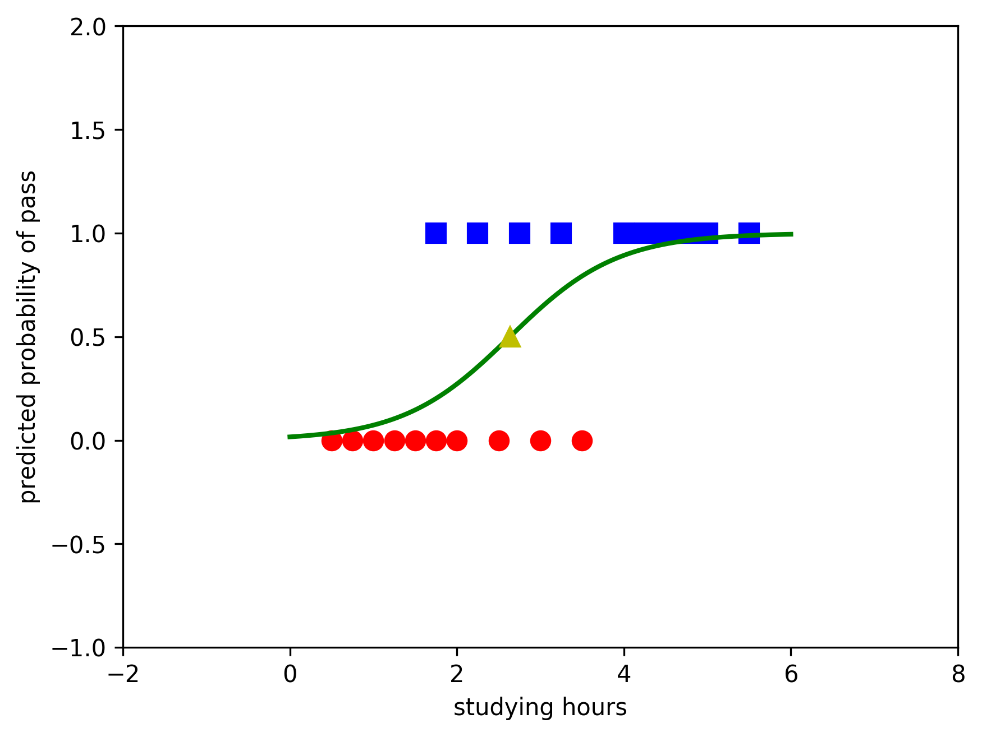
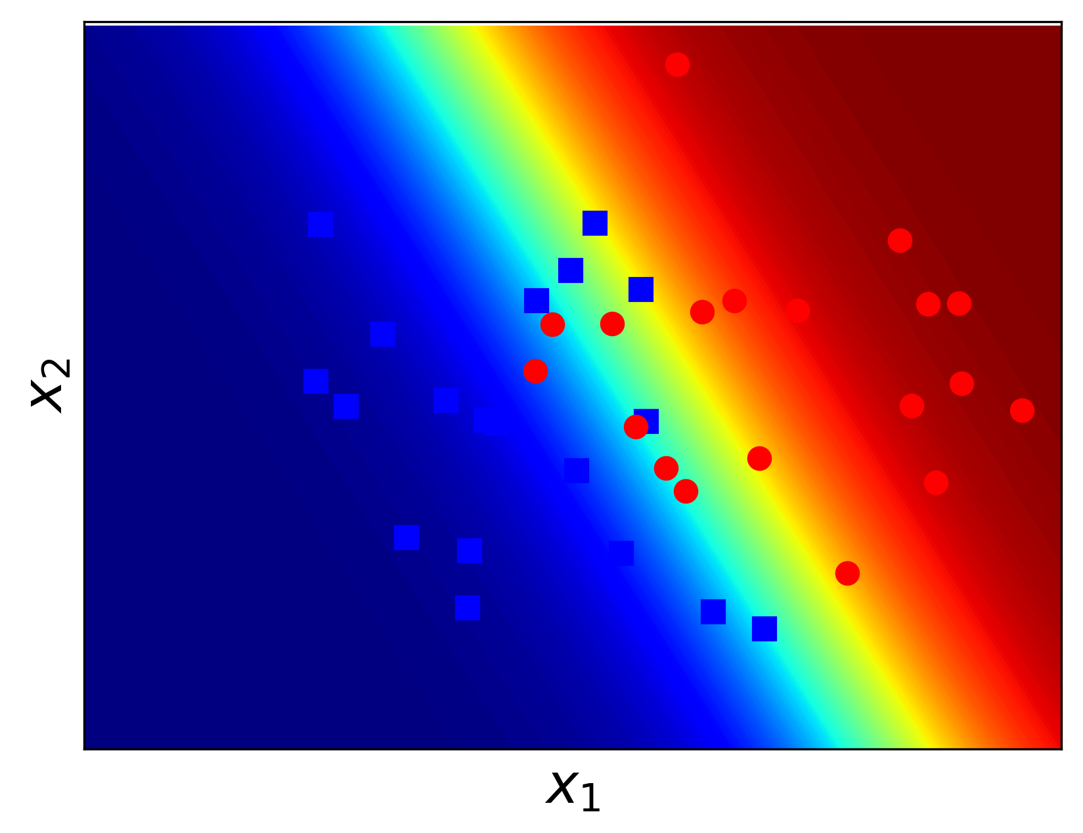
Logistic Regression
Gradient descent
Update rule:

Slide 15
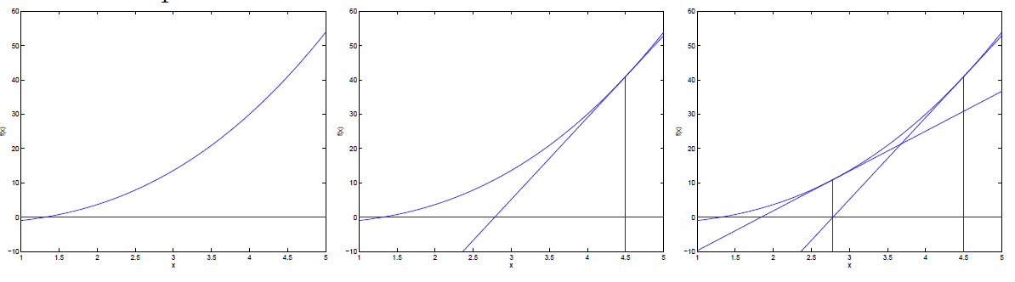


Logistic Regression
F(x)=0
F(x)=a^n
tangent line
Newton method
$$x_{i+1}=x_{i}−\frac{f(x_{i})}{f^{′}(x_{i})}$$
$$e_{i+1}=\frac{f^{′′}(x_{i})}{{2f}^{′}(x_{i})}e_{i}^{2}$$

Slide 16



Logistic Regression
Newton method

Slide 17
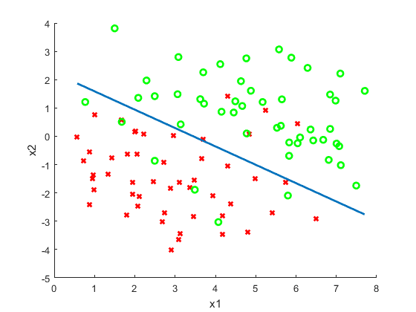
Logistic Regression
Newton method

