Slide 1



HEDAYA MOSTAFA
241002546
BIOBANK & BIOSPECIMEN MANAGEMENT SYSTEM
DATABSE PROJECT PRESENTATION
DR. MOHAMED MAHMOUD ELSAYEH

Slide 2

PROBLEM STATEMENT & SCOPE
Biobank need to manage:
Biological samples
Donor consent
Sample storage
Reasearch requests
This database tracks samples from collection to testing
scope:
donor information & consent
research test requests
sample collection & storage
test results tracking

Slide 3
ENTITIES
(9 TABLES)
donors
consent
sample_types
storage_locations
samples
sample_storage
researchers
test_requests
test_results

Slide 4

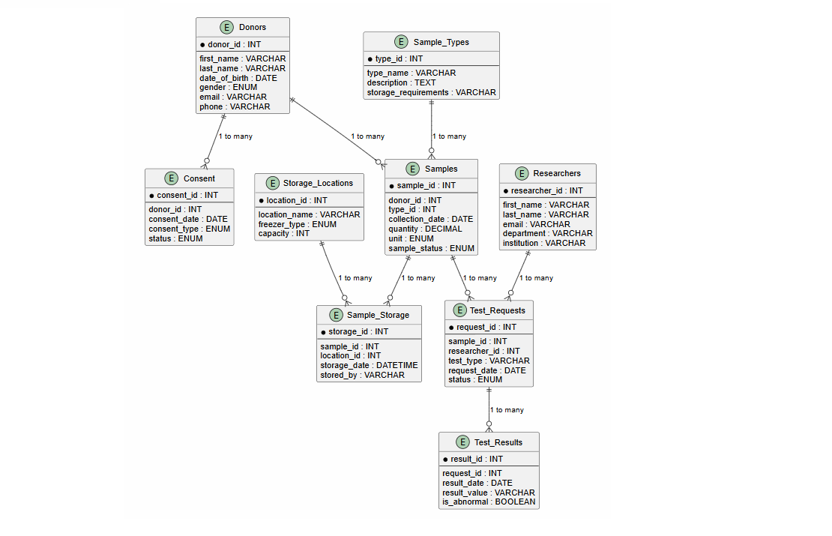
ER DIAGRAM

Slide 5
NORMALIZATION (3NF)
1NF: All tables have primary keys, atomic values
2NF: No partial dependencies
3NF: No transitive dependencies
Database is fully normalized to 3NF

Slide 6

VIEWS & TRIGGERS
views:
sample_tracking_view
research_request_summary
triggers:
update storage capacity when sample is stored
update sample status when test completes

Slide 7

SAMPLE QUERY
SELECT s.sample_id, d.first_name, d.last_name, st.type_name FROM Samples s JOIN Donors d ON s.donor_id = d.donor_id JOIN Sample_Types st ON s.type_id = st.type_id WHERE s.sample_status = 'Available';
-shows all available samples with donor and type information

Slide 8

CONCLUSION
The project successfully implements a relational database for a biobank facility using MySQL.
& ready for deployment in real world biobank to manage Donors, samples, storage, & research requests
Key achievements:
9 tables with proper relationships
normalized to third normal form (3NF)
2 views for reporting
2 triggers for automation
2 stored procedures and 1 function
test data with 10+ records per table
sample queries demonstrating JOINs, aggregation, and subqueries
GitHub Repository: https://github.com/hedayastarx/Biobank-databasepro

Slide 9
THANK YOU

