Slide 1
Intro to Randomized Designs
NSF Improving Education R&D Evaluations Workshop 2021 Tipton

Slide 2
Random assignment
…“does not mean that the experimenter writes down the names of the varieties [treatments] in any order that occurs to him, but that he carries out a physical experimental process of randomization, using means that shall ensure that each variety [treatment] will have an equal chance of being tested on any particular plot of ground [unit] (Fisher, 1935, p. 51).”

Slide 3
How to randomize?
There are several processes that can be used to randomize:
Use a well shuffled deck of cards.
Use random number generators.
Use a random number table.
Use software that directly randomizes into groups.
In each case, however, care should be made to ensure that the process is truly random. Every unit should have a known probability of being in the intervention vs. comparison group.

Slide 4
Deck of cards approach
Let’s say we want to randomize a set of 10 individuals into two groups, with ½ (5 individuals) allocated to each group. We use a deck of 10 cards, 5 of which are red and 5 of which are black.
Red = intervention group
Black = comparison group
Shuffle the cards well

Slide 5
Deck of cards approach
For each unit, choose a card, determining which group they are in.
Person 1 is Red (intervention group)
Person 2 is Black (comparison group)
Continue down the list of units.
When one group is full, the rest go into the other group.

Slide 6
Example (n = 10)
1. We have 5 red cards and 5 black cards.
2. We shuffle the cards.
3. In order, draw a card.

Slide 7
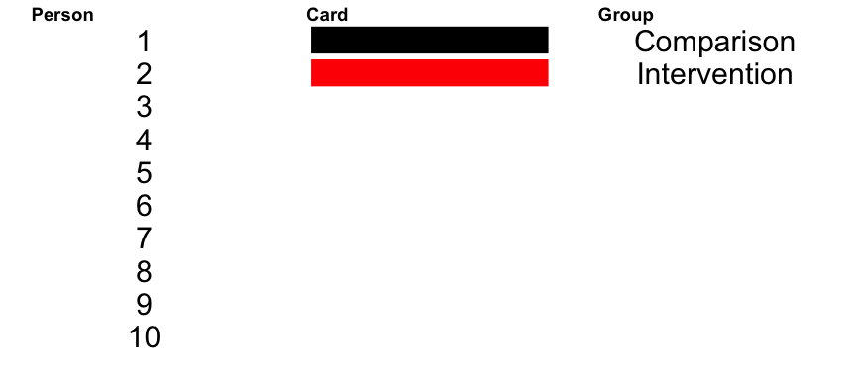
First two…

Slide 8
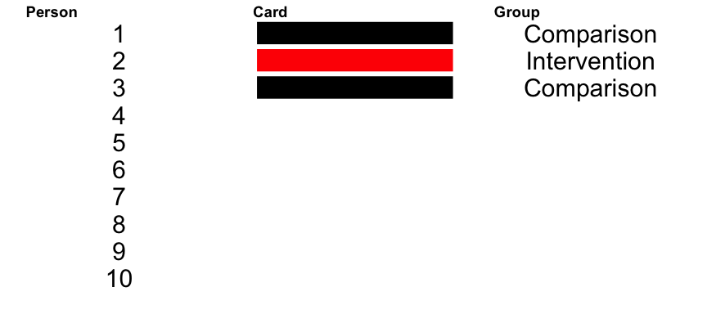

Slide 9
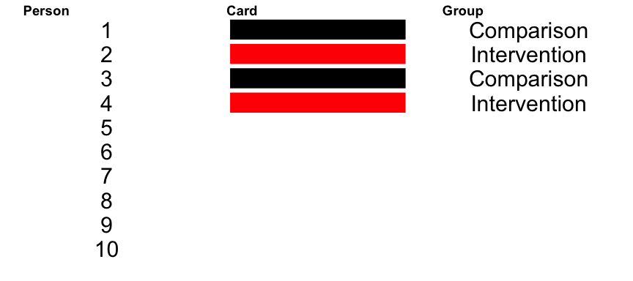

Slide 10
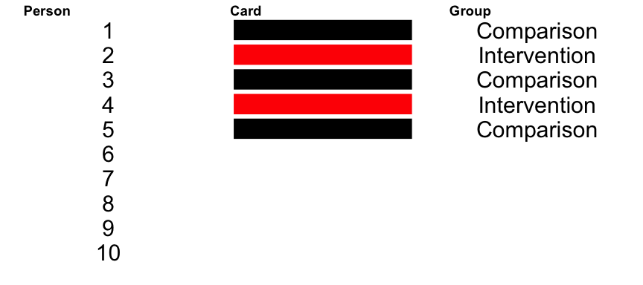

Slide 11
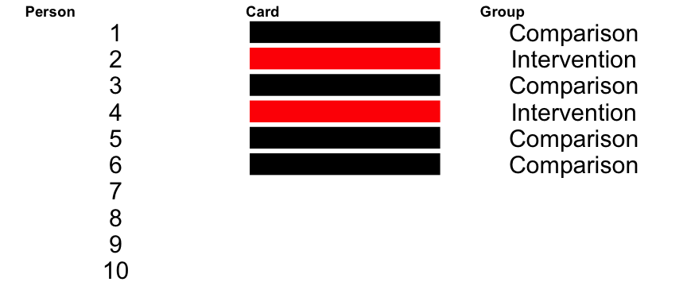

Slide 12
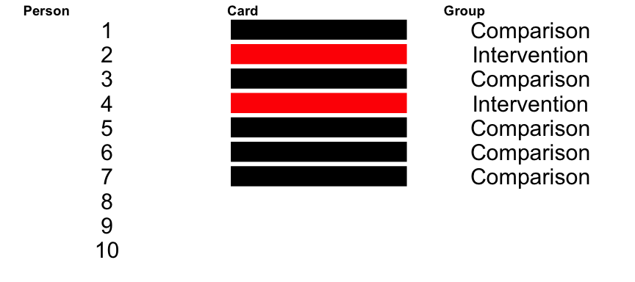
What group are the last 3 in ?

Slide 13
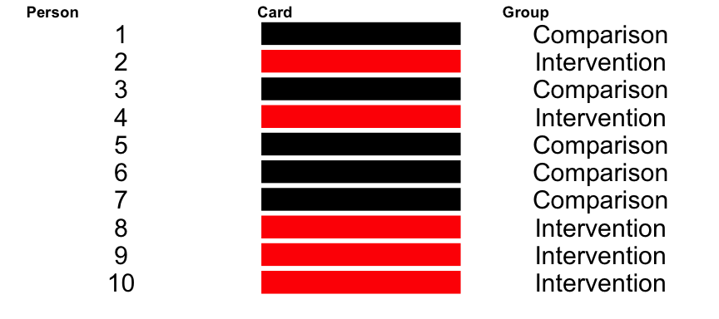
For the last 3, I didn’t even need to draw the cards to know which group they were in.

Slide 14
Is this random?
“When one group is full, the rest go into the other group.”
Is that really random? Doesn’t this induce a dependence between the units?
Yes, it really is independent and random. To see why, just imagine a different shuffling of the cards … every unit would have some the same chance being selected at the start as at the end.

Slide 15
Why does this seem not random?
Because humans aren’t very good at generating random numbers.
For example, which of these runs is more likely?
#1: T, C, T, C, T, C, T, C, T, C
#2: T, C, C, T, T, C, T, C, T, C
They are both equally likely (1 out of 252 possible ways to randomize 5 out of 10 to treatment)!

Slide 16
Computer generated random numbers
Computer random number generators start with what is called a seed value , which is transformed in a complex way to yield the ‘random’ number.
If you start with the same seed value, the process always yields the same random numbers.

Slide 17
What’s so wrong with alternation?
Notice that in run #1, the red and blacks alternated in a pattern. Why not just use this approach? Three good reasons:
You can manipulate this easily, particularly if you know that there are some units you’d like to be in the intervention group.
It’s not actually random … which means that the statistical properties that we need do not hold.
If there is any sort of cyclical property to your data, you can end up with two groups that are quite different than one another.

Slide 18
Theoretical Objections to Randomization
There are a variety of criticisms of random assignment and experiments. These include that they:
Offer an oversimplified theory of causation.
Are unsuited for complex organizations like schools.
Are premature without good theory.
Are politically unfeasible.

Slide 19
Theoretical Objections to Randomization
Despite these claims, however, randomized experiments have been possible in education. In the last 20 years, for example, over 400 such studies have been conducted in schools in the US funded by IES.

Slide 20
Experiments often fail
Another criticism is that experiments often result in ‘null’ findings. That is, the effect sizes are small and often not statistically different than zero.
But isn’t this a finding in and of itself?
Incidentally, this is true in fields beyond education. In medicine, too, for example, the vast majority of new treatments are not found to be effective.

Slide 21
Aren’t there alternatives?
Yes, there are alternatives available. We will talk about two of these later this week:
Non-equivalent control group designs
Difference-in-difference designs
But in order to recover the causal effect, these methods:
Require assumptions, some of which cannot be verified
Require advanced statistical methods to be used in the analyses
Require more data than experiments

Slide 22
Are they unethical?
In an experiment, some people don’t get the intervention. Isn’t this unethical?
To answer this, we need to consider the risks and benefits to both participants and society.
If the potential benefits do not outweigh the risks, overall, then it is essentially never ethical to randomize.

Slide 23
Risks of being in an intervention
Recall that many interventions, once evaluated, indicate that there is no evident benefit of the intervention.
Yet there is a cost to being in the intervention group:
Your routine is disrupted
Time you could have spent learning or doing some other practice or intervention is focused on this one

Slide 24
The clinical equipoise principle
…states that it is ethical to randomly assign patients to a treatment or control if there is genuine uncertainty in the scientific community about whether the treatment is more effective than the control condition.

Slide 25
Caveat
The concept of equipoise does not mean that there must be no reason to suspect the treatment is either more or less effective than the control.
It would make no sense to evaluate a treatment if there were no reason to think it might be effective.
There is little evidence from field trials to support the effectiveness of a treatment that is undergoing an initial field trial.

Slide 26
Randomization can be complex
When you think of randomization, you likely think:
Every unit in the study has to be randomized
Every unit has to have an equal chance of being in the intervention or comparison groups
Randomization occurs once at the beginning of the study
None of these rules is required though!

Slide 27
Randomization can be complex
The only requirements: - We know which units were randomized - Units that are randomized have a known probability $0<p<1$ of being in either group

Slide 28
Complexities are your friend
Being flexible with the design can make it more palatable to potential participants.
It can help you frame the study and the study design.
For example, since studies do not involve unlimited resources, it is simply not possible for every unit interested to receive the intervention.
This means that a lottery randomization is a fair way to allocate resources.

Slide 29
Restricted randomization
In an evaluation, not all units have to be randomized. The question of what units to randomize relates not to internal validity but to external validity .

Slide 30
Restricted randomization
It may be beneficial to only randomize units to the intervention within a subset of the sample. For example,
You might choose to exclude some students in order to reduce variation on the pretest.
There are certain students or teachers that you know you would like to guarantee are included in the intervention group we call these ‘wildcards’.
In either case, the units that are not randomized do not end up in the analytic sample for the analysis . But they do end up in the study.

Slide 31
Unequal probabilities
There is no requirement that every unit have an equal probability of being in the intervention or comparison groups.
It may be more feasible in terms of money or political capital to have unequal groups, e.g., 2:1 or 1:2 instead of 1:1.
Again, the key is to know what these probabilities are and to incorporate them into the analysis.

Slide 32
Everyone eventually gets the intervention
There is also no rule that everyone has to stick to their assigned group forever.
Instead, it may be better to eventually provide the intervention to everyone, while randomizing the order in which they receive it.
Those that are randomized to receive it later serve as the comparison group at first.
Often referred to as a ‘delayed treatment’ design.

Slide 33
Every unit gets some of the intervention
Another approach, useful in clustered settings like schools, is to guarantee that some units within the cluster will get the intervention.
For example, in a school:
You might randomize different grade levels to receive the program
You might only include 2nd grade in the study randomizing groups, but then provide the curriculum to everyone in the other grades

Slide 34
But you have to explain it
When you recruit schools (& teachers & students) to be part of an evaluation, you have to get their informed consent .
This includes their consent to be randomized. Obtaining this consent requires that they understand: - That any of the schools including theirs could be in the intervention or comparison - That all of their “best” schools or teachers … could end up in the comparison condition

Slide 35
Overview of 4 Designs
 | Notation | Sample Sizes | Chapter 7 | Chapter 8 | Chapter 9 | Chapter 10
Intervention vs. Comparison | $α_{i}$ | 2 | Individually Randomized Design | Randomized Block Design | Cluster Randomized Design | Multisite Cluster Randomized Design
Schools | $β_{j}$ | $m$ |  | RE | RE, RA | RE
Students | $ϵ_{k}$ | $n$ | RE, RA, O | RA, O | O | O
Classrooms/Teachers | $γ_{jl}$ | $p$ |  |  |  | RA
School by Intervention Interaction | $αβ_{ij}$ | $2m$ |  | M* |  | M
RE = recruited, RA = randomized, O = observed/outcome, M = measured, * = in some models

