Slide 1

How to Become Involved
Finding your place in the Drupal community
Lucas Hedding (heddn)
www.mtech-llc.com
Session: heddn.github.io/drupal-find-your-place

Slide 2
Overview
Overview
Self Identify
Exploring Drupal
Experienced with Drupal
Make a living using Drupal
Project Manager
Community Involvement is Similar
Barriers to contribution
Motivations to contribute
Getting started
Redefine involvement
Non-code involvement
Documentation. Documentation. Documentation.
Translations
Usability Testing
Accessibility Testing
Manual Testing
Screenshots
DevOps
Testbots
Graphics Design
Organize a sprint
Organize a meetup
Give Talks
Write
Provide Support
Record a Video/Screencast
Record a podcast
Sponsor an Event
Become a Mentor
Triage an issue
Encourage your org to join #majoraweek
My introduction to Drupal
Four years and counting...
Now?
Code Involvement
But first...
Wait, there's more
Re-roll patches
Novice Tasks
Add automated tests
Update a patch
Review patches
Develop a D8 theme
Contribute to Contrib
Port a D7 module to D8
Write a D7 => D8 migrate plugin
Test a D6/D7 => D8 migration
Write a change record
Why #majoraweek?
How to participate
Review Time

Slide 3
Overview
Where are you NOW in the path to involvement?
Non-coding way to get involved
Mental Break – More about the speaker
Coding ways
#majoraweek

Slide 4
Self Identify
Are you just exploring Drupal?
Have you used Drupal for a while?
Do you make your living using Drupal?
Are you a Project Manager?

Slide 5
Exploring Drupal
Interested in understanding terms like entities, nodes, taxonomies, fields, etc.
Great to help with usability testing.
Testing translations are accurate.
You have something I don't, you are NEW. I'll never be there again, so your feedback is invaluable.
You are in the right spot. Today you will find out how you can use your lack of knowledge to help the community.

Slide 6
Experienced with Drupal
You have drush installed.
You have a user account on drupal.org.
You've attended at least one Drupal camp.
You know about IRC and have used it some.
But you don't know where to start. You need help finding something to do.

Slide 7
Make a living using Drupal
You build sites using Drupal every day.
You self-identify as a front-end, back-end developer or site-builder.
Maybe you've installed Drupal 8 and Drupal Console.
You'd like to help with Drupal 8.
But you don't know where to start learning more about Drupal 8. You also are in the right spot. You will find direction today on what you can do to move the Drupal project forward.

Slide 8
Project Manager
You know how to manage work and workload.
Many contrib modules would LOVE help managing their workload.
Take a look at Rules D8 port; someone is filling that role. That doesn't exist for the panels & panelizer D8 port.
If you depend on Panels on D7, then maybe you or your organization could justify spending some time helping out?

Slide 9
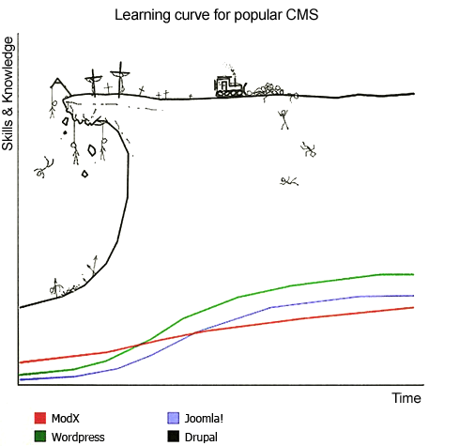
Community Involvement is Similar
Notes:
You feel like you can't get involved until you master Drupal.

Slide 10
Barriers to contribution
You must be super smart to contribute (Einstein complex).
You don't know where to start.
You have limited time.
You're company doesn't pay you to contribute.
You don't know good (enough) English.

Slide 11
Motivations to contribute
Why do you want to contribute?
What do you want to do?
What do you want to learn?
what do you want to learn from this session?

Slide 12
Getting started
Get over your fears
Find someone who will mentor you.
Meet with someone face-to-face.
As a last resort, #drupal in IRC each Wednesday

Slide 13
Redefine involvement
Involvement doesn't have to mean writing or reviewing code.

Slide 14
Non-code involvement
20 number of ways to contribute, without writing a line of code.
No specific order.

Slide 15
Documentation. Documentation. Documentation.
Poor documentation raises the entry-level.
Update documentation, especially in Spanish
  http://drupal.org.es/node/9 – super old

Slide 16
Translations
localize.drupal.org/translate/languages/es
Use poedit
Or use web interface (Look Mom, no software needed!)

Slide 17
Usability Testing
Usability, d8ux, D8UX usability, D7UX usability drupal.org/project/issues/search/drupal?issue_tags=D8UX+usability,+d8ux,+Usability,+D7UX+usability
simplytest.me
Experts in UX needed too!

Slide 18
Accessibility Testing
accessibility drupal.org/project/issues/search/drupal?&issue_tags=accessibility
simplytest.me
chromevox.com
addons.mozilla.org/en-us/firefox/addon/fangs-screen-reader-emulator
nvaccess.org (Windows only client)
Experts in accessibility needed too!

Slide 19
Manual Testing
Needs manual testing drupal.org/project/issues/search/drupal?issue_tags=Needs+manual+testing
simplytest.me

Slide 20
Screenshots
Needs screenshots drupal.org/project/issues/search/drupal?&issue_tags=Needs+screenshots
simplytest.me
Closely related: Cross-browser testing

Slide 21
DevOps
DevOps to make on-boarding to Drupal easier.
drupal.org/tools
Other solutions also exist.

Slide 22
Testbots
Related to DevOps
Related to Continuous Integration
drupal.org/project/drupalci

Slide 23
Graphics Design
Market Drupal to the world!
groups.drupal.org/marketing-drupal

Slide 24
Organize a sprint
groups.drupal.org/node/447258
drupal.org/core-mentoring/sprint-resources

Slide 25
Organize a meetup
drupal.meetup.com

Slide 26
Give Talks
At your meetup
At your school or workplace
On street corners

Slide 27
Training
What threatens Drupal adoption?
  Demand out weights supply
  Professionalism is comparatively low
  Training is less available than other technologies
Notes:
Global Training Days
Training hours for the community

Slide 28
Write
Write a blog post, or several posts
  Explain how you you are using Drupal
  Or blog about #majoraweek

Slide 29
Provide Support
IRC #drupal-es, #drupal, #drupal-support
Stack Overflow
Google+ Drupal community
LinkedIn Drupal community

Slide 30
Record a Video/Screencast
There is a lack of good walk-through videos
ESPECIALLY in Spanish
Find something you are interested in, then make a video.

Slide 31
Record a podcast
Talk about Drupal and record it.

Slide 32
Sponsor an Event
Provide space
Provide food
Provide organizational skills
Encouragement
Money

Slide 33
Become a Mentor
Informally mentor someone
Join the IRC core mentoring hours
Mentor at camps, conferences and meetups
Help someone install Drupal 8 for the first time.

Slide 34
Triage an issue
Update the issue summary
Add steps to reproduce the problem
Verify the version of Drupal
drupal.org/project/issues/search/drupal?issue_tags=Needs+issue+summary+update
drupal.org/contributor-tasks/write-issue-summary
drupal.org/contributor-tasks/add-steps-to-reproduce
dreditor.org

Slide 35
Encourage your org to join #majoraweek
A new, grass-roots effort to triage major issues in the drupal core issue queue.
How: https://www.drupal.org/node/2474049
Why: It is an investment in the future
Who: Anyone who works directly with Drupal as a day-job.

Slide 36
My introduction to Drupal
I decided I wanted to do something else with my career.
With Drupal, I can work and live anywhere.
I intentionally choose Drupal because of that.
Notes:
Who is speaking?
Where did I find all these ways?

Slide 37
Four years and counting...
My first year of Drupal was a hobby.
My second year was a Jr developer.
Into my second year I got my drupal.org project access.
Then I went to DrupalCon Portland.
Joined #drupal core mentoring
My third year, I went to DrupalCon Austin
Then got access to approve project applications.

Slide 38
Now?
I mentor on #drupal for core office hours.
I have a successful job working as a contractor for large design agencies in the USA.
I'm starting to help grow the Drupal community in Nicaragua
  Global training days
  Weekly mentoring sessions

Slide 39
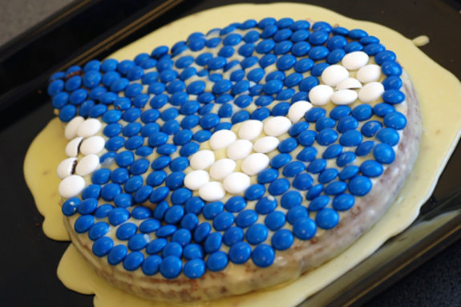
Today – Celebrating my birthday

Slide 40
Code Involvement
There are a few ways that writing code can help.
11 ways in fact.

Slide 41
But first...
Improvements are NOT made by a single person who is a genius!
Do not strive for perfection.
Contribute often, iteratively and in small chunks.
Ask for help, don't prefix it with anything, say thank you afterwards.

Slide 42
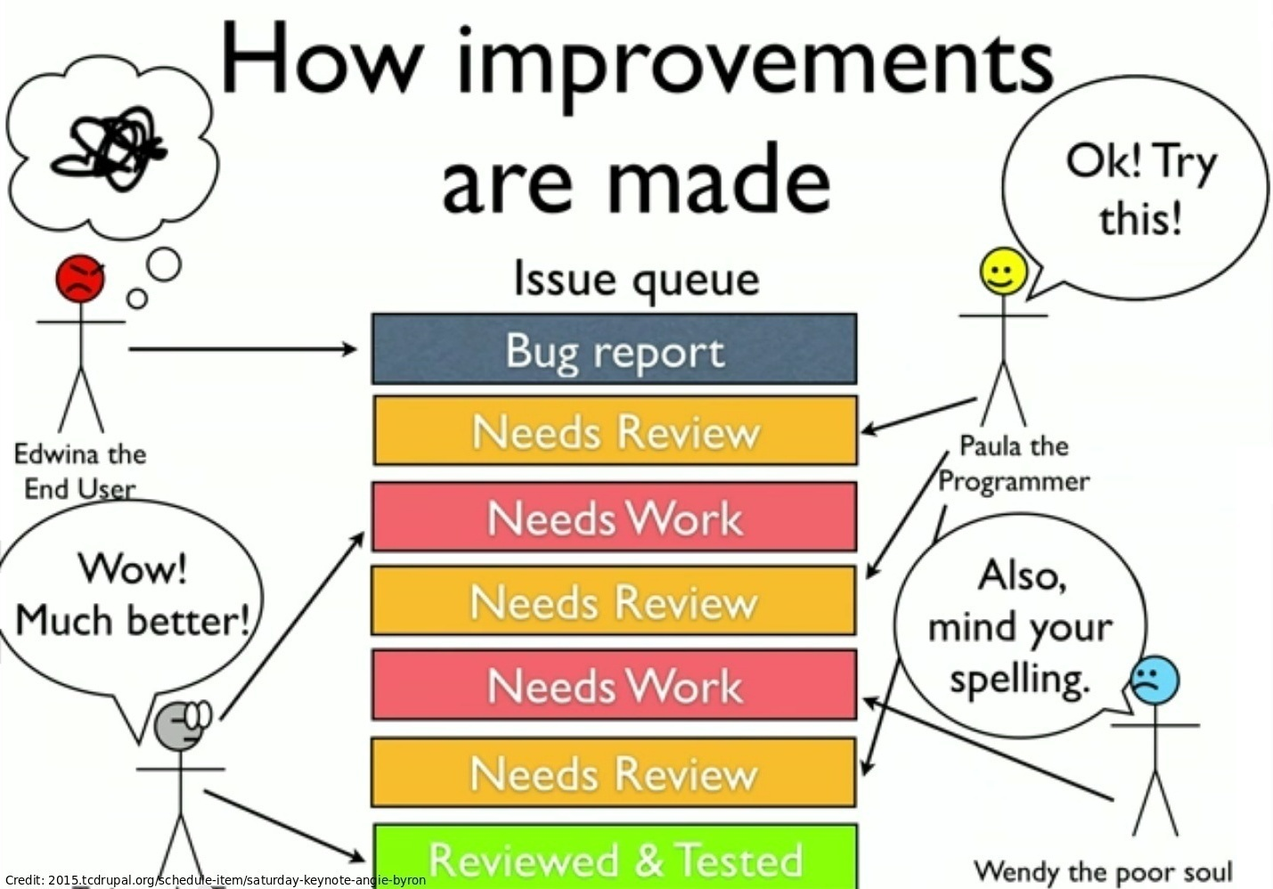
Wait, there's more
Notes:
Person finds a bug and opens a (good) bug report
Someone tries to fix problem
Someone tests and finds issues
Someone tries to fix again
Someone on Windows finds it still doesn't work
Someone tests again and finds it works
Someone find coding standard or spelling error

Slide 43
Re-roll patches
Needs reroll drupal.org/project/issues/search/drupal?issue_tags=Needs+reroll
drupal.org/contributor-tasks/reroll
drupal.org/patch/reroll
kdiff3

Slide 44
Novice Tasks
A bad name. Think something meaningful in a little amount of time.
drupal.org/core-mentoring/novice-tasks

Slide 45
Add automated tests
Simple Test or (my preference) PHP Unit
drupal.org/contributor-tasks/write-tests

Slide 46
Update a patch
Respond to feedback and update a patch
drupal.org/contributor-tasks/create-patch
drupal.org/documentation/git/interdiff

Slide 47
Review patches
drupal.org/project/issues/search/drupal?status[]=8
drupal.org/patch/review
drupal.org/contributor-tasks/review

Slide 48
Develop a D8 theme
There are very few (maybe no) contrib themes that a site can use off-the-shelf.
Build one and provide feedback on the development experience (DX)
Contribute it back as theme on d.o.

Slide 49
Contribute to Contrib
Most (all) contrib modules need help. Volunteer in the issue queue, then become a co-maintainer
drupal.org/taxonomy/term/9992
drupal.org/project/issues/projectownership?text=&status=Open&priorities=All&categories=All&version=All&component=Needs+maintainers

Slide 50
Port a D7 module to D8
Proceso Migración de Drupal 7 a Drupal 8, en cuarto OET
drupal.org/project/drupalmoduleupgrader

Slide 51
Write a D7 => D8 migrate plugin
drupalwatchdog.com/blog/2015/6/write-migrate-process-plugin-learn-drupal-8
events.drupal.org/losangeles2015/sessions/writing-custom-migration-plugin-drupal-8

Slide 52
Test a D6/D7 => D8 migration
Very little of Drupal 8.0.x is unfrozen at this point.
Migrations aren't frozen, so let's have some fun.
Report any bugs.
Reference: drupal.org/core/beta-changes

Slide 53
Write a change record
drupal.org/contributor-tasks/draft-change-record
English knowledge & ability to summarize required
Notes:
Most change records list code examples, otherwise this would be a non-code activity.

Slide 54
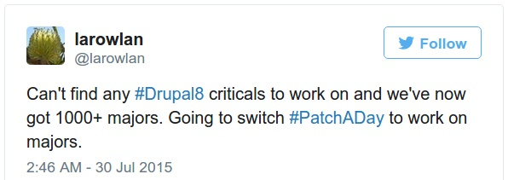
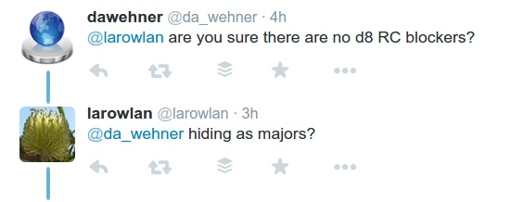
Why #majoraweek?

Slide 55
How to participate
Write a blog about #majoraweek
  Brag about the work your company (and you) are doing.
Find friends at Drupal businesses that will join the campaign.
Tweet your work like MAD
Pray it goes viral and you get good marketing.
Notes:
Non-code
Blogging
Marketing for you and for Drupal 8
Issue triage
Code
Follow-up on the triage and write code
Learn about Drupal 8

Slide 56
Review Time
Self identify
Ways to contribute
  Non-code
  Code
#majoraweek

Slide 57
Question time!

