Slide 1
Stock Mate
David Hedeen, Chris Nathan

Slide 2
Motivation
SEC.gov filing data is rather inaccessible and laborious to compile and save
Demonstration:
https://www.sec.gov/forms
David fill in more information….

Slide 3
Main Use Case
Main Success Scenario:
SuD asks user how they would like data to be stored
User selects “TXT” file exports and the SuD asks the user to enter in the local folder to save stock files.
User enters in a filepath
SuD confirms the folder is valid, saves the information and asks user which stock ticker they would like to retrieve
[ -- Repeat until user closes application
SuD asks the user which stock ticker there are interested in
User enters in a stock ticker
SuD returns number of filings present, outputs available (supported) stock tags (earnings per share, income, etc.), and asks which information they would like to retrieve.
User enters in a stock tag selection
SuD retrieves information from sec.gov website, displays a preview of the data and saves the stock information to the selected local folder.
--- ]

Slide 4
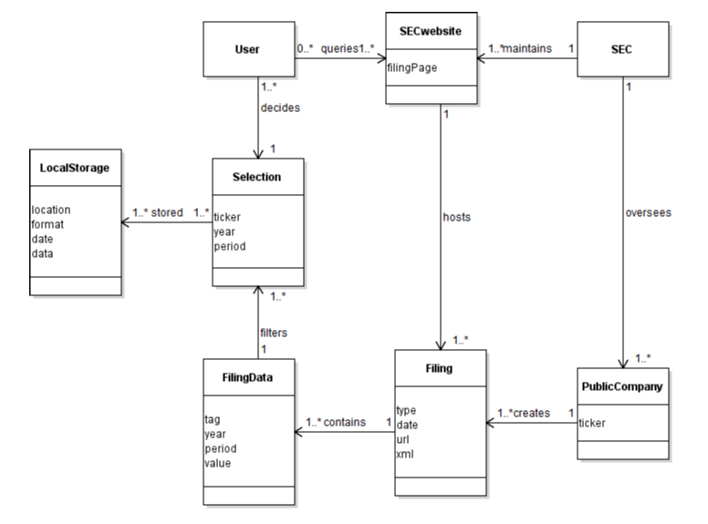
Domain Class Diagram

Slide 5
Example & Program Operation

Slide 6
GRASP Implementation

Slide 7
Test Coverage Summary

