Slide 1
Stock Mate
SEIS 635 Spring 2019
Wolves of Wallstreet:
David Hedeen, Chris Nathan

Slide 2
Motivation
SEC.gov filing data
Details important information about company’s financial health
Cumbersome and time consuming to aggregate
Unique identifier is not the ubiquitous Ticker, but CIK “Central Index Key”
Filings organized in a tree format
Proprietary XBRL format (similar to XML)
Other sites do offer data, but either only recent filings summary OR paid subscription access
DEMO https://www.sec.gov

Slide 3
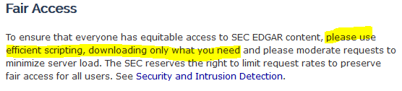
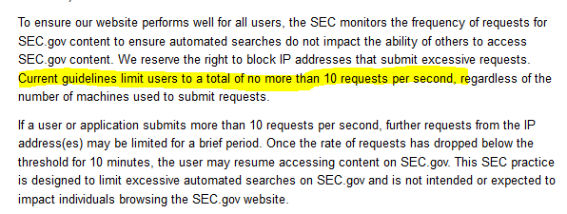
Legality
SEC.gov seems to acknowledge the lack of transparency afforded by their current website
Not only do they not forbid scraping, but seem to encourage it
They do request less than 10 requests per second

Slide 4
Main Use Case
Main Success Scenario:
SuD asks user how they would like data to be stored
User selects “TXT” file exports and the SuD asks the user to enter in the local folder to save stock files.
User enters in a filepath
SuD confirms the folder is valid, saves the information and asks user which stock ticker they would like to retrieve
[ -- Repeat until user closes application
SuD asks the user which stock ticker there are interested in
User enters in a stock ticker
SuD returns number of filings present, outputs available (supported) stock tags (earnings per share, income, etc.), and asks which information they would like to retrieve.
User enters in a stock tag selection
SuD retrieves information from sec.gov website, displays a preview of the data and saves the stock information to the selected local folder.
--- ]

Slide 5
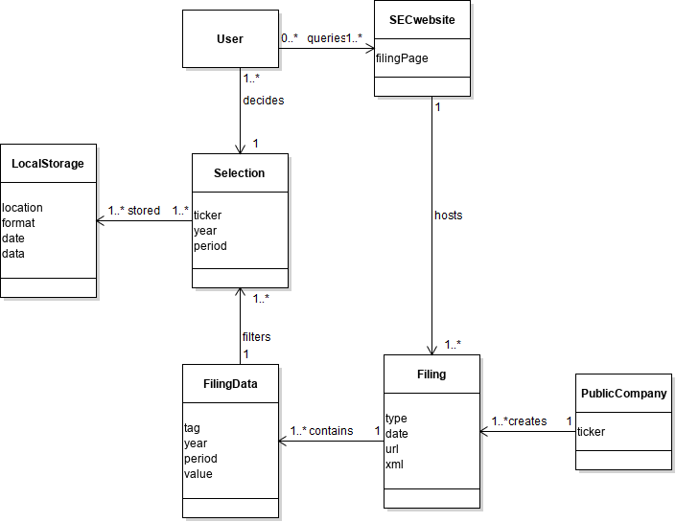
Domain Class Diagram

Slide 6
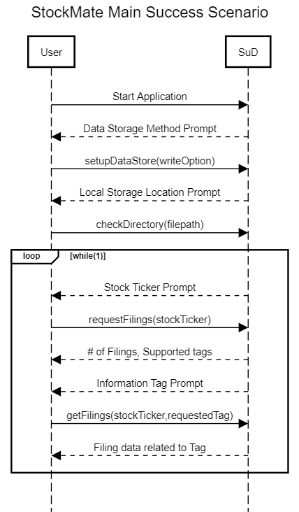
Domain Class Diagram

Slide 7
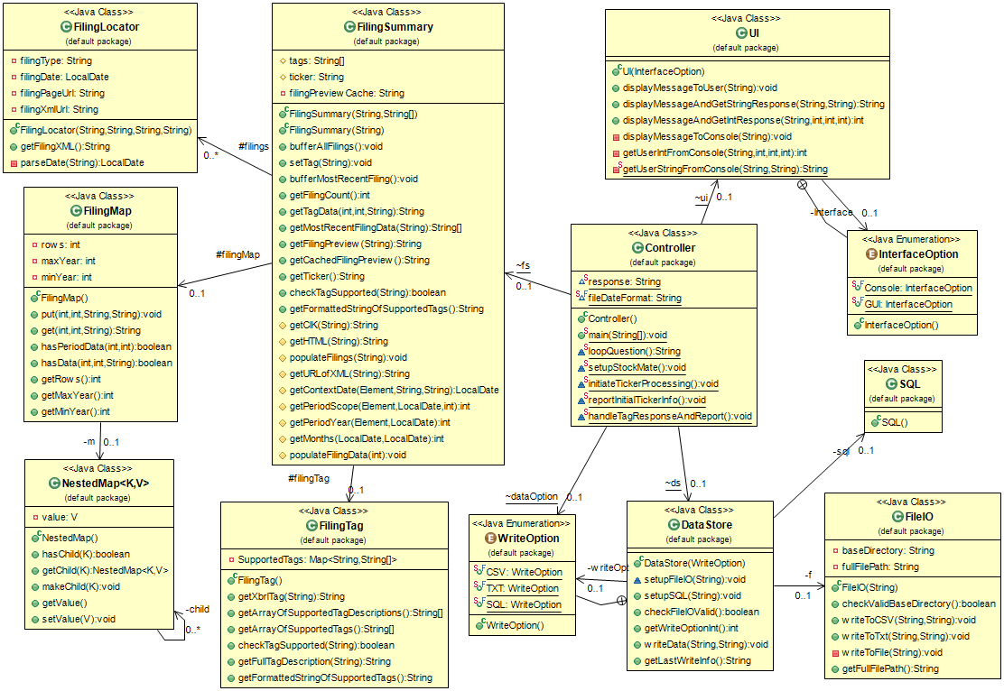

Slide 8
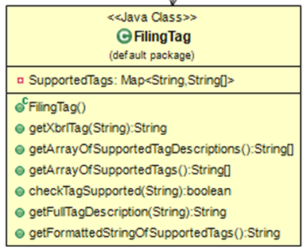

Slide 9
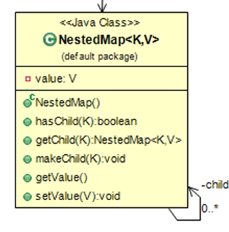

Slide 13
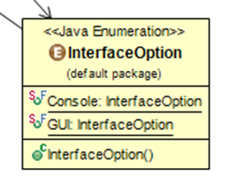

Slide 16
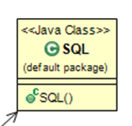

Slide 17


UML

Slide 18
GRASP Implementation
Focused on low coupling, high cohesion and controller
Low coupling
Low amount of intertwined classes
High Cohesion
Classes have a specific and narrow focus
Controller
Root object that coorindates system operation

Slide 19
DEMO ECLEmma test coverage

Slide 20
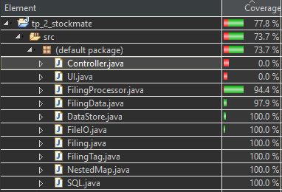
Test Coverage Summary
Test coverage was completed at an average of 99%
(with the removal for consideration of UI and Controller classes)
This was accomplished with strict compliance of separating the UI and domain software layer

Slide 21
Stock Mate
SEIS 635 Spring 2019
Wolves of Wallstreet:
David Hedeen, Chris Nathan

