Slide 1

ECHO INSIGHTS
YouTube Sentiment Analysis Tool
Sanjeev U 210701232
Sharan Adhitya C D 210701241
Senthilnaathan K 210701238

Slide 2

Abstract
ECHO INSIGHTS utilizes YouTube API V3 and Vader models for sentiment analysis. It translates comments with Google Translate and presents results in a Streamlit dashboard.
The dashboard visualizes sentiment patterns, including overall sentiment scores. A word cloud highlights prevalent topics within comments.
ECHO INSIGHTS empowers content creators with actionable insights for optimized content strategy and audience engagement.

Slide 3
ECHO INSIGHTS is an advanced social media analytics tool tailored for YouTube. It utilizes cutting-edge technology, including the YouTube API and sentiment analysis algorithms, to extract and analyze audience interactions. The platform offers intuitive data visualization through Streamlit, allowing users to identify popular topics and sentiment patterns from comments. With comprehensive sentiment analysis results content creators, marketers, and researchers can make decisions to optimize their YouTube content strategies.
INTRODUCTION

Slide 4

EXISTING SYSTEM
Currently, analyzing sentiments and extracting meaningful insights from YouTube comments require manual effort, often limited by language barriers when dealing with diverse global audiences.
Users typically have to sift through large volumes of comments without automated translation and sentiment analysis tools.
This manual process is time-consuming, prone to errors, and lacks a streamlined visualization mechanism for efficient interpretation.

Slide 5

PROPOSED SYSTEM
The proposed social media analytical tool addresses the limitations of the existing system by automating the process of extracting the YouTube comments, translating them into English, performing sentiment analysis using pre-trained models.
This streamlined approach significantly reduces the time and effort required for sentiment analysis, allowing users to gain insights into the overall sentiment of the audience.

Slide 6
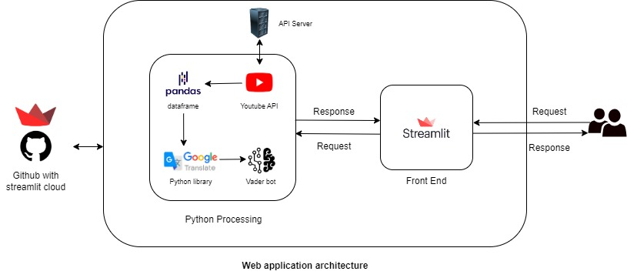
ARCHITECTURE DIAGRAM

Slide 7
Software / Hardware Used
Processor | Core i3 or more
RAM | 4GB or more
Browser | Chrome 64+ or Edge 79+
OS | Any OS with supported browsers
The software requirements for "ECHO INSIGHTS” are as follows:
Any mobile or computing devices with a web browser
All the libraries installed (Streamlit, Vader, Google trans, wordcloud)

Slide 8





Modules
DASHBOARD
FETCH COMMENTS
TRANSLATE
WORDCLOUD
PLOTLY PLOTS

Slide 9
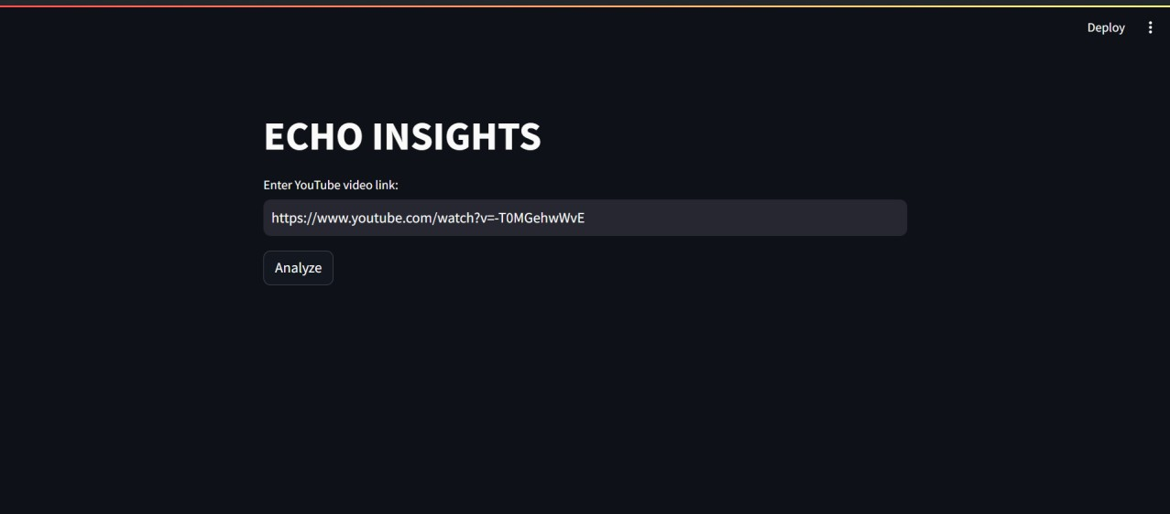
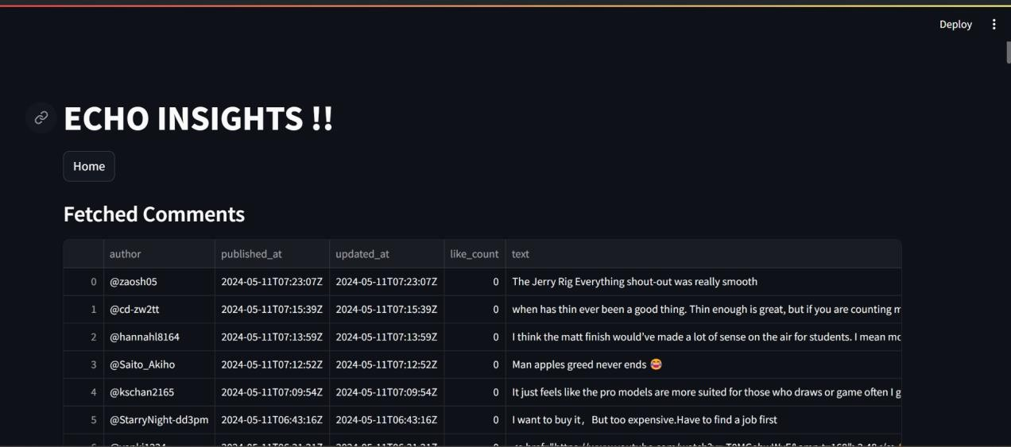
Output Screenshots
Welcome Page
Display fetched comments

Slide 10
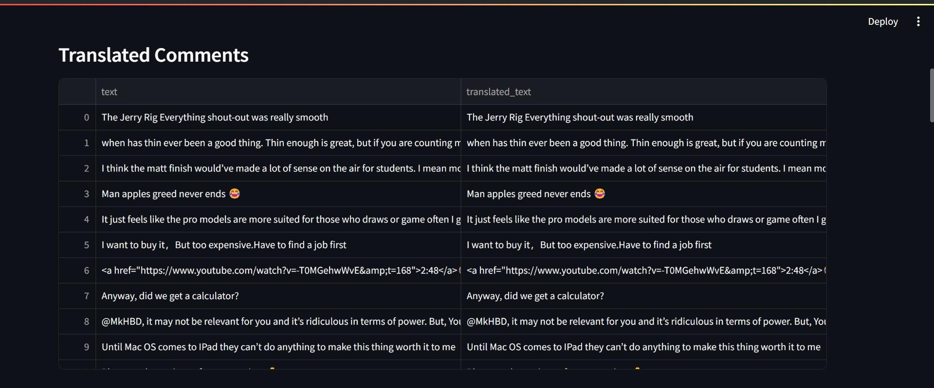
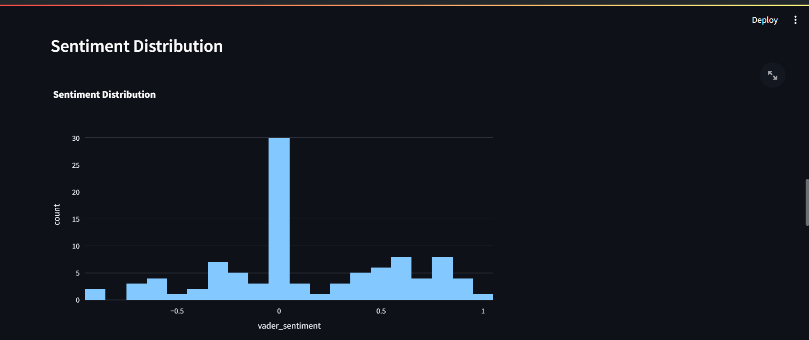
Output Screenshots
Displays translated comments
Sentimental Distribution Graph

Slide 11
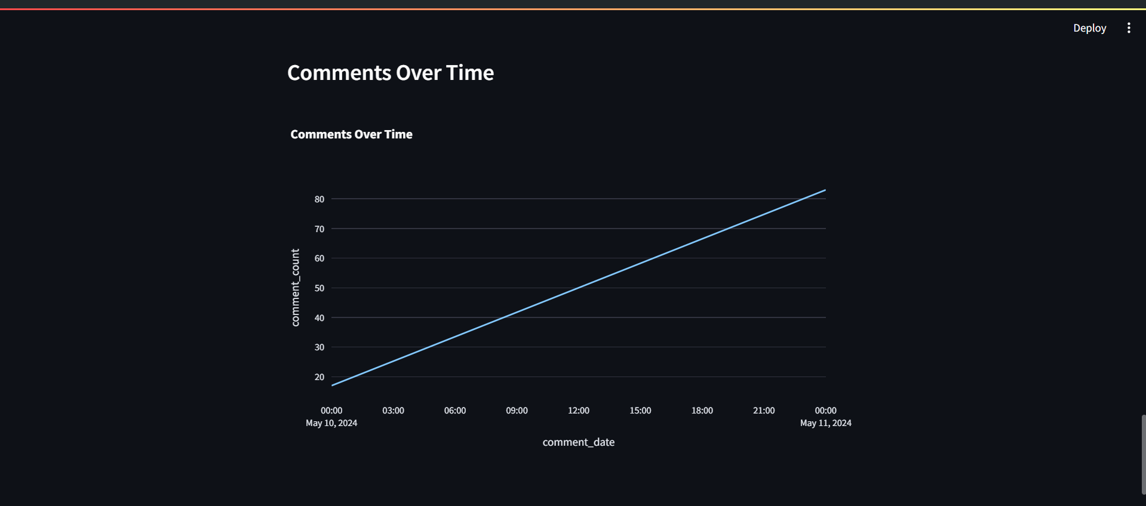
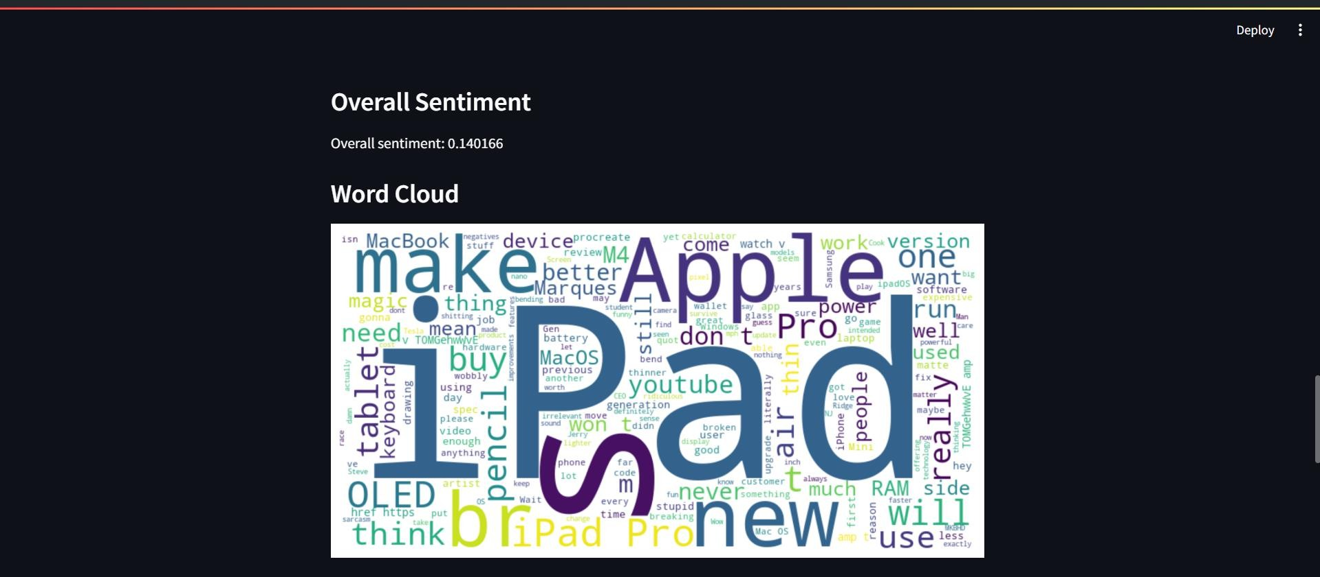
Output Screenshots
Comments over time graph
Word count of comments

Slide 12
t
CONCLUSION :
ECHO INSIGHTS helps researchers, marketers, and content creators understand audience emotions on YouTube through YouTube API and sentiment analysis.
Provides practical insights and interactive visualizations via a user-friendly Streamlit dashboard to optimize content strategies.
FUTURE ENHANCEMENT :
Multi-Platform Support: Expand ECHO INSIGHTS to analyze sentiment on Facebook, Instagram, and Twitter for a comprehensive digital footprint.
Report Generation: Introduce customizable reporting options in formats like interactive dashboards, CSV files, and PDFs.
Predictive Analytics: Integrate tools to predict future audience behavior, helping users optimize content strategies.

Slide 13
1. Singh, Ritika, and Ayushka Tiwari. "Youtube comments sentiment analysis." Int. J. Sci. Res.Eng. Manag.(IJSREM, no. May, p. 5, 2021,[Online]. 2. Elbagir, Shihab, and Jing Yang. "Sentiment analysis on Twitter with Python’s natural language toolkit and VADER sentiment analyzer.“ 3. Rana, Manish, and Mohammad Atique. "LANGUAGE TRANSLATION: ENHANCING BILINGUAL MACHINE TRANSLATION APPROACH USING PYTHON. 4. M. Khorasani, M. Abdou, and J. H. Fernández, Web Application Development with Streamlit. Apress. 5. W. McKinney, Python for Data Analysis: Data Wrangling with Pandas, NumPy, and IPython. “O’Reilly Media, Inc.,” 2012. 6. R. F. Alhujaili and W. M. S. Yafooz, “Sentiment Analysis for Youtube Videos with User Comments: Review,” in 2021 International Conference on Artificial Intelligence and Smart Systems (ICAIS), IEEE, Mar. 2021, pp. 814–820.
REFERENCE
“
”

Slide 14

Thank you

