Slide 1
Magpie ChatBot Lab
AP Computer Science Lab Presentation
이시현, 엄태준, 이승현, 전지현

Slide 2
Contents
- Introduction
- Activity explanation
- Problems in the code
- A new Chat Bot
- Introduction to Deep learning Mechanism

Slide 3
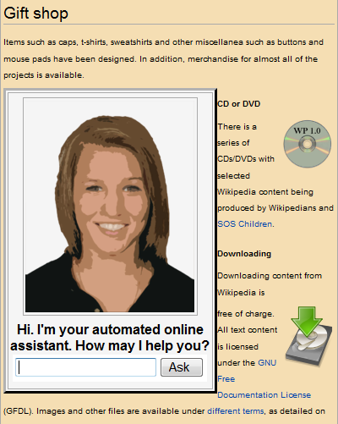
Introduction
What is Natural Language Processing?
: Field that attempts to have computers understand natural language.
: Area of computer science and artificial intelligence concerned with the interactions between
computers and human language, in particular how to program computers to fruitfully process
large amounts of natural language data.

Slide 4
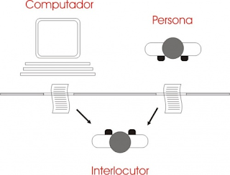
History of Natural Language (Chat Bots)
Turing test (1950)
“Computing Machinery and Intelligence”
Notes:
The test does not check the ability to give correct answers to questions, only how closely answers resemble those a human would give.

Slide 5
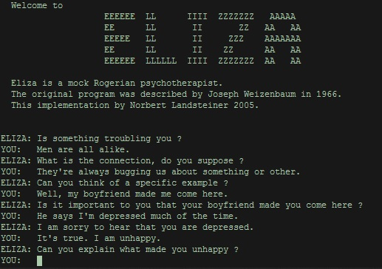
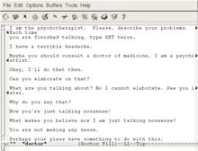
Notes:
1966년에 제작
MIT Artificial Intelligence Laboratory

Slide 6
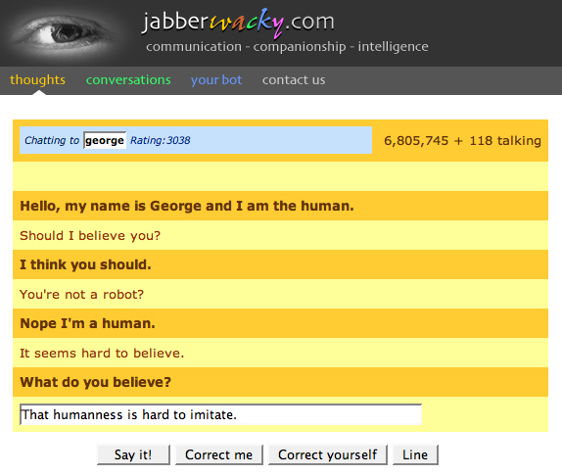
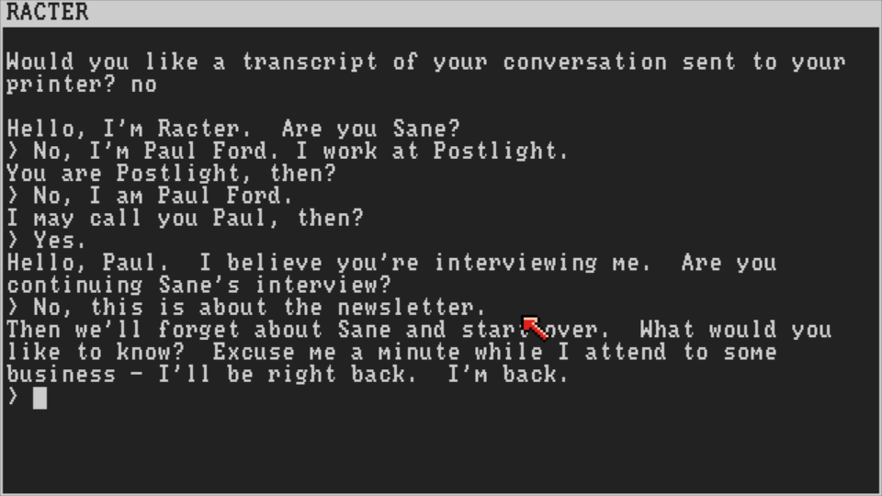

Slide 7
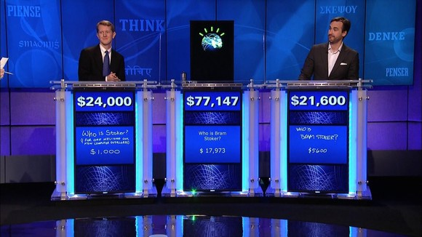


Slide 8
Current Work in NPL
- Spam filtering
- Virtual agents in websites
- Email parsing
- Sentiment analysis
- IBM’s Watson

Slide 9
Purpose of this lab
- String class
- If statement
(+) Switch - case statement

Slide 10
<Activity1>
:Getting Acquainted with Chatbots

Slide 11
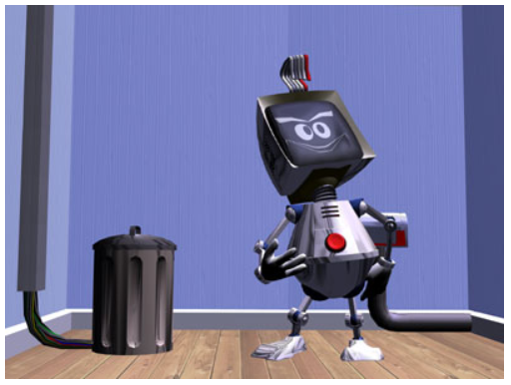
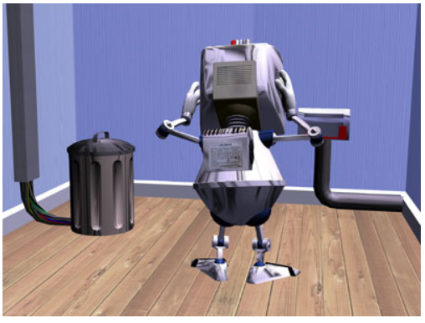
Activity 1 - Exploration
https://sites.google.com/site/webtoolsbox/bots
http://elbot_e.csoica.artificial-solutions.com/cgi-bin/elbot.cgi
<When Elbot receives the same question multiple times>

Slide 12
When can’t Elbot understand communication?

Slide 13
Activity 1 - Question
1. Can you identify keywords to which your chatbot responds?
2. Think of several keywords and the responds they might cause.

Slide 14
<Activity2>
:INTRODUCTION TO THE MAGPIE CLASS

Slide 15
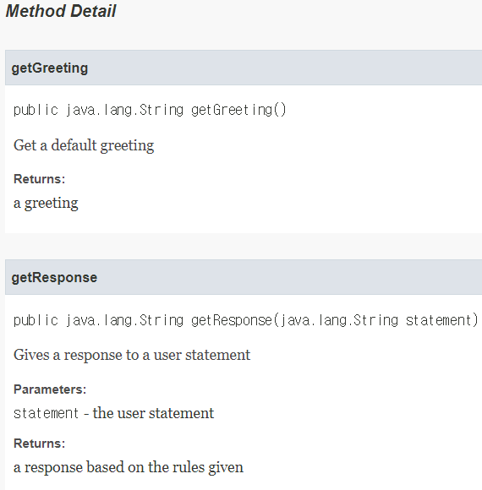
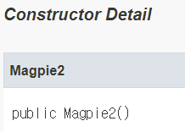
Activity 2
Magpie 2

Slide 16
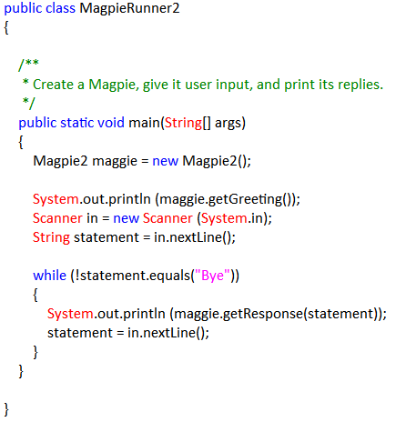
Magpie2Runner

Slide 17
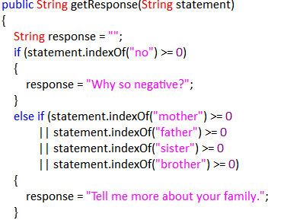
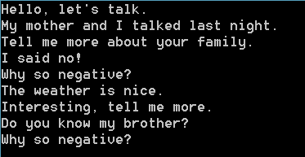
Activity 2 - Exploration

Slide 18
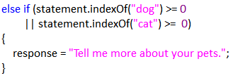
Activity 2 - Exercise
Q-1) Have it respond “Tell me more about your pets” when the statement contains the word “dog” or “cat.”
For example, a possible statement and response would be:

Slide 19
Q-2) Have it respond favorably when it sees the name of your teacher. Be sure to use appropriate pronouns!
For example, a possible statement and response would be:
Statement – Mr.Finkelstein is telling us about robotics.
Response: He sounds like a good teacher.

Slide 20

Q-3) Have the code check that the statement has at least one character. You can do this by using the trim method to remove spaces from the beginning and end, and then checking the length of the trimmed string. If there are no characters, the response should tell the user to enter something.
For example, a possible statement and response would be:

Slide 21
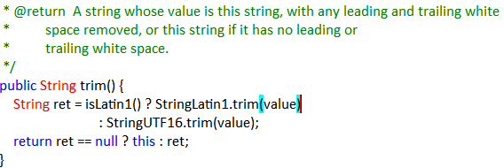
trim() - String class method

Slide 22
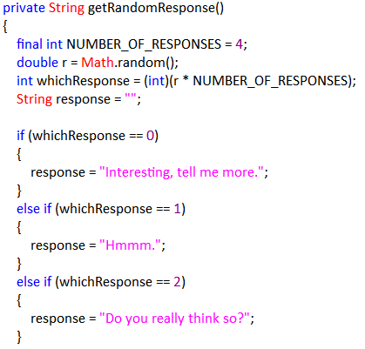
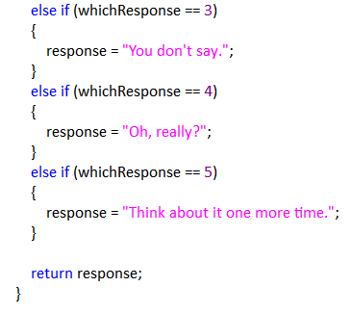
Q-4) Add two more noncommittal responses to the possible random responses.

Slide 23
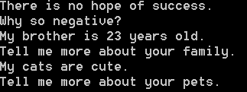
Q-5) Pick three more keywords, such as “no” and “brother” and edit the getResponse method to respond to each of these.
Enter the three keywords and responses below.

Slide 24

Q-6) What happens when more than one keyword appears in a string? Consider the string “My mother has a dog but no cat.”
Explain how to prioritize responses in the reply method.

Slide 25
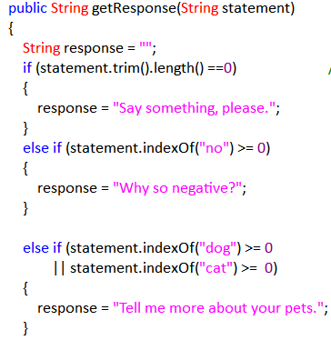
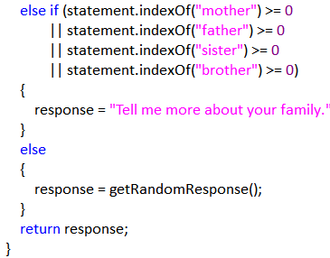

Slide 26

Activity 2 - Question
Q) What happens when a keyword is included in another word? Consider statements like “I know all the state capitals” and “I like vegetables smothered in cheese.”
Explain the problem with the responses to these statements.

Slide 27
<Activity3>
:BETTER KEYWORD DETECTION

Slide 28
Activity 3-Exploration
Q-1) What value is returned by indexOf if the substring does not occur in the string? Add the following lines to StringExplorer to see for yourself that indexOf behaves as specified:
int notFoundPsn = sample.indexOf("slow");
System.out.println("sample.indexOf(\"slow\") = " + notFoundPsn);
Q-2) Read the description of indexOf(String str, int fromIndex). Add lines to StringExplorer that illustrate how this version of indexOf differs from the one with one parameter.

Slide 29
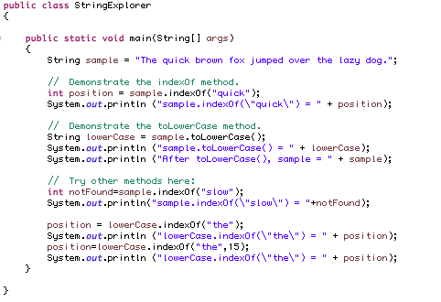


Slide 30
A)
1. What value is returned by indexOf if the substring does not occur in the string?
→ -1
2. How is indexOf(String str, int fromIndex) different from indexOf(String str)?
indexOf(String str) returns the index of the first occurrence of str,
indexOf(String str, int fromIndex) returns the first occurrence of str from fromIndex

Slide 31
Activity 3-Exploration
Q-3) This version of the Magpie class has a method named findKeyword to detect keywords. This method will only find exact matches of the keyword, instead of cases where the keyword is embedded in a longer word. Run it, using the instructions provided by your teacher. Trace the following method calls.
findKeyword("She's my sister", "sister", 0);
findKeyword("Brother Tom is helpful", "brother", 0);
findKeyword("I can't catch wild cats.", "cat", 0);
findKeyword("I know nothing about snow plows.", "no", 0);

Slide 32
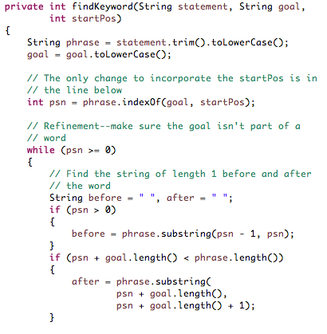
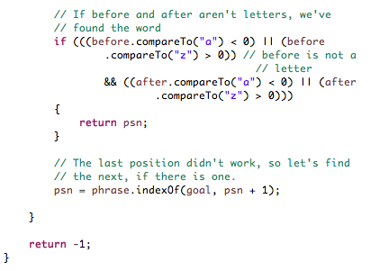

Slide 33


A) findKeyword(“She’s my sister”, “sister”, 0)
findKeyword(“Brother Tom is helpful”, “brother”, 0)
findKeyword(“I can’t catch wild cats.”, “cat”, 0)
findKeyword(“I know nothing about snow plows”, “no”, 0)

Slide 34
Activity 3-Exercise
Q) Repeat the changes you made to the program in Activity 2, using this new method to detect keywords.

Slide 35
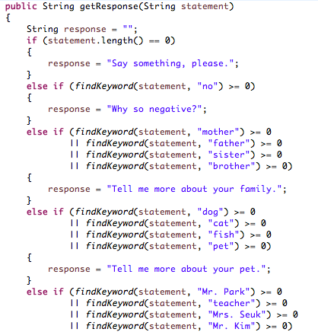
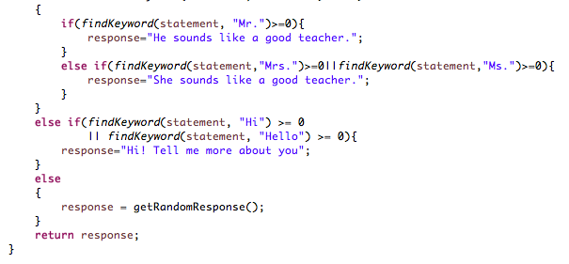


Slide 36
<Activity4>
:RESPONSES THAT TRANSFORM STATEMENTS

Slide 37
Activity 4 - Exploration
Q) Get to know the revised Magpie class. Run it, using the instructions provided by your teacher. How does it respond to :
A)
I want to build a robot. | What would it mean to build a robot?
I want to understand French. | What would it mean to understand French?
Do you like me? | What would it mean to understand French?
You confuse me. | What makes you think that I confuse you?

Slide 38
Activity 4 - Exercises
Q) Look at the code. See how it handles “I want to” and you/me statements. Alter the code :
Have it respond to “I want something” statements with “Would you really be happy if you had something?” In doing this, you need to be careful about where you place the check. Be sure you understand why.
For example :
- Statement : I want fried chicken.
- Possible response : Interesting, tell me more./ Hmmm./Do you really think so?/You don’t say.
- Response : Would you really be happy if you had fried chicken?

Slide 39
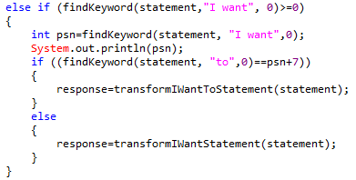


Slide 40
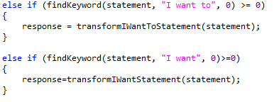

Slide 41
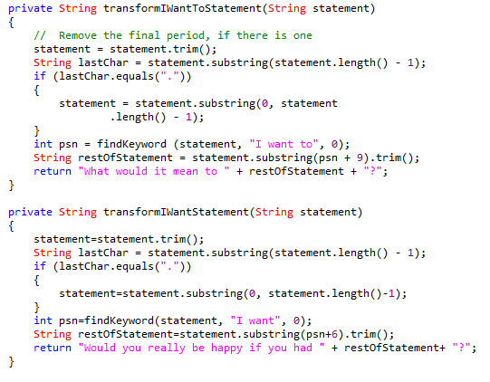

Slide 42
Q) Look at the code. See how it handles “I want to” and you/me statements. Alter the code :
2) Have it respond to statements of the form “I something you” with the restructuring “Why do you something me?”
For example :
- Statement : I like you.
- Response : Why do you like me?
Find an example of when this structure does not work well. How can you improve it?

Slide 43
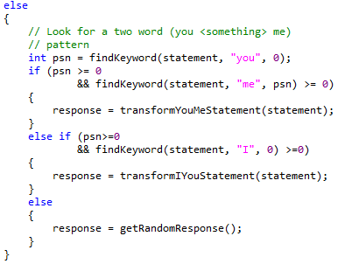
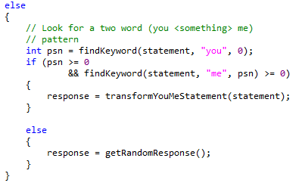

Slide 44
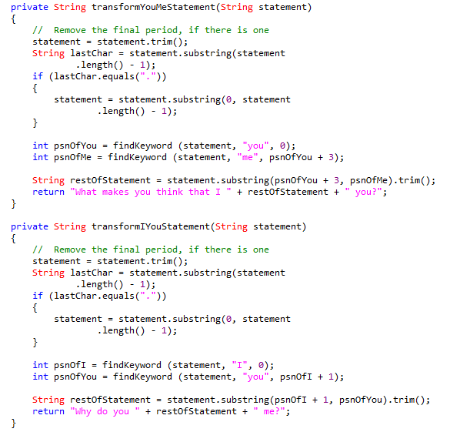

Slide 45
<Activity5>
:ARRAYS AND THE MAGPIE (Optional)

Slide 46
Activity 5
Code refactoring:
The process of restructuring existing computer code without changing its external behavior.
- Effect
: Improved code readability, reduced complexity

Slide 47
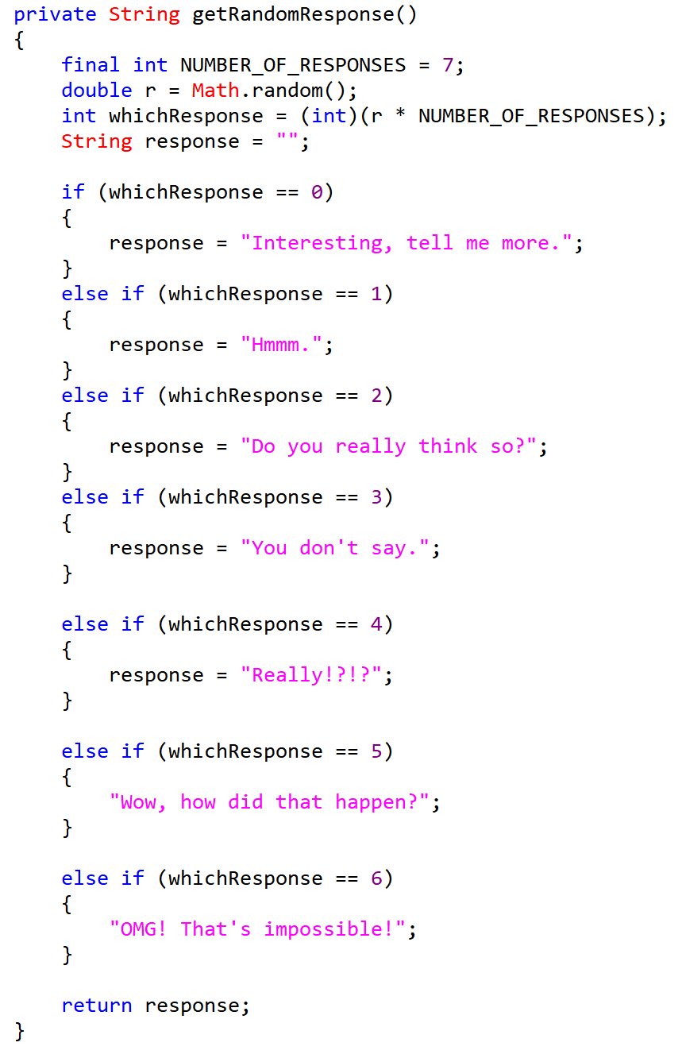
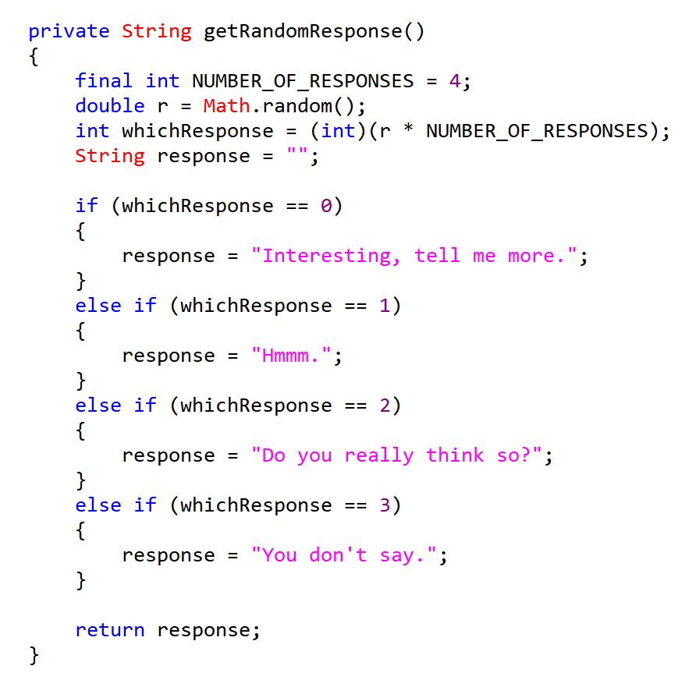

Slide 48
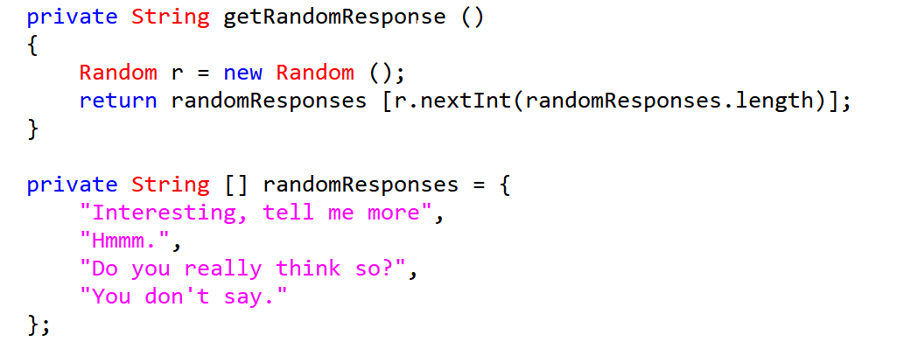
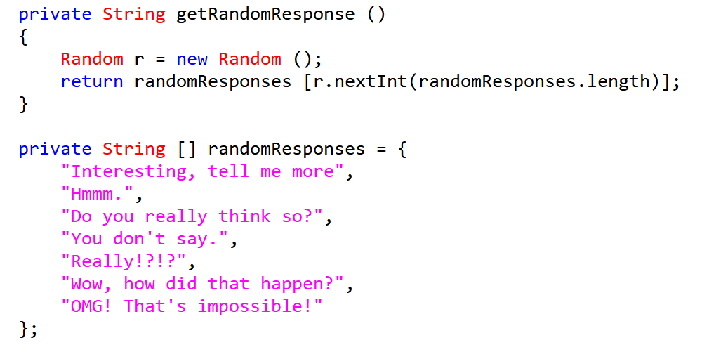

Slide 49
3. Problems
Using if else if else for finding keywords
→ Not universal
→ Simple answers
→ Hard to revise
→ Long but ineffective

Slide 50
4. A New Chat Bot
1. Differentiating subject, verb, and etc.
2. Changing the subject, verb, and etc.
3. Considering verb’s tense.
4. Considering types of verb.
→ stacking verbs
5. Manage unnatural answers.
Notes:
-키워드를 위주로 검색-->일일이 다 체킹 하고 없으면 랜덤 -->단조롭고 개선이 어렵다.
-->만들어보자
-주어 동사 어떻게 구분하지 ??? -->형식을 입력하고 형식에 맞게 하자.
-주어로 질문 할 때 주어를 바꿔야 한다.
-동사의 시제에 따라 할 수 있는 대답이 달라진다. -->시제 구분
-일부 형식은 동사들의 종류에 따라 던질 수 있는 질문이 달라진다.
==>동사를 저장한다.
-어색한 코드 ==> 어색한 코드를 저장한다.

Slide 51
code

Slide 52
Limitations
0. not smooth and only fixed forms are allowed (and user should aware of those formats)
1. No way to fix your mistyped answer (@both txt and command prompt)
2. No negative statements are allowed
3. Only storing the weird conversations, not revising
4. No plural subject allowed
5. Handling cases of subject is hard
6. Cannot differentiate jame|s| and apple|s|
7. Two verbs are not allowed
8. Verbs that have same format, different tense cause “thinking” message
9. Cannot reflect the tone of auxiliary verbs

