Slide 1
UNIVERSITY OF AGDER
MAS512 Assignment 1
Group 9
Computer Vision
Object Detection
Depth Data
Model Evaluation
By:
Renwa Hamid
Sebastian Skogland
Hedda Winther-Sørensen
MAS512 | Assignment 1 | Group 9

Slide 2
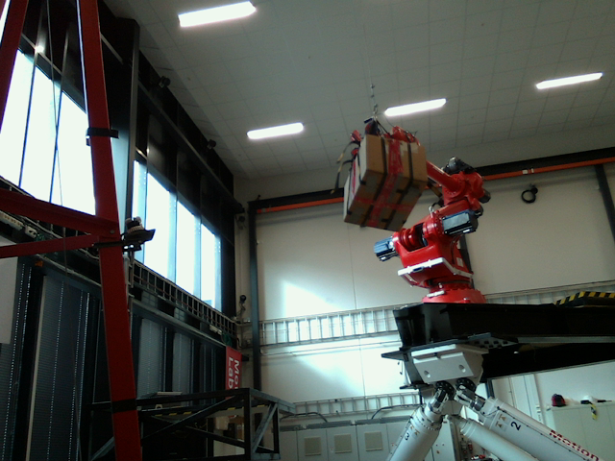
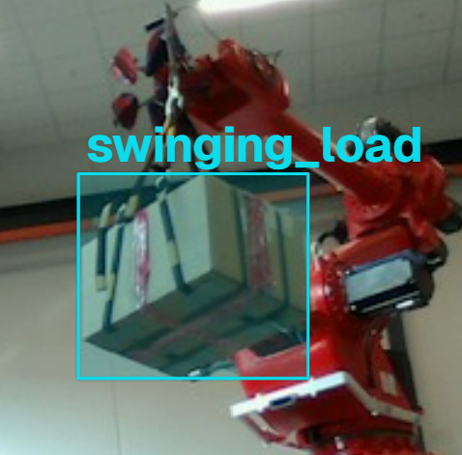
Pre Q1 YOLO Model Development
Objective: Train a YOLO model to detect the swinging load in RGB frames extracted from the recorded video.
1
Data collection
2
Frame selection
3
Annotation
4
Dataset preparation
5
Model training
6
Model output
NDJSON
YOLO_swinging
_load.pt
YOLO26n
YOLO format
Used transfer learning
with a pretrained
YOLO26n model and
train on 30 images
(100 epochs, 640 px)
Split: 24 training / 6 validation
Trained model saved
and ready for evaluation
on independent
test video
Extracted RGB frames
from recorded video
900 training RGB frames
300 test RGB frames
Selected 30 representative
frames for annotation
Manually annotated
bounding boxes in
Ultralytics Platform.
(The answers the model learns from)
Convert annotations
from NDJSON to YOLO
format and verify classes
Exported annotations (NDJSON)
Converted to YOLO format (images, labels, data.yaml)
Best model weights saved as YOLO_swinging_load.pt
Then the model is ready for evaluation

Slide 3

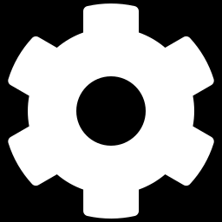
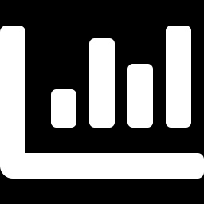
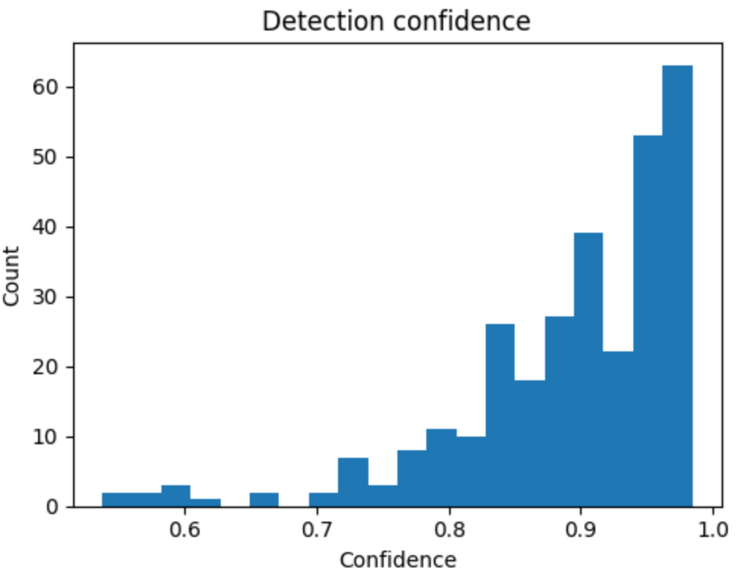
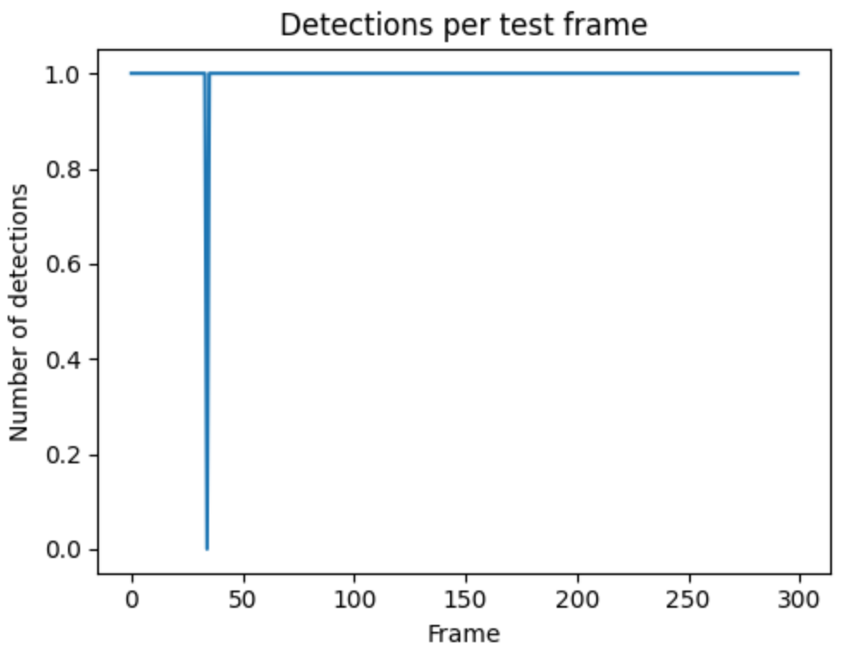
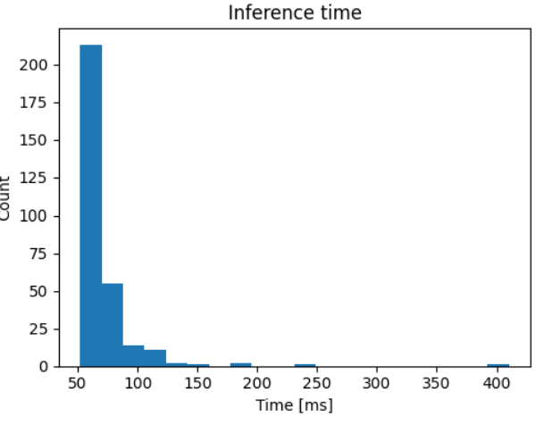
Q1(a) Model Evaluation
Evaluation of the trained YOLO model on validation data and the independent 300-frame test video.
Objective/Task
Method
Show the performance of the model on test data set by plotting relevant KPIs
1. Evaluate the model on the validation set using Precision, Recall, F1 and mAP.
2. Runned the trained model on 300 independent test frames and measure confidence, missed detections and inference speed.
Results (KPIs)
Results: Test frames Performance (300 frames)
Precision: When it says “load”, is it right?
0.990
Mean confidence
Frames with no detection
Mean inference time
Approximate FPS
0.892
1 / 300
69.5 ms
14.4
Recall: Does it find the load every time?
0.833
F1-score: balance between precision and recall
0.905
mAP@50: detection accuracy when predicted boxes overlap the true boxes by at least 50% IoU
0.955
mAP@50–95: performance across IoU 0.50–0.95, requiring more precise box overlap.
0.790

Slide 4
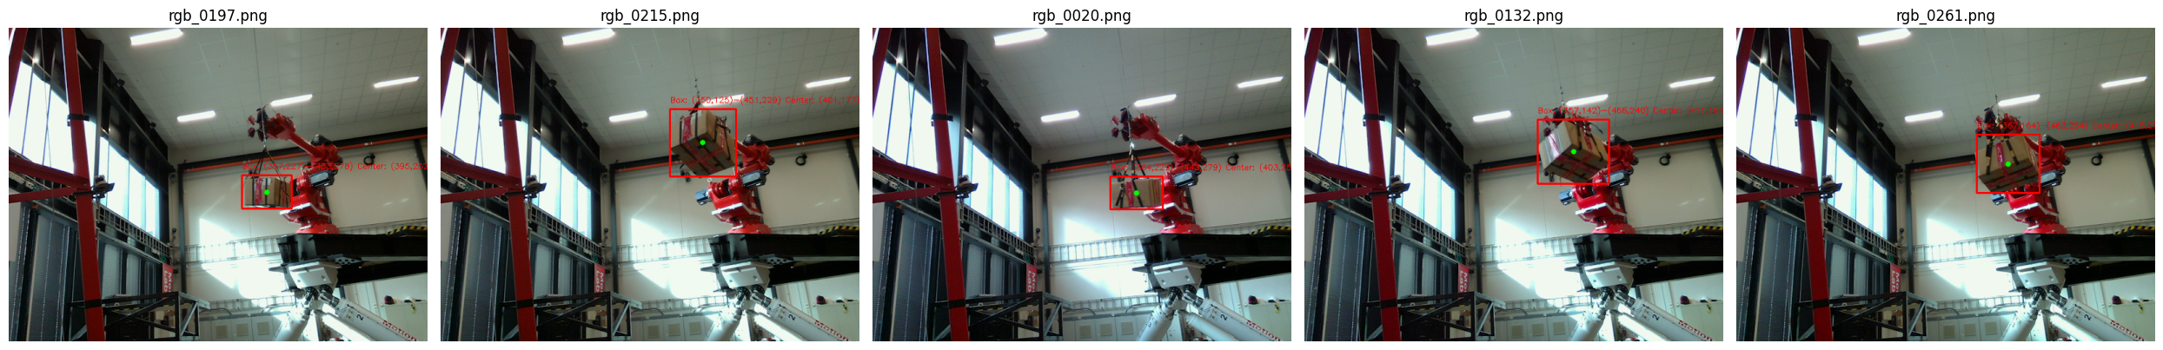
Q1(b) Bounding Box and Center Coordinates
OBJECTIVE
Show the predicted bounding box, its coordinates and the center point on five randomly sampled test images.
cx = (x1 + x2) / 2
cy = (y1 + y2) / 2
METHOD
2
Runned YOLO prediction
4
Calculate center and visualize with OpenCV
Center point calculation:
where (x1, y1) and (x2, y2) are the opposite corners of the bounding box.
1
Randomly sampled 5 test frames
3
Extract box as (x1, y1, x2, y2)
RESULTS
Five sampled test frames with the detected swinging load, bounding-box coordinates and center point:

Slide 5
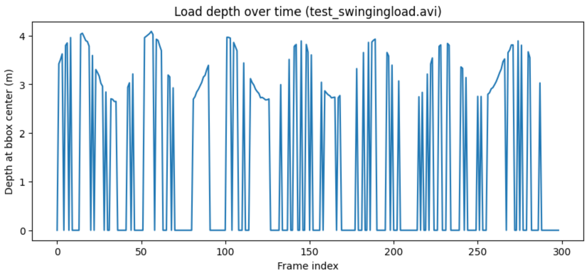
Q1(c) Depth at Bounding-Box Center
Using YOLO center coordinates together with aligned RealSense depth data
OBJECTIVE
Find the YOLO bounding-box center for every test frame and read the corresponding depth value from the matching depth frame.
METHOD
REALSENSE PRINCIPLE
1
Match RGB and depth by frame index
2
Use YOLO center (cx, cy)
3
Read aligned depth at same pixel
Aligned color and depth frames use corresponding pixel locations.
RGB frame 0042 → depth frame 0042
Center calculated from the predicted bounding box
Raw depth × scale → meters
This makes it valid to use the RGB bounding-box center as the pixel location in the corresponding depth frame.
Before correction: zero readings appear as false drops to 0 m
PROBLEM OBSERVED
!
Some center pixels returned a raw depth value of 0.
Depth reads 0, does not mean 0 metres; it means the camera could not measure that point E.g reflections.
Example output: frame 0000 → depth = 0.0 m
SOLUTION: treat raw depth = 0 as missing (NaN), not as 0 m. The plot then shows a gap instead of a false distance.
Current run: 300 frames processed; YOLO detected the load in 299/300 frames. Valid-depth count should be reported separately after zero-value handling.

Slide 6

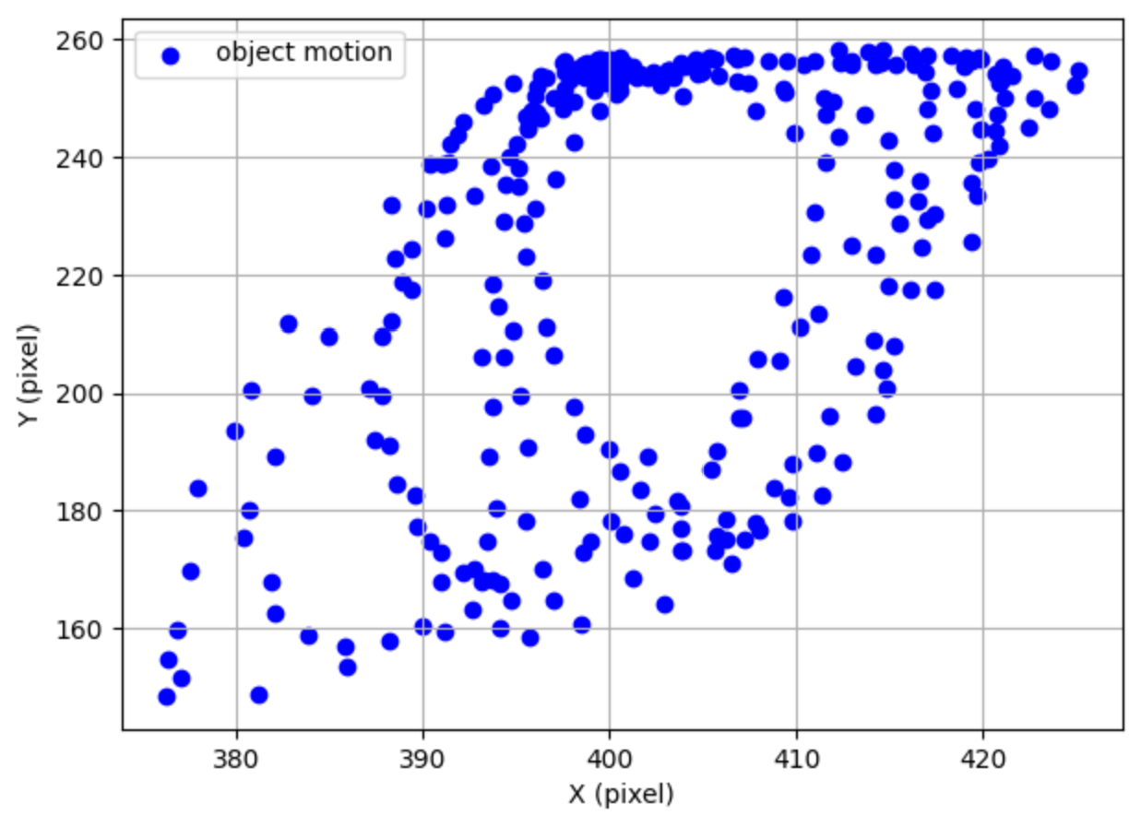



Q2 Object Tracking
Track the swinging load in each frame of test_swingingload.avi and visualize motion trajectory in image coordinates (X, Y).
Results
Objective
Method
Went through test frames
Read all frames from test_swingingload.avi
Ran YOLO tracking
Used [trained_model.track(..., persist=True)]frame by frame on every image.
Identified the load and then calculated the center point
Selected the highest confidence detection and calculated the bouningbox center (X, Y).
Stored the center coordinates and plot trajectory

Slide 7
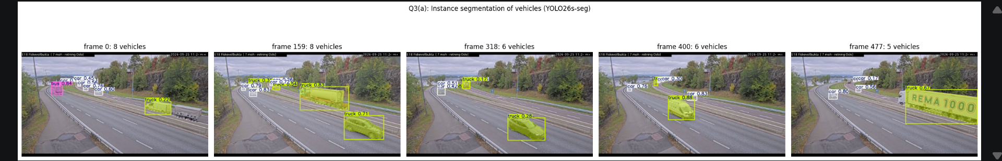
Q3 Instance Segmentation
Objective
Perform instance segmentation of multiple vehicles in selected frames from biler.mp4 and visualize each detected vehicle separately.
Method
Model choice:
KITTI has bounding boxes, not segmentation masks, so pretrained YOLO26s-seg was used.
1
Loaded the segmentation model
3
Ran segmentation
Used pretrained YOLO26s-seg.
Five frames; conf = 0.15, imgsz = 1280.
2
Selected vehicle classes
4
Visualized results
Car, bus, truck.
Masks and vehicle count per frame.
▥
Results
Vehicle counts
8 • 8 • 6 • 6 • 5
Separate masks were produced for multiple vehicle instances in the same scene.

Slide 8
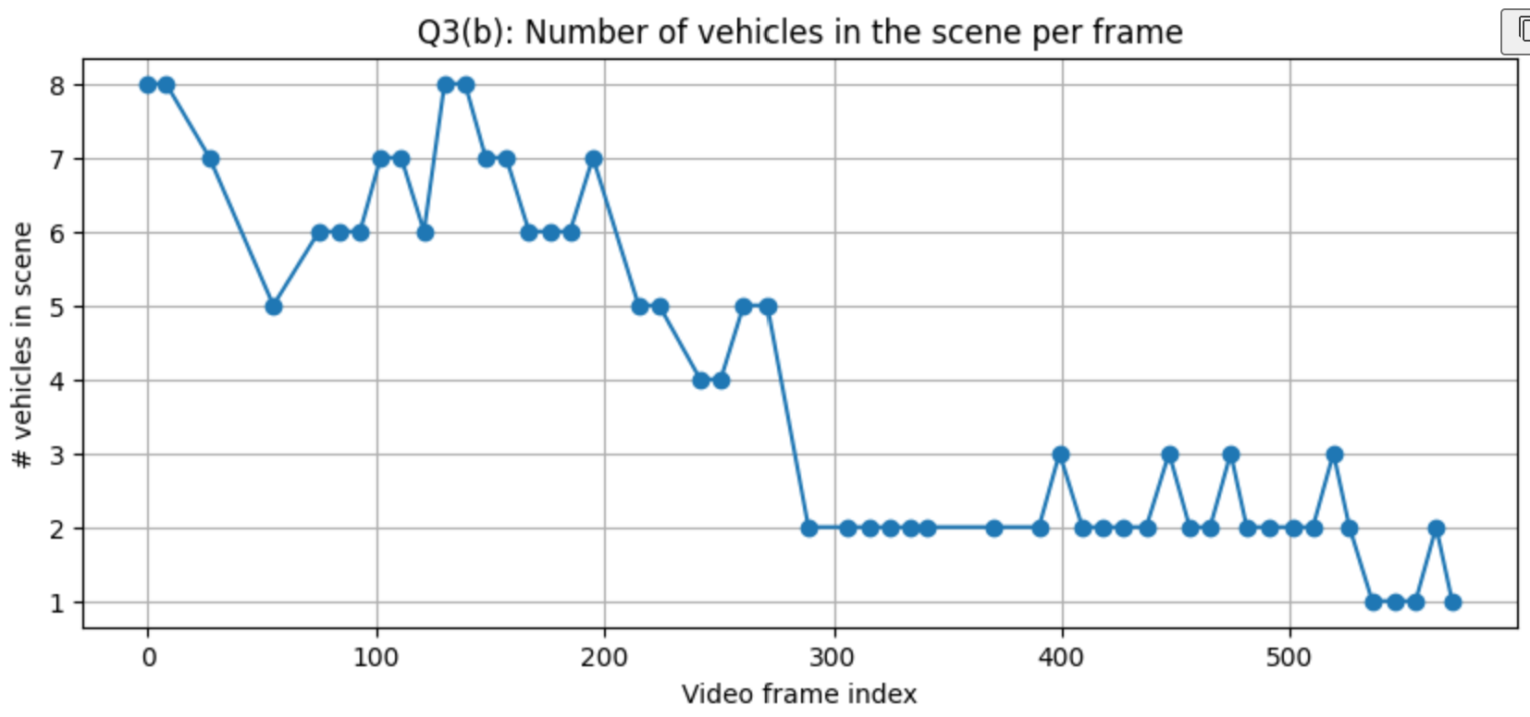
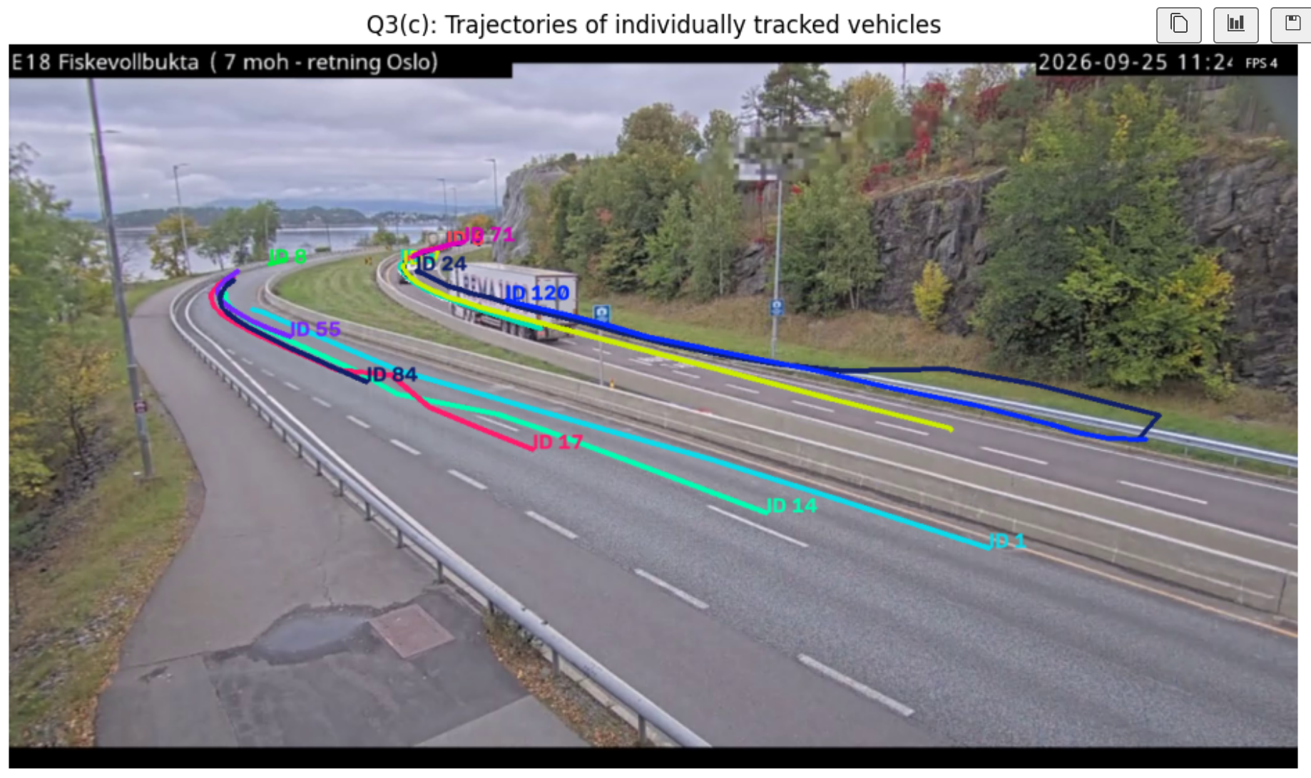
Q3 Vehicle Counting & Individual Tracking
Counting vehicles in each scene and following individual vehicles through the traffic sequence
Objective
Count the vehicles in each processed frame and track each vehicle using persistent Ids.
METHOD
1
Removed duplicate camera frames
2
Tracked car / bus / truck
3
Store ID trajectories; kept tracks seen in ≥3 processed frames
Processed camera images
52 / 637
Unique vehicles tracked
14
Max in one frame
8
Mean per frame
3.9

Slide 9
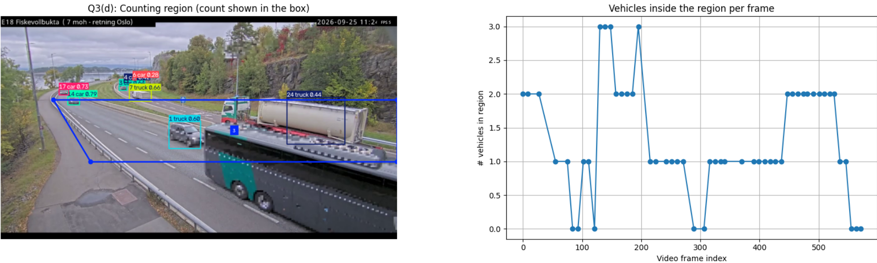

Slide 10
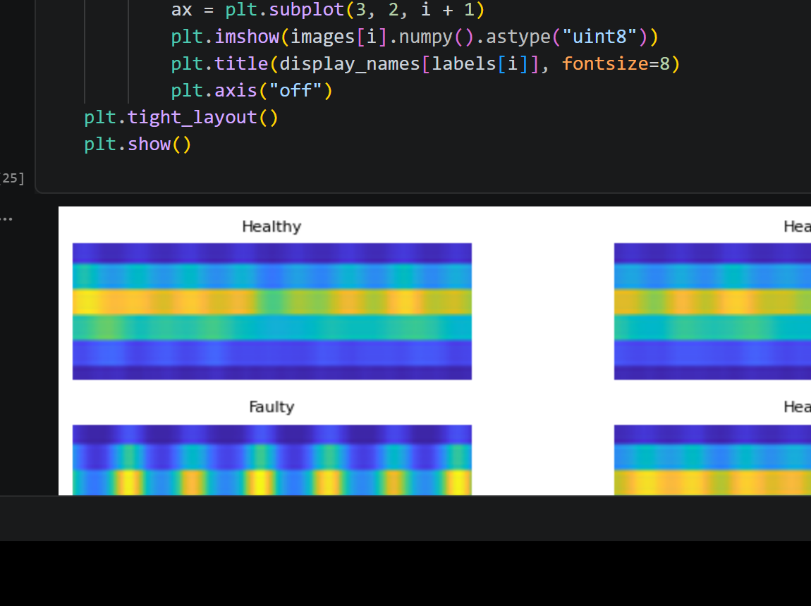
Q4(a) Motor Health Classification – Model Development
Binary CNN classification of Healthy vs Faulty motor condition from RGB scalogram images
OBJECTIVE
Develop an ML model that determines the state of health of the motor from the provided fault-classification dataset.
Dataset & preparation
Our CNN model
Example scalograms
• Two classes: 00_15 = Healthy and 10_15 = Faulty.
• Input images: 60 × 175 RGB scalograms.
• Total: 2000 images.
• Training: 1440 images; validation: 360 images; test: 200 images.
• Training directory was split 80/20 using the same seed so train and validation do not overlap.
• Based on "model 2" from the CNN lecture / lab work 2.
• Normalization layer followed by Conv2D blocks with filters 8 → 16 → 32 → 64 → 64 → 64.
• Max pooling reduces spatial dimensions between convolution stages.
• Flatten → Dense 64 → Dense 64 with L2 regularization → Softmax(2).
• Training: Adam, 15 epochs, batch size 8.
Data split
Model size
123,225 parameters
1440 train
360 val
200 test
Healthy and faulty examples show visibly different time–frequency patterns.
Key takeaway:
A deeper CNN from the course material was trained on the same two-class motor-health dataset used by the baseline.

Slide 11
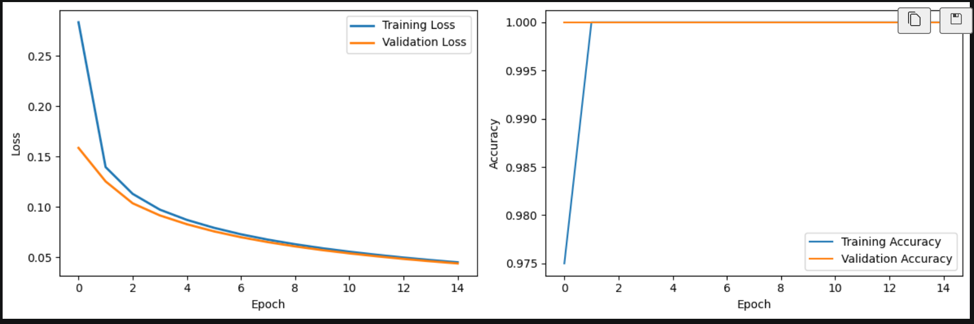
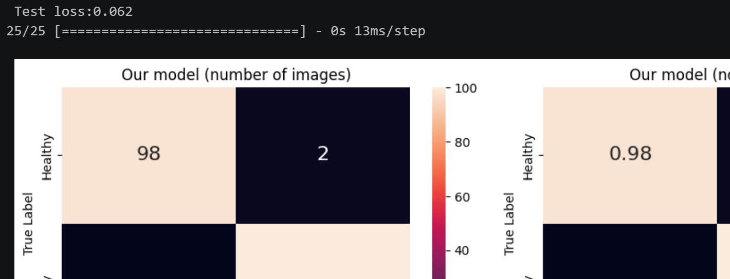
Q4(b) Training & Test-set Evaluation
Train/validation behaviour, confusion matrix and classification performance of our CNN
2.376 ms/img
Training time
106.8 s
Test accuracy
0.990
Test loss
0.062
Inference
Train / validation curves
Confusion matrix – test set
Loss decreases steadily and training/validation accuracy reaches 1.00 after the first epochs.
Classification report
Healthy: Precision 1.000 Recall 0.980 F1 0.990
Faulty: Precision 0.980 Recall 1.000 F1 0.990
Overall accuracy: 0.990
Key takeaway:
On 200 held-out test images, the model classified all 100 faulty samples correctly and misclassified only 2 healthy samples.

Slide 12
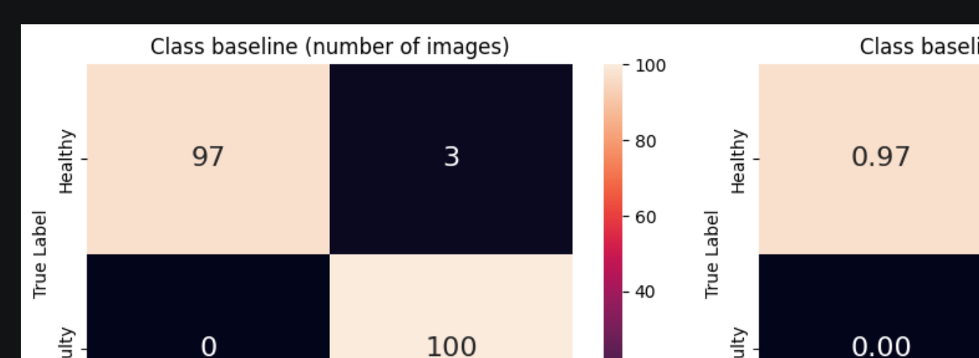
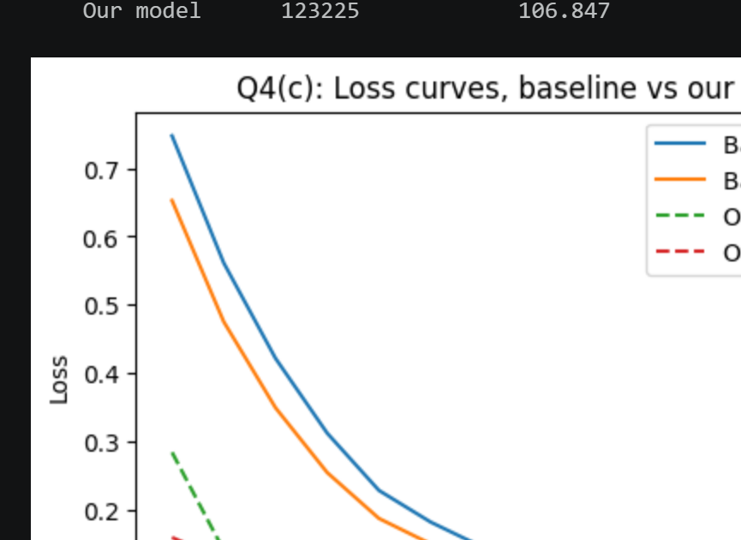
Q4(c) Comparison with the Class Baseline
Same data split and evaluation procedure; Faulty is treated as the positive class
Baseline
Comparison logic
The CNN from the class notebook was copied unchanged and trained with the same settings (Adam lr=1e-4, 15 epochs, batch size 8).
Both models were evaluated on the same 200-image held-out test set. For fault detection, recall is especially important because a false negative means a fault is missed.
Model
Parameters
Train time (s)
Inference (ms/img)
Accuracy
Precision
Recall
F1
Class baseline
9,339
52.829
1.818
0.985
0.971
1.000
0.985
Our model
123,225
106.847
2.376
0.990
0.980
1.000
0.990
Baseline confusion matrix
Loss curves – baseline vs our model
Key takeaway:
Our model improved accuracy, precision and F1 slightly while keeping perfect fault recall, but it used far more parameters and was slower.

Slide 13
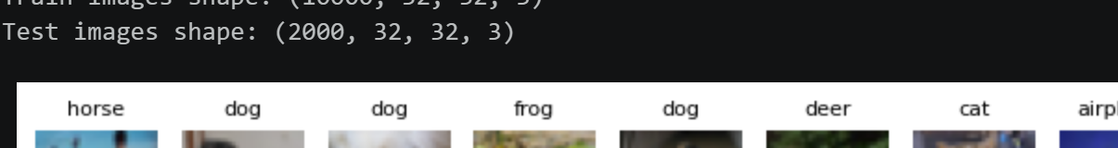
Q5(a) CIFAR-10 Classification – Model Fusion
Feature fusion using two frozen ImageNet-pretrained CNNs
OBJECTIVE
Classify CIFAR-10 images by combining features from two pretrained models, then train a new classification head.
Dataset & setup
Model fusion method
Result
• CIFAR-10: 10 image classes, 32 × 32 × 3 RGB.
• Random CPU-friendly subset: 10,000 training images and 2,000 test images.
• 20% of the training subset is used for validation.
• Batch size 32 and 5 epochs per model.
• Each pretrained network uses its own preprocess_input function.
• Frozen MobileNetV2 extracts 1,280 pooled features.
• Frozen ResNet50 extracts 2,048 pooled features.
• The two feature vectors are concatenated → 3,328 fused features.
• Dense 64 → Dense 32 with L2 regularization → Softmax(10).
• Only the new classification head is trained.
Training time
142.55 s
Final val. accuracy
0.5925
Train subset
Test subset
Total parameters
26,061,162
Example CIFAR-10 images used in the experiment
10,000
2,000
Trainable: 215,466
Key takeaway:
Feature fusion combines complementary representations from MobileNetV2 and ResNet50, but it is the largest and slowest of the three methods.

Slide 14
Q5(b–c) Transfer Learning vs Fine-tuning
Same MobileNetV2 backbone, but different numbers of trainable layers
OBJECTIVE
Compare a fully frozen pretrained backbone with a partially unfrozen backbone trained at a lower learning rate.
Q5(b) Transfer learning
Q5(c) Fine-tuning
• MobileNetV2 pretrained on ImageNet.
• All backbone layers frozen.
• GlobalAveragePooling2D → Dense 64 → Dense 32 → Softmax(10).
• Only the new head is trained.
• 84,394 trainable parameters.
• Training time: 42.84 s.
We kept everything the model already knew, only taught it the new classes.
• Same ImageNet-pretrained MobileNetV2 backbone.
• Earlier layers frozen; last 30 layers unfrozen.
• BatchNorm statistics kept fixed during training.
• Lower learning rate: Adam, 0.0001.
• 1,610,794 trainable parameters.
• Training time: 57.24 s
We let the model adapt to our pictures not just learn a new decision on top.
Test Accuracy
0.275
F1
0.255
Inference
0.962 ms/img
Test Accuracy
0.549
F1
0.544
Inference
0.928 ms/img
Observation
Fine-tuning substantially improved the frozen-backbone result (accuracy 0.549 vs 0.275) while keeping inference time below 1 ms/image.
Key takeaway:
Allowing part of the pretrained feature extractor to adapt to CIFAR-10 gave much better classification performance than training only a new head.

Slide 15
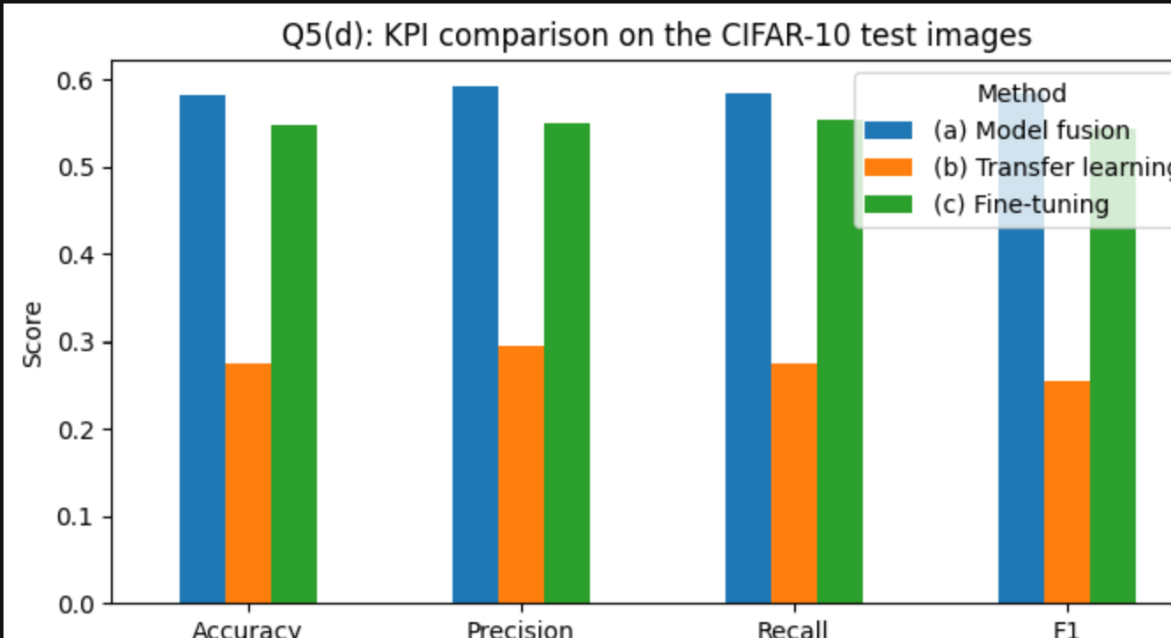
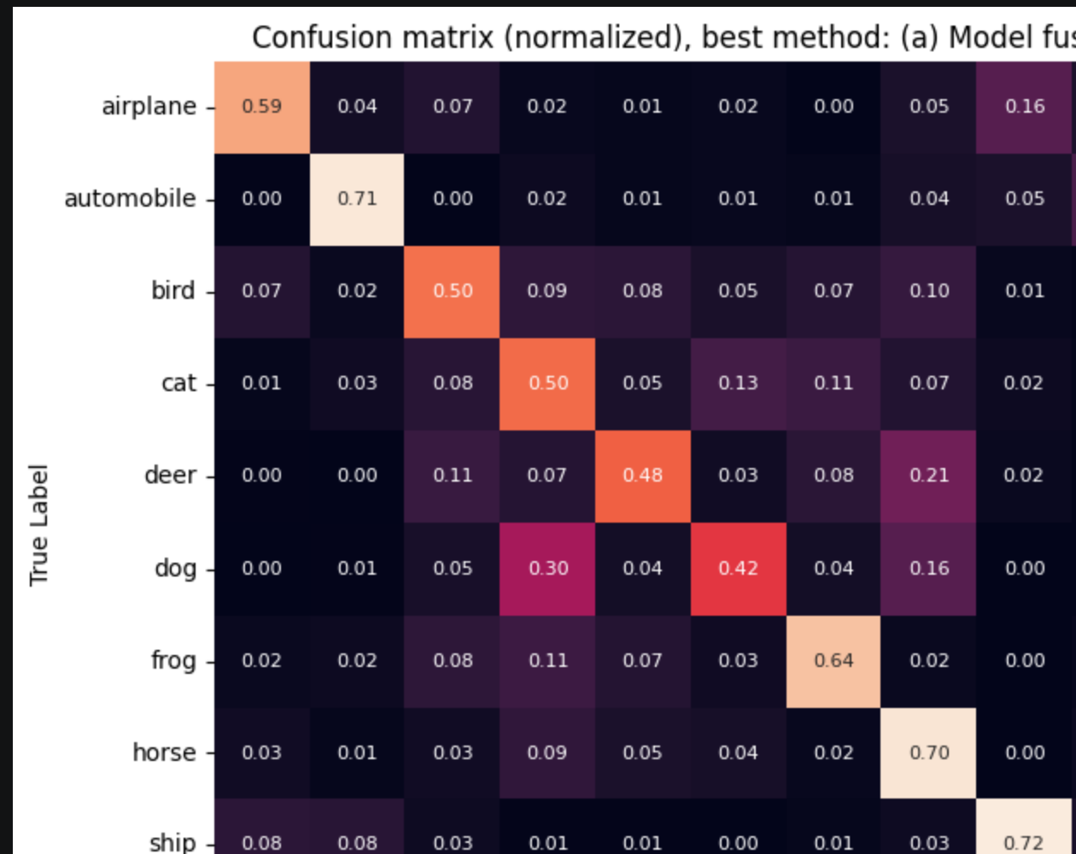
Q5(d) Comparison of the Three Classification Methods
Evaluation on the same 2,000 CIFAR-10 test images using classification KPIs
Inference
(ms/img)
Accuracy
(imgs right)
Precision
(cat = cat?)
Recall
(How many real cats)
Method
Parameters
Trainable
Train time (s)
F1
Model fusion
26,061,162
215,466
142.553
3.306
0.582
0.593
0.585
0.584
Transfer learning
2,342,378
84,394
42.837
0.962
0.275
0.295
0.275
0.255
Fine-tuning
2,342,378
1,610,794
57.242
0.928
0.549
0.551
0.554
0.544
KPI comparison
Best method: model fusion
Result:
Model fusion achieved the best overall test performance (F1 = 0.584), while fine-tuning was close (F1 = 0.544) with far fewer parameters and faster inference.
Trade-off: highest accuracy → Model fusion | best efficiency/performance balance → Fine-tuning

Slide 16
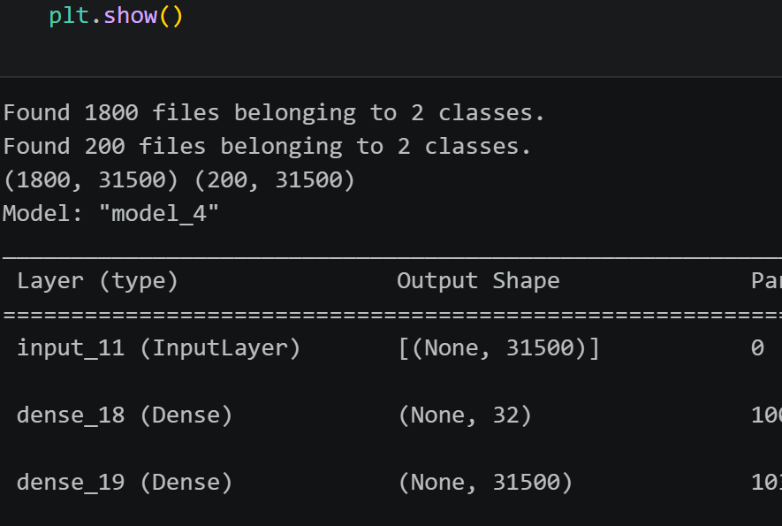
Q6 Autoencoder – Compression and Reconstruction
Autoencoder on the fault-classification dataset
OBJECTIVE
Compress each motor image to a latent representation and reconstruct it, then compare reconstruction quality for Healthy and Faulty classes.
Data preparation
Autoencoder method
Training result
• Dataset: fault-classification-class.
• Classes: Healthy (00_15) and Faulty (10_15).
• 1,800 training images and 200 test images.
• RGB image size: 60 × 175 × 3.
• Each image is scaled to [0, 1] and flattened to 31,500 values.
• Dense encoder: 31,500 → 32 latent values with ReLU.
• Dense decoder: 32 → 31,500 values with sigmoid.
• Latent compression ≈ 31,500 / 32 = 984×.
• Optimizer: Adam.
• Loss: binary cross-entropy; MSE also monitored.
• Training: 50 epochs, batch size 32.
Final train loss
0.5014
Final val. loss
0.5018
Input dimension
31,500
Latent dimension
32
Test set
200 images
Parameters
2,047,532
Train and validation loss converge quickly and remain close.
Key takeaway:
The network compresses each 31,500-value image to only 32 latent values and reconstructs it with similar train/validation behaviour.

Slide 17
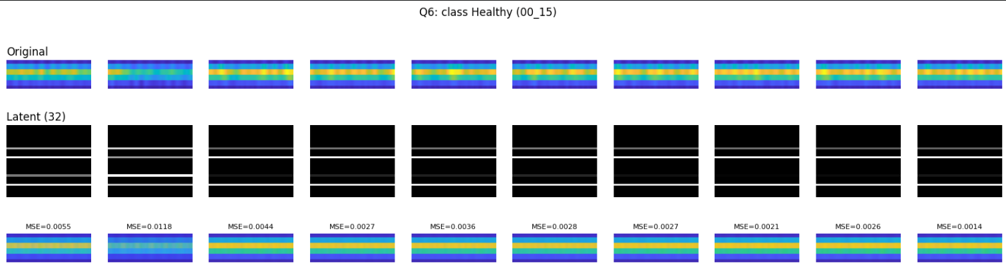
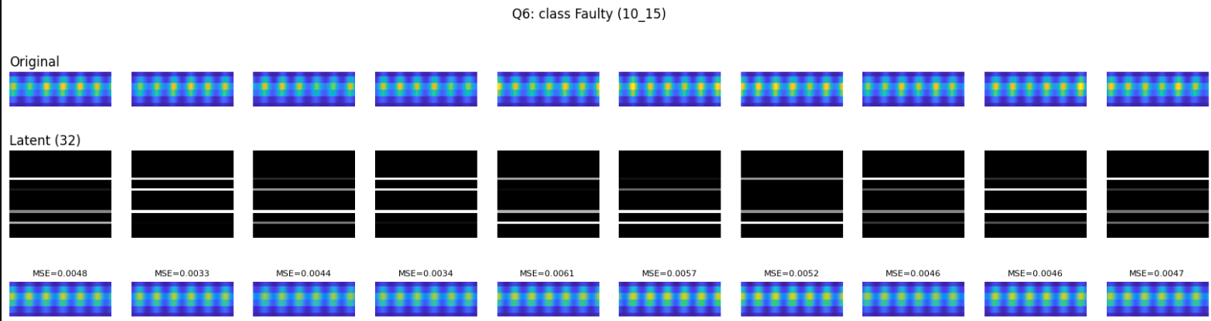
Q6(a–c) Original → Latent Vector → Reconstruction
10 random test images are sampled from each class
METHOD
For each class: sample 10 images → encode to 32 latent values → decode back to 60 × 175 × 3 → display original, latent representation and reconstruction.
Squeeze down an image into a few numbser then rebuild it. ( how well can our model «redraw» an image.
Healthy class (00_15)
Faulty class (10_15)
Observation:
The 32-value bottleneck retains the main horizontal/periodic structure, but fine detail is smoothed in the reconstructed images.

Slide 18
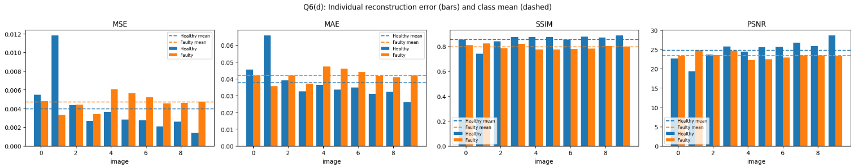
Q6(d) Reconstruction Error by Class
Individual reconstruction error for 10 random images and mean performance for each class
Evaluation metrics
Mean reconstruction quality
• MSE – lower is better.
• MAE – lower is better.
• SSIM – higher means greater structural similarity.
• PSNR – higher indicates better reconstruction quality.
Class
MSE
MAE
SSIM
PSNR
Healthy
0.0040
0.0377
0.8545
24.7869
Faulty
0.0047
0.0418
0.7939
23.3723
Individual error values and class means
RESULT
Healthy images were reconstructed slightly better overall: lower MSE/MAE and higher SSIM/PSNR. This indicates that the autoencoder preserves Healthy-class structure more accurately than Faulty-class structure for the sampled images.

