Slide 1
1
UNIVERSITY OF AGDER
MAS512 Assignment 2
Group 9
Camera Geometry
LiDAR Tracking
Sensor Fusion
Navigation
By:
Renwa Hamid
Sebastian Skogland
Hedda Winther-Sørensen
MAS512 | Assignment 2 | Group 9

Slide 2
Assignment 2 — Our workflow
2
From camera-based tracking to LiDAR, sensor fusion and autonomous control
Q1
Q2
Q3
Q4
Camera
LiDAR
Camera–LiDAR
Webots
3D trajectory, camera intrinsics and coordinate mapping
Point-cloud clustering, load motion and KISS-ICP
KITTI calibration, 3D ranging and validation
Waypoint control, wheel slip and sensor logging
Assignment 1 models are reused where relevant; results shown in this deck come from the Assignment 2 notebook.
MAS512 | Assignment 2 | Group 9

Slide 3
Q1
Q1(a) Camera → 3D coordinates
3
Reuse the Assignment 1 YOLO model to reconstruct the swinging-load trajectory
1
RGB + depth
2
YOLO detection
3
Depth sampling
4
3D conversion
Match 900 RGB images with their aligned raw depth frames.
Predict the load bounding box and calculate its center (u, v).
Read depth at center; use nearest valid pixel in box if missing.
Apply focal lengths and principal point from the intrinsic matrix.
Pinhole camera model
900
889
X = (u − cₓ) · Z / fₓ
RGB + depth pairs
Load detections
Y = (v − cᵧ) · Z / fᵧ Z = depth [m]
11 frames with no YOLO detection
Aligned RGB and depth pixels are combined to obtain camera-frame XYZ coordinates.
3D positions were created for detected frames.
MAS512 | Assignment 2 | Group 9

Slide 4
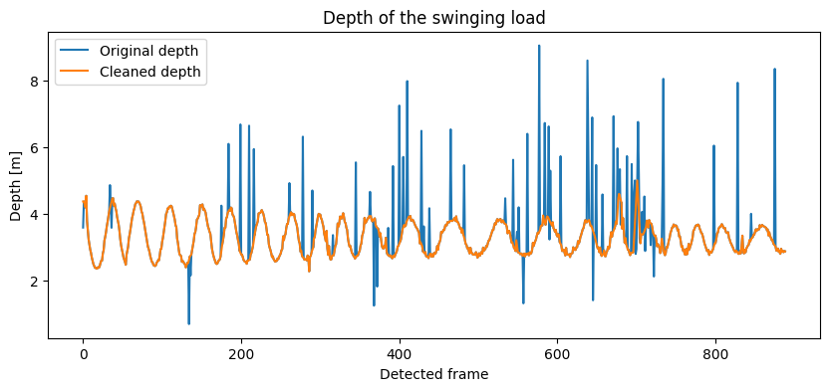
Q1
Q1(a) Depth handling and filtering
4
Missing center depth and measurement spikes are handled before 3D reconstruction
Measured depth vs cleaned depth
336 → 0
Missing depths among detected frames¹
70
Corrected depth samples
How it works
Nearest valid depth in YOLO box → 7-sample local median → flag deviations > 0.5 m → interpolate.
¹ For 889 detected frames; undetected frames are not included.
MAS512 | Assignment 2 | Group 9

Slide 5
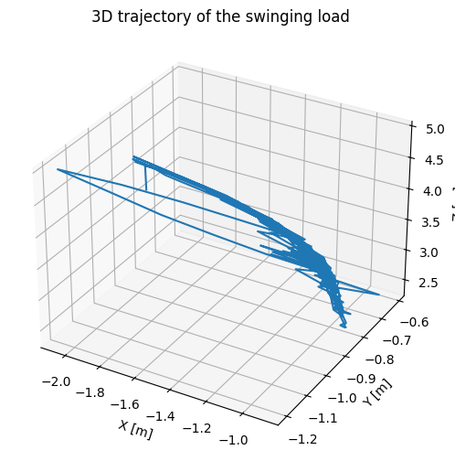
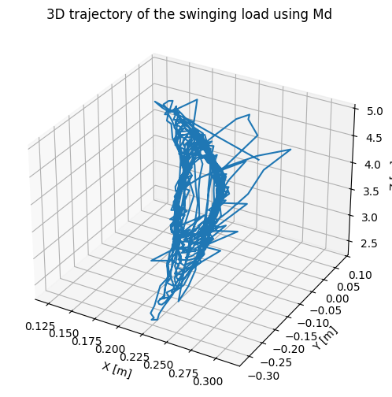
Q1
Q1(a–b) 3D trajectories — two camera matrices
5
The same detected pixels and cleaned depth values give different XYZ positions
o₁ using lab matrix M_int
o₂ using default matrix M_d
Example o₁ = (−1.805, −1.008, 4.384) m
Example o₂ = (0.265, −0.046, 4.384) m
MAS512 | Assignment 2 | Group 9

Slide 6
Q1
Q1(c) Which intrinsic matrix fits the frames?
6
Compare principal points and focal lengths for the 640 × 480 images
M_int · Lab calibration
M_d · Default L515
[ 1391.7 0 979.1 ]
[ 0 1388.5 540.2 ]
[ 0 0 1 ]
[ 1342 0 325 ]
[ 0 1342 235 ]
[ 0 0 1 ]
(320, 240)
(979, 540)
(325, 235)
Conclusion
M_d appears more suitable
Approx. frame center
M_int principal point
M_d principal point
Plausibility based on image geometry, not an independent 3D ground-truth test.
MAS512 | Assignment 2 | Group 9

Slide 7
Q1
Q1(d) Learning the coordinate mapping
7
Linear regression predicts o₂* from o₁ coordinates
INPUT
MODEL
OUTPUT
o₁ = [X, Y, Z]
→
Linear Regression
→
o₂* = predicted XYZ
711
178
1.000
≈ 0
Training samples
Test samples
Test R²
RMSE (7.61 × 10⁻¹⁶)
Near-perfect prediction is expected: both 3D outputs are computed from the same pixels and depths with different matrices.
MAS512 | Assignment 2 | Group 9

Slide 8
Q1
Q1(e) Euclidean coordinate differences
8
Compare direct matrix conversion and the regression-predicted coordinates
Mean Euclidean distance [m]
1.189–2.610 m
o₁ versus o₂ · min–max
o₁ vs o₂
1.718 m
1.293–2.281 m
o₁ versus predicted o₂* · min–max
o₁ vs o₂* (test)
1.713 m
Interpretation
The two means are similar because regression reproduces o₂ very closely.
Lower is not necessarily better here: this is a difference between coordinate definitions, not ground-truth position error.
MAS512 | Assignment 2 | Group 9

Slide 9
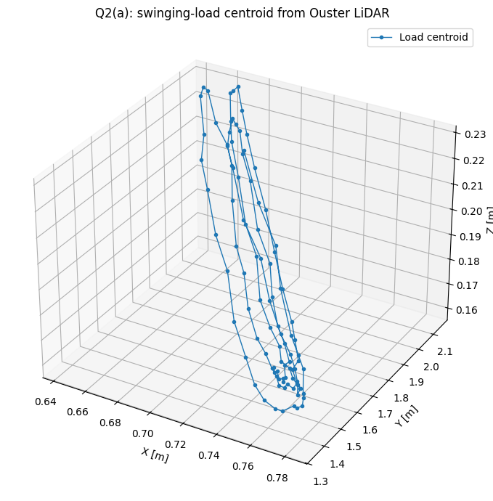
Q2
Q2(a) LiDAR swinging-load tracking
9
Ouster OS-1 point clouds → DBSCAN clusters → load centroid trajectory
Tracked load centroid (3D)
1
Decode scans
Use Ouster metadata + complete scans
2
Crop 3D region
Keep plausible load points
3
DBSCAN
Find compact moving cluster
4
Track centroid
Mean XYZ across scans
99 complete scans
99/99 clusters detected
MAS512 | Assignment 2 | Group 9

Slide 10
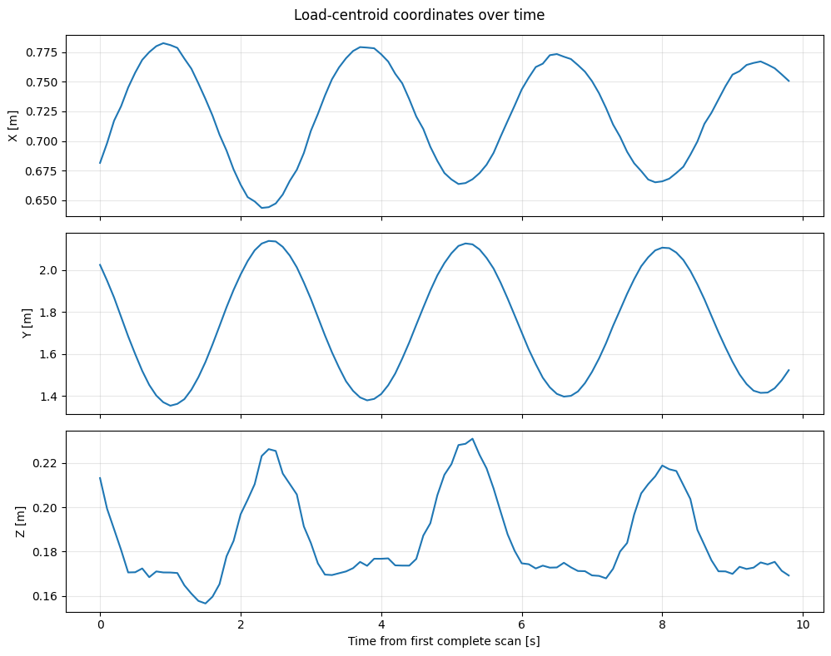
Q2
Q2(a) Load motion over time
10
XYZ centroid positions reveal repeated swinging motion
Measured centroid coordinates
0.785 m
Y-coordinate span
Observed ranges
X [m]
0.643–0.783
Y [m]
1.354–2.139
Z [m]
0.157–0.231
MAS512 | Assignment 2 | Group 9

Slide 11
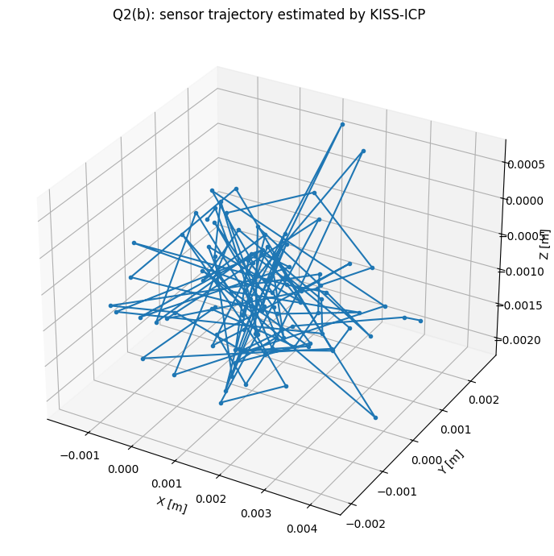
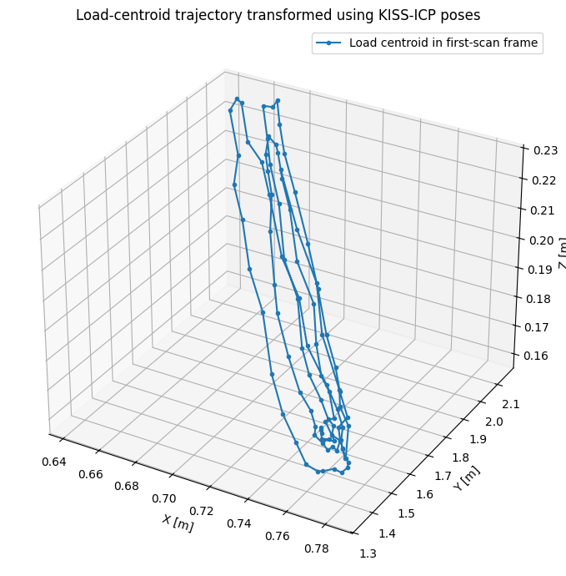
Q2
Q2(b) KISS-ICP — sensor motion vs load motion
11
ICP estimates LiDAR sensor poses; DBSCAN tracks the moving object
KISS-ICP: sensor trajectory
Load in first-scan reference frame
0.0046 m
0.0191°
Near-zero sensor motion ≠ stationary load
Max sensor translation
Max sensor rotation
MAS512 | Assignment 2 | Group 9

Slide 12
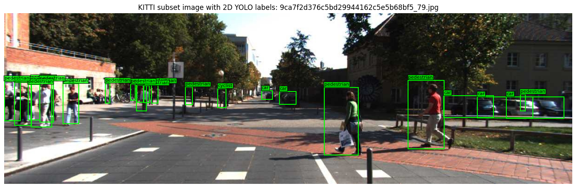
Q3
Q3(a) KITTI dataset and calibration
12
Combine synchronized camera images, LiDAR scans and 3D labels
Example: annotated KITTI subset
Files aligned by frame ID
image_2/
RGB camera images
velodyne/
XYZ + reflectance point clouds
calib/
P2, R0_rect, Tr_velo_to_cam
label_2/
Object labels and 3D locations
Coordinate transformation
LiDAR XYZ → Tr_velo_to_cam → R0_rect → P2 → image pixel (u, v)
Local 2D YOLO subset: 150 train + 40 val images; 5 separate KITTI 3D frames used for paired sensor fusion.
MAS512 | Assignment 2 | Group 9

Slide 13
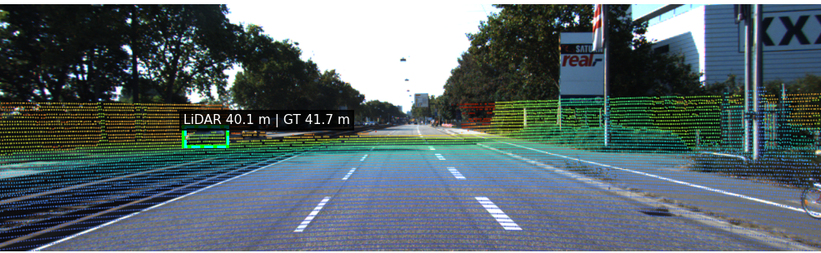
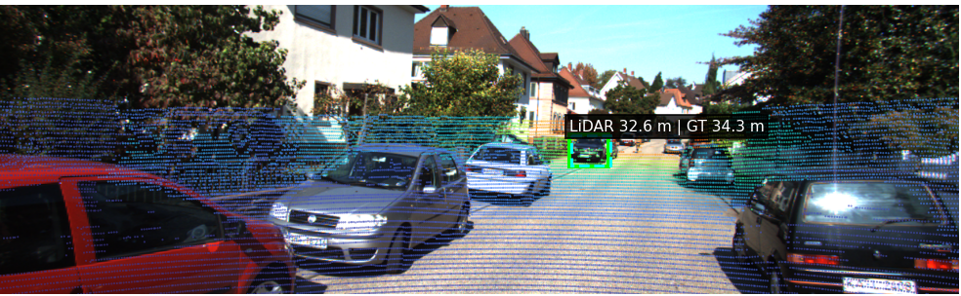
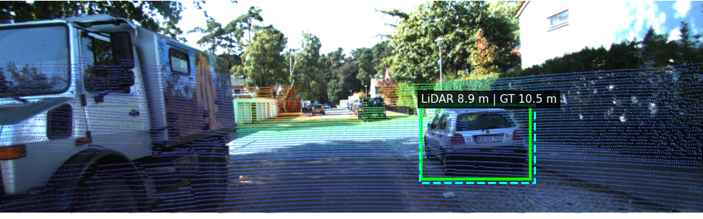
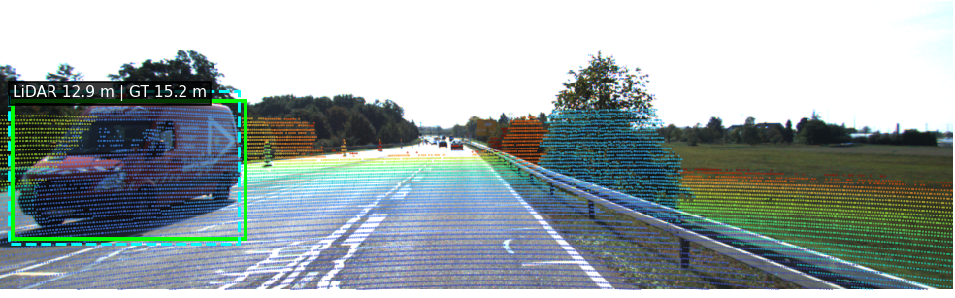
Q3
Q3 Camera–LiDAR fusion in five KITTI frames
13
Projected LiDAR points are overlaid with YOLO boxes and distance estimates
000004 · IoU 0.93 · 40.06 m
000008 · IoU 0.86 · 32.57 m
000019 · IoU 0.92 · 8.91 m
000027 · IoU 0.87 · 12.90 m
Green = YOLO prediction · Cyan dashed = matched KITTI 2D label · Point colors represent LiDAR range.
MAS512 | Assignment 2 | Group 9

Slide 14
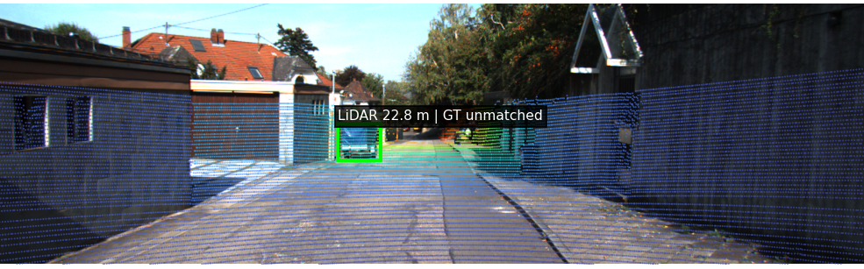
Q3
Q3 Fusion range validation
14
Compare LiDAR-estimated object range to matched KITTI 3D annotations
4 / 5
1.82 m
0.50
Matched 2D detections
Matched range MAE
Minimum match IoU
Frame
Box IoU
LiDAR [m]
GT [m]
|Error| [m]
Unmatched example
000004
0.93
40.06
41.67
1.61
000008
0.86
32.57
34.29
1.71
000019
0.92
8.91
10.53
1.62
Frame 000029
000027
0.87
12.90
15.24
2.34
Excluded from error average
000029
0.00
22.77
—
—
Range estimate = 20th percentile of projected LiDAR points in the YOLO box; GT range is to the labeled 3D object location.
MAS512 | Assignment 2 | Group 9

Slide 15
Q4
Q4(a) Webots navigation setup
15
A Supervisor controller follows a fixed route and records repeatable friction experiments
Planned waypoint route (XY)
GPS + encoders
1
Estimate position and wheel motion
2
3
Waypoint heading
2
Compute target angle and speed
3
LiDAR obstacle check
Turn if front range < 0.65 m
4
Motor commands
Differential-drive wheel speeds
5
Logging
Start
1
4
Goal
Save all sensors and camera frames
Controller starts at (−3.0, 0) and follows 5 waypoints toward (2.15, 0).
MAS512 | Assignment 2 | Group 9

Slide 16
Q4
Q4(a) Slip estimation and experiment logs
16
Longitudinal slip is computed from encoder and GPS velocity; every trial saves synchronized sensor data
Longitudinal slip estimate
Recorded devices
GPS · accelerometer · gyro · IMU
slip = (v_enc − v_x) / v_x
Left/right encoders · left/right motors
Camera snapshots every 12 steps
v_enc = 0.1 · (ω_left + ω_right) / 2
LiDAR range array every simulation step
Computed only when |v_x| ≥ 0.05 m/s.
Outputs per friction condition
sensors.csv
lidar.jsonl
camera/
summary.json
GPS XY, distance, wheel speed, slip, IMU
Timestamped LiDAR ranges
Recorded PNG images
Goal reached, time, distance, clearance
MAS512 | Assignment 2 | Group 9

Slide 17
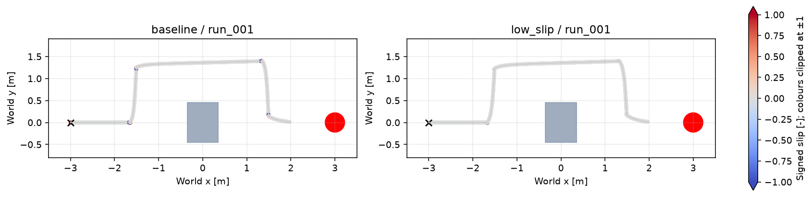
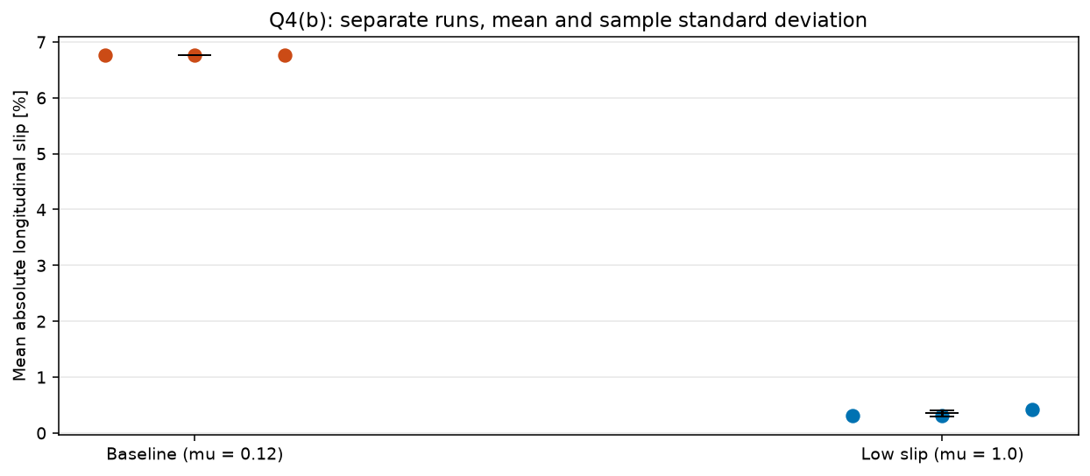
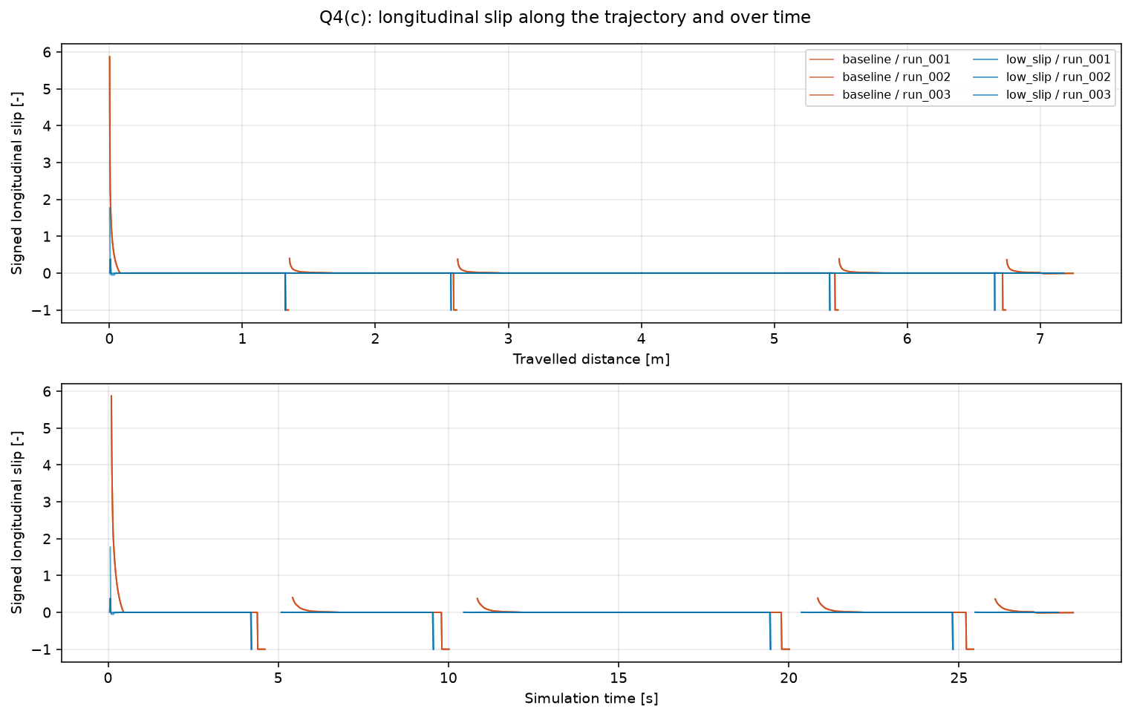
Q4
Q4(b–c) Friction experiment results
17
Higher wheel–floor friction greatly reduces measured longitudinal slip
Key results
Condition summary
3 baseline trials (μ = 0.12) and 3 higher-friction trials (μ = 1.0).
6/6 runs reached the stopping area near the target.
Mean |slip| dropped by 94.8%.
Condition
Mean |slip|
Duration [s]
Distance [m]
Baseline
6.7622%
28.3520
7.248
High friction
0.3515%
27.9093
7.176
94.8% reduction
Trajectory coloured by slip
MAS512 | Assignment 2 | Group 9

Slide 18
Assignment 2 — Summary and conclusions
18
What we implemented and measured across camera, LiDAR, fusion and Webots
Camera geometry
889/900 YOLO detections; 70 depth corrections; R² = 1.0 mapping
Camera intrinsics need correct image resolution
Q1
LiDAR motion
99/99 load centroids; 0.785 m Y span; ≈ 0 sensor motion
KISS-ICP tracks sensor pose, not the moving load
Q2
Sensor fusion
4/5 KITTI box associations; mean range difference 1.82 m
Small five-frame sample; range surfaces differ
Q3
Webots experiments
6 successful Webots runs; mean absolute slip fell from 6.76% to 0.35%
Higher friction reduced slip by 94.8% while keeping path length and duration almost unchanged
Q4
MAS512 | Assignment 2 | Group 9

