Slide 1
1
UNIVERSITY OF AGDER
MAS512 Assignment 2
Group 9
Camera Geometry
LiDAR Tracking
Sensor Fusion
Navigation
By:
Renwa Hamid
Sebastian Skogland
Christopher Olsen
MAS512 | Assignment 2 | Group 9
Notes:
Welcome. We are Group 9. Our assignment covers four parts: camera geometry, LiDAR tracking, camera-LiDAR fusion on KITTI, and autonomous navigation with slip estimation in Webots.

Slide 2
Assignment 2 — Our workflow
2
From camera-based tracking to LiDAR, sensor fusion and autonomous control
Q1
Q2
Q3
Q4
Camera
LiDAR
Camera–LiDAR
Webots
3D trajectory, camera intrinsics and coordinate mapping
Point-cloud clustering, load motion and KISS-ICP
KITTI calibration, 3D ranging and validation
Waypoint control, wheel slip and sensor logging
Assignment 1 models are reused where relevant; results shown in this deck come from the Assignment 2 notebook.
MAS512 | Assignment 2 | Group 9
Notes:
The work goes from one sensor to another, then combines them, and ends with a robot that uses sensors to drive. Q1 camera, Q2 LiDAR, Q3 fusion, Q4 Webots. We reuse the Assignment 1 YOLO model where it fits.

Slide 3
Q1
Q1(a) Camera → 3D coordinates
3
Reuse the Assignment 1 YOLO model to reconstruct the swinging-load trajectory
1
RGB + depth
2
YOLO detection
3
Depth sampling
4
3D conversion
Match 900 RGB images with their aligned raw depth frames.
Predict the load bounding box and calculate its center (u, v).
Read depth at center; use nearest valid pixel in box if missing.
Apply focal lengths and principal point from the intrinsic matrix.
Pinhole formula
900
889
X = (u − cₓ) · Z / fₓ
RGB + depth pairs
Load detections
Y = (v − cᵧ) · Z / fᵧ Z = depth [m]
11 frames with no YOLO detection
Aligned RGB and depth pixels are combined to obtain camera-frame XYZ coordinates.
3D positions were created for detected frames.
MAS512 | Assignment 2 | Group 9
Notes:
To get 3D from a camera we need the pixel position and the depth. YOLO gives the box, the box centre is (u, v), the depth camera gives Z. The pinhole model then gives X and Y using the focal lengths and the principal point. YOLO found the load in 889 of 900 frames.

Slide 4
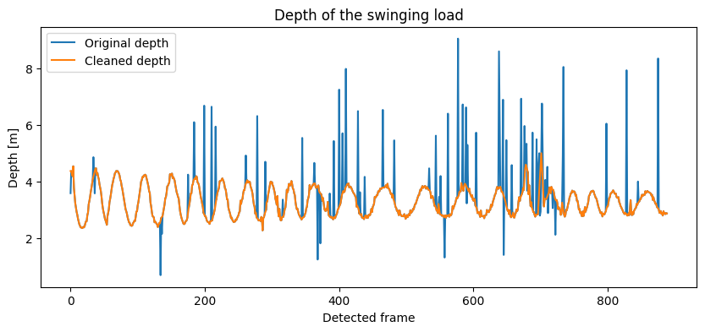
Q1
Q1(a) Depth handling and filtering
4
Missing center depth and measurement spikes are handled before 3D reconstruction
Measured depth vs cleaned depth
336 → 0
Missing depths, before → after filling¹
70
Corrected depth samples
¹ For 889 detected frames; undetected frames are not included.
MAS512 | Assignment 2 | Group 9
Notes:
Depth cameras often return zero or spikes. When the centre pixel had no depth, we took the nearest valid pixel inside the box, which filled all 336 gaps. Then a 7-sample rolling median flagged jumps above 0.5 m, and we interpolated those 70 samples.

Slide 5
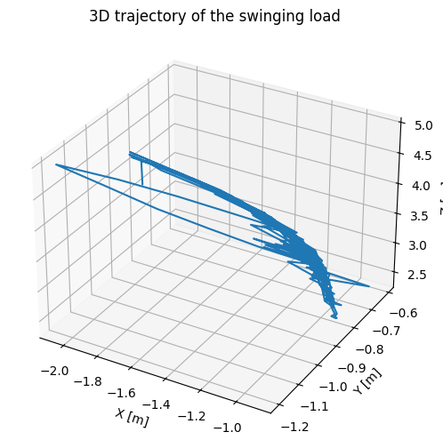
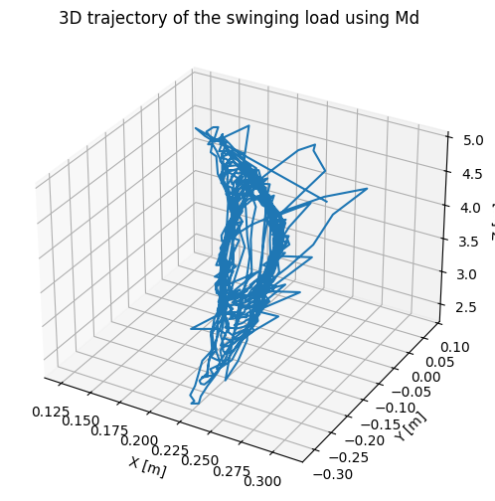
Q1
Q1(a–b) 3D trajectories — two camera matrices
5
The same detected pixels and cleaned depth values give different XYZ positions
o₁ using lab matrix M_int
o₂ using default matrix M_d
Example o₁ = (−1.805, −1.008, 4.384) m
Example o₂ = (0.265, −0.046, 4.384) m
MAS512 | Assignment 2 | Group 9
Notes:
Same pixels and same depth, two matrices. Z is identical in both. Only X and Y change, because the matrices have different focal lengths and principal points. With M_int the load ends up about 1.8 m to the side, which does not match the video.

Slide 6
Q1
Q1(c) Which intrinsic matrix fits the frames?
6
Compare principal points and focal lengths for the 640 × 480 images
M_int · Lab calibration
M_d · Default L515
[ 1391.7 0 979.1 ]
[ 0 1388.5 540.2 ]
[ 0 0 1 ]
[ 1342 0 325 ]
[ 0 1342 235 ]
[ 0 0 1 ]
Conclusion
M_d appears more suitable
Focal length: lecture value ≈ 1285 px (1.8 mm lens ÷ 1.4 µm pixels). M_d (1342) is closer than M_int (1391).
MAS512 | Assignment 2 | Group 9
Notes:
Our frames are 640 by 480, so the centre is about (320, 240). M_d's principal point (325, 235) matches that. M_int's (979, 540) is the centre of a 1920 by 1080 image, so it was calibrated at a different resolution. Second reason: the expected focal length from the lecture is about 1285 px, and M_d's 1342 is closer than M_int's 1391. M_int could be used if rescaled by 640/1920.

Slide 7
Q1
Q1(d) Learning the coordinate mapping
7
Linear regression predicts o₂* from o₁ coordinates
INPUT
MODEL
OUTPUT
o₁ = [X, Y, Z]
→
Linear Regression
→
o₂* = predicted XYZ
711
178
1.000
≈ 0
Training samples
Test samples
Test R²
RMSE (7.61 × 10⁻¹⁶)
Near-perfect prediction is expected: both 3D outputs are computed from the same pixels and depths with different matrices.
MAS512 | Assignment 2 | Group 9
Notes:
We trained a linear regression from o1 to o2: 711 training and 178 test samples. R squared is 1.000 and RMSE is essentially zero. That is expected, not overfitting: both o1 and o2 are linear functions of the same (u, v, Z), so the mapping between them is exactly linear.

Slide 8
Q1
Q1(e) Euclidean coordinate differences
8
Compare direct matrix conversion and the regression-predicted coordinates
Mean Euclidean distance [m]
o₁ vs o₂
Interpretation
1.718 m
The two means are similar because regression reproduces o₂ very closely.
o₁ vs o₂* (test)
1.713 m
Lower is not necessarily better here: this is a difference between coordinate definitions, not ground-truth position error.
MAS512 | Assignment 2 | Group 9
Notes:
In part (d) we trained a linear regression that maps o₁ to o₂, with 711 training and 178 test samples. On the test set we get R² = 1 and RMSE ≈ 0. That’s not overfitting: both coordinates come from the same pixels and depths, so the relationship between them is exactly linear, a scale factor from the focal lengths plus an offset from the principal points. The model just recovered that formula.

Slide 9
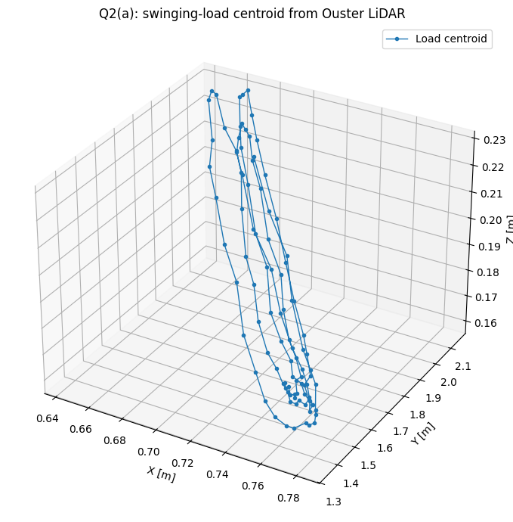
Q2
Q2(a) LiDAR swinging-load tracking
9
Ouster OS-1 point clouds → DBSCAN clusters → load centroid trajectory
Tracked load centroid (3D)
1
Decode scans
Use Ouster metadata + complete scans
2
Crop 3D region
Keep plausible load points
3
DBSCAN
Find compact moving cluster
4
Track centroid
Mean XYZ across scans
99 complete scans
99/99 clusters detected
MAS512 | Assignment 2 | Group 9
Notes:
For the LiDAR part we decoded the Ouster scans, cropped the region where the load hangs, and used DBSCAN to find the compact cluster of the load. DBSCAN groups dense points and needs no fixed number of clusters. The mean XYZ of the cluster is the load centre. It worked in 99 of 99 scans.

Slide 10
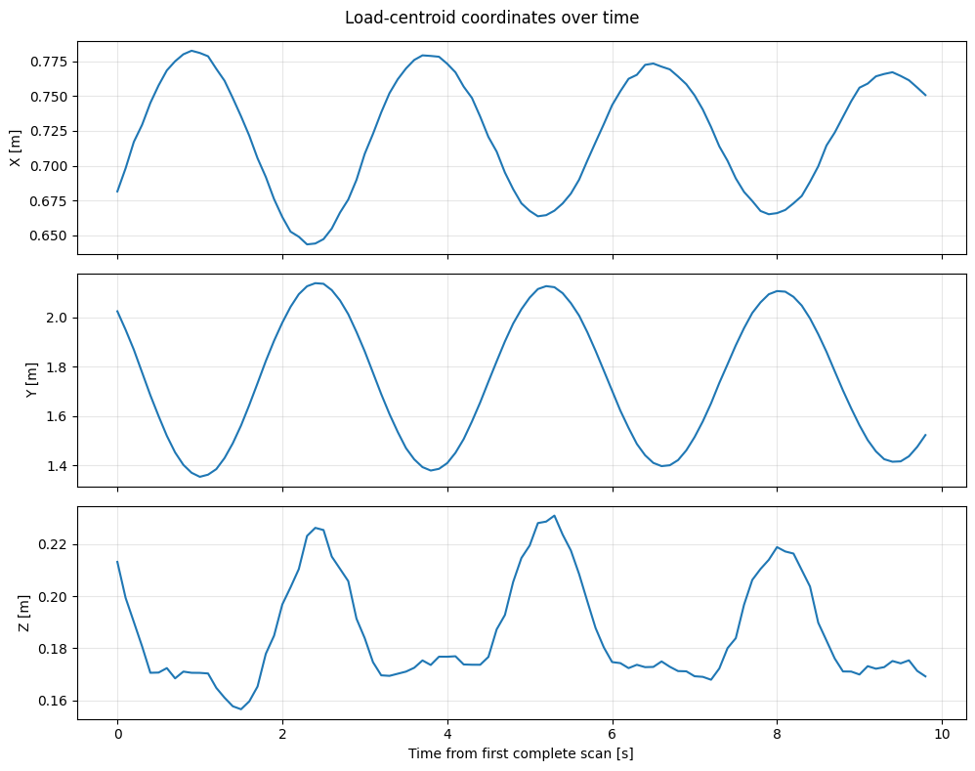
Q2
Q2(a) Load motion over time
10
XYZ centroid positions reveal repeated swinging motion
Measured centroid coordinates
0.785 m
Y-coordinate span
Observed ranges
X [m]
0.643–0.783
Y [m]
1.354–2.139
Z [m]
0.157–0.231
MAS512 | Assignment 2 | Group 9
Notes:
Over time the load swings mainly along Y, with a span of 0.785 m. X and Z change very little. That is what a pendulum should look like.

Slide 11
Q2
Q2(b) How KISS-ICP works
11
LiDAR odometry: align each new scan to a local map to estimate how the sensor moved
Uses and drawbacks
1
Voxel downsample
Thin the scan into a sparse voxel grid
Uses
• Robot and vehicle odometry
• Front end of a SLAM system ( own position tracking in uknown places)
• No camera, GPS or training data needed
Drawbacks
• Drifts over time (no loop closure)
• Weak in repetitive or sparse scenes
• Assumes a mostly static world; moving objects bias it
• Gives the sensor pose, not object poses (position and orientation)
2
Predict pose
Constant-velocity guess from the last poses
3
Point-to-point ICP
Nearest-point matches
4
Update local map
Add scan to map; adapt the match threshold
Keep It Small and Simple
Vizzo et al., RA-L 2023
MAS512 | Assignment 2 | Group 9
Notes:
KISS-ICP stands for Keep It Small and Simple. It is LiDAR odometry. The scan is added to the local map, and the matching threshold adapts, so it needs almost no tuning. It is used for robot and car odometry and as the front end of SLAM. Drawbacks: it drifts because there is no loop closure, it struggles in repetitive or sparse scenes, it assumes the world is static, and it only gives the sensor pose.

Slide 12
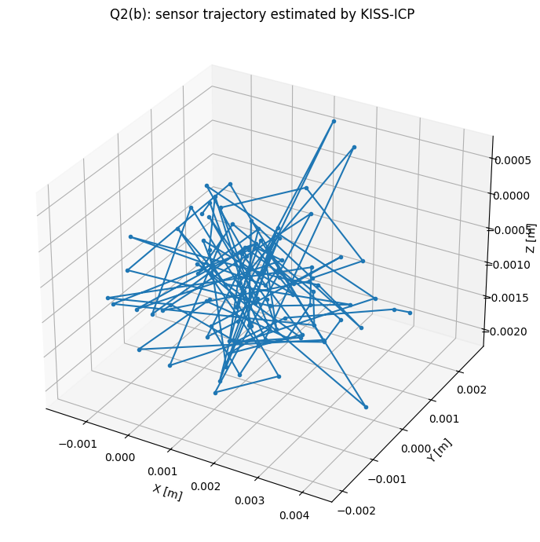
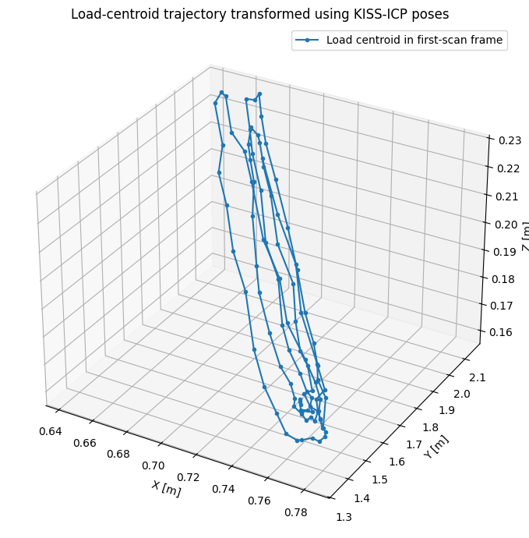
Q2
Q2(b) KISS-ICP — sensor motion vs load motion
12
ICP estimates LiDAR sensor poses; DBSCAN tracks the moving object
KISS-ICP: sensor trajectory
Load in first-scan reference frame
0.0046 m
0.0191°
Near-zero sensor motion ≠ stationary load
Max sensor translation
Max sensor rotation
MAS512 | Assignment 2 | Group 9
Notes:
Our result: the maximum sensor translation was 4.6 mm and the maximum rotation 0.019 degrees. The sensor was standing still, so this is the correct answer. Near-zero sensor motion does not mean the load is still: KISS-ICP tracks the sensor, DBSCAN tracks the load. We used the poses to express the load in the first scan's frame.

Slide 13
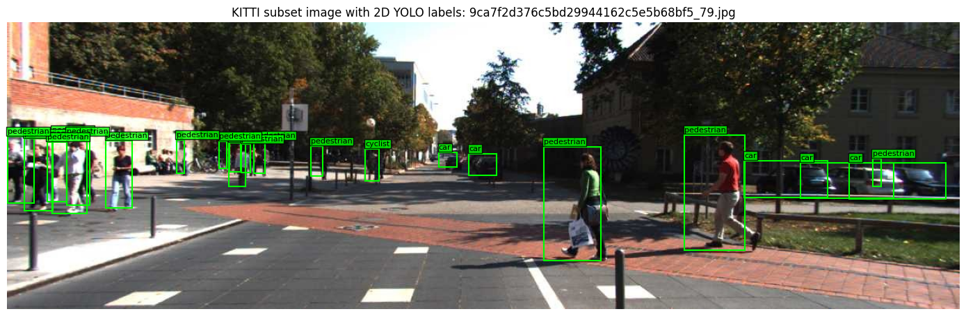
Q3
Q3(a) KITTI dataset and calibration
13
Q1 – Pixel to 3D - Q3 3D to pixel.
Example: annotated KITTI subset
Every fram ID – Dataset saves:
image_2
Camera Images
Velodyne (Lidar)
XYZ Lidar Coordinates/points
calib
Calibration information
label_2
Reference object annotations
Coordinate transformation
LiDAR XYZ → Tr_velo_to_cam → R0_rect → P2 → image pixel (u, v)
MAS512 | Assignment 2 | Group 9
Notes:
“In Q1 we went from pixel to 3D. In Q3 we go from 3D to pixel. It’s the same pinhole camera model, just in the opposite direction. The only extra work is first moving the LiDAR point into the camera’s coordinate system.”

Slide 14
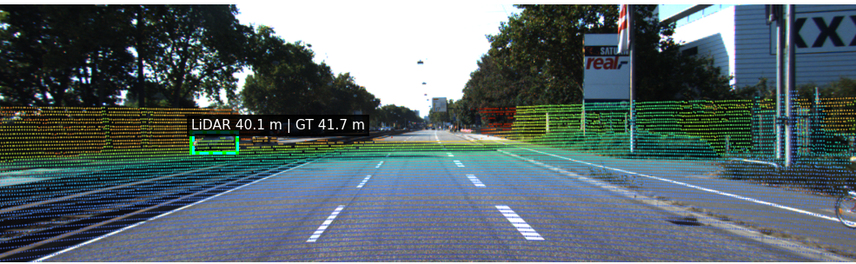
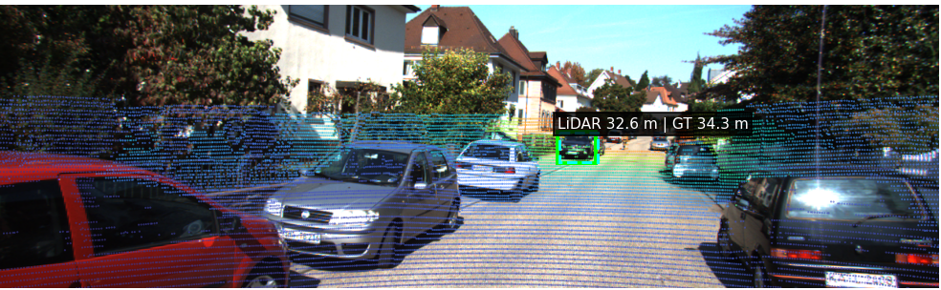
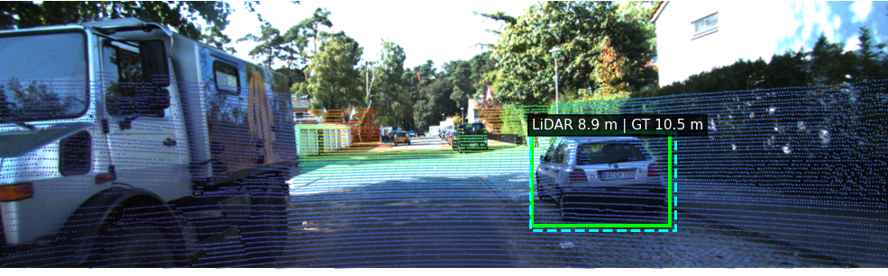
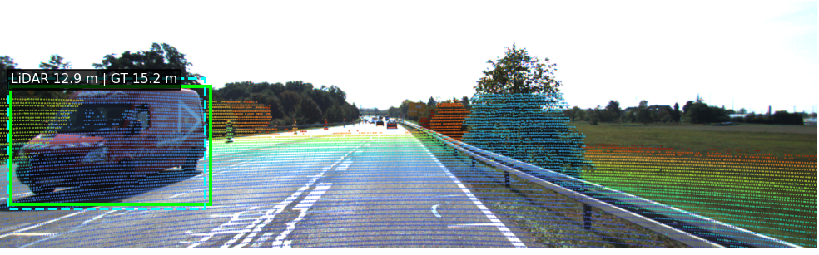
Q3
Q3 Camera–LiDAR fusion in five KITTI frames
14
Projected LiDAR points are overlaid with YOLO boxes and distance estimates
000004 · IoU 0.93 · 40.06 m
000008 · IoU 0.86 · 32.57 m
000019 · IoU 0.92 · 8.91 m
000027 · IoU 0.87 · 12.90 m
Green = YOLO prediction · Cyan dashed = matched KITTI label · Fifth frame (000029, unmatched) on next slide
MAS512 | Assignment 2 | Group 9
Notes:
Here are four of the five frames. LiDAR points are coloured by range using the colour bar, green boxes are YOLO detections and cyan dashed boxes are the KITTI labels. The distance is printed next to each box. The fifth frame is on the next slide.

Slide 15
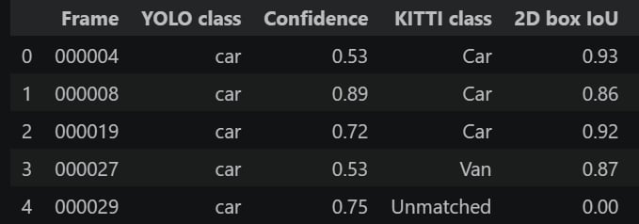
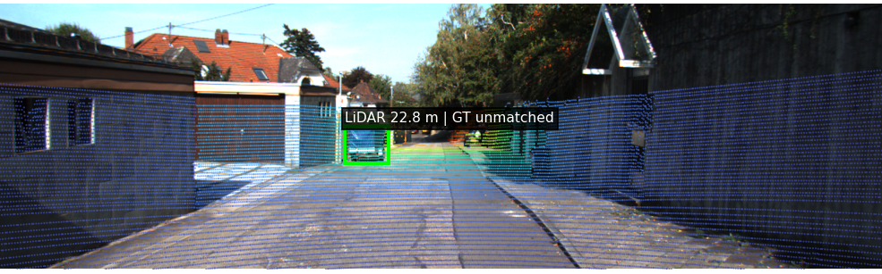
Q3
Q3 Fusion range validation
15
Compare LiDAR-estimated object range to matched KITTI 3D annotations
4 / 5
1.82 m
Matched 2D detections
Matched range MAE
Frame
Box IoU
LiDAR [m]
GT [m]
|Error| [m]
Unmatched example
000004
0.93
40.06
41.67
1.61
000008
0.86
32.57
34.29
1.71
000019
0.92
8.91
10.53
1.62
Frame 000029
000027
0.87
12.90
15.24
2.34
Excluded from error average
000029
0.00
22.77
—
—
LiDAR > Front of the car – Kitti Centre of car.
GT is the 3D box centre.
MAS512 | Assignment 2 | Group 9
Notes:
The range estimate is the 20th percentile of LiDAR distances inside the box. That picks the near surface of the object and ignores background points. Four of five boxes matched a label, with a mean absolute error of 1.82 m. LiDAR is lower than ground truth every time, so this is a systematic bias: LiDAR hits the front of the car, while the KITTI label is the centre of the 3D box, about half a car length further away. Frame 000029 had no matching label, so it is excluded.

Slide 16
Q4
Q4(a) Webots navigation setup
16
A Supervisor controller follows a fixed route and records repeatable friction experiments
Planned waypoint route (XY)
GPS + encoders
1
Estimate position and wheel motion
2
3
Waypoint heading
2
Compute target angle and speed
3
LiDAR obstacle check
Turn if front range < 0.65 m
4
Motor commands
Differential-drive wheel speeds
5
Logging
Start
1
4
Goal
Save all sensors and camera frames
Known 5-waypoint route from (−3.0, 0) to (2.15, 0); camera logged, not used for goal detection.
MAS512 | Assignment 2 | Group 9
Notes:
In Webots we used a Supervisor controller that follows five known waypoints with GPS and orientation. If the LiDAR sees something closer than 0.65 m in front, the robot turns and holds the turn for 1.2 seconds. To be clear: the route is known, and the camera is logged but not used to detect the goal.

Slide 17
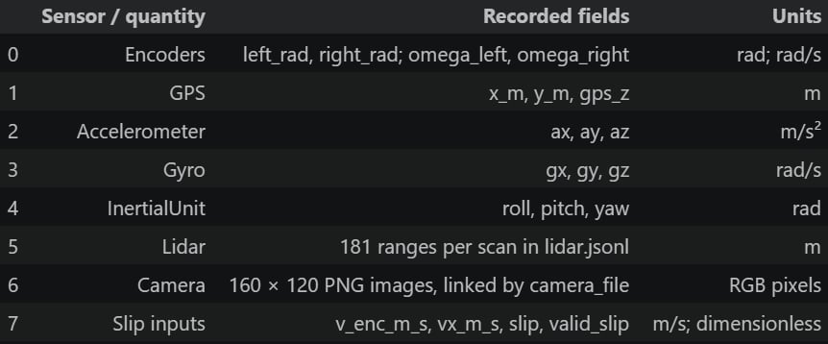
Q4
Q4(a) Slip estimation and experiment logs
17
Longitudinal slip and recorded devices
Sensors sent to .csv
Recorded devices
GPS · accelerometer · gyro · IMU
Left/right encoders · left/right motors
Camera snapshots every 12 steps
LiDAR range array every simulation step
Outputs per friction condition
sensors.csv
lidar.jsonl
camera/
summary.json
GPS XY, distance, wheel speed, slip, IMU
Timestamped LiDAR ranges
Recorded PNG images
Goal reached, time, distance, clearance
MAS512 | Assignment 2 | Group 9
Notes:
Slip is the encoder speed minus the true speed, divided by the true speed. The encoder speed is wheel radius 0.1 m times the mean wheel angular speed. The true speed comes from the Supervisor. We only compute slip when the true speed is at least 0.05 m/s, to avoid dividing by near zero. Every run logs GPS, IMU, encoders, LiDAR and camera images.

Slide 18
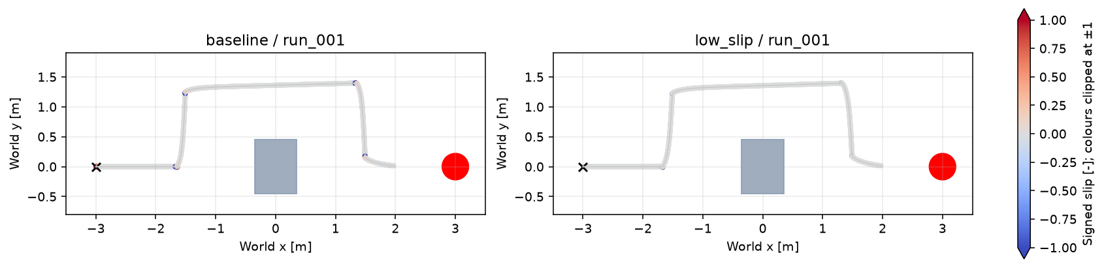
Q4
Q4(b–c) Friction experiment results
18
Higher wheel–floor friction greatly reduces measured longitudinal slip
Key results
Condition summary
3 baseline trials (μ = 0.12) and 3 higher-friction trials (μ = 1.0).
6/6 runs reached the stopping area near the target.
Mean |slip| dropped by 94.8%.
Condition
Mean |slip|
Duration [s]
Distance [m]
Baseline
6.7622%
28.3520
7.248
High friction
0.3515%
27.9093
7.176
94.8% reduction
Trajectory coloured by slip
MAS512 | Assignment 2 | Group 9
Notes:
We ran three trials at friction 0.12 and three at friction 1.0. All six reached the goal. Mean absolute slip dropped from 6.76 percent to 0.35 percent, a 94.8 percent reduction, while time and distance stayed almost the same. The plot colours are clipped at plus or minus 1, so typical slip looks grey; the table shows the real difference.

