Slide 1
ECG Outlier Identifier
Hedi Xia

Slide 2
Task and Problems
Task
Problem
1
Problem
2
Given a person’s ECG lead 2, a sequence of voltage related with heartbeats, we want to identify abnormal heartbeats within the sequence.
Different people have different normal heartbeats, although they do share some similarities.
A person’s normal heartbeats differs in length at a pretty wide range, 60-100 beats/s.

Slide 3
Mathematical Formulation
We identify the problem as a manifold learning problem. The reason we don’t regard it as a classification problem is that abnormalities may not be representative of the true distribution of abnormalities due to regional limitation of samples.
As a manifold learning problem, we want to learn some manifolds where normal heartbeats lies in, so that we may label the data significantly away from manifold as abnormal. This way, we avoid using sample abnormality data as representation of true abnormality data.

Slide 4
Prediction Pipeline
0. Input: a ECG signal of heartbeats (HB)
Slice and stretch for each HB so that they form a matrix (MHB)
Apply pre-trained Model 1 to MHB to get a crude estimate of the “Outlying Index” (OI)
Choose the lowest few heartbeats and train Model 2
Apply Model 2 to MHB to get a estimate of the local OI
Set up a cutoff point based on the number of outliers you want or the level of OI, or just output a stream of positions of significant abnormalities

Slide 5
1. Slicing and Stretching
Currently we are working on lead 2. Slicing is easy because of significant r-wave. Each heartbeat is sliced from the peak of an r-wave to the next peak.
A sample point is activated if it is >.3, an r-wave identifier is activated if there are consecutive 3 activated sample points. The cutoff point is the highest node in a r-wave.
In the future if we are working on other lead, we might need other method to assist slicing, like Wavelet.

Slide 6
1. Slicing and Stretching
Stretching is a somehow loss of information. First, given a heartbeat with arbitrary length >1, we interpolate it to get a function f. The definition scope of the function is [0, len(HB)-1]. We squeeze/stretch the function so that it is defined in [0,319], so the stretched output is the new function at 0,1,…,319.
We can apply same technique to reformat stretched matrix back to the original wave, albeit not exactly the same. Also, if we have labels for each row of the matrix, it can be mapped back to the original sequence of heartbeats

Slide 7
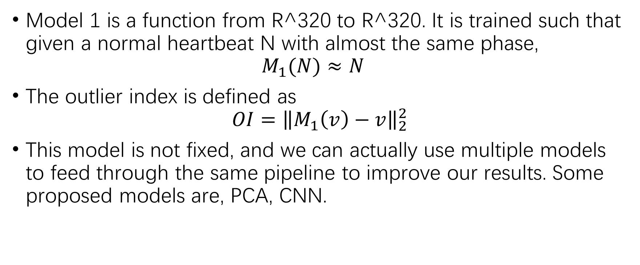
2. Model 1
Model 1 is a function from R^320 to R^320. It is trained such that given a normal heartbeat N with almost the same phase, $M_{1}(N)≈N$
The outlier index is defined as $OI={\left\|M_{1}\left(v\right)−v\right\|}_{2}^{2}$
This model is not fixed, and we can actually use multiple models to feed through the same pipeline to improve our results. Some proposed models are, PCA, CNN.

Slide 8
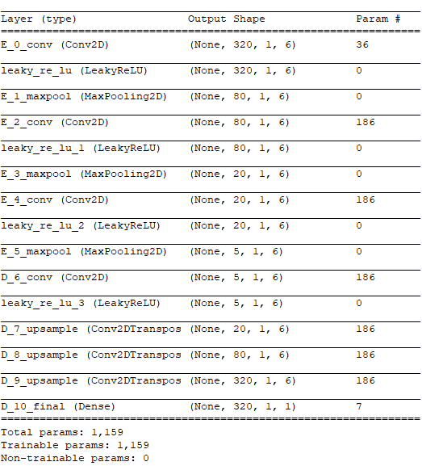
2. Model 1
The right slide is a sample of CNN. The name of these type of network is called an “autoencoder”. Because the layer between E_5_maxpool and D_6_conv is small, it defines a lower dimensional manifold as M(x)=x.
Training this model requires around only 20 data to avoid overfit in practice. It gets better with more data feed into it and it does not have great change after 2000 data. A more complicated model should be built if more data is available.

Slide 9
3. Localization Choice
The amount of data chosen is relative. Depending of different model we use in the next step, we may have different number of data needed.
Temporarily we set is to 100, which is around 2 minutes if the data is mostly normal.
In practice, we may redo the retrain process if we have large enough dataset. For example, after 2 min of outlier monitoring by the doctor, M2 will be the outlier monitoring instead, and maybe after 2 hours we can have more data to retrain M3 for a more accurate model.

Slide 10
4. Model 2
To get model 2, we can train from model 1 by adding in more data if it is constructed as a neural network. Or less preferably, train a model 2 only based on the sampled data.
The amount of training steps has effect on whether it is more globally considered or more locally considered. If it is more globally considered, it will take in more consideration on whether it looks like a normal heartbeat in general. If it is more locally considered, it will take into account more about patient’s normal status.
Retraining process is around 2min/round without GPU support, and average training process for localization is around 2 to 3 rounds. Expected total time with GPU support is below 1 minute.

Slide 11
5. Output
The raw output of model 2 is a positive numerical label for each heartbeat indicating its level of outlier.
We can rank the heartbeats given the level of outliers and output a sequence of heartbeats for doctor to look at, until he/she think its normal enough to stop.
If we know the number of outliers, we can get the heartbeats with the highest few OI.
If we choose a cutoff point, if a heartbeat exceeds the cutoff point we may set the alarm. The cutoff point is dependent on the level of alarm.

Slide 12
More
In practice, with more data coming in, retraining process can be redo. Doing on M1 or M2 might have a different result.
OI can be scaled by its average if needed
We prefer M1 and M2 to be the same structure because it is easier to do the retraining process. For different model structures, we can apply them to the same procedure and the output OI can be defined as the mean of scaled OIs, or weighted mean.

Slide 13
Example:
In the following example, we use MIT-BIH dataset. M1 is trained on 100, 103, 122, and is tested on 109.
The total test MSE is 0.185 for M1, and 0.204 for M2. It differs a little bit because of randomness of Neural Network training.
The following are some images of models fitting the original signal. The x-axis is 3 second window, and y-axis is voltage. The blue line is the original signal, and the orange line is the fitted line. The yellow region is a “identified single heartbeat signal”, and its SOI is marked on the lower-right corner.

Slide 14
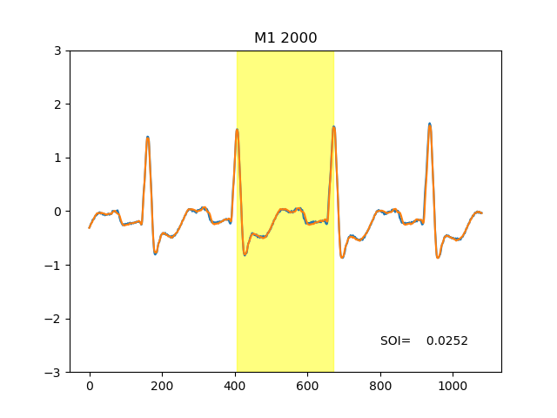

Normal Sample

Slide 15
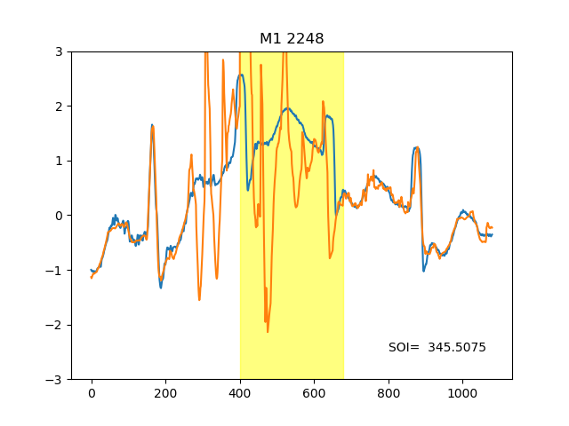
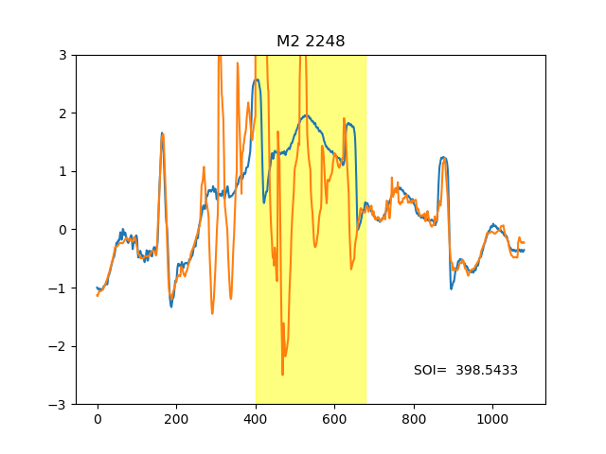
Up-Floating Data

Slide 16
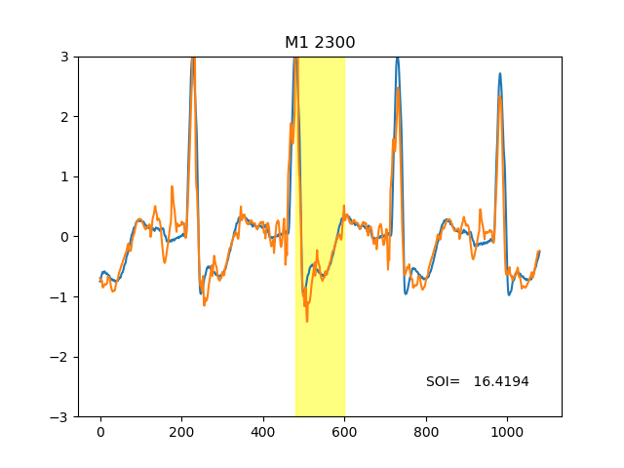
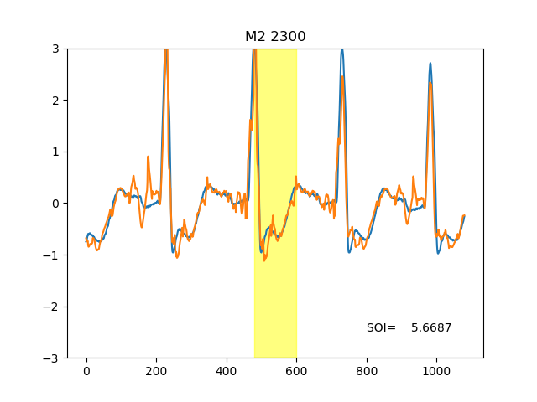
Significant T-wave (Slicing Problem)

Slide 17
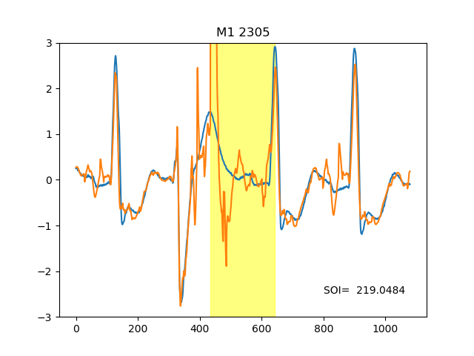
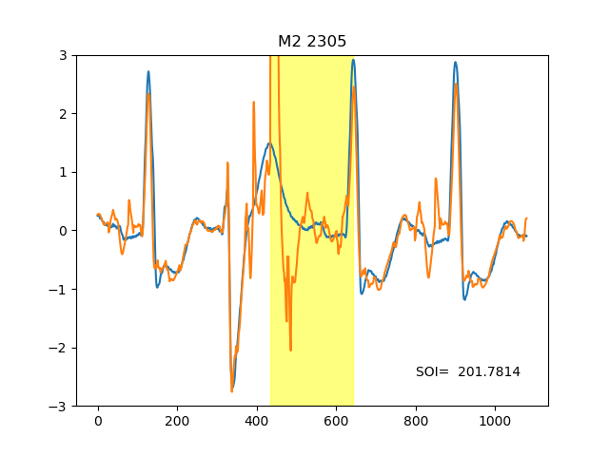
PVC

Slide 18
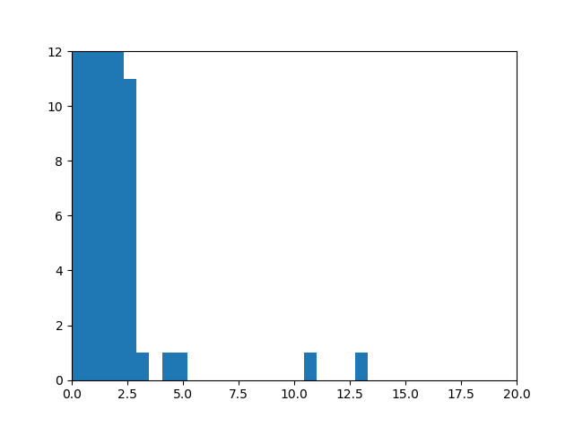
M2 SOI Distribution
There are much more occurrence near 0, for visibility this plot only shows up to 12.
This plot shows that obviously >10 are outliers. They are classified as not normal. The outliers >20 are not shown in image.

Slide 19
Limitation and Future Plan
Limitation | Plan
Wrong slicing due to significant T-wave | Improve Slicing Methods, use wavelet transform to increase r-wave significance
Does not directly indicate the issue of disease | This method does not cluster abnormality, but it can filter out normal heartbeats to increase efficiency of clustering methods.
Does not consider outside intervention of force | These effects can be stabilized if we add a linear/quadratic component to the approximation. But because of lack of data and interest, we may not proceed with this aspect.

