Slide 1
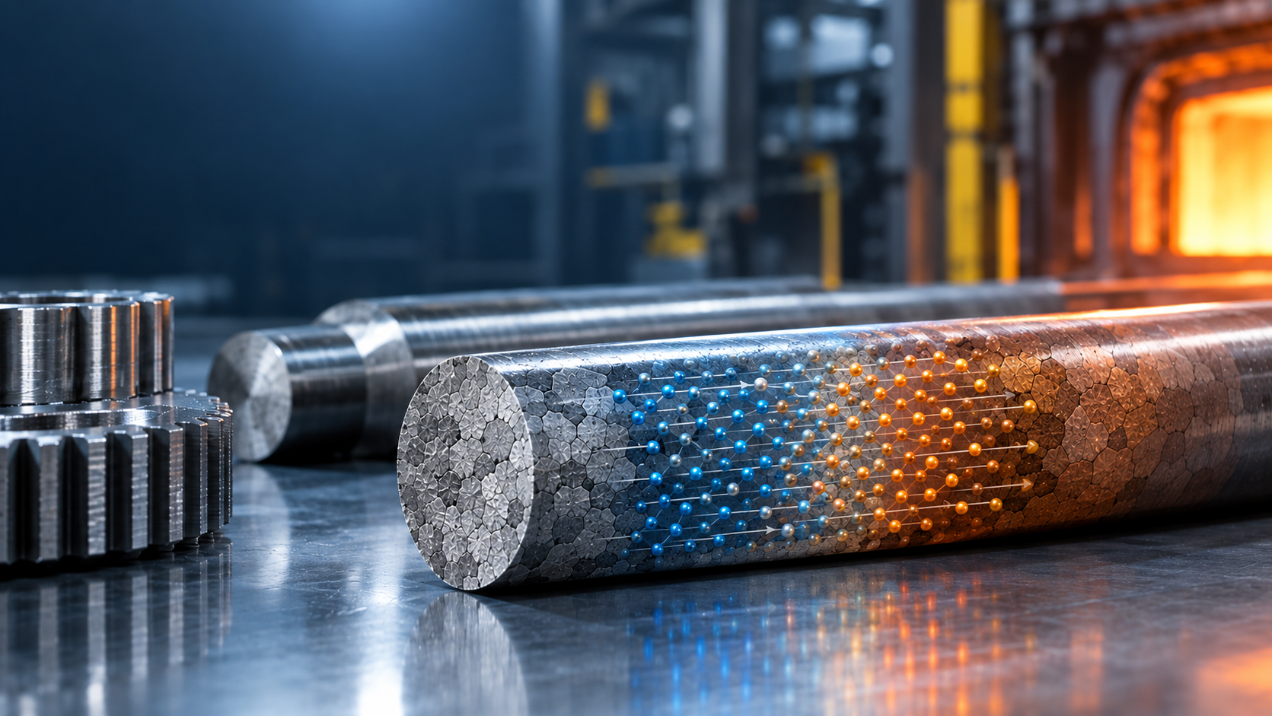
Project 1: Diffusion in diffusion couples
Isak Vooren, Vegard Stangnes, and Hedda Kjeldsen
Notes:
AI bilde hehe, Vi kan droppe dette hvis det er teit.

Slide 2

Part 1: Self-diffusion of tracer atoms
$$D_{0}\left(T\right)=D_{0}\exp\left(−\frac{Q}{RT}\right)$$
$$D_{Cu}\left(T\right)=1.87⋅{10}^{−13} m^{2}/s$$
$$D_{Ni}\left(T\right)=6.35⋅{10}^{−16}m^{2}/s$$
Diffusion couples
  Cu/Cu*
  Ni/Ni*
T = 1000 °C
Total time = 30 hr
B (C2)
A (C1)
< -2 mm ->
Notes:
Comment on the bars being semi-infinite

Slide 3
i) Derivation

Slide 4
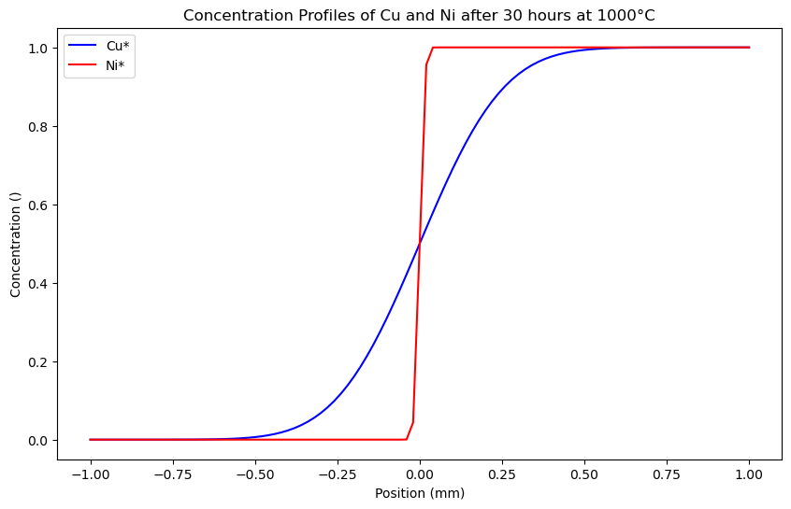

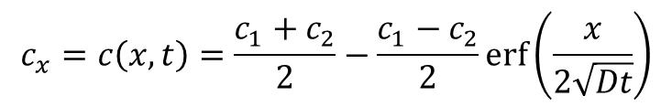
ii) Analytical solution
$$c_{x}=c\left(x,t\right)=\frac{c_{1}+c_{2}}{2}−\frac{c_{1}−c_{2}}{2}\operatorname{erf}\left(\frac{x}{2\sqrt{Dt}}\right)$$
Initial conditions at
C(x, t=0)=1 for x>1
C(x,t=0) =0 for <x
$$D_{Cu}\left(T\right)=1.87⋅{10}^{−13}$$
$$D_{Ni}\left(T\right)=6.35⋅{10}^{−16}$$

Slide 5
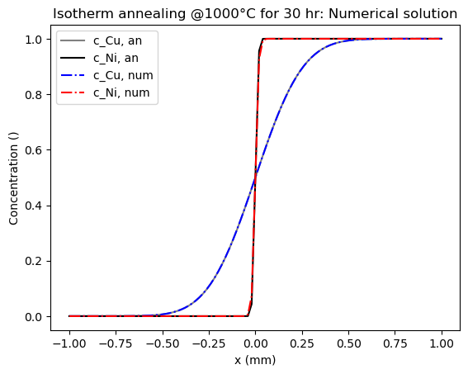
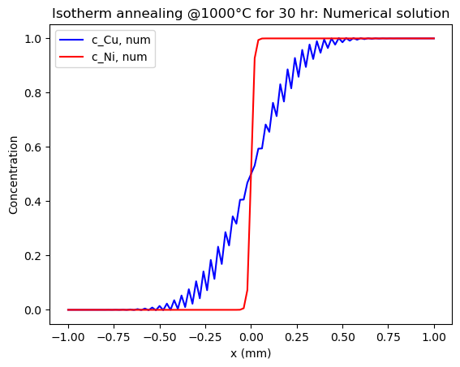
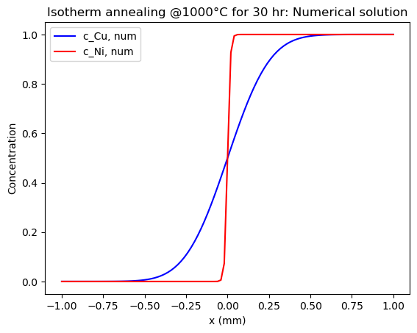

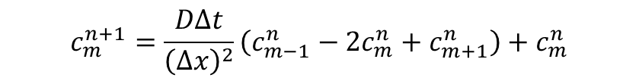
iii) Numerical Solution: FDM Explicit
$$c_{m}^{n+1}=\frac{DΔt}{{\left(Δx\right)}^{2}}\left(c_{m−1}^{n}−2c_{m}^{n}+c_{m+1}^{n}\right)+c_{m}^{n}$$
Grid
  Δx=0.02 mm
  Δt=600 s
    Way below stbility condition of
    $$Δt≤\frac{{\left(Δx\right)}^{2}}{2D}$$
Boundary conditions
  Dirichlet,
    Diffusion lengths small compared to bar length
    $X_{Cu}=\sqrt{\left(1.8⋅{10}^{−13}⋅30⋅3600\right)}=0.14 mm$
    $X_{Ni}=\sqrt{\left(6.35⋅{10}^{−16}⋅30⋅3600\right)}=8.3 µm$
Notes:
Three point FDM scheme
Short diffusion lengths
If longer annealing time use Neuman (calculate the time) might touch onto it later?
Upper bound for delta t is ca 1063 -> tested delta t=1090 and we start to se the unstability for the copper plot

Slide 6
iii) Implicit
Why do this and not stick with explicit?
  Higher T gives higher D which require higher time resolution
  Implicit is unconditionally stable
Why not do this and stick with explicit?
  Explicit is faster for shorter time steps
  Even though stability is guaranteed, accuracy is not
Notes:
Why implisitt? Unconditionally stable
Stability and accuracy

Slide 7
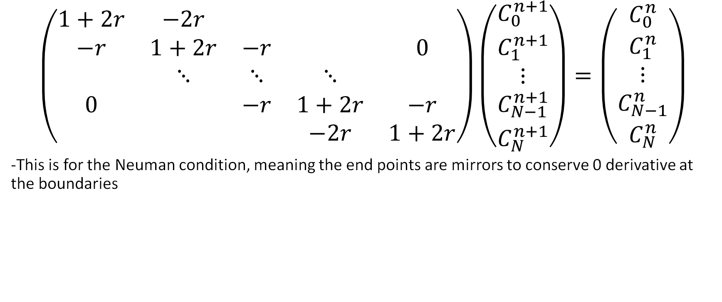
Method of solution for implicit
$$\left(\begin{matrix}1+2r & −2r & & & \\ −r & 1+2r & −r & & 0 \\ & ⋱ & ⋱ & ⋱ & \\ 0 & & −r & 1+2r & −r \\ & & & −2r & 1+2r\end{matrix}\right)\left(\begin{matrix}C_{0}^{n+1} \\ C_{1}^{n+1} \\ ⋮ \\ C_{N−1}^{n+1} \\ C_{N}^{n+1}\end{matrix}\right)=\left(\begin{matrix}C_{0}^{n} \\ C_{1}^{n} \\ ⋮ \\ C_{N−1}^{n} \\ C_{N}^{n}\end{matrix}\right)$$
-This is for the Neuman condition, meaning the end points are mirrors to conserve 0 derivative at the boundaries
Notes:
Comparison of results with

Slide 8
Results for implicit solution
25 time steps gave MSE of ~10**-5

Slide 9
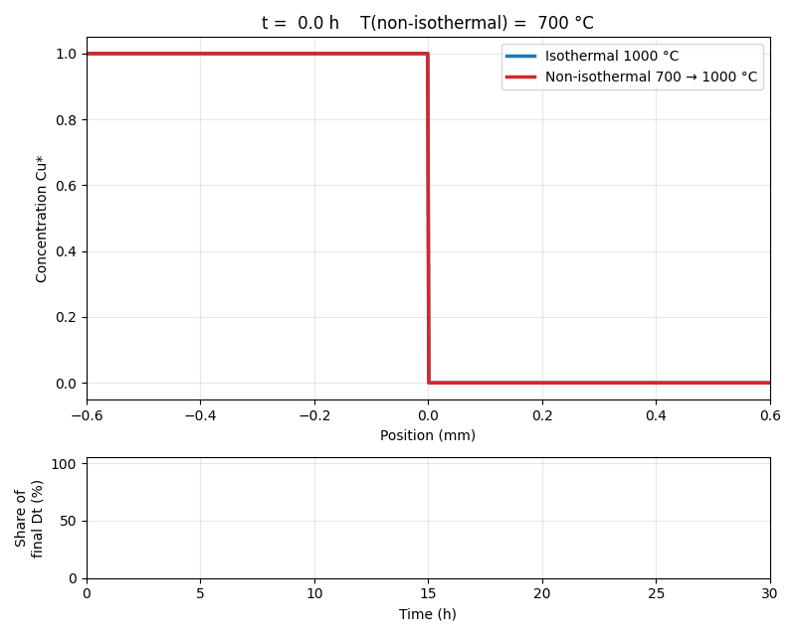
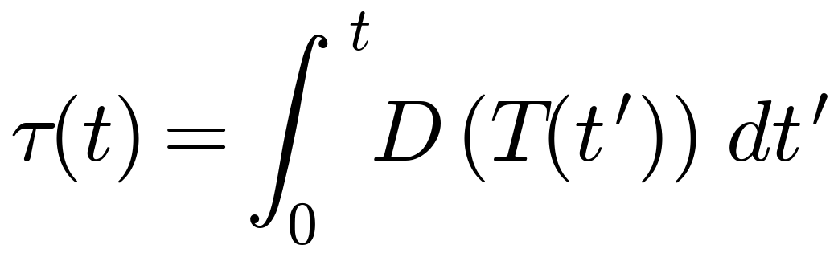
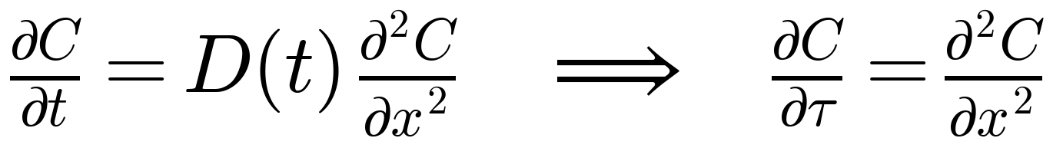
iv) Non-isothermal annealing: Dt → τ
Accumulated diffusion
Units m², same as Dt.
Isothermal: τ = Dt
Change of variable dτ = D(t) dt
T has dropped out → same solution as isothermal, with Dt replaced by τ.
20 %
83 %
τ relative to isothermal Dt
of τ is gained in the last 10 h
Valid only because D = D(t) is the same everywhere in the bar. Not in Part 2, where D̃ = D̃(X(x)).
Cu* in Cu, 30 h. Analytical solution with Dt → τ(t). Plays in slideshow.
Notes:
When T rises, D changes with time, so D·t no longer makes sense. We define tau as the integral of D over time. Since d(tau) = D(t) dt, the chain rule turns Fick's 2nd law into dC/dtau = d2C/dx2: D cancels and temperature disappears. Initial and boundary conditions are unchanged (tau = 0 at t = 0), so the isothermal solution holds with Dt replaced by tau. D grows exponentially with T, so most of the diffusion happens at the end: 83 % of tau comes in the last 10 hours, 57 % in the last 5. tau is only 20 % of the isothermal Dt, so the diffusion distance 2*sqrt(tau) is 0.13 mm instead of 0.28 mm. Equivalent to 30 h isothermal at about 900 C. The trick requires D to be independent of x. In Part 2 D-tilde depends on composition, so we must solve numerically.

Slide 10
Monte Carlo

Slide 11
Part 2: Interdiffusion (Kirkendall effect)
Diffusion couple
  Cu/Ni
D is composition dependent
Ni
Cu
< -2 mm ->

Slide 12
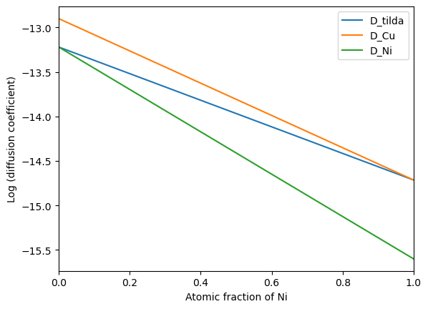
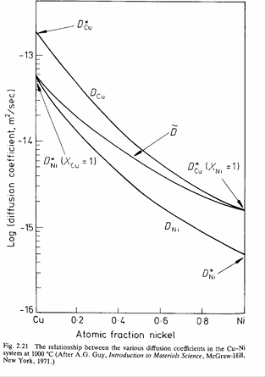

i) D vs composition
D̃ $=D_{Cu}X_{Ni}+D_{Ni}(1−X_{Ni})$
Notes:
Linear interpolation between endpoints

Slide 13
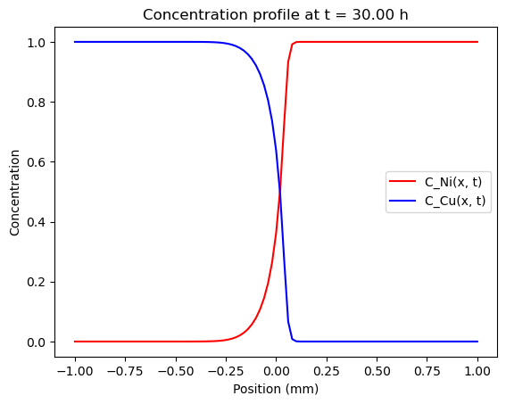
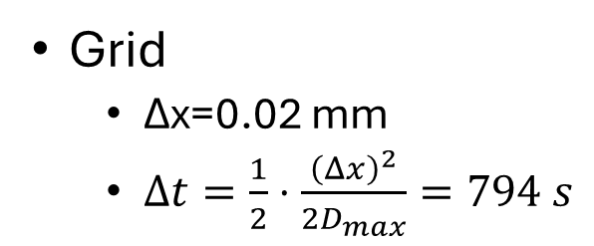
ii) Concentration profile: FDM explicit
$$c_{m}^{n+1}=\frac{{\text{D̃}}_{m−0.5}Δt}{{\left(Δx\right)}^{2}}\left({ (c}_{m+1}^{n}−c_{m}^{n})−{(c}_{m}^{n}−c_{m−1}^{n}\right)+c_{m}^{n}$$
Grid
  Δx=0.02 mm
  $Δt=\frac{1}{2}⋅\frac{{\left(Δx\right)}^{2}}{{2D}_{max}}=794 s$

Slide 14

ii) Concentration profile: FDM implicit
Implemented implicit and semi-implicit
Implicit part is done by Picard iterations
-Guessing $D_{i}^{n+1} = D_{i}^{n}$
-Iterating the resulting matrix until tolerance is low

Slide 15
iii) Implicit results
For 10 time steps and 100 spacial steps over 312 hours:
Method | MSE
Semi-implicit (previous D) | ~10**-1
Picard iteration (new D) | ~10**-5

Slide 16
iii)
Flux of different spicies

Slide 17
iv)

