Slide 1
Asteroids
Presented by Asteroids

Slide 2
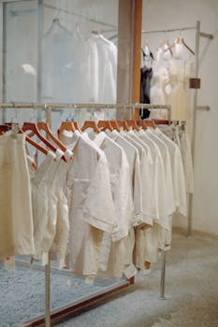
Asteroid Basics
Content:
- What are asteroids?
- Where are asteroids located
- Are all asteroids the same?
Keyword: Asteroid Definition

Slide 3

Asteroid Composition
Content:
- What are asteroids made of?
- Different types of asteroids
- Asteroid classification
Keyword: Asteroid Types

Slide 4
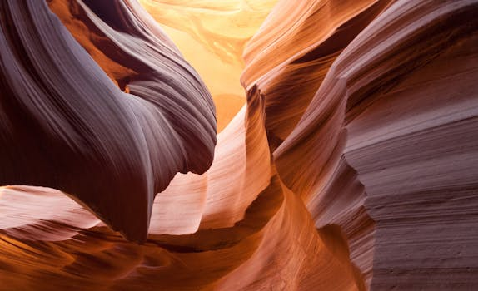
Asteroid Formation
Content:
- How were asteroids formed?
- The role of the solar nebula
- Asteroid accretion
Keyword: Asteroid Formation

Slide 5
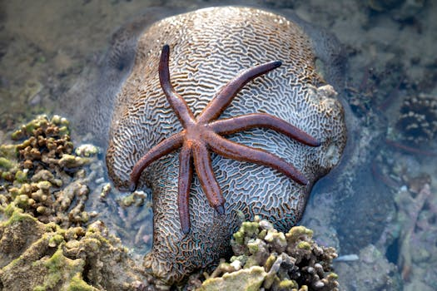
Asteroid Impacts
Content:
- The dangers of asteroid impacts
- Famous asteroid impacts
- Asteroid impact prevention
Keyword: Asteroid Impact

Slide 6
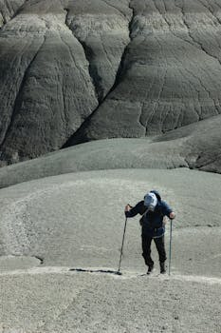
Asteroid Exploration
Content:
- Why explore asteroids?
- Asteroid mining
- The future of asteroid exploration
Keyword: Asteroid Exploration

Slide 7
Credits
Images provided by Pexels: https://www.pexels.com

