Slide 1
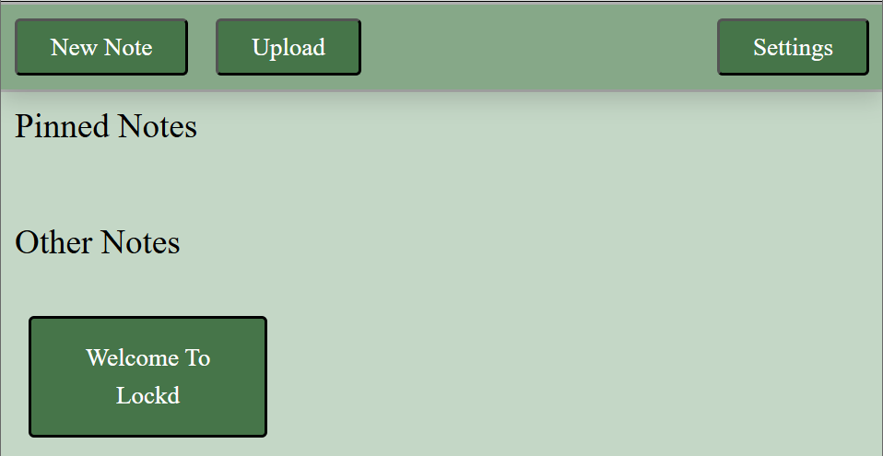
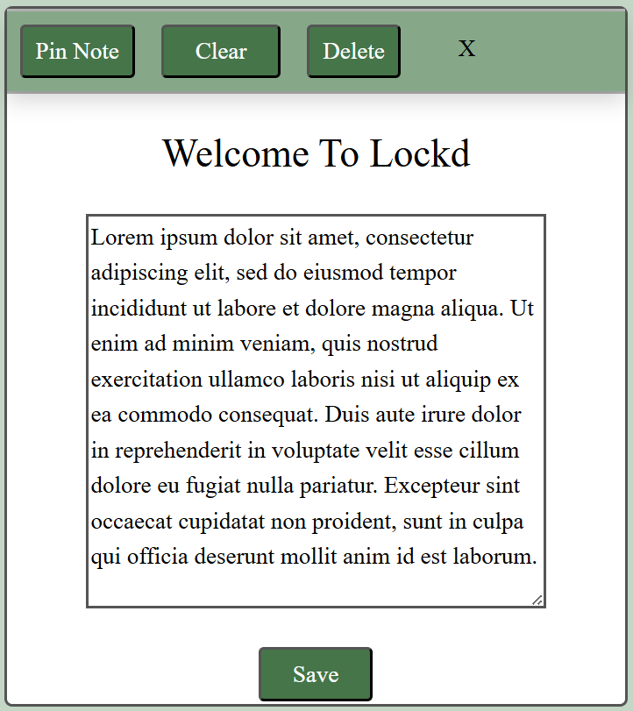
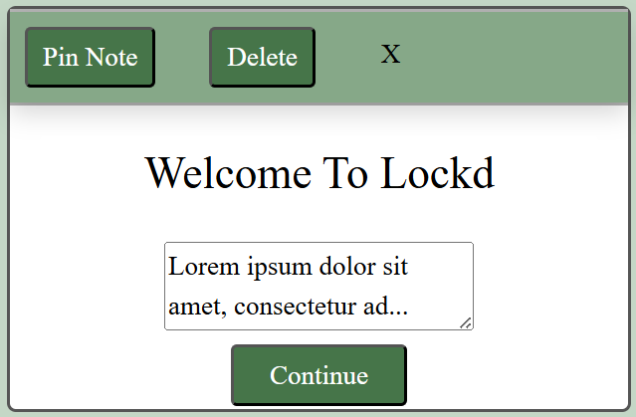
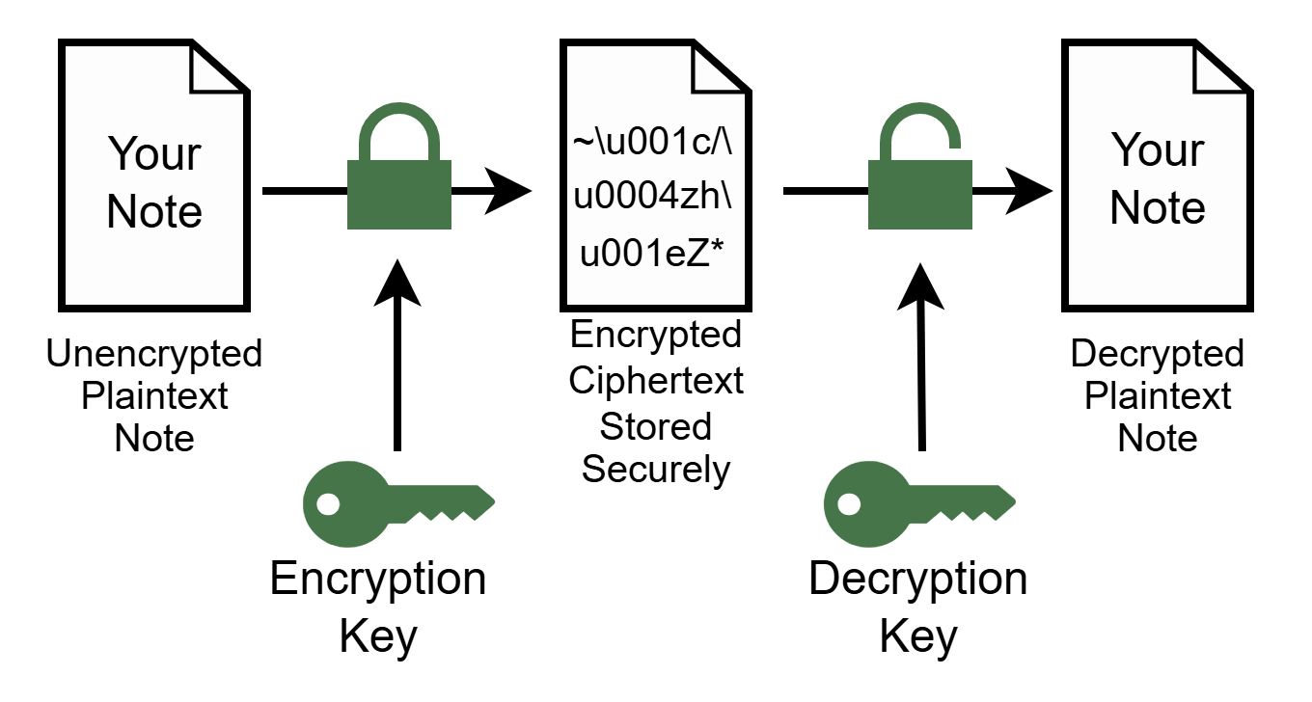

LOCKD
A Secure Notes Website
Background
As cyber attacks become more common, people are wanting a more secure way to store data
Most notes websites skip encryption and don’t allow local storage of data
LOCKD will fill the market gap by implementing both these ideas
This will ensure users data is always kept secure from hackers, which is rare in today’s world
Design
LOCKD uses bootstrap to implement the front end
Bootstrap allows the website to be scalable with screen size
Language tags, relevant element IDs and the ability to change font size all increase accessibility
Buttons are clearly labelled to increase usability
Light and Dark themes allow users to customise the website
Available in English and Swedish allowing a wider range of users
Upload button allows users to upload compatible encrypted files to the website
Users can pin notes, so they always appear at the top and are easier to find
Sign up page to easily allow users to create a new account
Home Page
Preview Page
Full Note Page
Security
Staggered note data released to increase protection from shoulder surfing
Note title displayed on home page
Preview page with 42 characters displayed
Note page displaying the whole note
All passwords salted and hashed to secure from hackers
All notes encrypted before storing, ensuring only the verified user can read them
Notes can be downloaded and deleted from our storage to ensure further security
Automatic log out when tab is shut, ensuring only the user has access to their account
Heidi Ginnaw
BSc (Hons) Computer Science (Cyber Security)
University of Plymouth
heidi.ginnaw@students.plymouth.ac.uk

