Slide 1
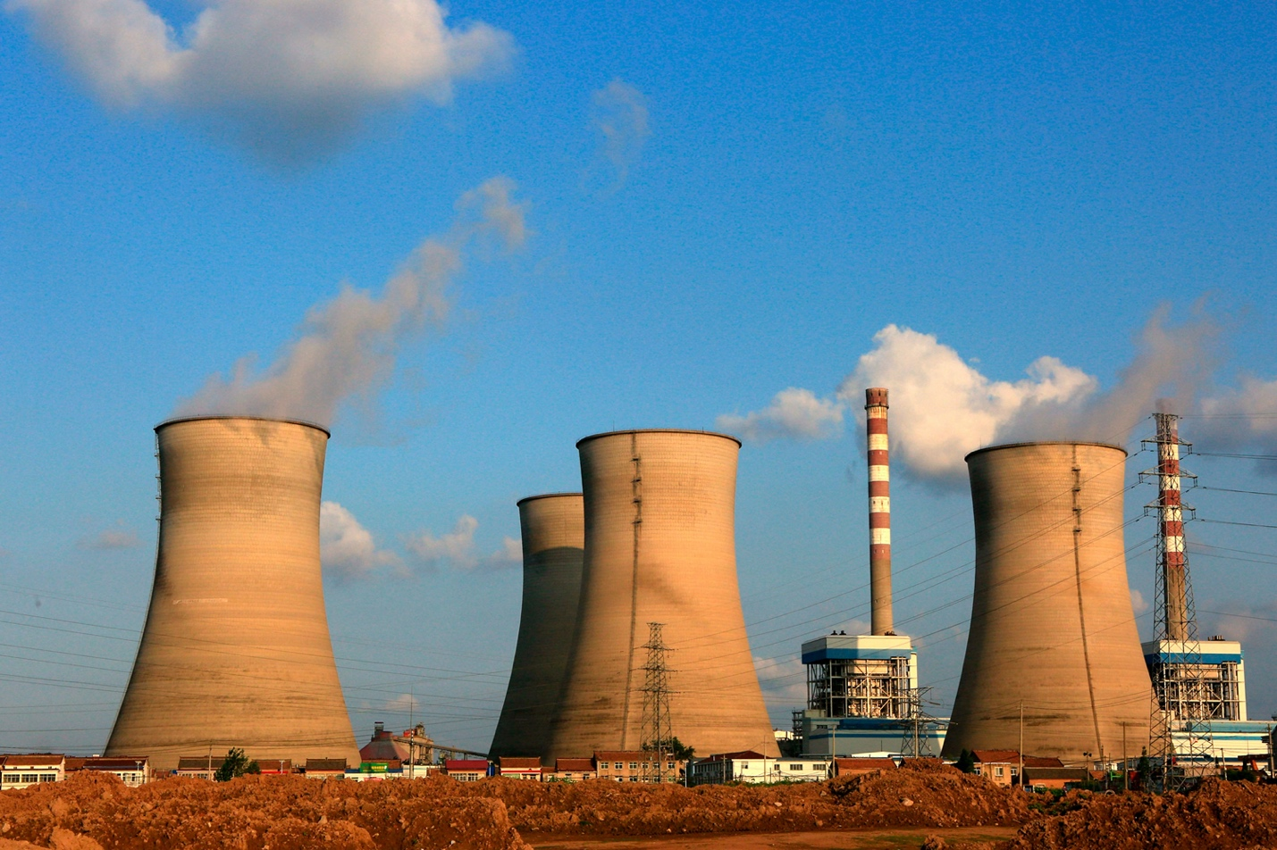

Output of Plant Energy
Hedyeh Erfani

Slide 2
Abstract
When we think of the things that keep our country running, we might quickly start thinking of things such as money. While this is important and essential, one thing that I feel is a driving force is power plants. Going to the core of what is needed for day-to-day operations, power plants help ensure that everything we have works. Without them, none of our infrastructure, technology, or way of life could exist. Power plants are also a driving force behind our agriculture (food) as well. So, for this project, I’ve decided to go ahead and look at creating a model that can accurately predict power plant output.

Slide 3
Data
The dataset contains 9568 data points collected from a Combined Cycle Power Plant over 6 years (2006-2011), when the power plant was set to work with full load. Features consist of hourly average ambient variables Temperature (T), Ambient Pressure (AP), Relative Humidity (RH) and Exhaust Vacuum (V) to predict the net hourly electrical energy output (EP) of the plant. These features were set to the following listed below:
- Temperature (T) in the range 1.81°C and 37.11°C, - Ambient Pressure (AP) in the range 992.89-1033.30 milibar, - Relative Humidity (RH) in the range 25.56% to 100.16% - Exhaust Vacuum (V) in teh range 25.36-81.56 cm Hg - Net hourly electrical energy output (EP) 420.26-495.76 MW
These measurements were averages that were taken by sensors. The sensors picked up on the measurements every second.

Slide 4
Walkthrough
A correlation test showed that there was a high correlation between AT and PE (EP). I performed a linear regression and decision tree regression to test this correlation.

Slide 5
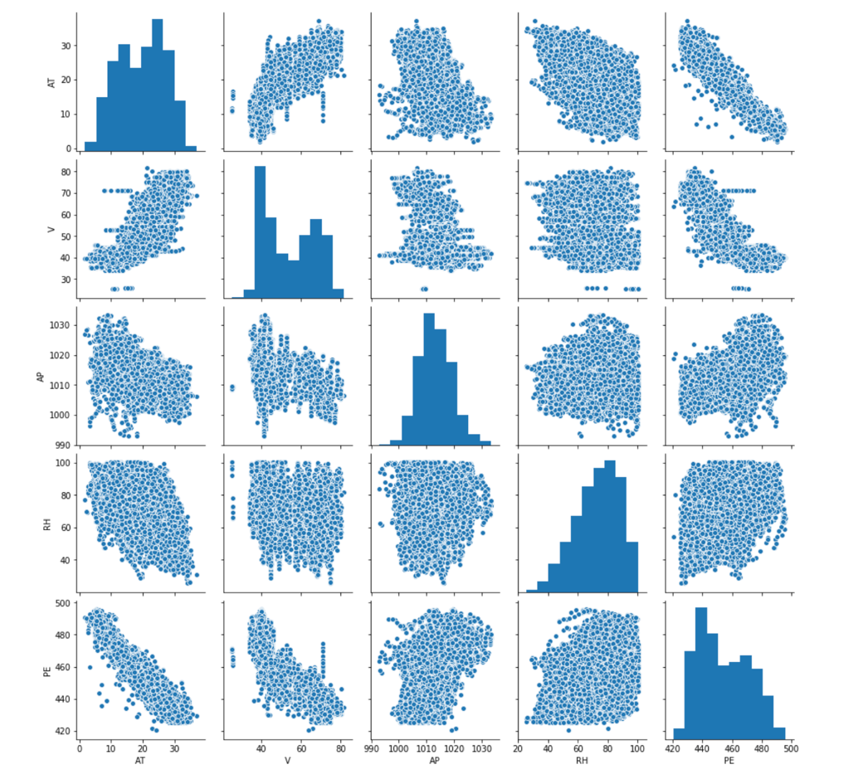
Results

