Slide 1

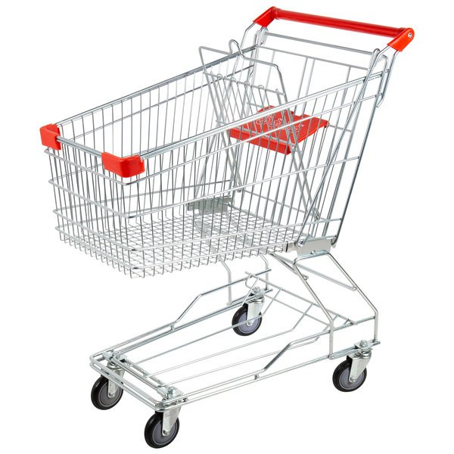

Online Shopping Analytics
Hedyeh Erfani

Slide 2
Abstract
The retail space has been changing for quite some time. We’ve seen a shift from in person shopping to online shopping. This trend has increased as COVID started impacting business operations. More and more people have started shifting towards online retail. While in this project I will not be analyzing current online retail trends, I’ll be looking at online retail in general to learn more about online purchases.

Slide 3
Data
The dataset contains data which was collected between 2009 and 2011. It contains data points which reflect the purchases for an online store in the United Kingdom. Below are the attributes of the dataset
InvoiceNo: Invoice number. Nominal. A 6-digit integral number uniquely assigned to each transaction. If this code starts with the letter 'c', it indicates a cancellation. StockCode: Product (item) code. Nominal. A 5-digit integral number uniquely assigned to each distinct product. Description: Product (item) name. Nominal. Quantity: The quantities of each product (item) per transaction. Numeric. InvoiceDate: Invice date and time. Numeric. The day and time when a transaction was generated. UnitPrice: Unit price. Numeric. Product price per unit in sterling (Â£). CustomerID: Customer number. Nominal. A 5-digit integral number uniquely assigned to each customer. Country: Country name. Nominal. The name of the country where a customer resides.
These measurements were recorded by the owner of the store. There are over 1M rows of data in this dataset with giftware being the main item sold

Slide 4
Walkthrough

Slide 5
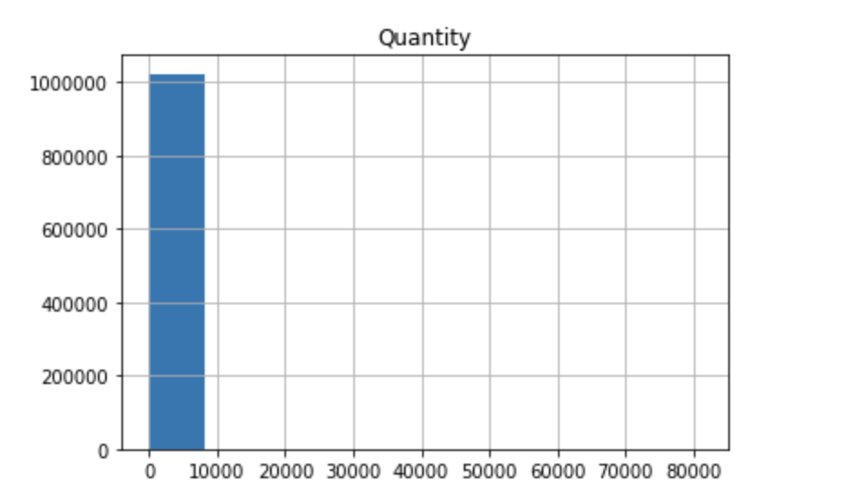
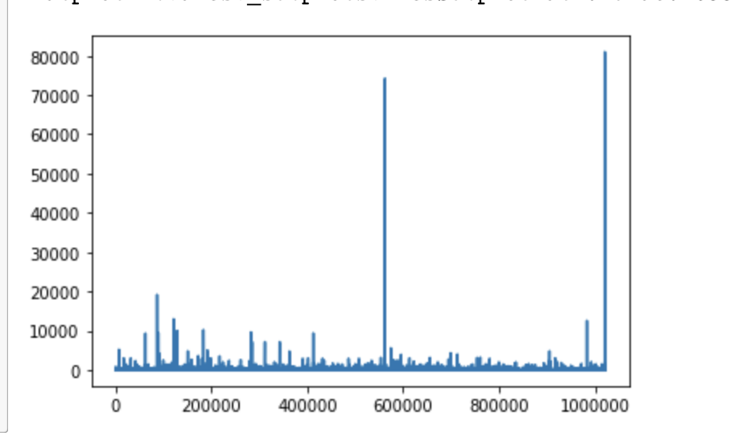
Results

Slide 6
Conclusion

