Slide 1
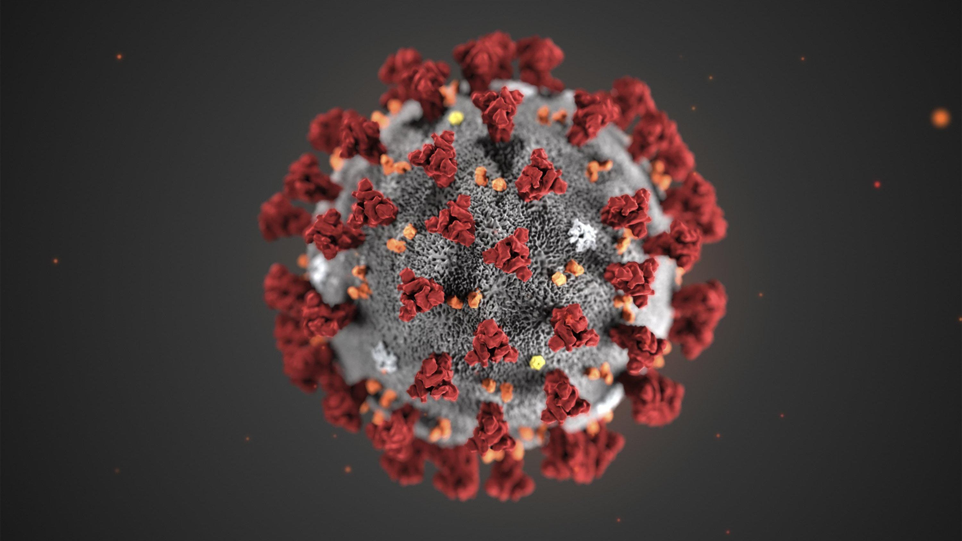

Race and COVID
Hedyeh Erfani

Slide 2
Abstract
COVID has been changing lives globally. It’s important for us to look at whether factors, such as race, play into the potential for an individual to get the illness.

Slide 3
Data

Slide 4
Walkthrough

Slide 5
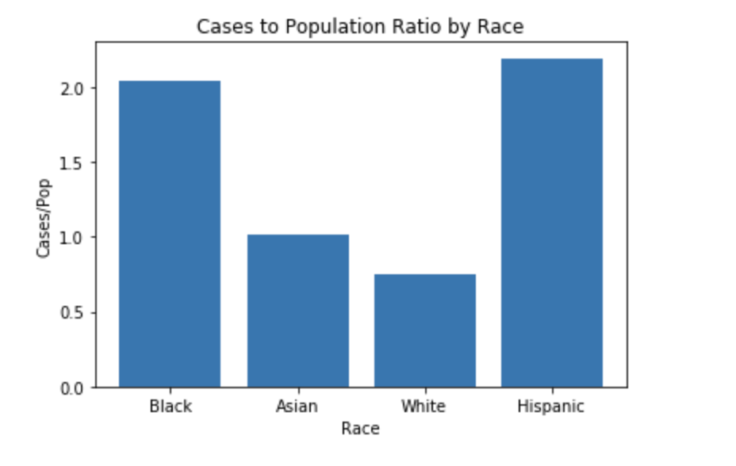
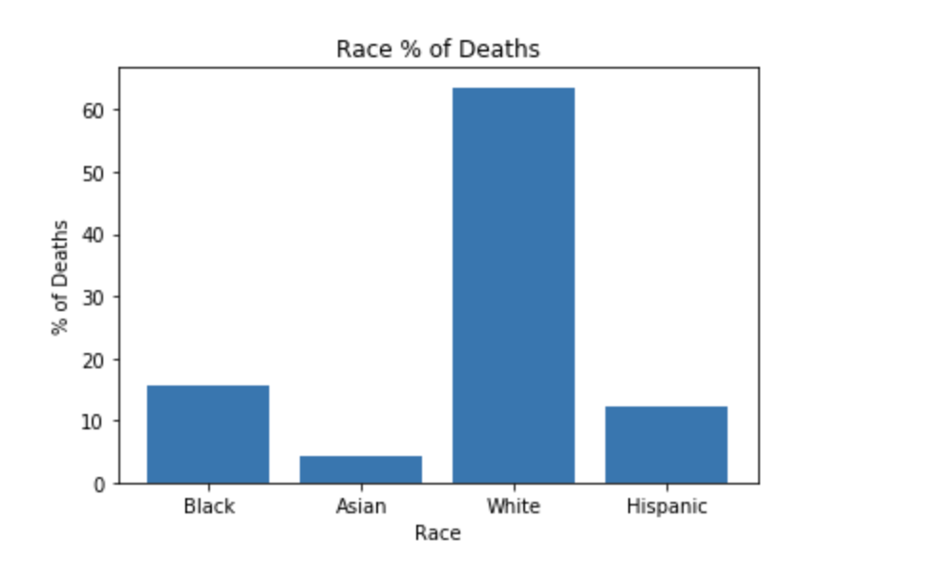
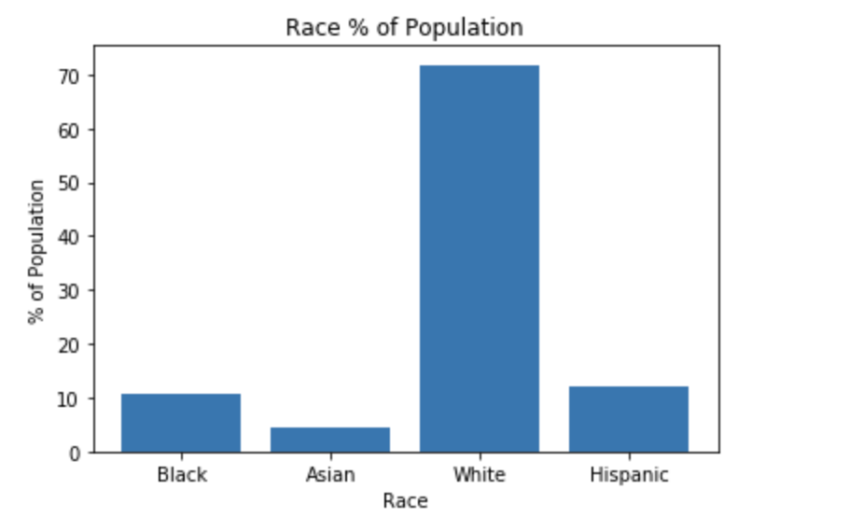
Results

Slide 6
Conclusion

