Slide 1


SSVEP manual

Slide 2
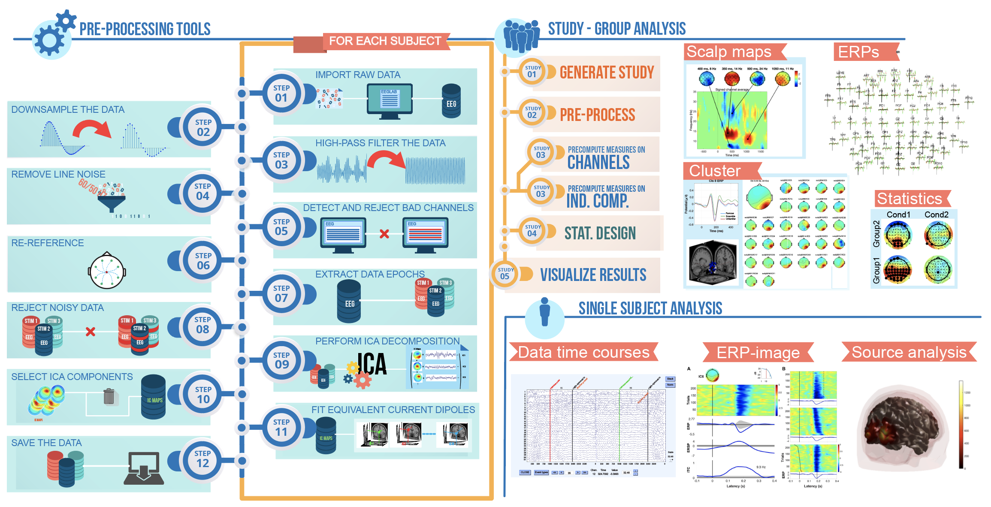
EEGLAB
EEGLAB
관련 링크: https://eeglab.org/
EEGLAB 이란?
MATLAB 기반의 오픈소스 EEG 분석 툴박스
EEG 데이터를 전처리(preprocessing)·시각화·통계/시간-주파수 분석·ICA 기반 아티팩트 제거를 위해 주로 사용

Slide 3
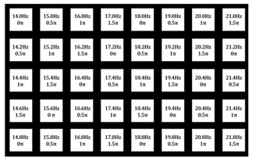
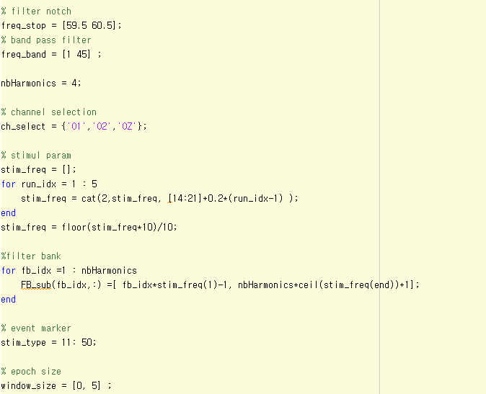
Data structure
Data
File format: gdf
EEG.data: channels(40) ⨯ timepoints(N)
1~32(EEG), 33~34(mastoids)
Device: Biosemi active two
Stimuli param.: 14~21.8Hz, 0.5π phase diff
Event marker: 11~50
Preproc param.
Filter: bps(1-45Hz), notch(59 – 61Hz)
Channel selection: O1, O2, Oz
Epoching: 0~5 sec

Slide 4
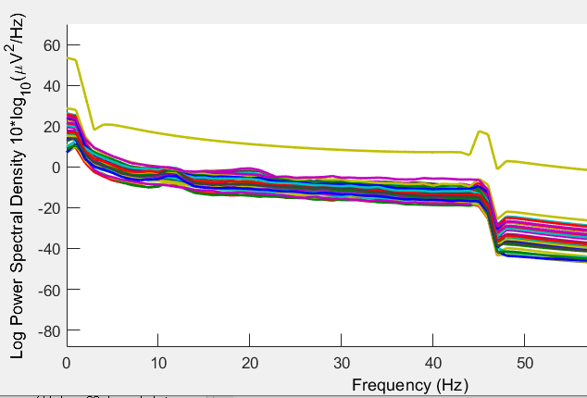
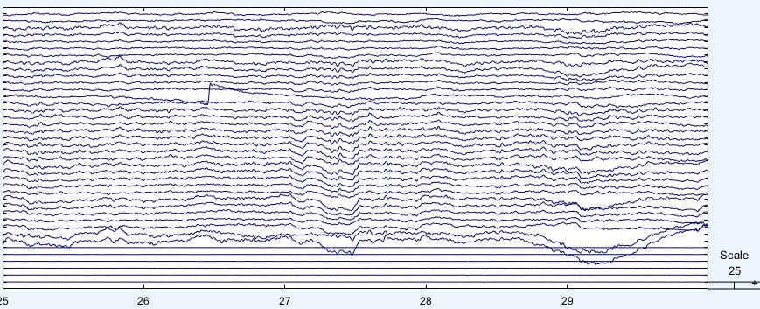
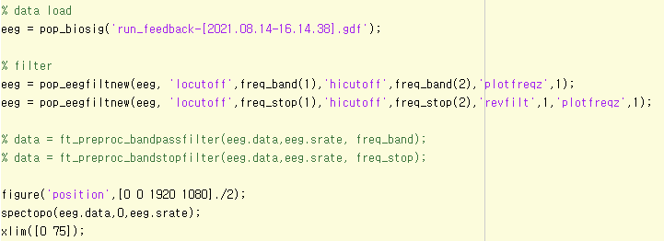
Preproc.
Data load
File format: gdf → pop_biosig
Filter
Band pass filter: 1-45Hz
Band stop filter: 59-61Hz (notch filter)
Plot
spectopo: frequecny domain
eegplot: time domain
freq_band: [1 45]
freq_stop: [59 61]

Slide 5
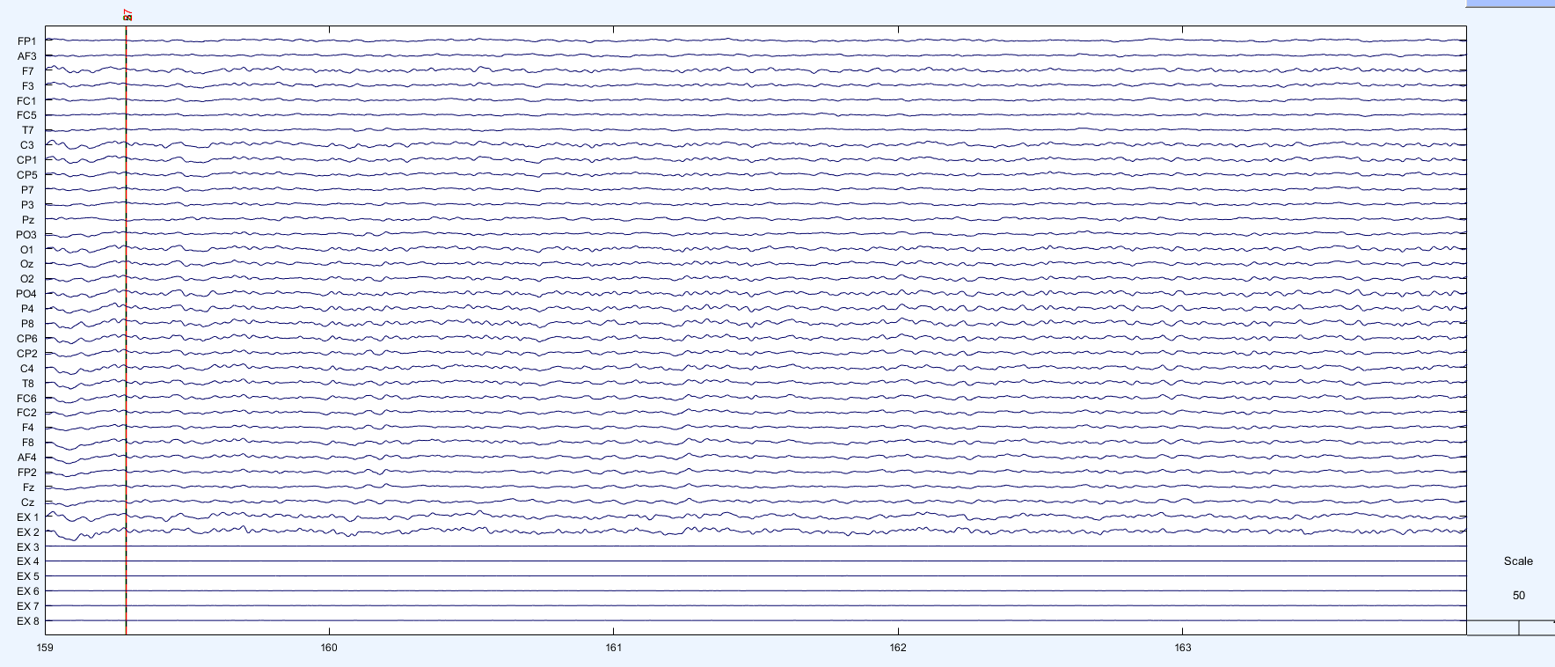
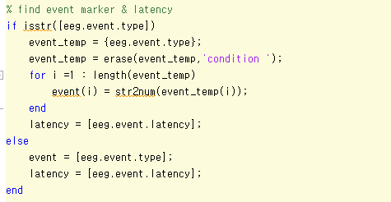
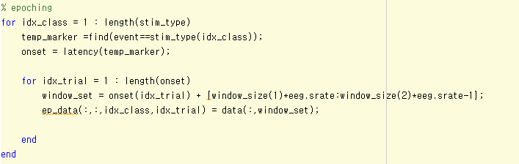
Preproc
Marker: 27
Epoching
Event marker: 11~50
Epoching: 0~5 sec
N sec
Event marker: 11:50
Event timestemp
Epoch
window_size: [0 5]
Ch
ch ⨯ time ⨯ class ⨯ trial
N sec

Slide 6
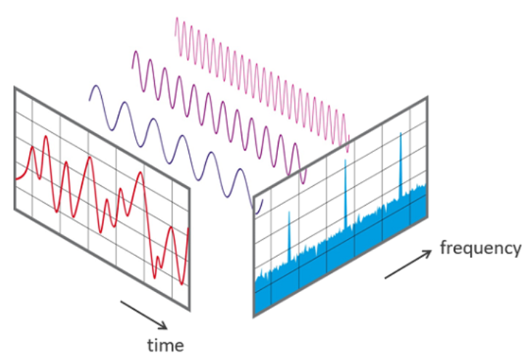
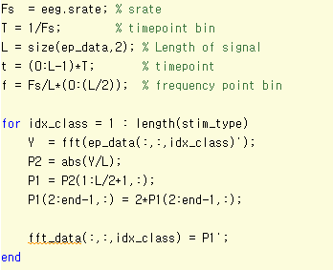
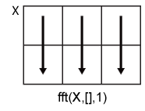
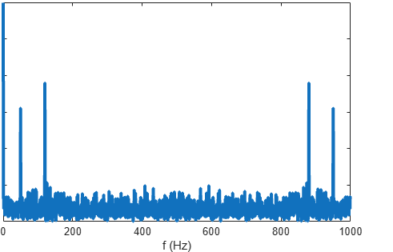
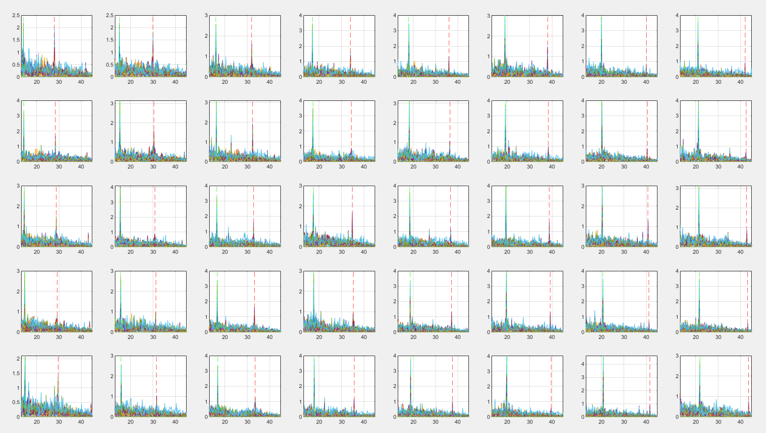
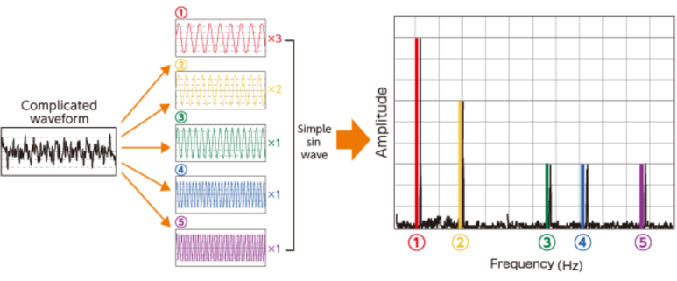
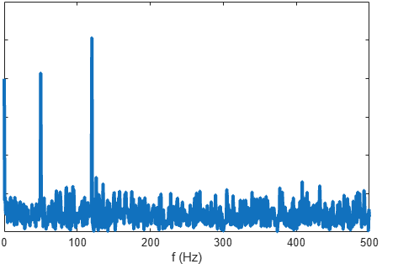
Fourier trasnform
Fs | sampling rate | 1024Hz
T | Timepoint bin | 1/1024
L | Singal length | Epoch size (5sec*srate)
t | timepoints | Vector(0~5sec)
f | Freq. point bin | Vector(0~512Hz)
FFT
Time to Frequency
Operating Column vector
Dividing L
Double to single sided spectrum
Double sided spectrum
Single sided spectrum
magnitude
freq

Slide 7
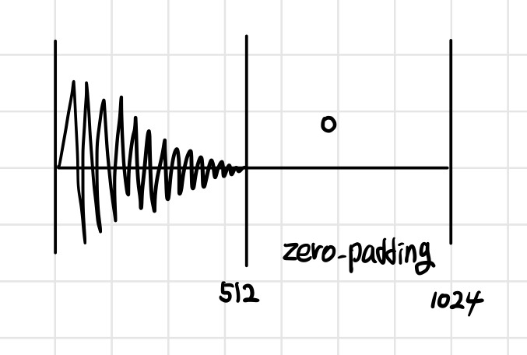
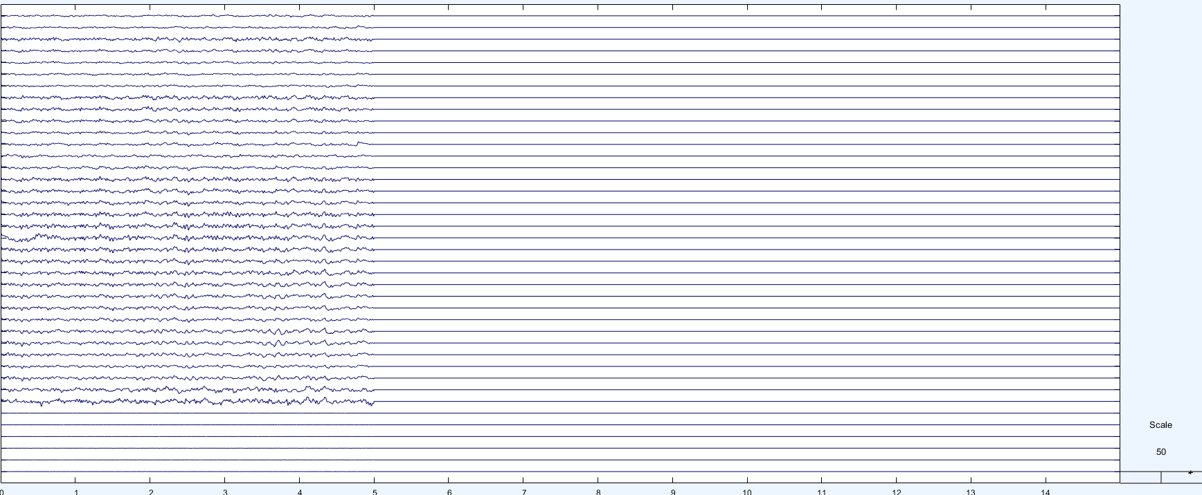
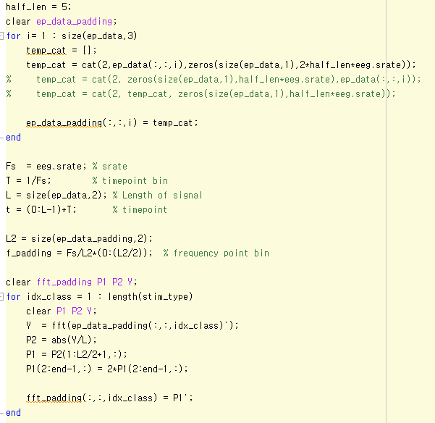
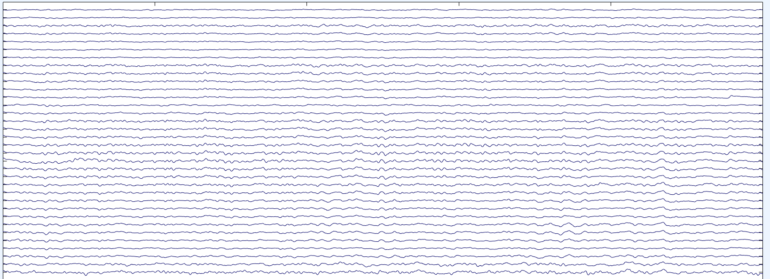
Fourier trasnform
ep_data_padding
Padding
3 sec of time series → 1/3Hz freq. bin
High resolution ← increase length of time series
5*srate → 15*srate
ep_data

Slide 8
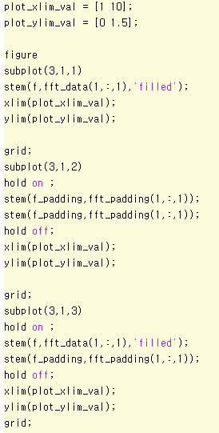
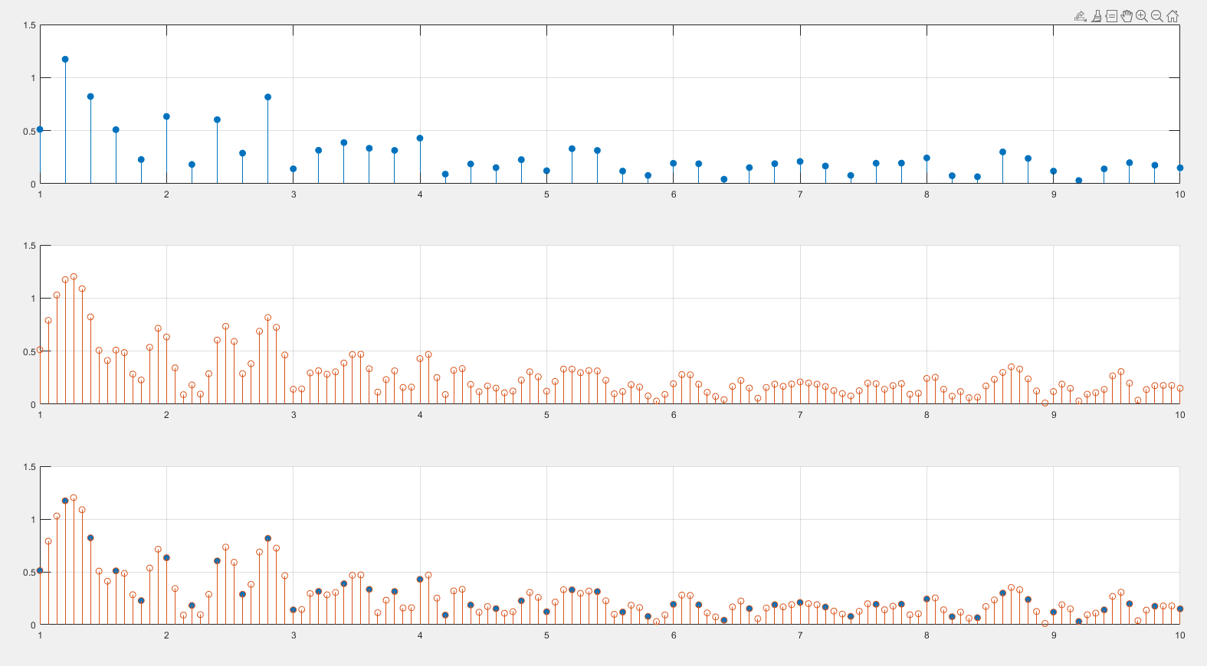
Fourier trasnform
Padding
3 sec of time series → 1/3Hz freq. bin
High resolution ← increase length of time series
origin
padding

Slide 9
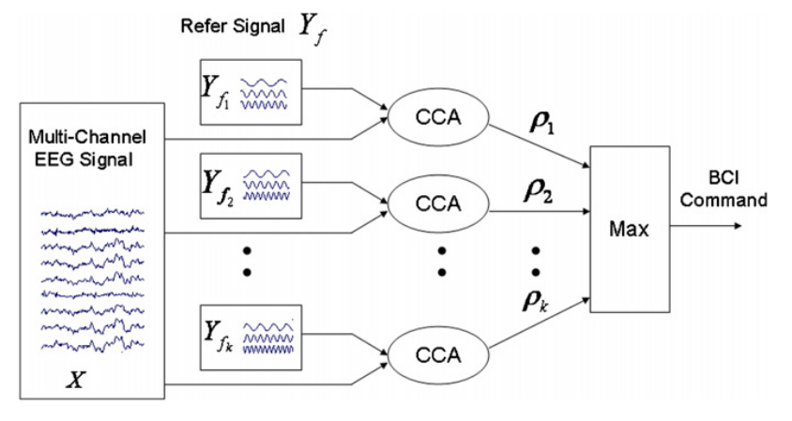
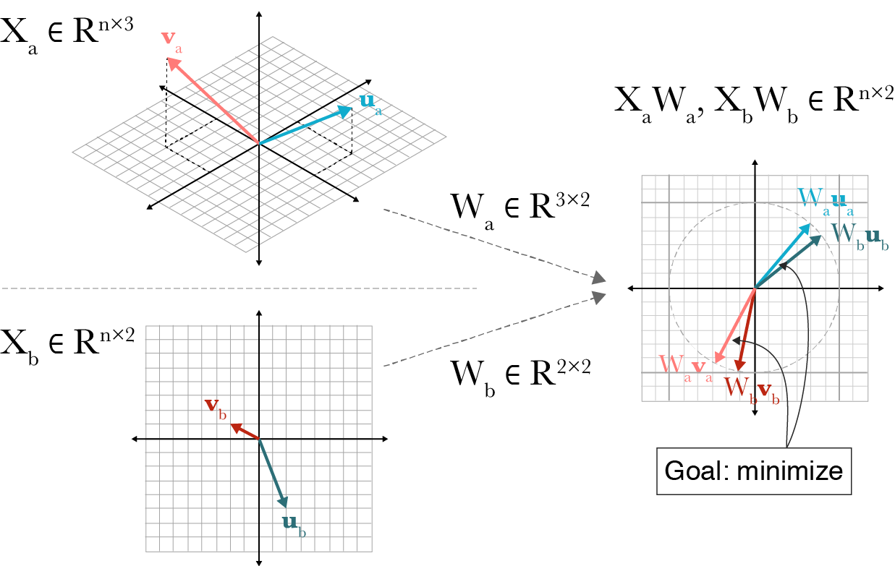
Canonical correlation analysis
Method for SSVEP recognition
Canonical correlation analysis(CCA)
Linear relationship between EEG signal and reference signal
Find highest correlation value between EEG signal and reference signal for each frequency
In standard CCA method, sinusoidal wave was used to reference signal
SSVEP recognition based CCA method

Slide 10
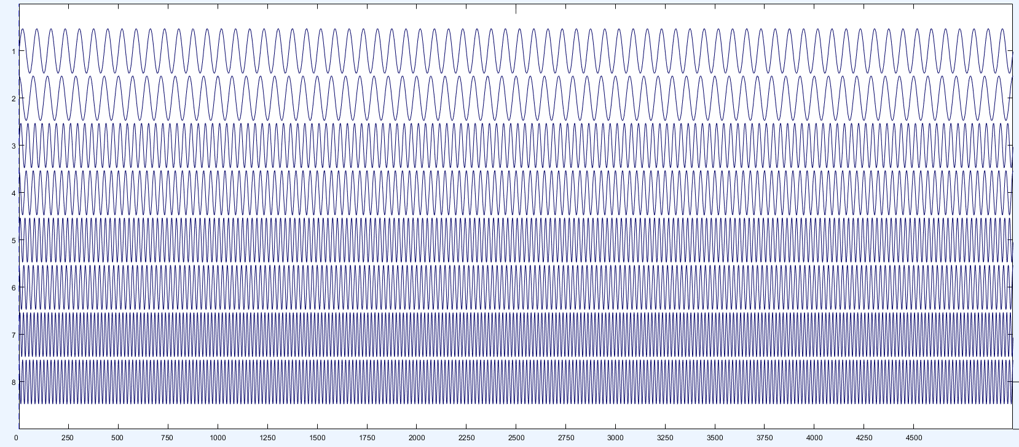








Canonical correlation analysis
Reference signal
$$Y_{sin⁡(2π f_{n})}$$
$$Y_{cos⁡(2πf_{n})}$$
$$Y_{sin⁡(2π 2f_{n})}$$
$$Y_{cos⁡(2π 2f_{n})}$$
$$Y_{sin⁡(2π 3f_{n})}$$
$$Y_{cos⁡(2π 3f_{n})}$$
$$Y_{sin⁡(2π 4f_{n})}$$
$$Y_{cos⁡(2π 4f_{n})}$$

Slide 11
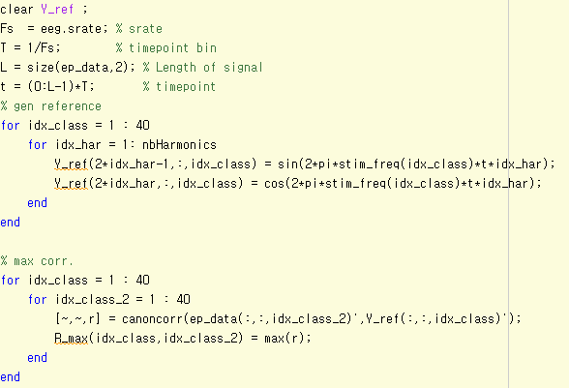
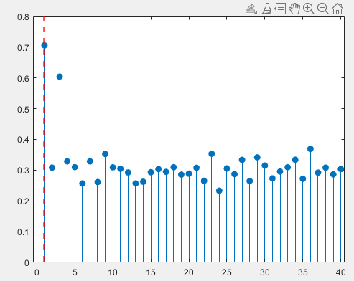






Canonical correlation analysis
Correlation Coefficient
Signal (X) Ref($Y_{1}$~$Y_{N}$) → [$ρ_{1}$, $ρ_{2}$, … , $ρ_{N}$]
argmax([$ρ_{1}$, $ρ_{2}$, … , $ρ_{N}$]) → $i_{predict}$
Target freq
$$ρ_{1}$$
$$ρ_{3}$$
$$ρ_{i}$$
$$ρ_{2}$$
$$ρ_{40}$$
Index of stimuli (1 to 40)

Slide 12
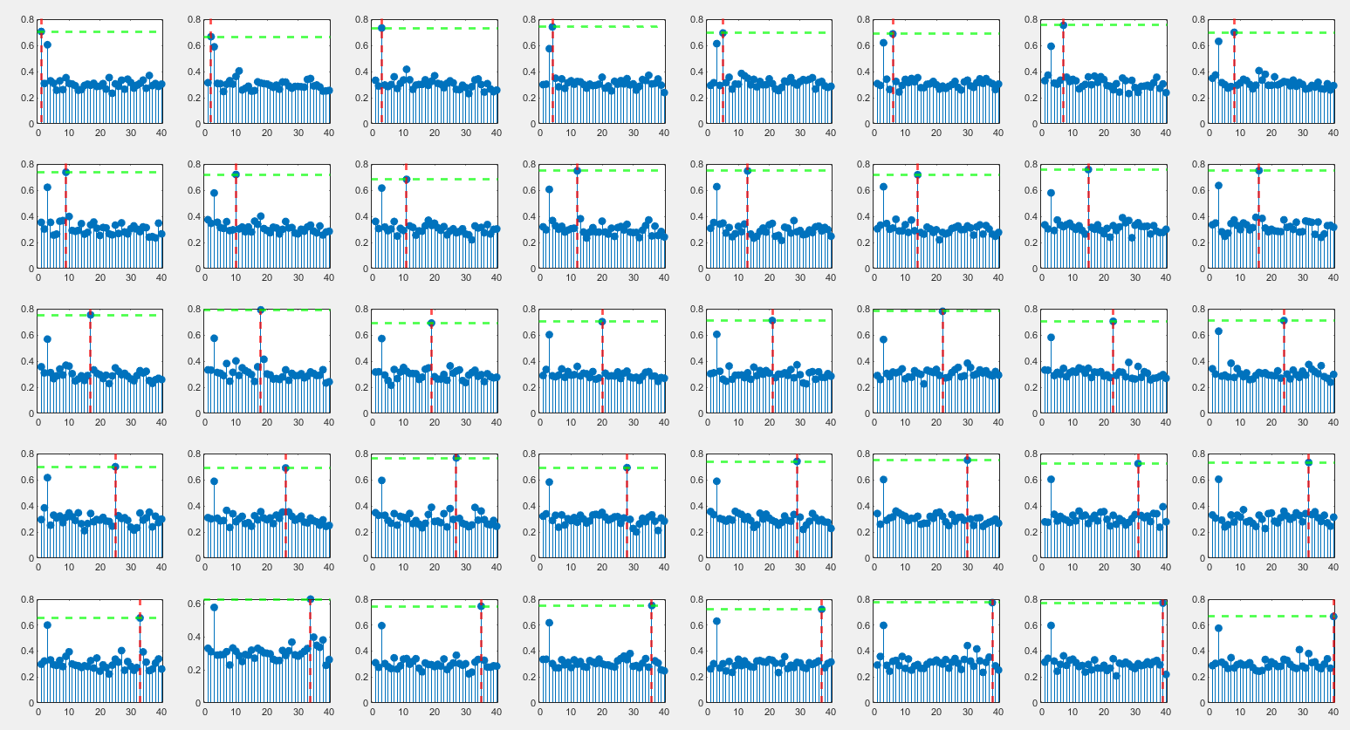
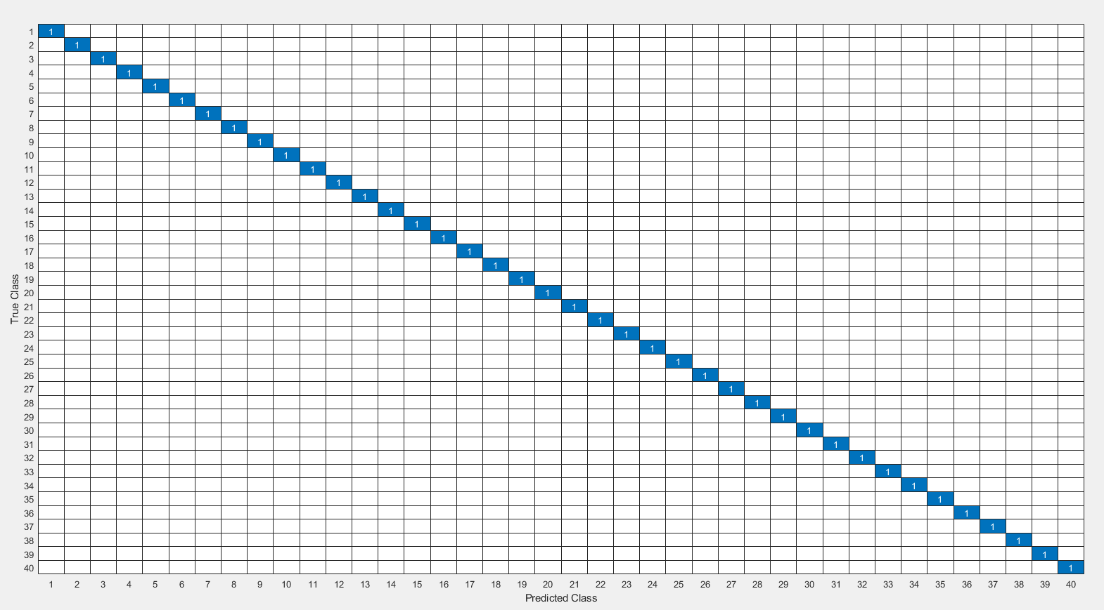
Canonical correlation analysis
Coefficient

Slide 13
Appendix

Slide 14
Data load function
데이터 포맷 | 확장자 | 대표 로드 함수 | 예시 코드
EEGLAB dataset | .set, .fdt | pop_loadset | EEG = pop_loadset('filename','sub01.set','filepath',rawDir);
MATLAB array | workspace variable | pop_importdata | EEG = pop_importdata('dataformat','array','data','eegdata','srate',256);
MATLAB file | .mat | pop_importdata 또는 load 후 import | EEG = pop_importdata('dataformat','matlab','data','sub01.mat','srate',256);
ASCII / TXT / CSV | .txt, .csv, .asc | pop_importdata | EEG = pop_importdata('dataformat','ascii','data','sub01.csv','srate',256);
Float binary | .f32, .float 등 | pop_importdata | EEG = pop_importdata('dataformat','float32','data','sub01.f32','srate',256);
BrainVision | .vhdr, .vmrk, .eeg | pop_loadbv | EEG = pop_loadbv(rawDir,'sub01.vhdr');
EDF / BDF / GDF | .edf, .bdf, .gdf | pop_biosig | EEG = pop_biosig('sub01.bdf');
BioSemi | .bdf | pop_biosig | EEG = pop_biosig('sub01.bdf');
FieldTrip 지원 포맷 | 다양함 | pop_fileio | EEG = pop_fileio('sub01.xxx');
EGI / NetStation MFF | .mff | pop_mffimport 또는 mff_import | EEG = pop_mffimport('sub01.mff');
XDF / LSL | .xdf | pop_loadxdf | EEG = pop_loadxdf('sub01.xdf','streamtype','EEG');
Neuroscan | .cnt | pop_loadcnt 또는 pop_biosig / pop_fileio | EEG = pop_loadcnt('sub01.cnt');
EGI simple binary | .raw | pop_readegi | EEG = pop_readegi('sub01.raw');

Slide 15
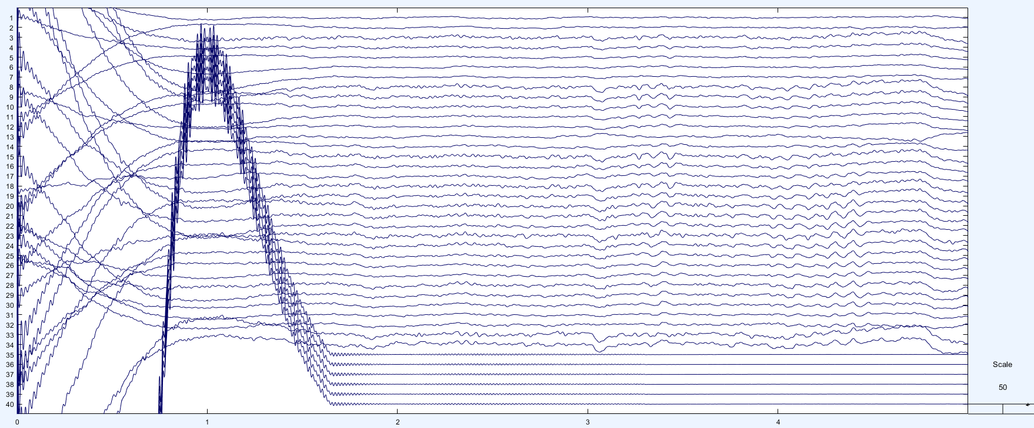
Biosemi data specific

Slide 16
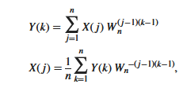

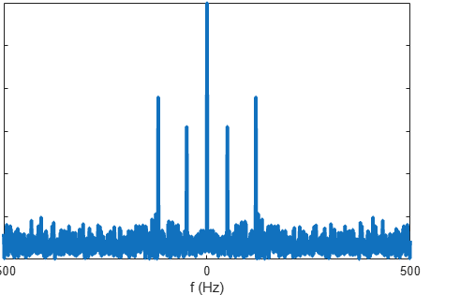
Matlab fft
Positive and negative spectrum
Single sided spectrum

