Slide 1
Project6 : Simulation Dashboard
Heejae Kwon
Taehoon Kwon
CS399 Data Visualization

Slide 2
Backtest
Price went up
Price went down
Difference between Open and Close
Difference between High and Low

Slide 3
Price went up
Choose companies that its Adjusted close of the current day is higher than its previous day’s.
If the number of company that we chose is more than 10, choose top 10 companies which have biggest difference.
Spend all account to buy stocks of them.
Hold the stocks only one day.

Slide 4
Price went down
Choose companies that its Adjusted close of the current day is lower than its previous day’s.
If the number of company that we chose is more than 10, choose top 10 companies which have biggest difference.
Spend all account to buy stocks of them.
Hold the stocks only one day.

Slide 5
Small Difference between Open and Close
Choose companies that has smallest difference between Open value and Close value.
The difference value should be positive.
If the number of company that we chose is more than 10, choose top 10 companies which have smallest difference.
Spend all account to buy stocks of them.
Hold the stocks only one day.

Slide 6
Small Difference between High and Low
Choose companies that has smallest difference between High value and Low value.
The difference value should be positive.
If the number of company that we chose is more than 10, choose top 10 companies which have smallest difference.
Spend all account to buy stocks of them.
Hold the stocks only one day.

Slide 7
Dashboard
Brief description of the encoding used
Key Visualization
Interactions
Demo

Slide 8
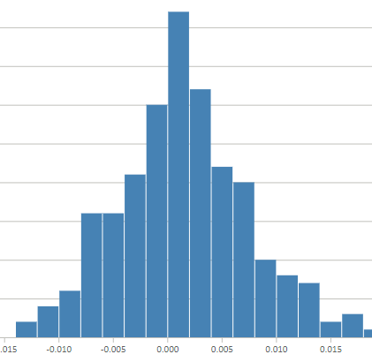
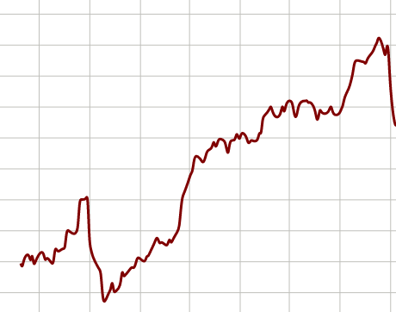
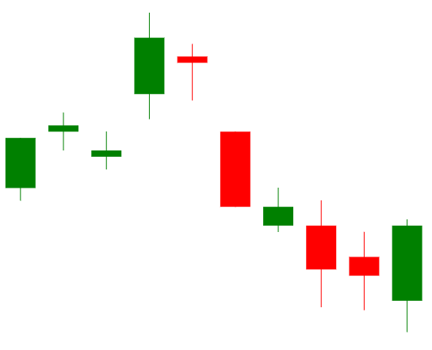
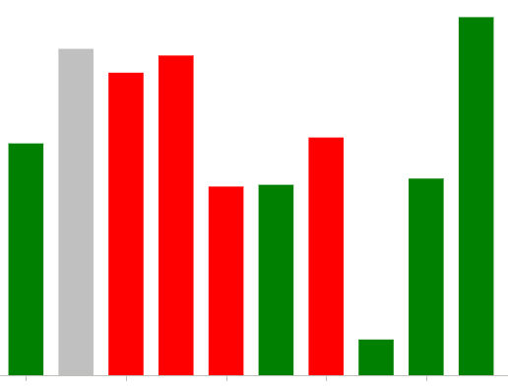
Encoding – Position & Color

Slide 9
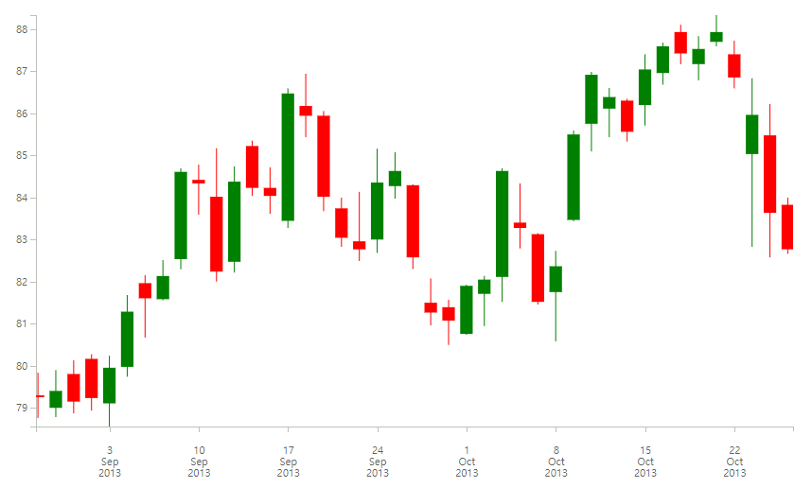
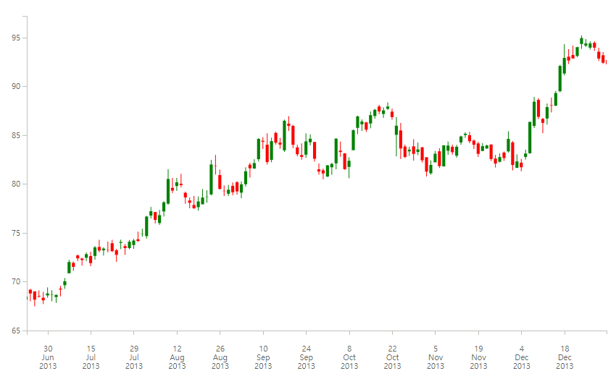
Interactions
A. Zoom In & Zoom Out
B. Drag to move domain of data

Slide 10

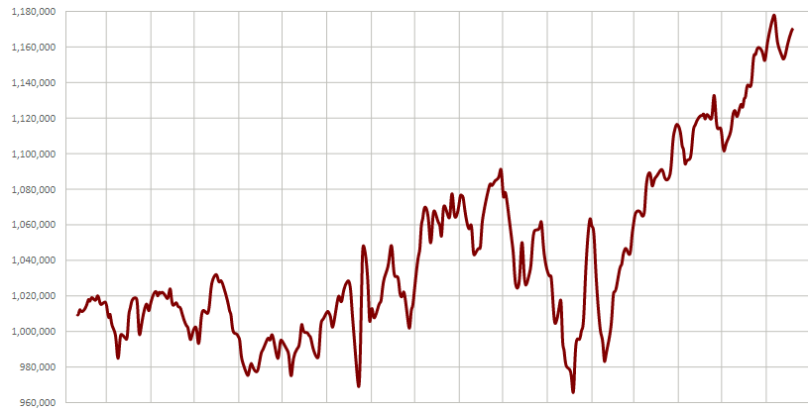
Key Visualization – Line Chart (Status)

Slide 11
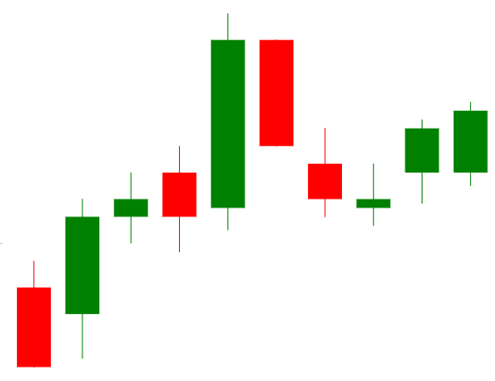
Key Visualization – Candlestick chart (OHLC)

Slide 12
Demo
CS399 Data Visualization

Slide 13
Questions/Comments
CS399 Data Visualization

