Slide 1

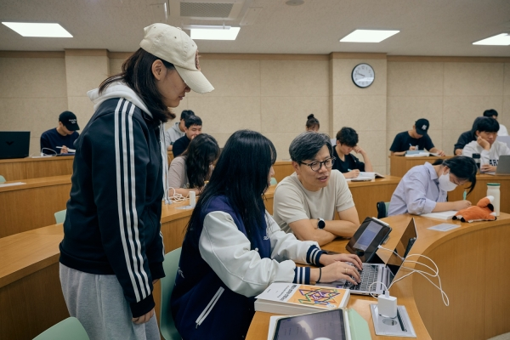
AI LITERACY IN EDUCATION
Can AI Replace
Teachers?
EXPLAIN ASSESS FEEDBACK
Knowledge and philosophy · Wikimedia Commons · CC BY-SA 4.0
DAY 01 / 01
Notes:
What is AI literacy? Can AI replace teachers? AI can explain concepts, assess work, and provide feedback. But does that mean human teachers are becoming optional?

Slide 2


AI LITERACY IN EDUCATION
What Is
AI Literacy?
UNDERSTAND EVALUATE USE RESPONSIBLY
Rahma Abdelrahman · Wikimedia Commons · CC0
DAY 01 / 02
Notes:
AI literacy involves understanding AI capabilities and limitations, evaluating its outputs critically, and using it responsibly. Teachers also contribute empathy, relationships, and ethical judgment. How might AI redefine the teacher’s role?

