Slide 1
Event Prediction and Our Collected Dataset
2022-01-25 09:30AM (KST), 2022-01-24 07:30PM (EST)
Huigyu Yang
Sungkyunkwan University
huigyu@skku.edu

Slide 2
Presentation Outline
Event Prediction
Related Paper Review
Our Dataset

Slide 3
Event Prediction (1/3)
Events refer occurrences in specific locations, time, and semantics that affects real-world
Event prediction is the capability to forecast possibility of the event occurrences in the future
The event prediction is challenging task across various domains due to incompleteness of our knowledge regarding the mechanisms driving the event occurrences
Notes:
Wasserkrug S. (2009) Event Prediction. In: LIU L., ÖZSU M.T. (eds) Encyclopedia of Database Systems. Springer, Boston, MA.
SEGEV WASSERKRUG, IBM Research Labs-Haifa, Haifa, Israel
Difference between observation and event

Slide 4
Event Prediction (2/3)
Recent efforts on the event prediction are aims to utilize deep/machine learning, data mining, or pattern recognition on the large amounts of historical events data
However, the event prediction struggles to build models that can learn from various characteristics of the event data
Time, location, semantics (i.e., the unique features of the data)
The event prediction models are not necessarily to be predicting all three domains of time, location, and semantics simultaneously, but a part of them should be predicted by the models

Slide 5
Event Prediction (3/3)
This results the prediction models to address the following challenges:
Complex dependencies among the prediction outputs
Not only dependencies between historical data and predicted result but also correlation of predicted results
The predicted events can influence the further events
Heterogeneous multi-output predictions
Multiple features of event needs to be predicted including its time, location, duration, intensity, etc.

Slide 6
Relate Paper Brief Review (1/2)
Web traffic and access-time of mobile users are predicted using Long Short-Term Memory (LSTM) and self-exciting point processes [1]
The traffic patterns are mapped with the dependencies on time, location, and popularity of webpages
The access events are modeled by self-exciting point processes and their intensities are utilized for access-time prediction
The predictions of both traffic and access-time are done by LSTM
[1] A. Abdulrahman, et al., "Predicting Mobile Users Traffic and Access-Time Behavior Using Recurrent Neural Networks," 2021 IEEE Wireless Communications and Networking Conference (WCNC), 2021.
Notes:
The intensity measure is a non-random measure and is defined as the expectation value of the random measure of a set, hence it corresponds to the average volume the random measure assigns to a set.
Hawkes 프로세스는 프로세스의 히스토리에 의해 부분적으로 결정되는 프로세스의 시간 변화 강도 또는 이벤트 발생률을 모델링합니다. 반면에 간단한 포아송 과정은 사건의 역사를 고려하지 않습니다.

Slide 7
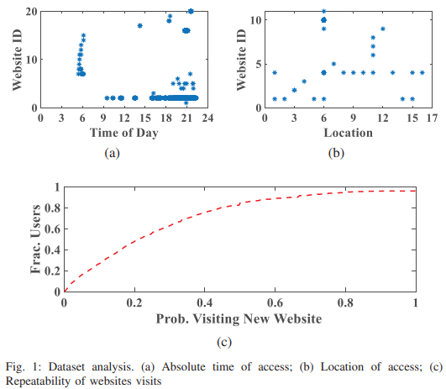
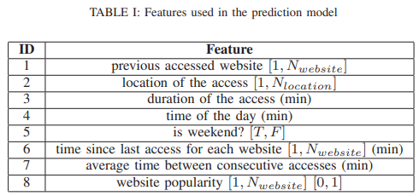
Relate Paper Brief Review (2/2)
The dataset for this work was collected for a period of one month over 1000 cell tower locations
Each log in the dataset contains the subscriber ID, session start and end time, cell tower ID, website ID, and traffic volume in kilobytes
[1] A. Abdulrahman, et al., "Predicting Mobile Users Traffic and Access-Time Behavior Using Recurrent Neural Networks," 2021 IEEE Wireless Communications and Networking Conference (WCNC), 2021.
Notes:
To extract item 8 in the table, we used a Bayesian estimator with a uniform prior (Laplace estimator) for estimating the popularity of the target websites from the same user

Slide 8
Our Dataset (1/2)
Our mobility dataset is collected from wireless network
Intelligent ICT Convergence Research Center
Cisco Access Point (AP)
12 APs with proprietary controller
It has logging functionality
Roaming Log Message
Time of occurrence
Terminal id
Source AP number
Destination AP number
Notes:
모델을 학습시키기 위해 활용한 데이터셋은 실제 환경의 이동성 데이터로
판교에 위치한 성균관대학교 연구센터의 AP간 핸드오버 로그를 통해 생성되었습니다.
약 17만개의 로그가 2달간 일평균 70여명의 상주인력에대해 수집되었으며 수집환경은 그림과 같습니다.

Slide 9

Our Dataset (2/2)
Currently, the Pangyo dataset is in two different formats
Pangyo original raw data
Converted raw data within timeslot
Time index refers that index of a day when 24 hours is divided into 5 mins

Slide 10
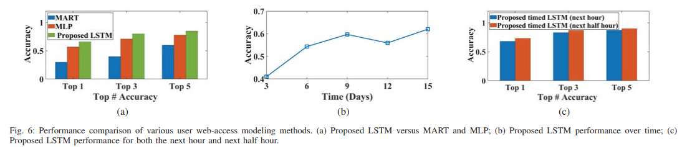
Appendix: result of the related paper
The result of traffic activity (i.e., next webpage access) predictions
Maximum 66% accuracy
Notes:
Multiple Additive Regression Tree (MART)

Slide 11
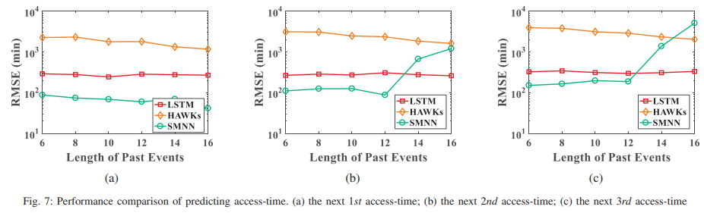
Appendix: result of the related paper
The result of access-time predictions
Notes:
Hawkes,
Root mean square error (RMSE) metric was adopted to measure the prediction accuracy. We tested the prediction performance for the next three future events, respectively.

