Slide 1
Event Prediction: Dataset Related Paper Review
2022-03-09 09:30AM (KST), 2022-03-08 07:30PM (EST)
Huigyu Yang
Sungkyunkwan University
huigyu@skku.edu

Slide 2
Presentation Outline
Citybike Dataset
Dataset Related Keywords
Crowd Flow Prediction

Slide 3
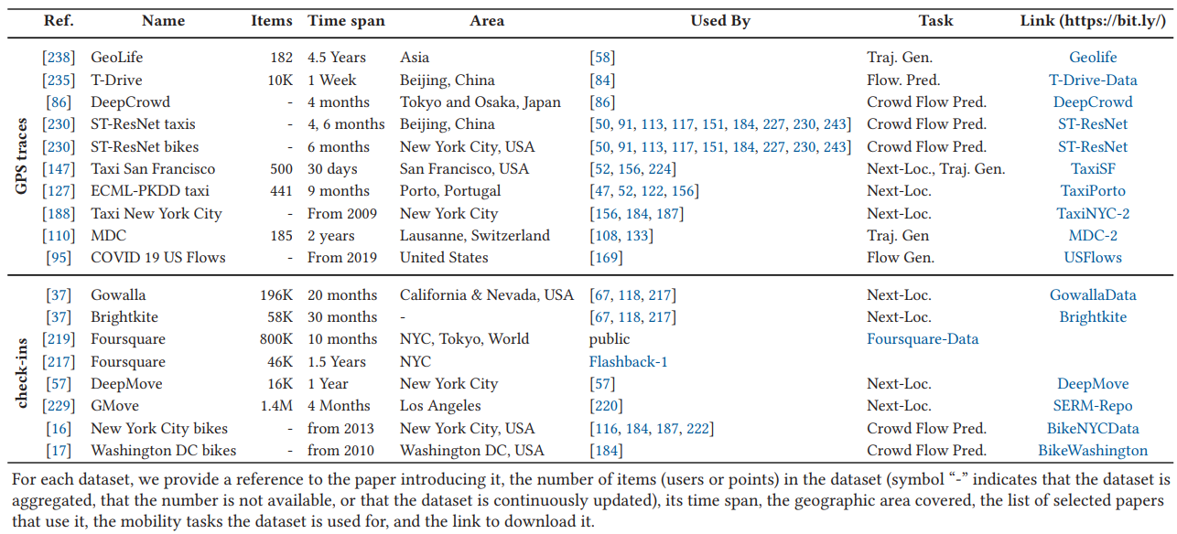
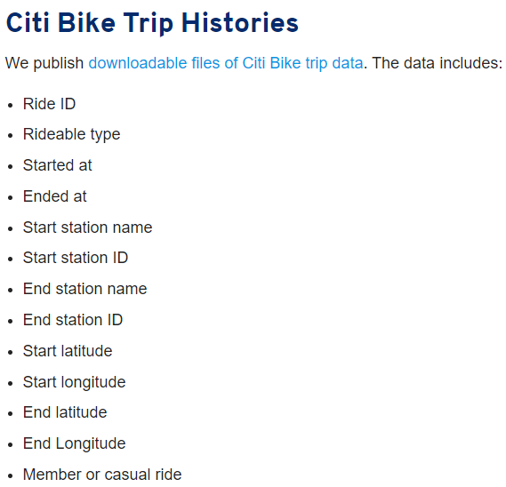
Citybike Dataset (1/2)
GPS and Check-in based log dataset: Citi Bike
Notes:
A Survey on Deep Learning for Human Mobility

Slide 4
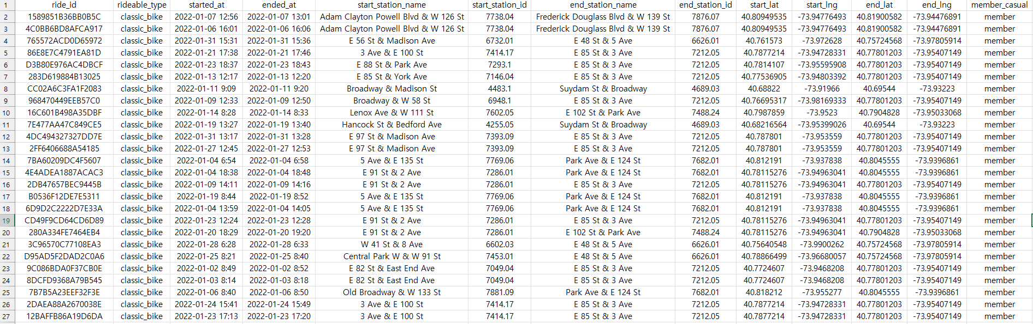
Citybike Dataset (2/2)
GPS and Check-in based log dataset: Citi Bike
Notes:
A Survey on Deep Learning for Human Mobility

Slide 5
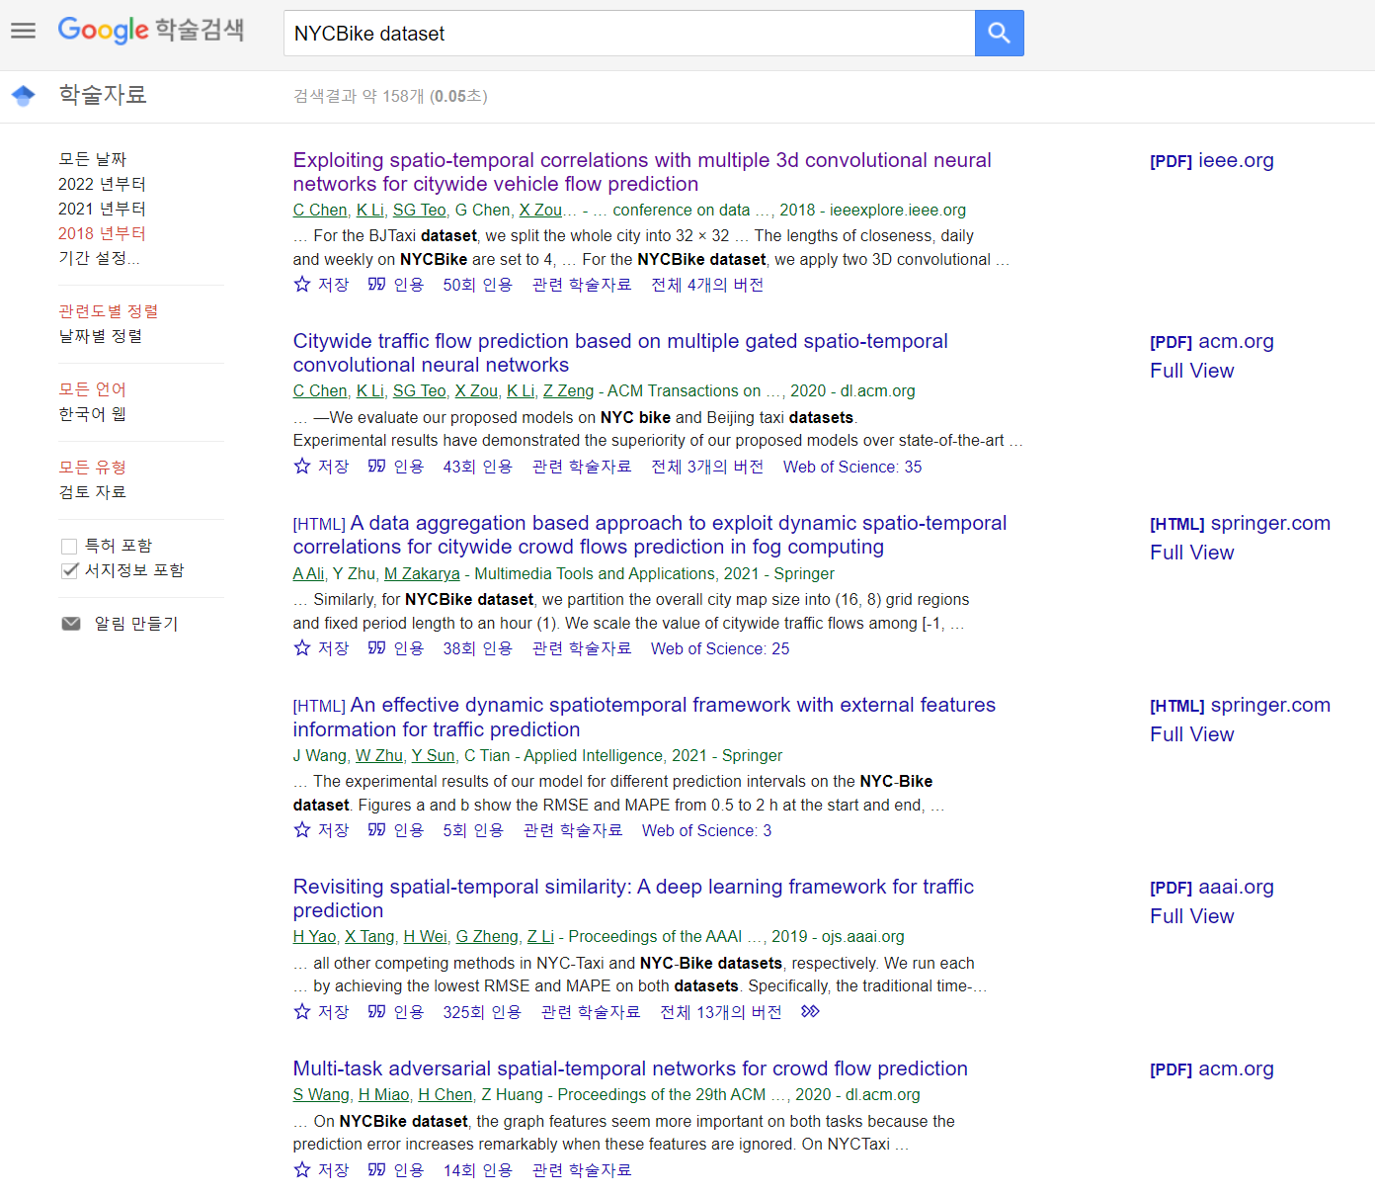
Dataset Related Keywords
Crow Flow
Spatiotemporal
Flow prediction
Traffic prediction
Incomplete Data

Slide 6
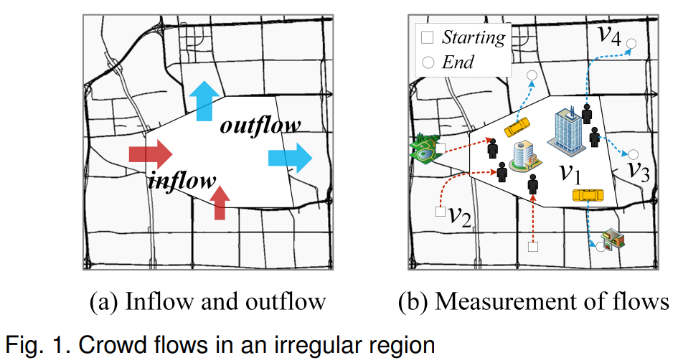
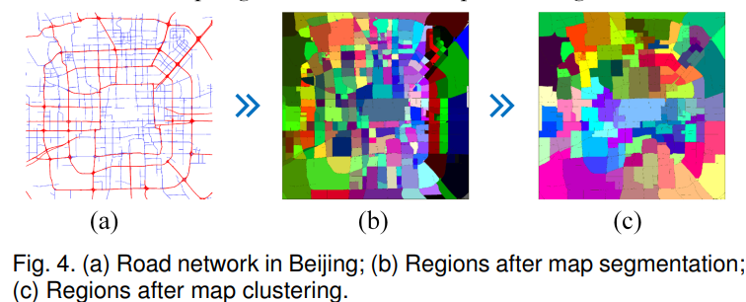
Crowd Flow Prediction Model (1/7)
Predicting Citywide Crowd Flows in Irregular Regions Using Multi-view Graph Convolutional Networks [1]
Highly cited paper that has used the citybike dataset
The paper aims to predict the crowd flow through Multi-View Graph Convolution Network (MVGCN)
The crowd flows are measured by the number of bikes running on the roads
<Irregular Regions>
[1] J. Sun, J. Zhang, Q. Li, X. Yi, Y. Liang and Y. Zheng, "Predicting Citywide Crowd Flows in Irregular Regions Using Multi-View Graph Convolutional Networks," in IEEE Transactions on Knowledge and Data Engineering, doi: 10.1109/TKDE.2020.3008774.

Slide 7
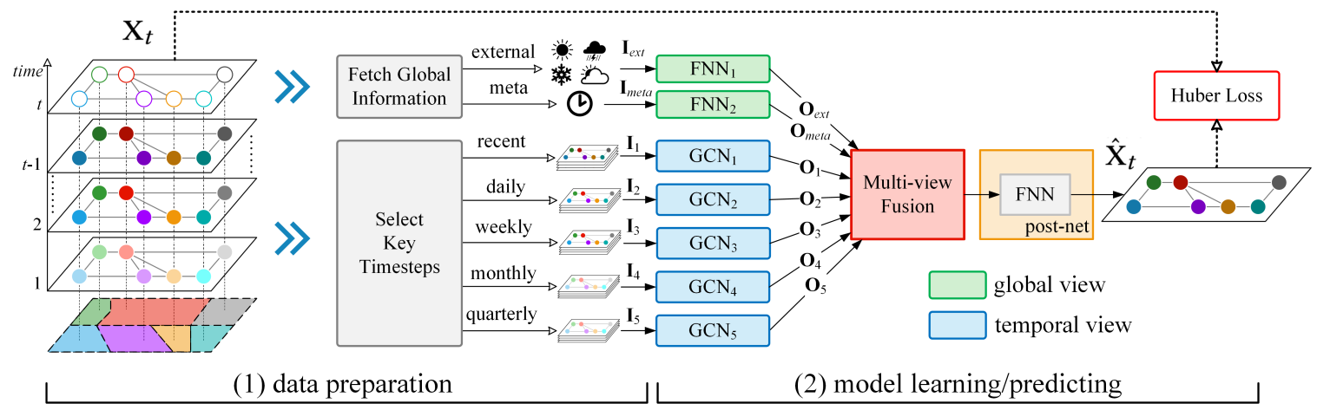
Crowd Flow Prediction Model (2/7)
The architecture of MVGCN and major components are shown below:
Fully-connected Neural Network (FNN)
Graph Convolutional Network(GCN)
Composed of two stage: data preparation and model training(and inference)

Slide 8
Crowd Flow Prediction Model (3/7)
Data preparation
Weather, time of the day, and period are used as major factor in the process
Those factors are processed in global and temporal views
Global view includes meteological data of previous timestep, time of the day and data of the week
Temporal view is composed of temporal closeness, period, and trend
Recent, daily, weekly, monthly, and quarterly timesteps
Multi-view of 5 key timesteps

Slide 9
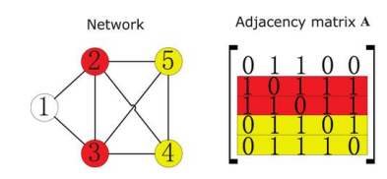
Crowd Flow Prediction Model (4/7)
Graph Convolutional Network in MVGCN
Convolutional computation with graph-represented data
Extract the spatial features from structured data
Graph representation of the crowd flow
Vertex of the graph refers geospatial positions (i.e., nodes)
Edge between two vertex has the value of region-wise transition flows
Graph

Slide 10
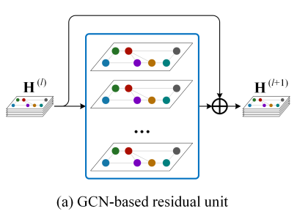

Crowd Flow Prediction Model (5/7)
Graph Convolutional Network models 5 different views of the data
Time-varying spatial correlations
Output of 5 GCNs are denoted $O_{1},O_{2},O_{3},O_{4},O_{5}$
Each GCN uses residual connection to establish deeper connection
To capture multi-hop(i.e., node distances) spatial correlations

Slide 11
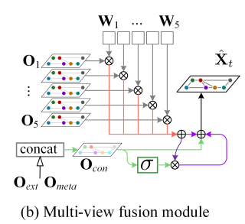

Crowd Flow Prediction Model (6/7)
Multi-view fusion module
$W_{1}, W_{2},W_{3},W_{4},W5$are the learnable parameters that control the influences from 5 different views

Slide 12
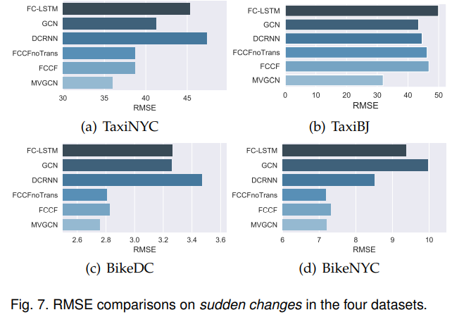
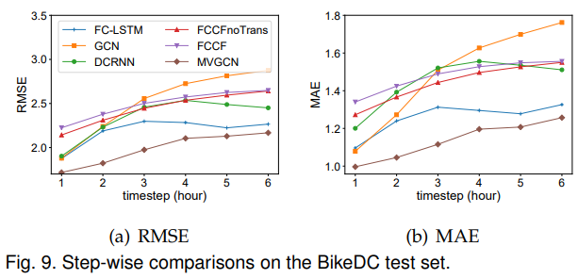
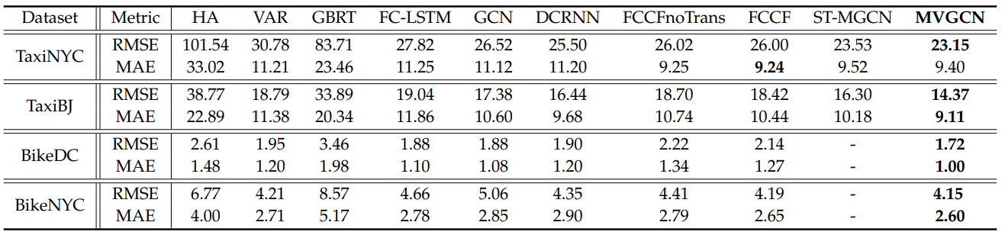
Crowd Flow Prediction Model (7/7)
Results: RMSE and MAE of the predicted crowd flow graph

