Slide 1
Event Prediction: Model Implementation and Evaluation
2022-05-03 11:00AM (EST)
Huigyu Yang
Sungkyunkwan University
huigyu@skku.edu

Slide 2
Presentation Outline
Chicago Bike Station Dataset
Model Implementation
Evaluation
Future Work

Slide 3
Event Dataset (1/3)
Datasets in the studies contain only bike rental and return location of user trips
New York, Washington DC, Singapore, and Taipei
Chicago city bike dataset has abundant information among above datasets
User trips: rental station, return station, time
Bike Routes: GPS information of common traveling routes
Historical bike stations: station, capacity, utilization of bike docks

Slide 4
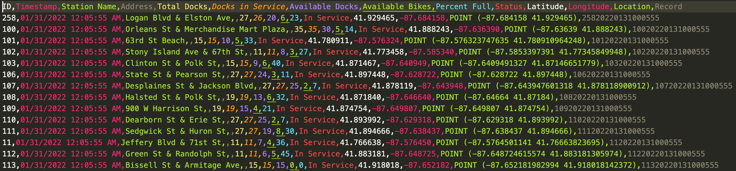
Event Dataset (3/3)
Chicago historical bike stations dataset
3,451,068 rows for 1 month
842 stations
Dock utilization status is logged at every 1 hour

Slide 5

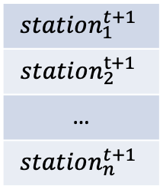


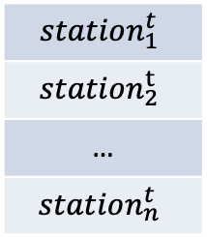

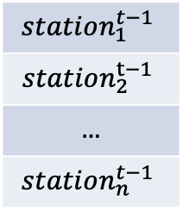

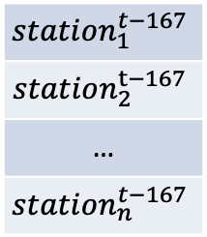


Implementation
A prediction model using single LSTM layer
$$station_{1}^{t+1}$$
$$station_{2}^{t+1}$$
…
$$station_{n}^{t+1}$$
t refers time-step(unit: an hour)
n refers number of stations
$$Output$$
$$LSTM_{t−167}$$
$$LSTM_{t−1}$$
$$LSTM_{t}$$
$$input_{t−167}$$
$$input_{t−1}$$
$$input_{t}$$
$$station_{1}^{t−167}$$
$$station_{2}^{t−167}$$
…
$$station_{n}^{t−167}$$
$$station_{1}^{t−1}$$
$$station_{2}^{t−1}$$
…
$$station_{n}^{t−1}$$
$$station_{1}^{t}$$
$$station_{2}^{t}$$
…
$$station_{n}^{t}$$

Slide 6
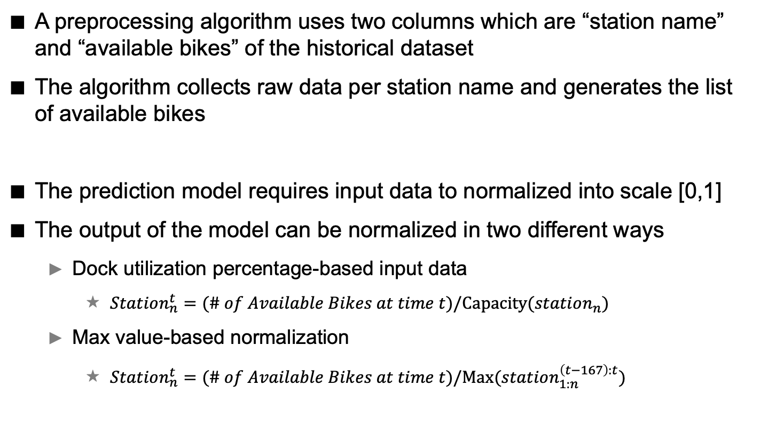
Implementation
A preprocessing algorithm uses two columns which are “station name” and “available bikes” of the historical dataset
The algorithm collects raw data per station name and generates the list of available bikes
The prediction model requires input data to normalized into scale [0,1]
The output of the model can be normalized in two different ways
Dock utilization percentage-based input data
$Station_{n}^{t}=(\# of Available Bikes at time t)/Capacity(station_{n})$
Max value-based normalization
$Station_{n}^{t}=(\# of Available Bikes at time t)/Max(station_{1:n}^{\left(t−167\right):t})$

Slide 7
Implementation: errors in previous trial
Glob library loads raw historical data from single directory where the multiple files of daily historical datasets
The library of latest version randomly selects files in allocated directory path
This caused training and testing data to be concatenated without any temporal continuity
This logical error in previous experiments has been fixed using function Sorted()

Slide 8
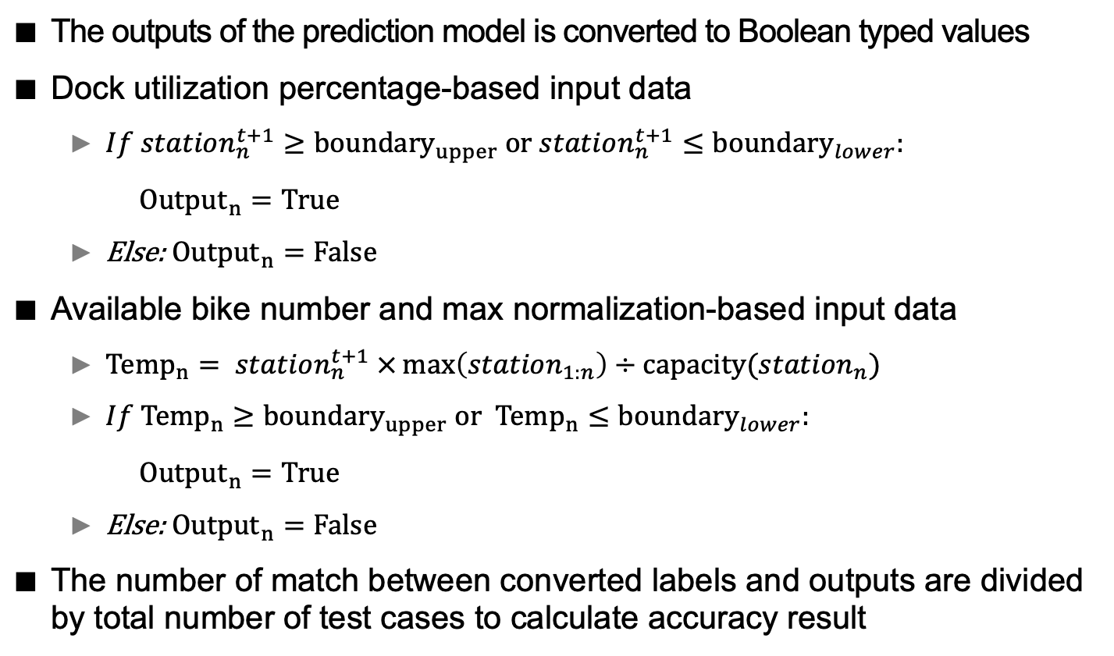
Evaluation
The outputs of the prediction model is converted to Boolean typed values
Dock utilization percentage-based input data
$If station_{n}^{t+1}≥{boundary}_{upper} or station_{n}^{t+1}≤boundary_{lower}:$
${Output}_{n}=True$
Else: ${Output}_{n}=False$
Available bike number and max normalization-based input data
${Temp}_{n}= station_{n}^{t+1} ×\max\left(station_{1:n}\right)÷capacity({station}_{n})$
$If{ Temp}_{n}≥{boundary}_{upper} or{ Temp}_{n}≤boundary_{lower}:$
${Output}_{n}=True$
Else: ${Output}_{n}=False$
The number of match between converted labels and outputs are divided by total number of test cases to calculate accuracy result

Slide 9
Evaluation
Percentage based normalization
Input: 168 hours, Output: 1 hour
Hidden dimension(LSTM): 256
Accuracy: 93.46
Max value-based normalization
Input: 168 hours, Output: 1 hour
Hidden dimension(LSTM): 256
Accuracy: 83.46
Number of LSTM layers, input length didn’t affect on the result

Slide 10
Future Work
Find time period when both historical and trip data are available
Generate bike transition matrix using trip data
Add fusion layers in the model to train the matrix with historical data

