Slide 1
Event Prediction: Datasets
2022-02-16 09:30AM (KST), 2022-02-15 07:30PM (EST)
Huigyu Yang
Sungkyunkwan University
huigyu@skku.edu

Slide 2
Presentation Outline
Event Time Prediction
Datasets in Papers
Dataset in Kaggle

Slide 3
Event Time Prediction
Event time prediction can be categorized into three types:
Event occurrence; simplest type of event time prediction task
This can be formulated as a binary classification problem whether the event will occur or not
Discrete-time prediction
Approximate time prediction of future events through time-slot based data composition
Continuous-time prediction
Continuous-time prediction extends discrete-time prediction by increasing granularity of discretization
Regression, Point processes
Notes:
Granularity 세분화
Event Prediction in the Big Data Era: A Systematic Survey
[1] Liang Zhao, “Event Prediction in the Big Data Era: A Systematic Survey,” ACM Comput. Surv. 54, 5, Article 94, June 2022.

Slide 4
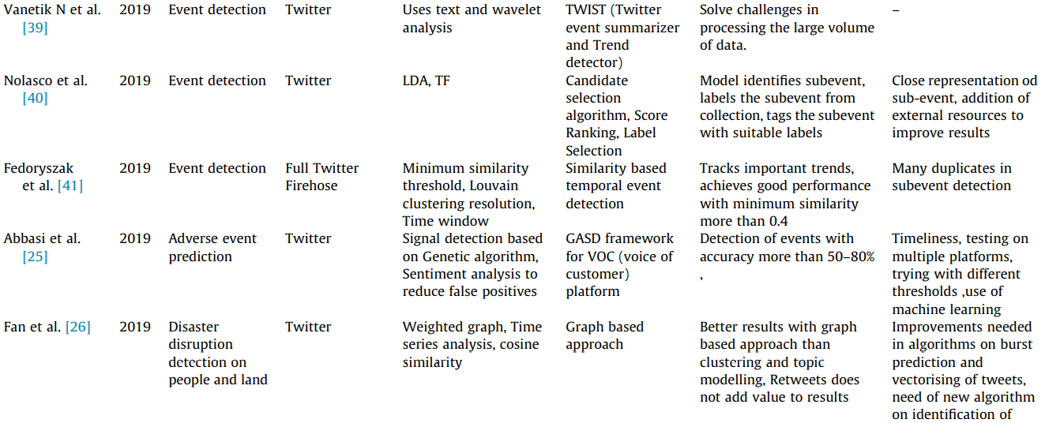
Datasets in Papers (1/9)
Event dataset from Social Media Platforms (SMP) [1]
Offline frameworks on event detection and predictions
[1] Poonam Tijare, Jhansi Rani Prathuri, “A Survey on Event Detection and Prediction Online and Offline Models using Social Media Platforms,” Materials Today: Proceedings, 2021
Notes:
A Survey on Event Detection and Prediction Online and Offline Models using Social Media Platforms

Slide 5
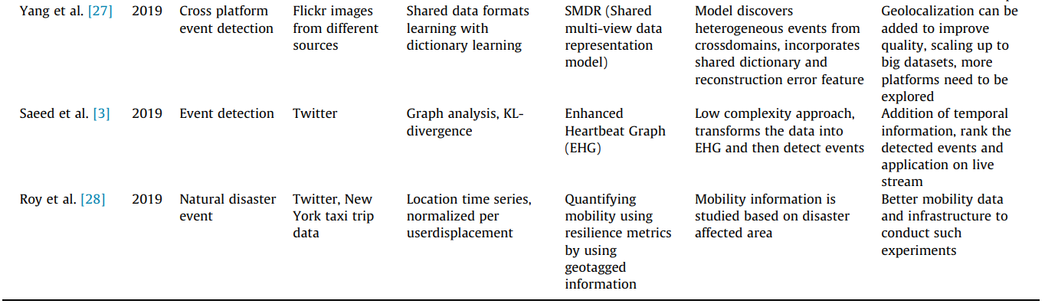
Datasets in Papers (2/9)
Event dataset from Social Media Platforms (SMP)
Offline frameworks on event detection and predictions

Slide 6
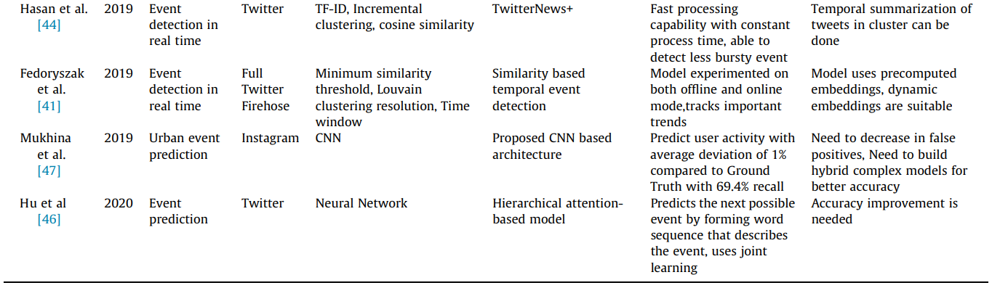
Datasets in Papers (3/9)
Event dataset from Social Media Platforms (SMP)
Online frameworks on event detection and predictions
The datasets collected from SMP are huge and mostly given as natural language based data (i.e., tweets)

Slide 7
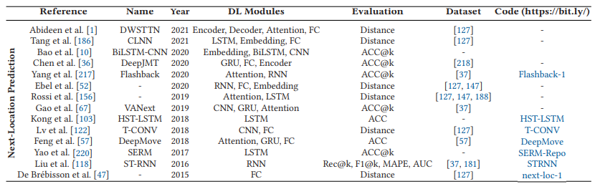
Datasets in Papers (4/9)
Mobility related datasets: Next-location Prediction
The data representations of mobility dataset are categorized into GPS trace and check-in based logs

Slide 8
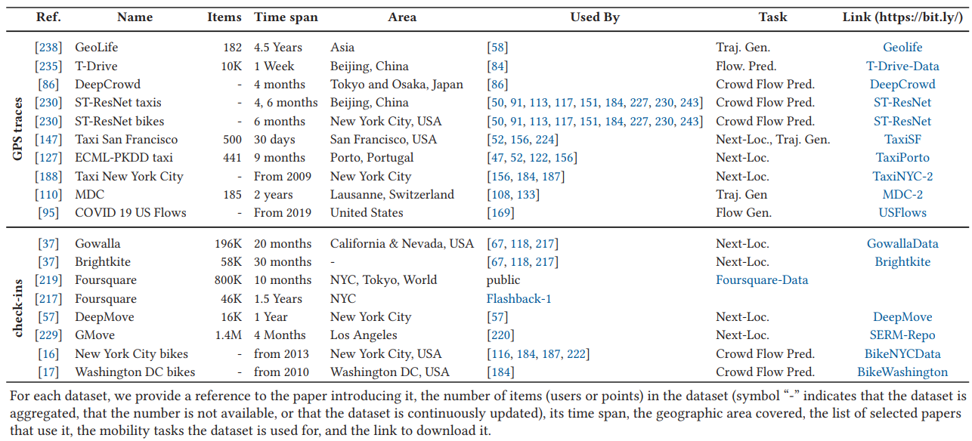
Datasets in Papers (5/9)
Mobility related dataset lists [2]
[2] Massimiliano Luca, Gianni Barlacchi, Bruno Lepri, and Luca Pappalardo. “A Survey on Deep Learning for Human Mobility.” ACM Computing Survey, Article 7. Nov. 2021
Notes:
A Survey on Deep Learning for Human Mobility

Slide 9
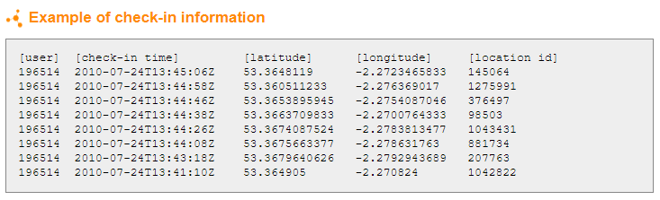
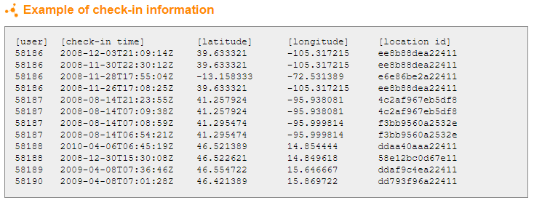
Datasets in Papers (6/9)
Check-in based log dataset
Notes:
A Survey on Deep Learning for Human Mobility

Slide 10
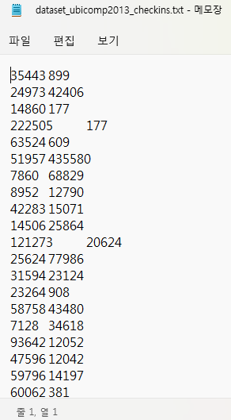
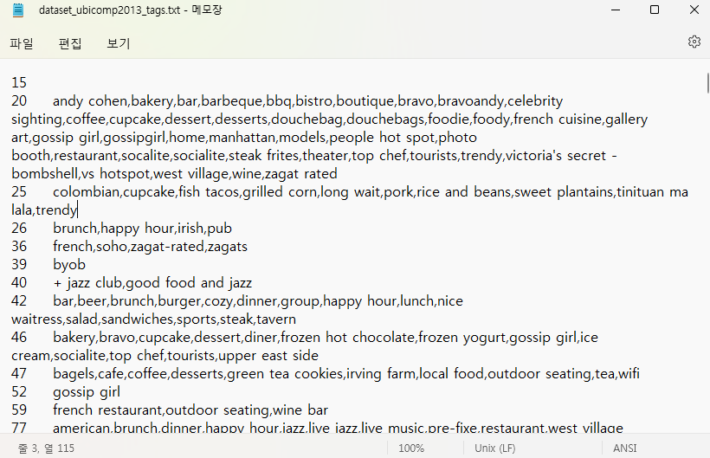
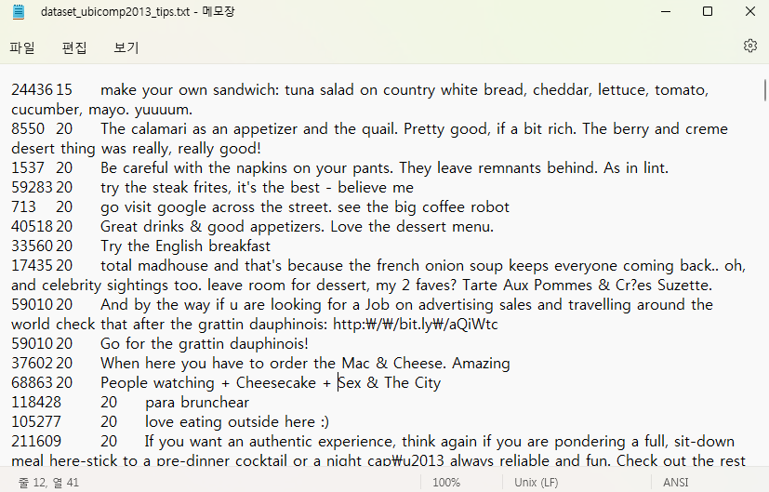
Datasets in Papers (7/9)
Check-in based log dataset: Foursquare Dataset (by Dingqi YANG)
Notes:
A Survey on Deep Learning for Human Mobility

Slide 11
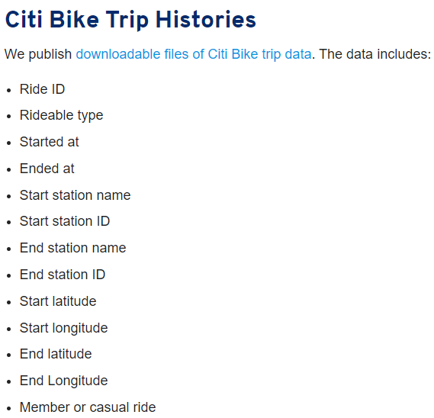
Datasets in Papers (8/9)
GPS and Check-in based log dataset: Citi Bike
Notes:
A Survey on Deep Learning for Human Mobility

Slide 12
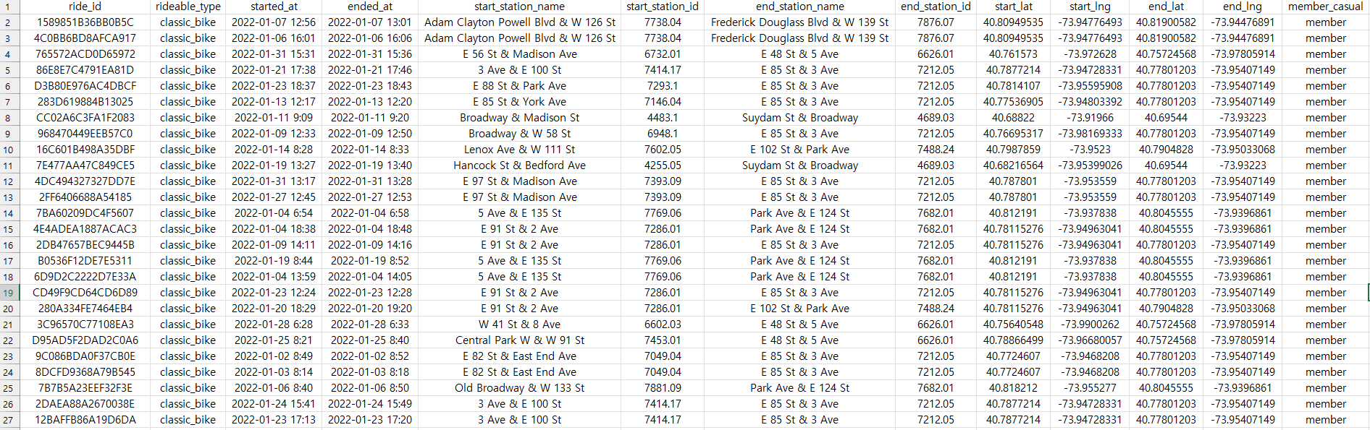
Datasets in Papers (9/9)
GPS and Check-in based log dataset: Citi Bike
Notes:
A Survey on Deep Learning for Human Mobility

Slide 13
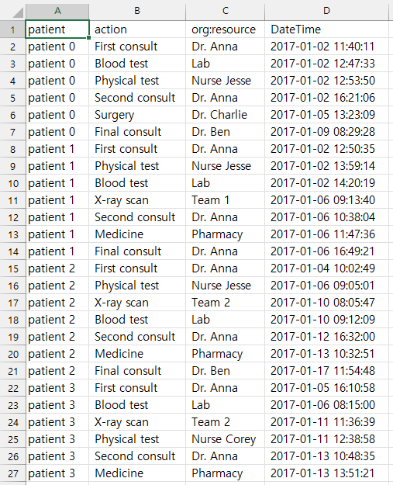
Dataset in Kaggle
Event log of hospital

Slide 14
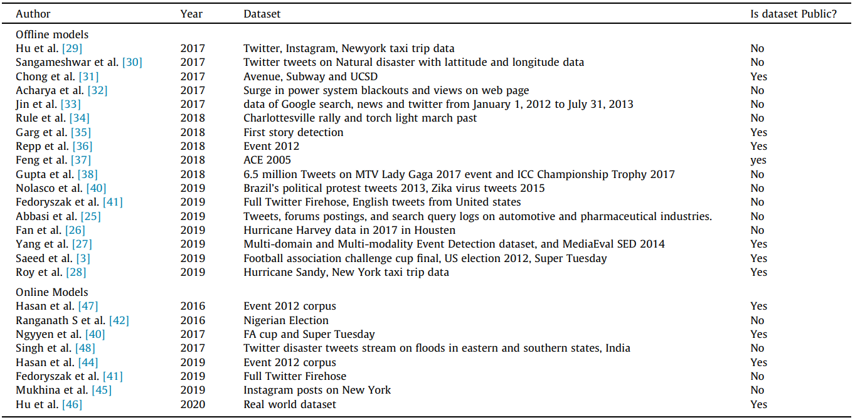
Datasets in Papers
Event dataset from Social Media Platforms (SMP)
Notes:
A Survey on Event Detection and Prediction Online and Offline Models using Social Media Platforms

