Slide 1
Event Prediction: Model Implementation and Evaluation
2022-05-10 11:00AM (EST)
Huigyu Yang
Sungkyunkwan University
huigyu@skku.edu

Slide 2
Presentation Outline
Chicago Bike Station Dataset
Model Implementation
Evaluation
Future Work

Slide 3

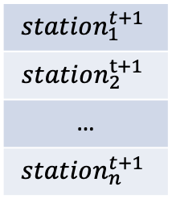


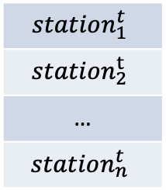

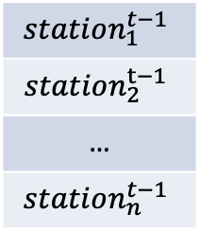

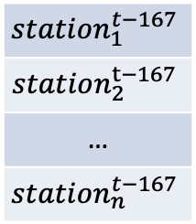


Implementation
A prediction model using single LSTM layer
$$station_{1}^{t+1}$$
$$station_{2}^{t+1}$$
…
$$station_{n}^{t+1}$$
t refers time-step(unit: an hour)
n refers number of stations
$$Output$$
$$LSTM_{t−167}$$
$$LSTM_{t−1}$$
$$LSTM_{t}$$
$$input_{t−167}$$
$$input_{t−1}$$
$$input_{t}$$
$$station_{1}^{t−167}$$
$$station_{2}^{t−167}$$
…
$$station_{n}^{t−167}$$
$$station_{1}^{t−1}$$
$$station_{2}^{t−1}$$
…
$$station_{n}^{t−1}$$
$$station_{1}^{t}$$
$$station_{2}^{t}$$
…
$$station_{n}^{t}$$

Slide 4
Implementation: errors in previous trial
A historical station dataset acquires station logs in every 10 mins
The results in previous seminars are not predictions for the next 1 hour
Percentage based normalization
Input: 1680 mins, Output: 10 mins
Hidden dimension(LSTM): 256
Accuracy: 93.46
Max value-based normalization
Input: 1680 mins, Output: 10 mins
Hidden dimension(LSTM): 256
Accuracy: 83.46

Slide 5

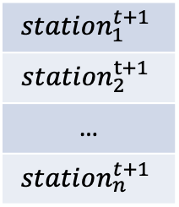


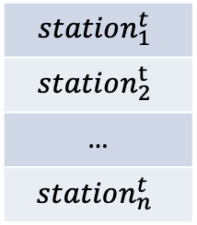



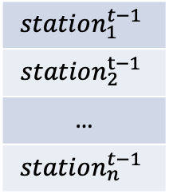


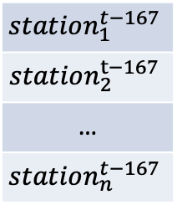



Implementation
$$station_{1}^{t+1}$$
$$station_{2}^{t+1}$$
…
$$station_{n}^{t+1}$$
$$Output$$
A prediction model using single LSTM layer
$$FCNN$$
$$FCNN$$
$$FCNN$$
t refers time-step(unit: 10mins)
n refers number of stations
$$LSTM_{t−167}$$
$$LSTM_{t−1}$$
$$LSTM_{t}$$
$$input_{t−167}$$
$$input_{t−1}$$
$$input_{t}$$
$$offset$$
$$station_{1}^{t−167}$$
$$station_{2}^{t−167}$$
…
$$station_{n}^{t−167}$$
$$station_{1}^{t−1}$$
$$station_{2}^{t−1}$$
…
$$station_{n}^{t−1}$$
$$station_{1}^{t}$$
$$station_{2}^{t}$$
…
$$station_{n}^{t}$$

Slide 6
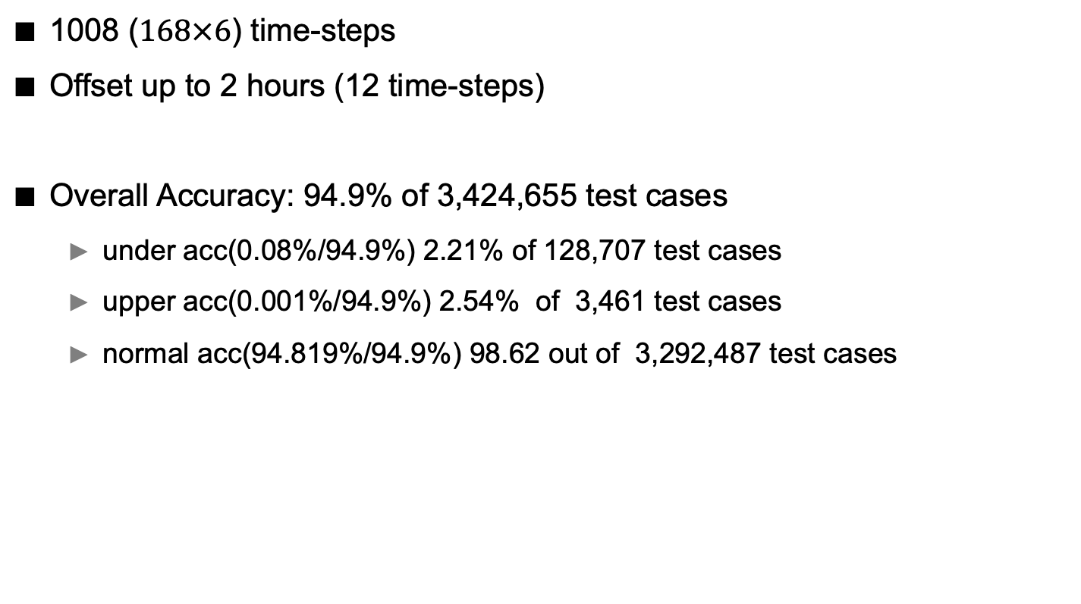
Implementation
1008 ($168×6$) time-steps
Offset up to 2 hours (12 time-steps)
Overall Accuracy: 94.9% of 3,424,655 test cases
under acc(0.08%/94.9%) 2.21% of 128,707 test cases
upper acc(0.001%/94.9%) 2.54% of 3,461 test cases
normal acc(94.819%/94.9%) 98.62 out of 3,292,487 test cases

Slide 7
Implementation
t+1: all acc 81.24
t+2: all acc 96.13
t+3: all acc 96.13
t+4: all acc 96.13
t+5: all acc 96.14
t+6: all acc 96.14
t+7: all acc 96.14
t+8: all acc 96.14
t+9: all acc 96.14
t+10: all acc 96.15
t+11: all acc 96.15
t+12: all acc 96.15

Slide 8
Future Work
Find time period when both historical and trip data are available
Generate bike transition matrix using trip data
Add fusion layers in the model to train the matrix with historical data

