Slide 1
Healthy Meals Data – EDA Summary
Cleaning • Feature Engineering • Health Score • Key Insights

Slide 2
Project Summary
Rows (original): 2000
Rows after cleaning: 1116
Excluded rows %: 44.2%
Composite Health Score based on calories, sodium, sugar, fiber, and macro balance.

Slide 3
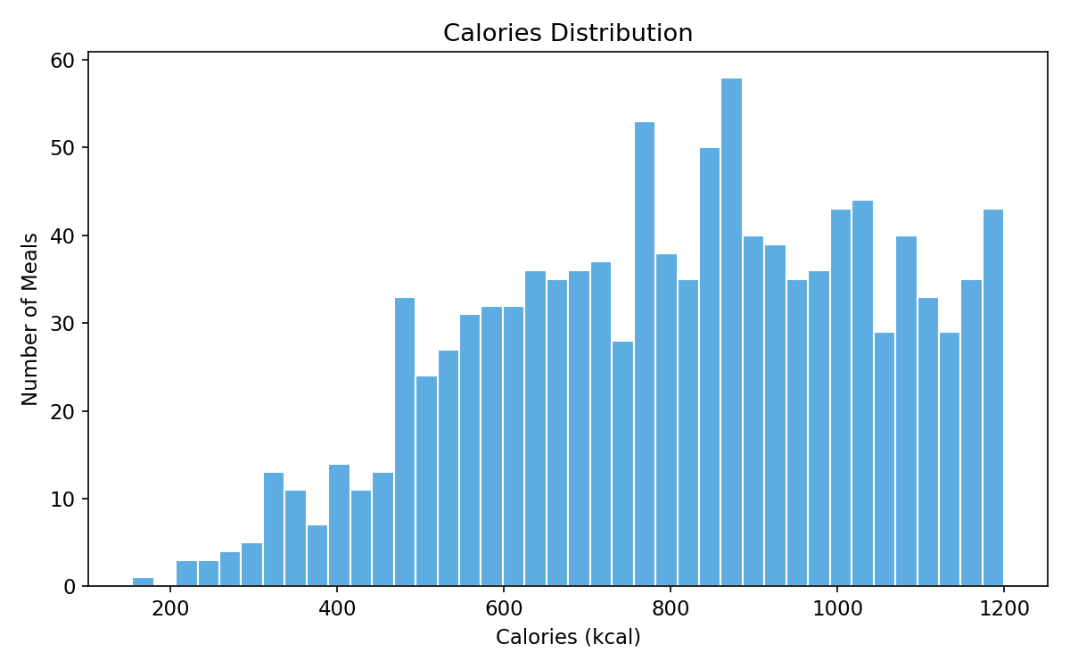
En Fig1 Calories Hist

Slide 4
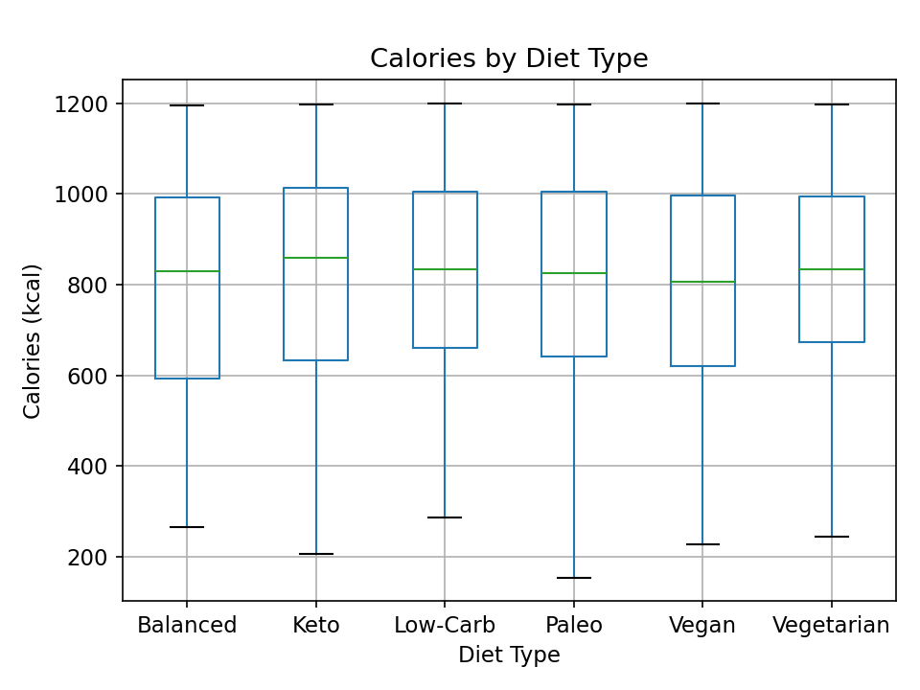
En Fig2 Calories By Diet

Slide 5
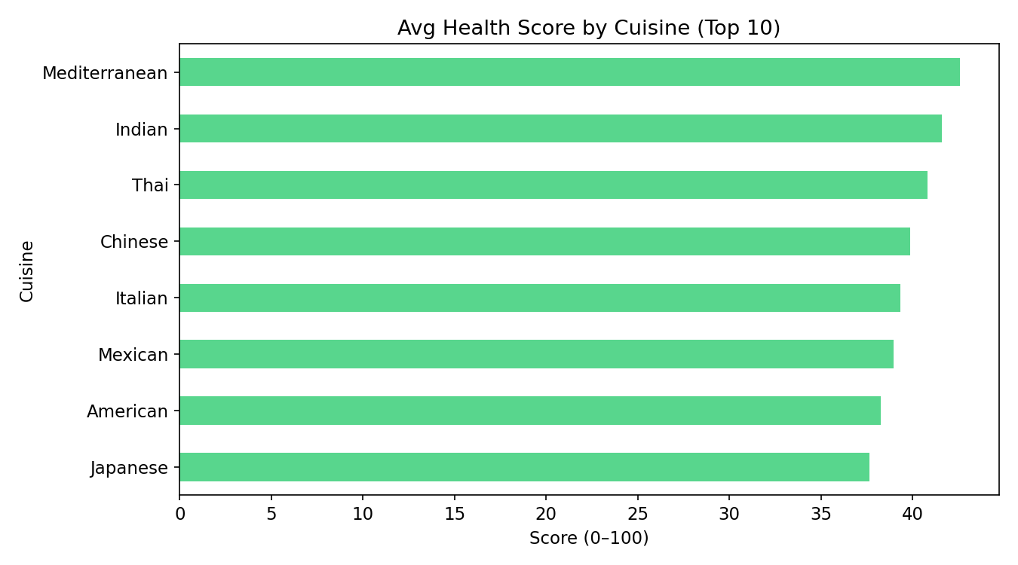
En Fig3 Healthscore By Cuisine

Slide 6
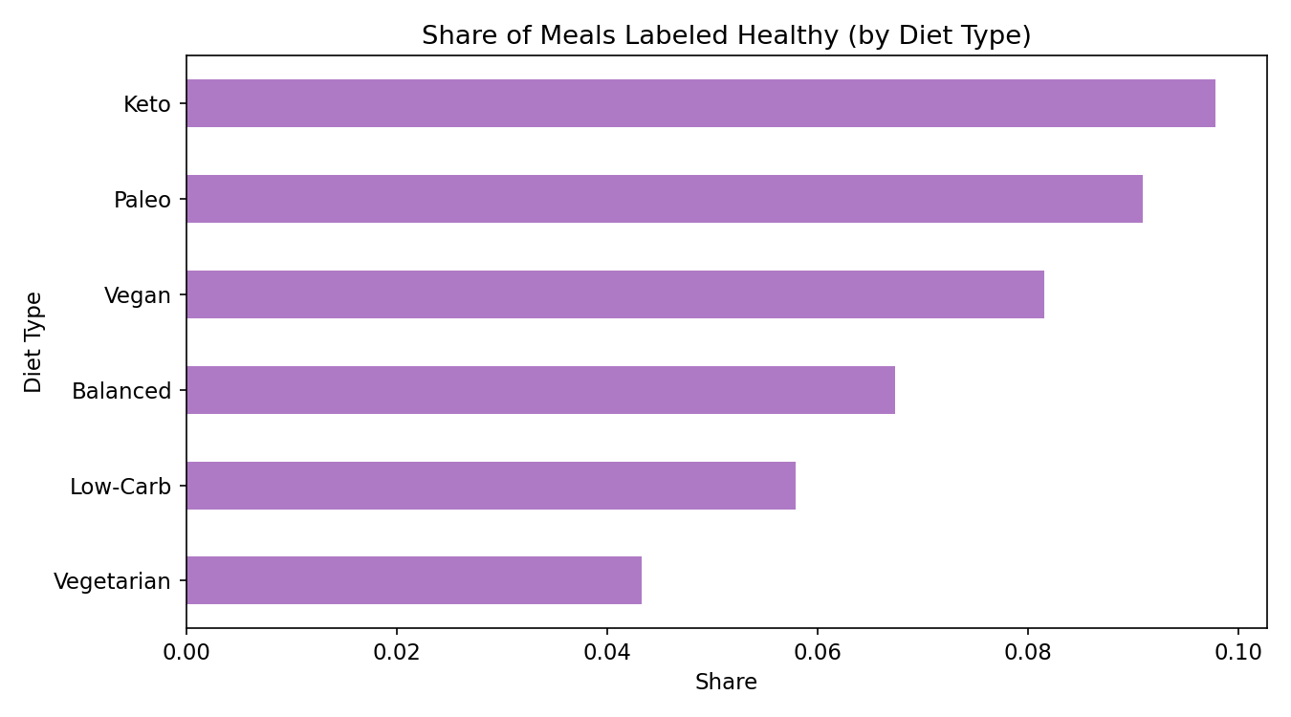
En Fig4 Healthy Ratio By Diet

Slide 7
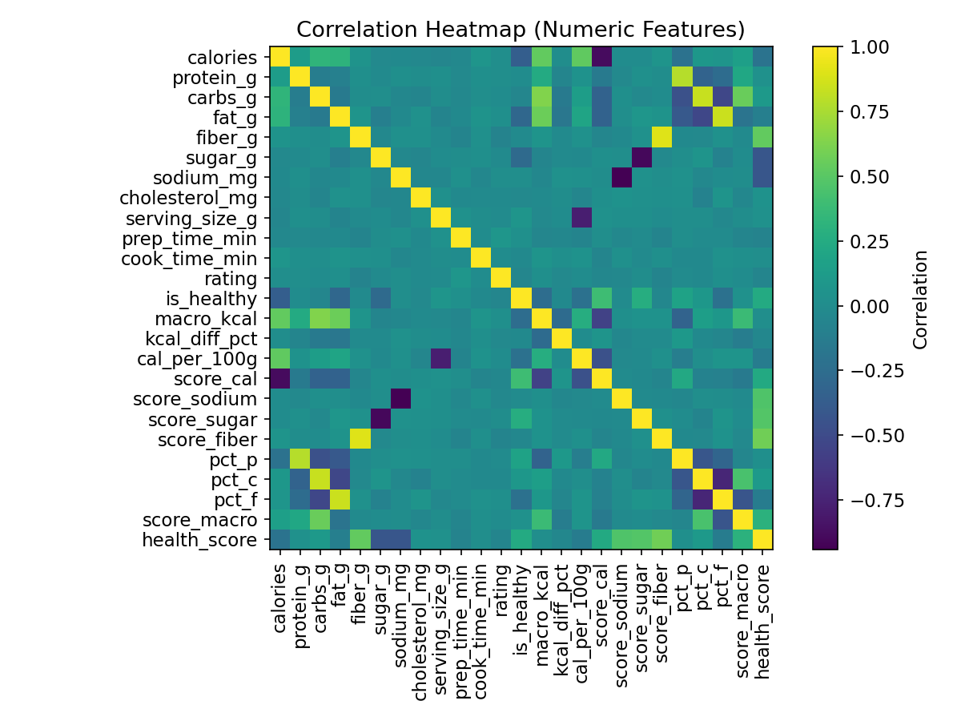
En Fig5 Corr Heatmap

