Slide 1
PROJECT : LOAN MANAGEMENT SYSTEM
BY HEEMANTH M S

Slide 2
OBJECTIVE :
SHEET 1 :
Import table from sheet 1- customer income status
set customer criteria based on applicant income
Applicant Income Criteria :
Applicant income >15,000 = grade a
Applicant income >9,000 = grade b
Applicant income >5000 = middle class customer
Otherwise low class
(Create this as new table)
Monthly interest percentage Criteria :
Applicant income <5000 rural=3%
Applicant income <5000 semi rural=3.5%
Applicant income <5000 urban=5%
Applicant income <5000 semi urban= 2.5%
Otherwise =7%

Slide 3
New field creation based on interest
Calculate monthly interest amt and annual interest amt based on loan amt
Create all the above fields as a table
Table name - customer interest analysis (create this into a new table and connect with sheet 2 (loan status) bring the output)
SHEET 2 – LOAN STATUS :
Create row level trigger for loan amt
Criteria
Loan amt null = loan still processing
Create statement level trigger for cibil score
Criteria
Cibil score >900 high cibil score
Cibil score >750 no penalty
Cibil score >250 penalty customers
Cibil score <=0 reject customers (loan cannot apply)
*Then delete the reject and loan still processing customers

Slide 4
SHEET 3 CUSTOMER INFO :
Import the table
Update gender and age based on customer id
SHEET 4 AND 5 COUNTRY STATE AND REGION :
Import the table
Join all the 5 tables without repeating the fields - output 1 *find the mismatch details using joins - output 2
Filtering information using inner join
Filter high cibil score - output 3
Filter home office and corporate - output 4
Store all the outputs as procedure

Slide 5
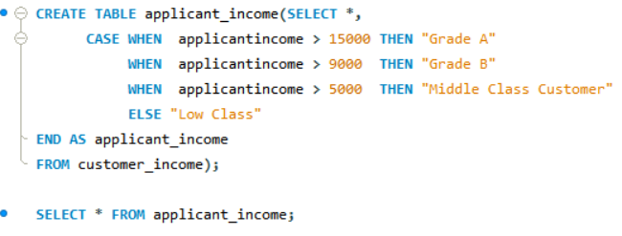
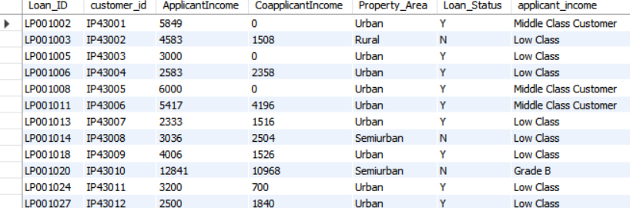
TASK 1
Imported table from customer_det.
Written query to set customer_criteria based on applicant income and Created table for the same separately.
Created tables applicant_name and monthly_interest_percent, which are then joined using inner join and new table is created namely customer_income_status
Table applicant_income
Table applicant_income sample output

Slide 6
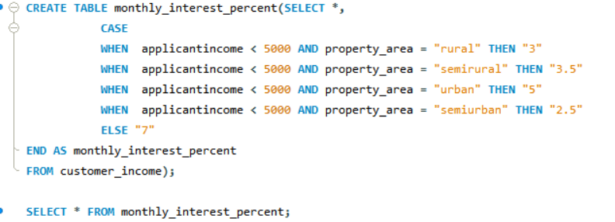
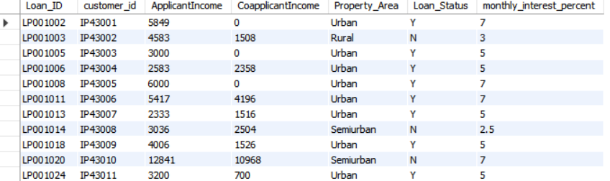
Table Monthly_interest_percent
Table Monthly_interest_percent
Sample Output

Slide 7
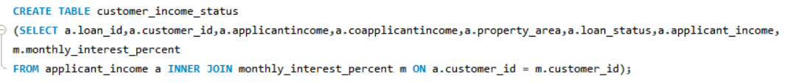
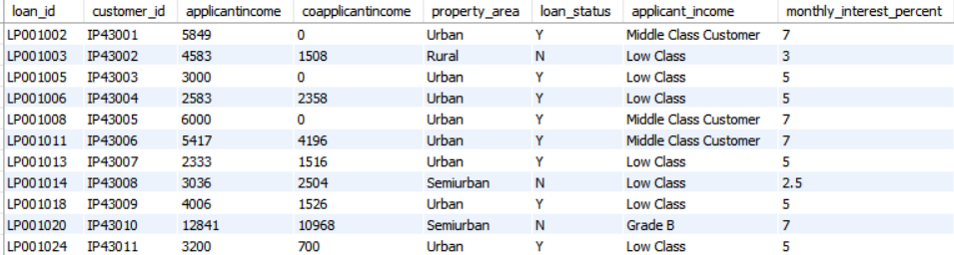
Table 1.customer_income_status
Table 1 sample output

Slide 8
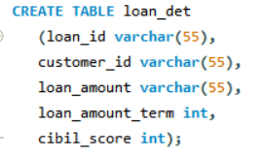
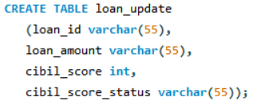
TASK 2
Created two tables namely loan_det , loan_update and delimiter has been set for the same based on criteria - loan amount and cibil score.
The values are then inserted .
Table loan_det
Table loan_update

Slide 9
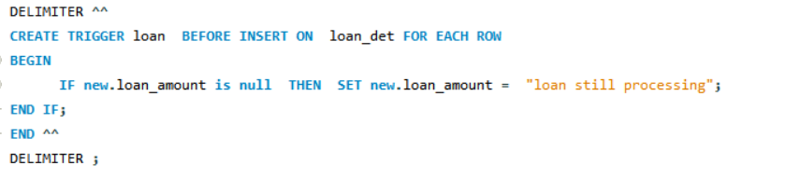
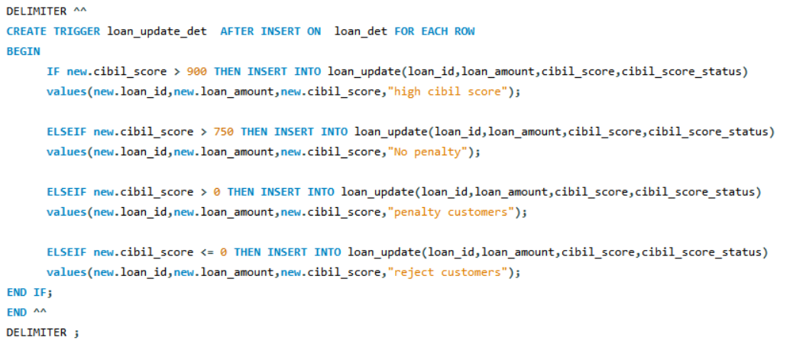
Delimiter set based on criteria
If loan amount null = loan still processing
Delimiter set based on criteria
If,
Cibil score > 900 “high cibil score”
Cibil score > 750 “no penalty”
Cibil score > 0 “penalty customers”
Cibil score <= 0 “reject customers”

Slide 10
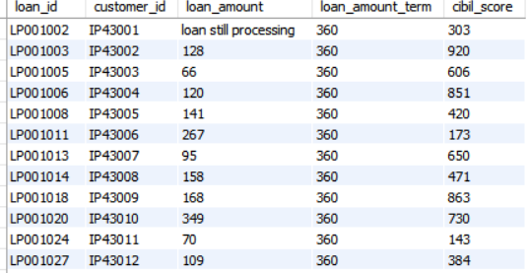
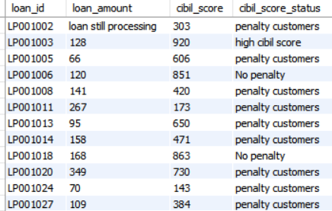
Table loan_det - sample output
Table loan_update - sample output

Slide 11
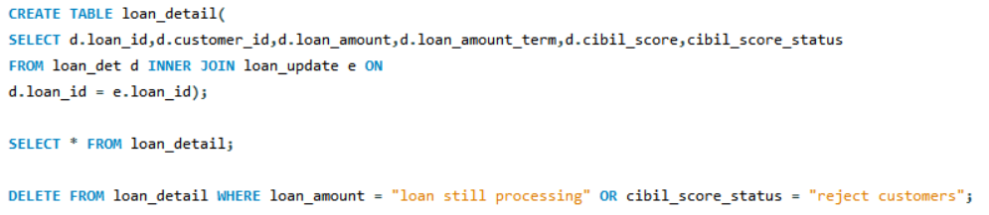
By using Inner join tables loan_det and loan_update are joined and new table named loan_detail is created.
Few rows are deleted in loan_detail where loan_amount = “loan still processing” or cibil_score_status = “reject customers .
Table loan_detail

Slide 12
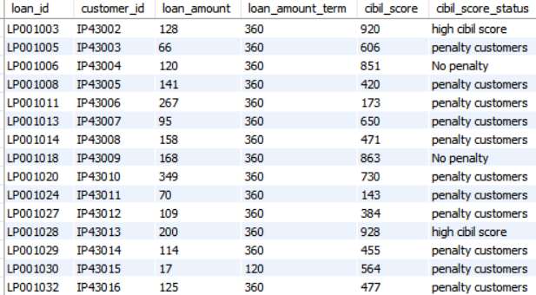
Table loan_detail – sample output

Slide 13
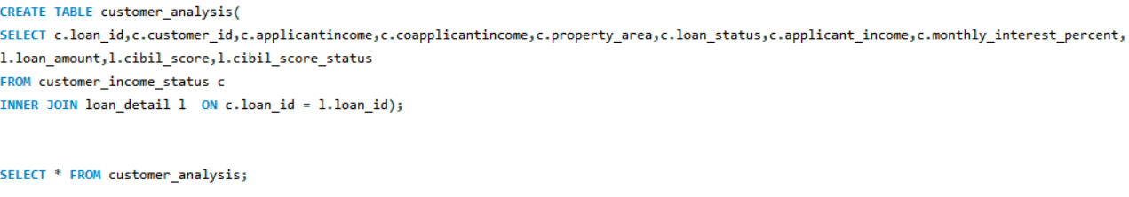
Created new table customer_analysis by using inner join to join two tables customer_income_status and loan_detail.
Contains updated columns such as cibil score status , monthly interest percentage and annual interest
percentage.
Table 2. customer_analysis

Slide 14
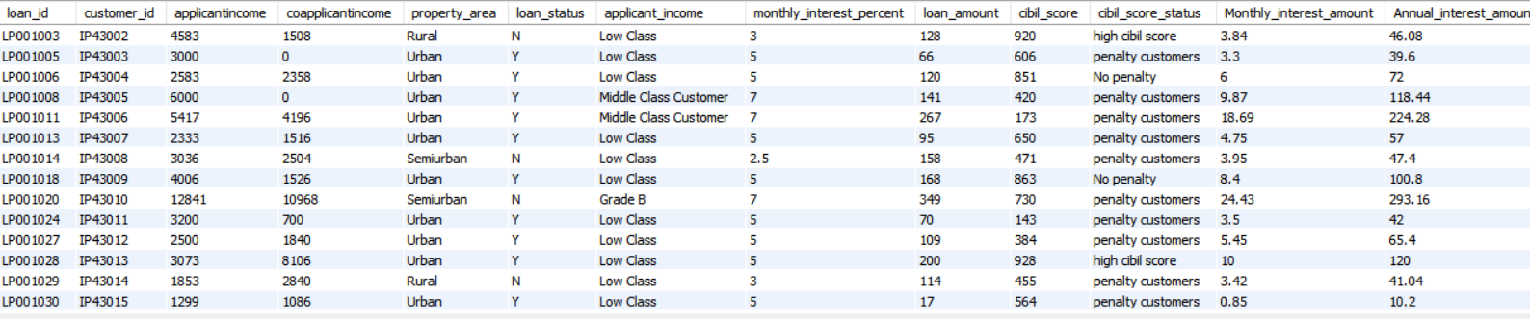
Table 2. customer_analysis – sample output

Slide 15
TASK 3
Imported table from customer_det.
Updated age and gender based on customer id.
Created new table customer_info containing updated age and gender along with table 2.customer_interest_analysis which is connected using inner join.
Table 3. customer_info

Slide 16
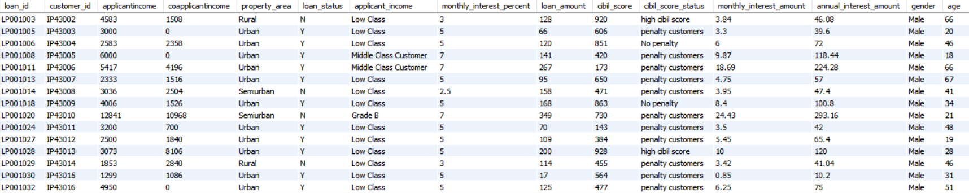
Table 3. customer_info - sample output

Slide 17
TASK 4
Imported table country_state and region_info .
Created new table region by joining tables country_state and region_info using inner join.
Joined all 5 tables namely (without repeating fields) :
Customer_income_status
Customer_analysis
Customer_info
Country_state
Region_info
Separate table named region_mismatch created to find mismatch details.
Created procedure based up on criteria given in objective.

Slide 18
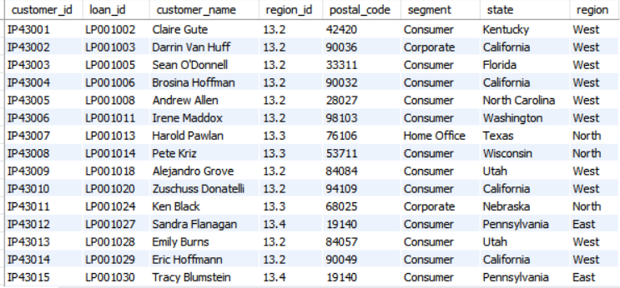
Table region
Table region – Sample output

Slide 19
Final Table : customer_region_info

Slide 20
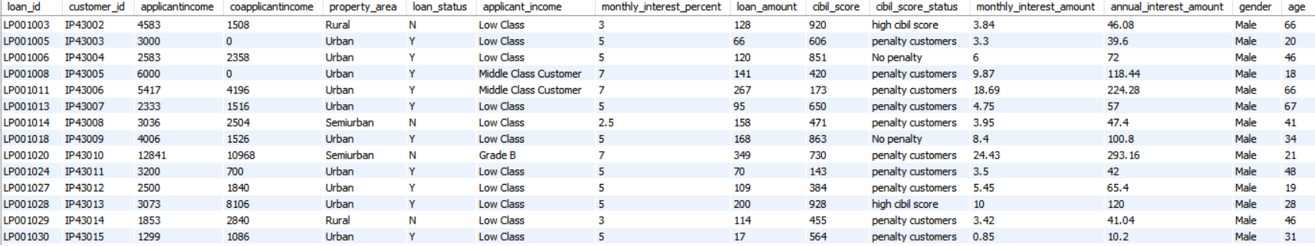
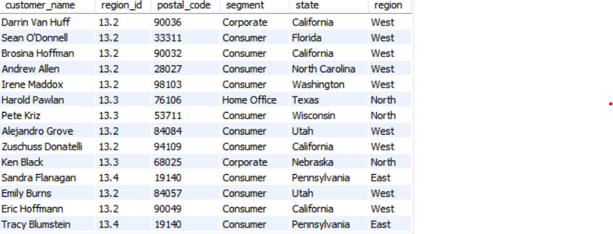
Table Final customer_region_info –Sample Output

Slide 21
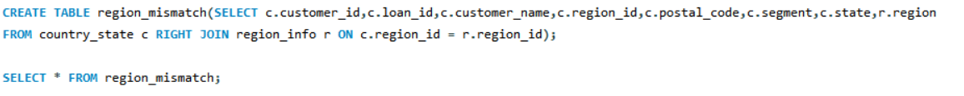
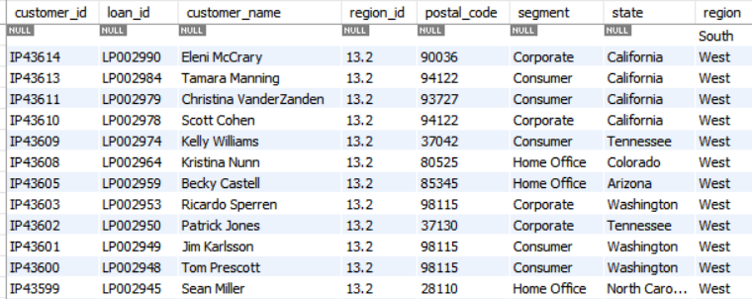
Table region_mismatch
Table region_mismatch – sample output

Slide 22
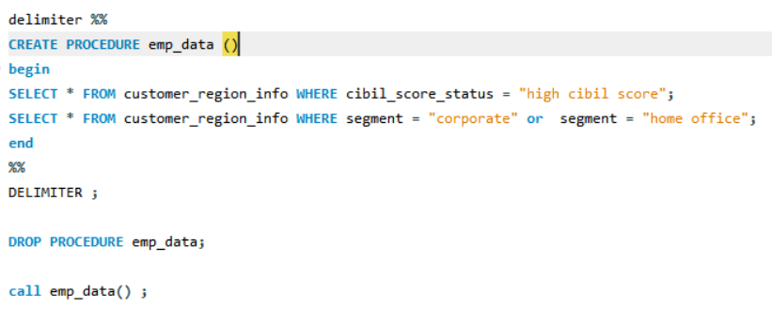
PROCEDURE BASED ON CRITERIA:
Where,
1.cibil_score_status = “high cibil score”
2.segment = “corporate” or segment = “home office”

Slide 23
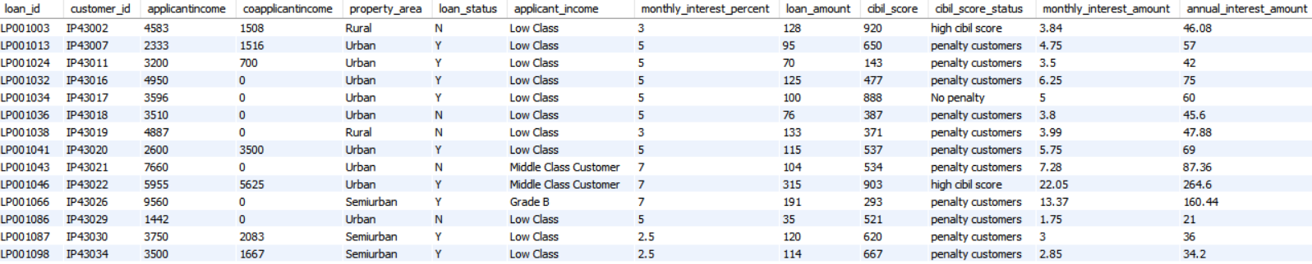
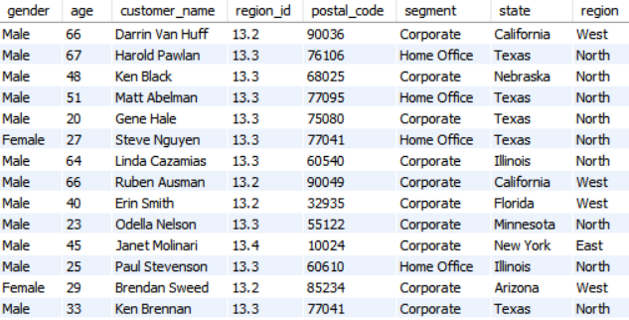
Procedure emp_data – Sample output

Slide 24
THANK YOU

