Slide 1
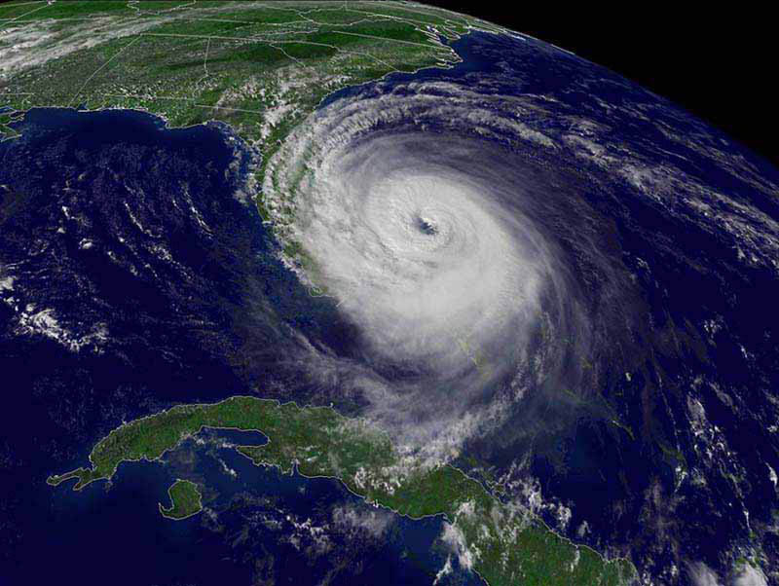

Urban Forest Hurricane Recovery Program
http://treesandhurricanes.ifas.ufl.edu

Slide 2
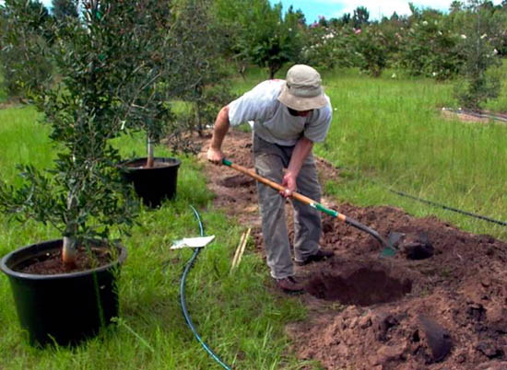
Planting and establishing trees
Dr. Edward F. Gilman and Traci Partin

Slide 3
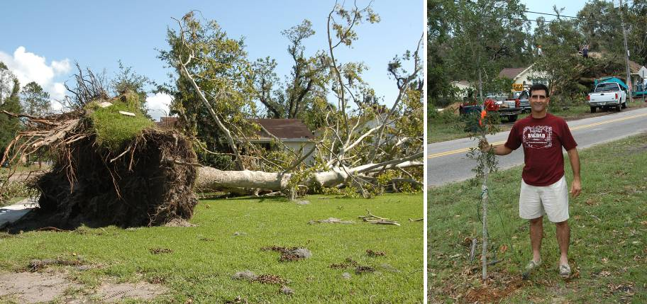
Remember!
If you remove a tree after a hurricane,
plant another one in its place.
http://orb.at.ufl.edu/FloridaTrees/index.html
Notes:
Visit the web site http://orb.at.ufl.edu/FloridaTrees/index.html for tree selection software

Slide 4
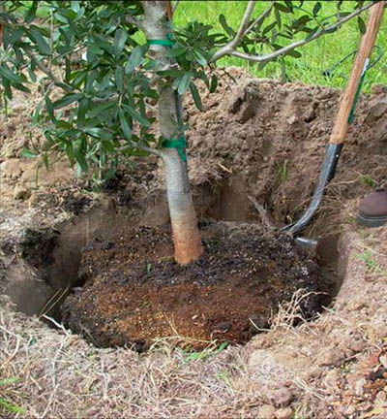
Steps for proper planting
Look up for wires/lights
Dig shallow/wide hole
Find the top-most root and treat root defects
Place tree in hole
Position top root 1-2 inches above landscape soil
Straighten tree
Remove synthetic materials
Add backfill soil and firm the root ball
Add mulch
Stake and prune if needed
Notes:
Ten simple steps to planting a tree.

Slide 5
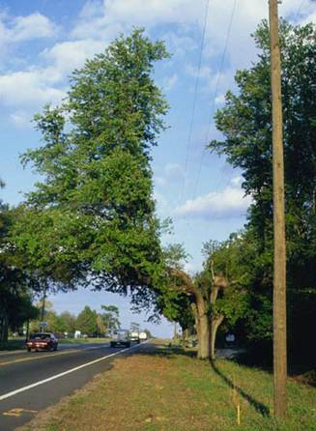
Look up!
This is your last chance to be sure you have selected the right tree for the right place.
If there is a wire, security light, or building nearby:
Plant elsewhere, or
Plant a small-maturing tree
Notes:
Unfortunately, many trees are planted too close to wires. This increases costs of providing electrical service and reduces reliability.

Slide 6
Steps for proper planting
Look up for wires/lights
Dig shallow/wide hole
Find the top-most root and treat root defects
Place tree in hole
Position top root 1-2 inches above landscape soil
Straighten tree
Remove synthetic materials
Add backfill soil and firm the root ball
Add mulch
Stake and prune if needed
Notes:
Ten simple steps to planting a tree.

Slide 7
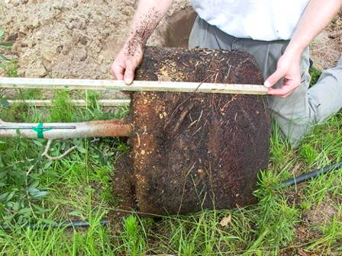
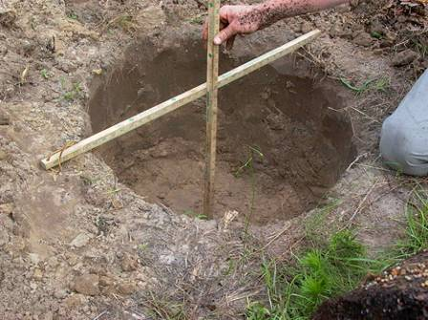
Measure the distance between the top most root and the bottom of the root ball.
Dig the hole to about 90 to 95% of this depth.
Notes:
This results in the point where the top-most root meets the trunk and inch or two above the landscape soil. This is appropriate for planting in well drained soils.

Slide 8
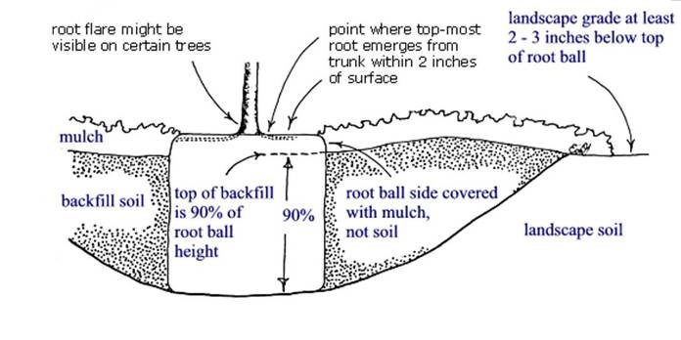
Dig the planting hole as wide as possible
The planting hole is at least 1.5 times the diameter of the root ball.
This provides loose soil for the expansion of new roots.
Notes:
The depth of the planting hole in the illustration above is about 90% of the depth of the root ball. No more than about 2 or 3 inches of the root ball needs to be above the soil unless the site is poorly drained. If the soil is poorly drained, plant even higher. If the hole was inadvertently dug too deep, add soil and compact it with your foot. Make the hole at least 1.5 times the diameter of the root ball. Breaking up compacted soil in a large area (out to the dripline of the tree) around the tree provides the newly emerging roots room to expand into loose soil. This will hasten root growth translating into quicker establishment.

Slide 9
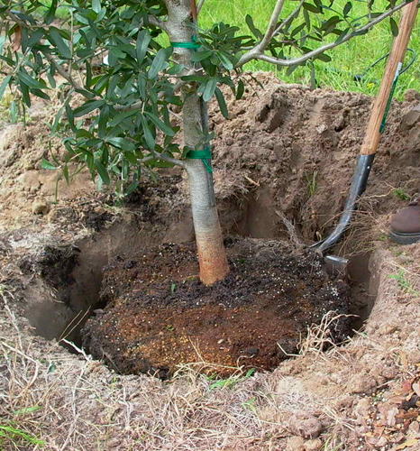
Steps for proper planting
Look up for wires/lights
Dig shallow/wide hole
Find the top-most root and treat root defects
Place tree in hole
Position top root 1-2 inches above landscape soil
Straighten tree
Remove synthetic materials
Add backfill soil and firm the root ball
Add mulch
Stake and prune if needed
Notes:
Ten simple steps to planting a tree.

Slide 10
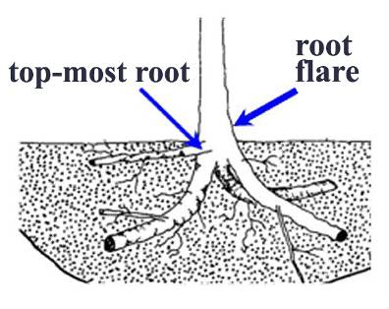
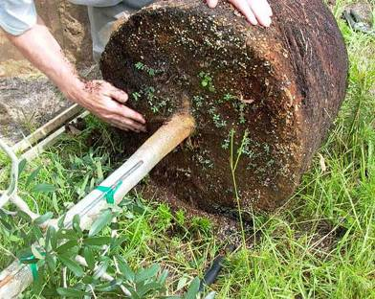
Find the top-most root
The point where the top-most root meets the trunk of the tree should be no more than 2 inches deep in the root ball.
Notes:
It is great if you can see the top-most root at the surface but not all root balls come from the nursery like that. The top most root in the root ball should be no more than 2 inches deep in the root ball.

Slide 11
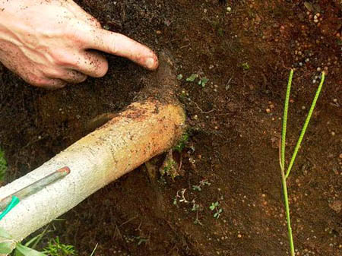
Desirable root ball
The point where the top-most root emerges from the trunk is at the surface. Encourage growers to grow trees like this to make it easy to check for root defects.
Notes:
The point where the top-most root emerges from the trunk is at the surface on this root ball. This is good and makes it easy to check for circling and stem girdling roots.

Slide 12
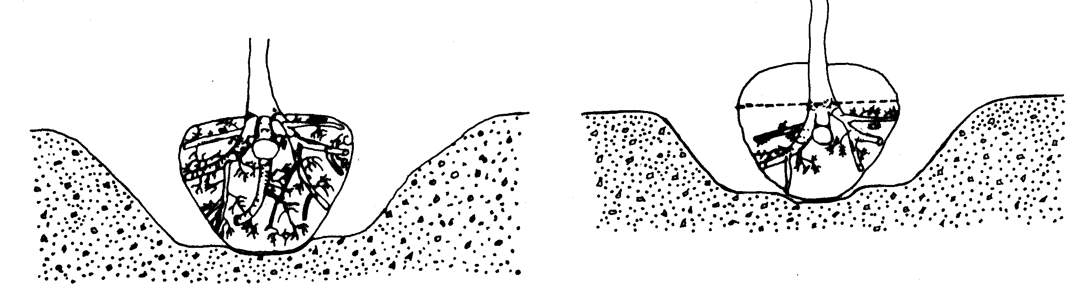
Root ball quality
Good-quality root ball
Remove excess soil
Poor quality root ball
(RIGHT) Too much soil on top of the root ball can indicate a poor-quality root ball.
(LEFT) Trees with the top-most root near the surface of the root ball have more of a root system.
Notes:
The highest-quality root balls have the point where the top-most root emerges from the trunk within 2 inches of the surface as shown at left. Poorer-quality root balls have the the top-most root and root flare (if present) buried down inside the root ball as shown at right. A close look at the two root systems above will show that trees with the top-most root too deep in the ball have less of a root system than trees with the top-most root near the surface. As the distance between the top-most root and the soil surface increases, the percentage of the root system harvested from the field nursery decrease.

Slide 13
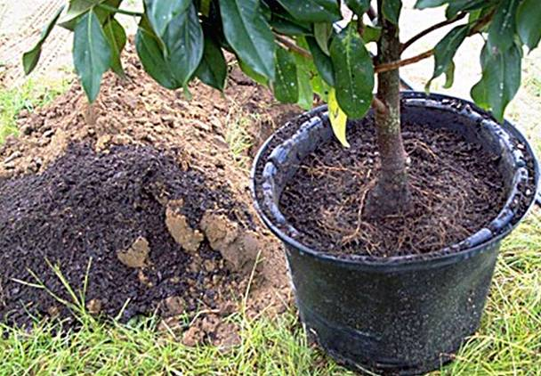
Remove excess soil
Remove excess soil from the top of the root ball.
Three inches of soil and media were removed from the top of this ball.
Notes:
There were no roots evident where the trunk met the root ball. This indicated that the point where the top-most root met the trunk might have been too deep in the root ball. The black media on the ground to the left of the container was just removed from the top of the container to expose the top-most root and the swollen root flare. After cutting the circling roots growing at the base of the trunk, this tree is ready for planting.

Slide 14
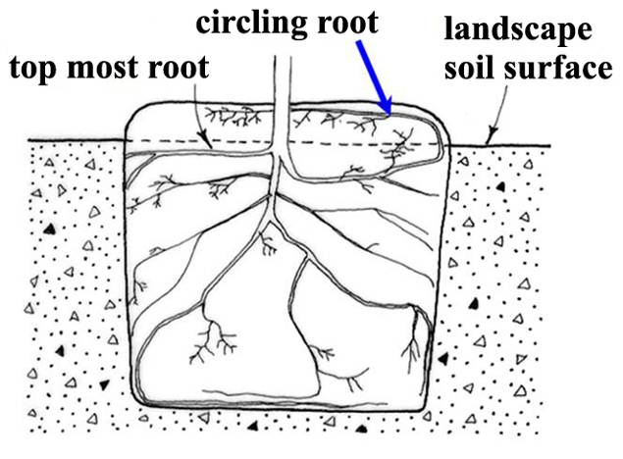
Treating root defects
Cut or spread out any circling or kinked roots growing up above the top-most root.
Notes:
To check for circling and kinked roots in containers or field-grown trees, you might have to displace or remove soil and media that is above the point where the top-most root emerges from the trunk. Cut or spread out any circling or kinked roots growing up into this media on top. Position the top-most root about even with or slightly above (like 2 inches above) the top of the landscape soil in well-drained soil. Plant even higher in soil that drains poorly.

Slide 15
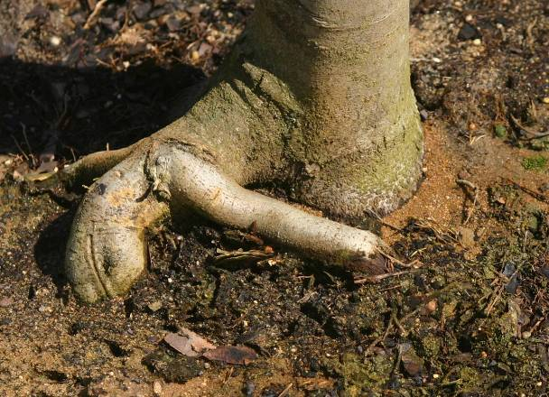
Defects at top of ball
Remove media from top of root ball and cut circling and crossed roots
Notes:
Cut root at dotted line to prevent root from strangling the trunk a few years from now.

Slide 16
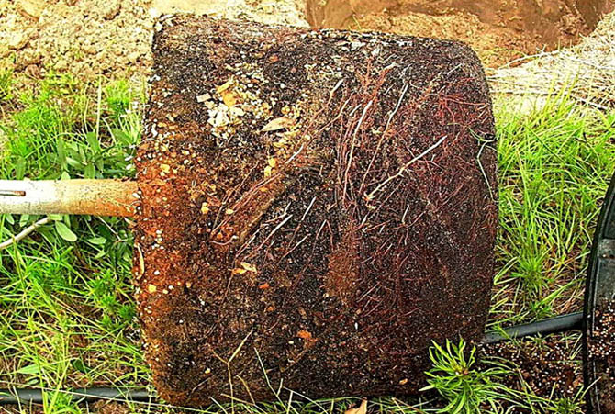
Circling roots – cut them, or tear up the edge of the root ball to spread roots out
Notes:
Look for roots that circle the outside of the container (arrows). These should be cut before planting.

Slide 17
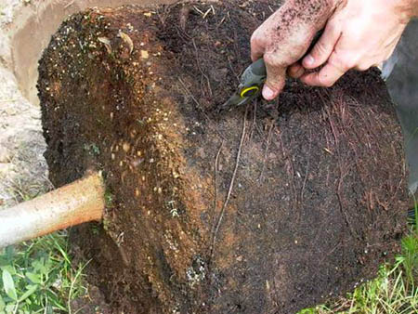
Cutting circling roots
New roots will grow quickly into backfill soil following cutting and stem girdling roots are less likely to form.
Notes:
Circling roots can be found on container trees, B&B trees (shown above) or bare root trees. Eliminate this defect by cutting roots at planting. This can be accomplished 1) on B&B or container trees with pruners before trees are placed in the hole or 2) by slicing the edge of a container root ball from top to bottom with a balling spade after trees are in the hole. Cut roots that are kinked or any that circle the top of the root ball. If these cut roots are large (larger than about 1/3 trunk diameter), the tree might shock and could die.

Slide 18
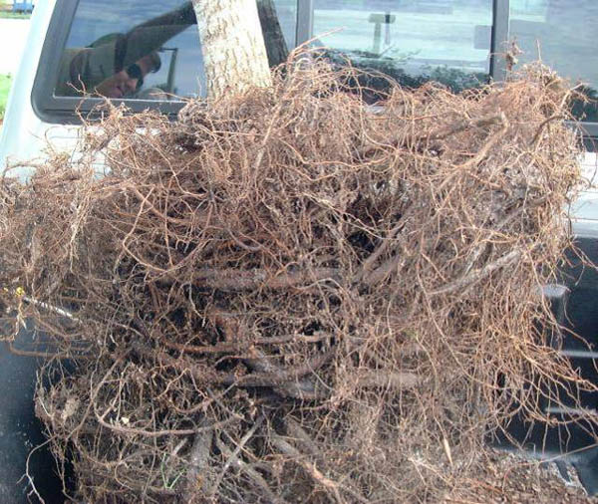
Defects can be inside root ball
Be sure to look for roots that circle when trees were in a smaller container
These are difficult to cut because they are hidden in the interior of the ball.

Slide 19
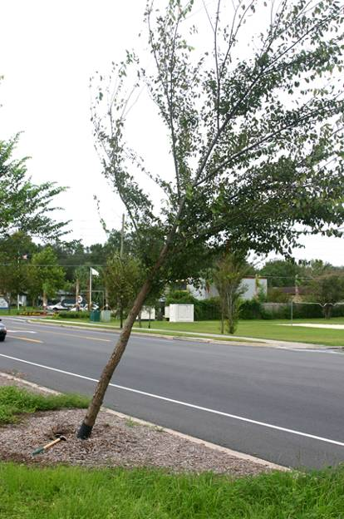
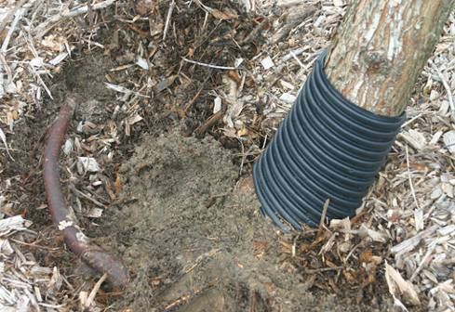
Trees with circling root defects are often found leaning or fallen after a storm.
Notes:
Circling roots do not always result in trunk girdling. This picture shows a tree with a healthy green canopy and no apparent above ground symptoms of root problems, however the tree developed a severe lean after a wind storm due to an issue with circling roots (see arrow).
Few branch roots form on the outside curve of a circling root, causing the tree to become unstable. Because few if any roots develop on the outside of a circling root there may be few if any supporting roots on one side of the tree. That is what happened for this elm tree.

Slide 20
Steps for proper planting
Look up for wires/lights
Dig shallow/wide hole
Find the top-most root and treat root defects
Place tree in hole
Position top root 1-2 inches above landscape soil
Straighten tree
Remove synthetic materials
Add backfill soil and firm the root ball
Add mulch
Stake and prune if needed
Notes:
Ten simple steps to planting a tree.

Slide 21
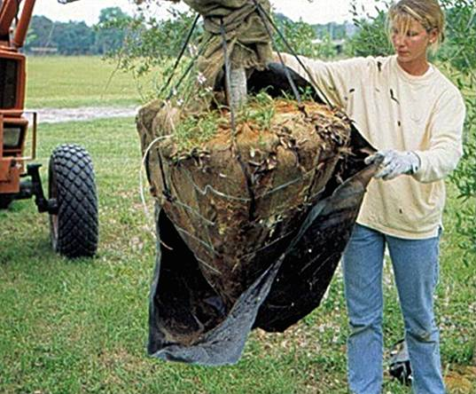
Lifting tree into the planting hole
To avoid damage when setting the tree in the hole, lift the tree with straps or rope around the root ball, not by the trunk.
Notes:
Special strapping mechanisms need to be constructed to carefully lift trees out of large containers and to handle large B&B trees as shown above. This prevents bark damage on the trunk and branches. B&B trees should be handled by the root ball as shown. Remove any plastic wrapped around the root ball before planting as shown above.

Slide 22
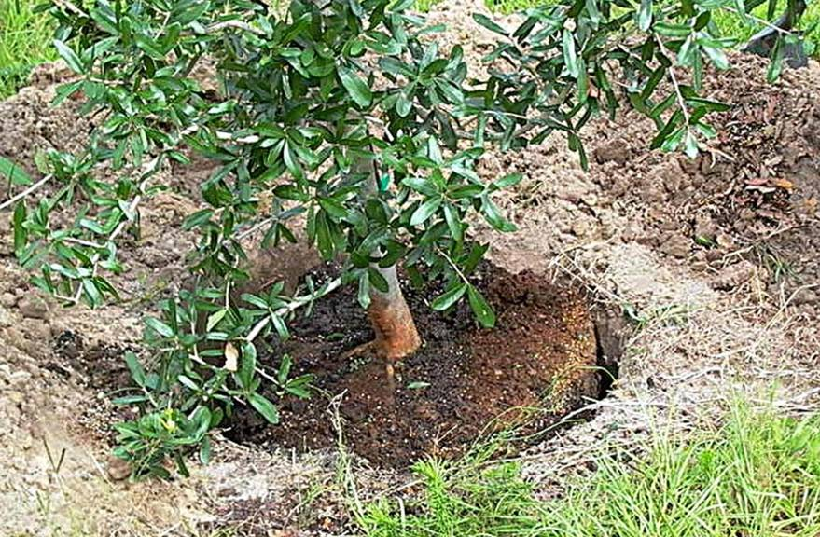
Set tree in the hole
Notes:
Set the tree in the hole preferable by lifting by the root ball or sliding the ball in. If you measure carefully the root ball will not have to be removed to adjust hole depth.

Slide 23
Steps for proper planting
Look up for wires/lights
Dig shallow/wide hole
Find the top-most root and treat root defects
Place tree in hole
Position top root 1-2 inches above landscape soil
Straighten tree
Remove synthetic materials
Add backfill soil and firm the root ball
Add mulch
Stake and prune if needed
Notes:
Ten simple steps to planting a tree.

Slide 24
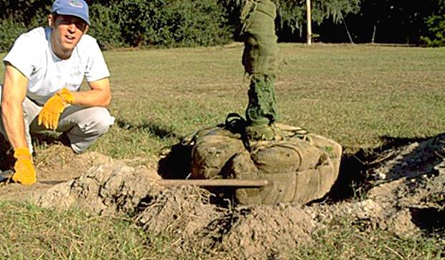
Position the tree in the soil
Many professionals agree that it is better to plant the tree a little high than too deeply.
When the top-most root is too deep in the root ball, set the top of the ball several inches higher than the landscape soil to adjust as shown above.
Notes:
The point where the top-most root emerges from the trunk on some trees may not be at the soil surface. This can result from deep planting in the nursery, soil naturally washing over the roots in the nursery, cultivation between rows, soil pushing in toward the trunk during the digging process, from soil shifting up the trunk during transportation, soil pushing against the trunk when the top of the root ball is squeezed to tighten the ball, or for other reasons. A shovel handle provides a convenient tool for gauging proper height. Shown is a shovel handle (see arrow) used to help position the root ball at the appropriate depth. Be sure to pack the bottom of the hole with your feet to prevent the tree from settling.

Slide 25
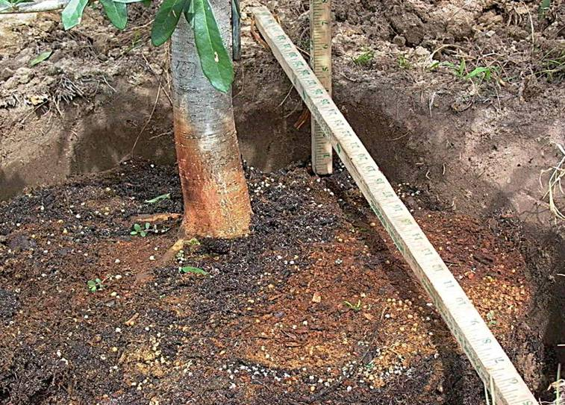
TOO DEEP! - add soil to bottom of hole
Notes:
Use a shovel or another convenient device for checking root ball depth. This hole is way too deep! Look carefully at the vertical ruler and you will see that the tree is about 6 inches too deep. Remove the root ball and add soil to the bottom of the hole and pack is by bouncing on it several times. If the tree is too deep, tip it from side to side or raise the tree up while sliding soil under it until the root system is at the appropriate depth

Slide 26
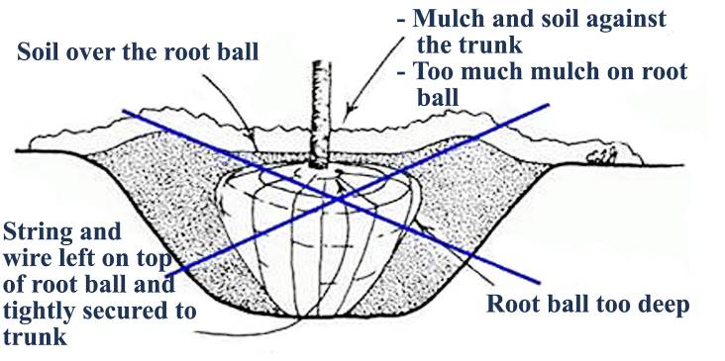
Effect of planting depth on stress after planting
Soil intercepts water meant for the root ball causing roots to dry out.
Notes:
This diagram shows many common mistakes made when planting trees.

Slide 27
Steps for proper planting
Look up for wires/lights
Dig shallow/wide hole
Find the top-most root and treat root defects
Place tree in hole
Position top root 1-2 inches above landscape soil
Straighten tree
Remove synthetic materials
Add backfill soil and firm the root ball
Add mulch
Stake and prune if needed
Notes:
Ten simple steps to planting a tree.

Slide 28
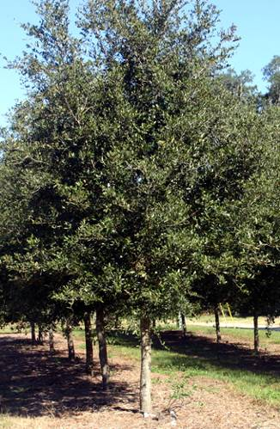
Straighten the tree
Before adding backfill, be sure to check that the tree is straight by looking at it from two perpendicular directions.
Notes:
Before you begin backfilling have someone view the tree from two directions perpendicular to each other to confirm the tree is straight. Fill in with some more backfill soil to secure the tree in the upright position. Once you add large amounts of backfill, it is difficult to reposition the tree.

Slide 29
Steps for proper planting
Look up for wires/lights
Dig shallow/wide hole
Find the top-most root and treat root defects
Place tree in hole
Position top root 1-2 inches above landscape soil
Straighten tree
Remove synthetic materials
Add backfill soil and firm the root ball
Add mulch
Stake and prune if needed
Notes:
Ten simple steps to planting a tree.

Slide 30
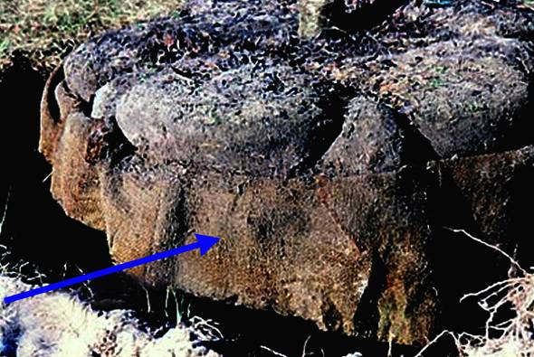
Balled-in-burlap trees
Burlap should be removed from the bottom of the trunk and the top of root ball.
Notes:
Some contractors leave the burlap pinned in place. This seems to be alright as long as the top-most root is not too deep and there are no root defects to treat. Removing burlap from the top of the ball allows you to check for root defects including deep planting in the root ball and circling roots. If the burlap is made from synthetic material that will not decompose, remove all of it at planting.

Slide 31
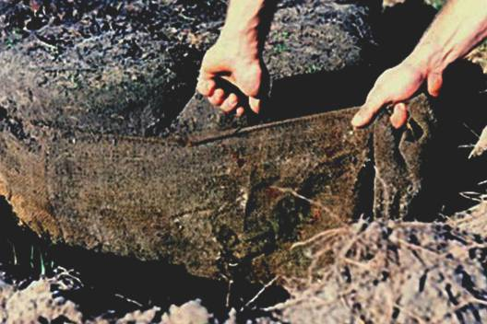
Remove all synthetic burlap
Synthetic burlap melts into a plastic goo while real burlap flames and turns to ash when lit.
If burlap is synthetic, be sure to remove all of it with a pruner, knife or other sharp blade.
Notes:
The top tier of wire on this wire basket was removed when this tree was planted making it easier to remove synthetic burlap.

Slide 32
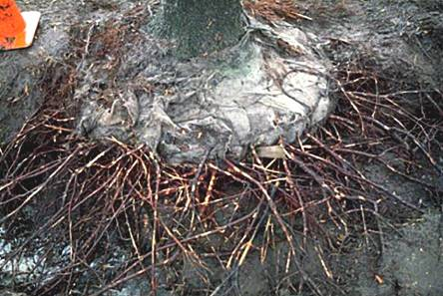
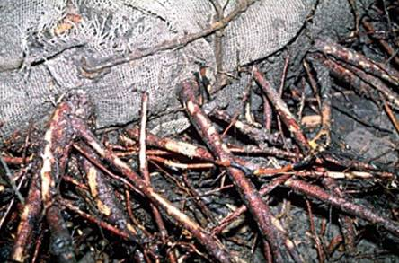
Synthetic burlap can girdle roots
Roots grow through artificial burlap with little difficulty, but as the roots attempt to expand in diameter, they become girdled or strangled.
Each of these roots is very easy to break off at the burlap because there is very little wood that developed through the burlap.
Notes:
These trees were struggling about ten years after planting. The close up on the bottom shows that roots are able to grow through artificial burlap but are unable to expand in diameter sufficiently to remain vigorous. The artificial burlap is still intact 10 years after planting. Only natural burlap, either treated or not treated, should be used for wrapping root balls.

Slide 33
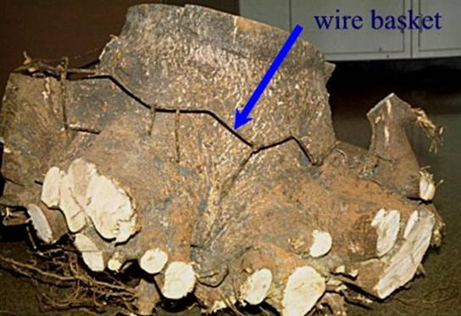
Wire baskets
Baskets made from heavy gauge wire are often used to help keep a root ball intact during shipping and handling.
There is no research documenting the detrimental effects of wire baskets on trees.
Notes:
The dead maple that was excavated above was planted with a wire basket. This does not mean the basket killed the tree because many factors are associated with tree death in urban landscapes. Live oaks appear to grow around a wire basket just fine with little or no effect on the tree. If wire was a huge problem I would think we would know about it by now because there would be reports of problems from all corners of the industry – this has not happened. Some arborists have stated that the wire basket can present a risk to the operator of a stump grinder, or could damage the machine itself, should the tree need to be removed from the landscape and the stump ground before the wire degrades.

Slide 34
Steps for proper planting
Look up for wires/lights
Dig shallow/wide hole
Find the top-most root and treat root defects
Place tree in hole
Position top root 1-2 inches above landscape soil
Straighten tree
Remove synthetic materials
Add backfill soil and firm the root ball
Add mulch
Stake and prune if needed
Notes:
Ten simple steps to planting a tree.

Slide 35
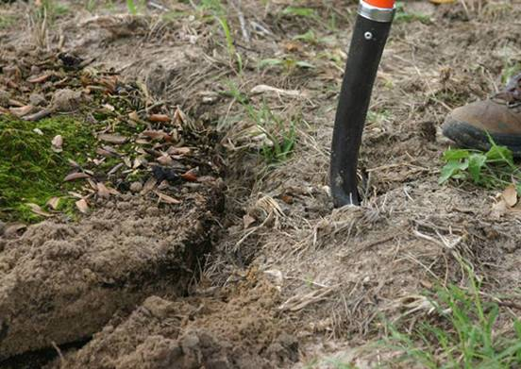
Cut into the backfill
Slice a shovel into the soil at the edge of the hole to enlarge the hole.
Push this soil against the root ball.
Notes:
Slice a shovel into the soil around the edge of the hole and push it toward the root ball. Then use landscape soil to finish filling in around the root ball. Slice the shovel into the backfill soil 20 to 30 times all around the tree as you add backfill soil. Attempt to break up the large clayey soil clumps as much as possible. Do not pulverize the soil because small soil clumps help add air space to the soil. When the planting hole is filled with soil the root ball should remain 1 (small trees) to 3 (larger trees) inches above the backfill soil.

Slide 36
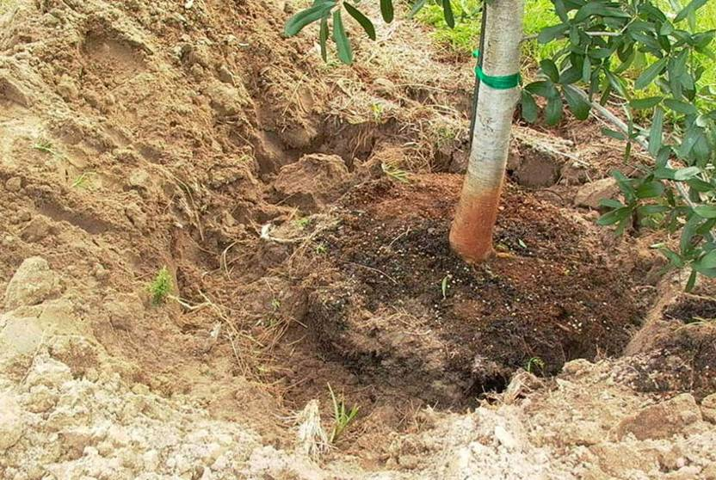
Enlarged hole and loosened soil
Notes:
Enlarging the hole by loosening the soil at the edge of the hole is an easy method of making a big area of loose soil without digging a giant hole. Here you can see a large area of loose soil being constructed around the root ball. Click to the next slide to see finished large loose soil area.

Slide 37
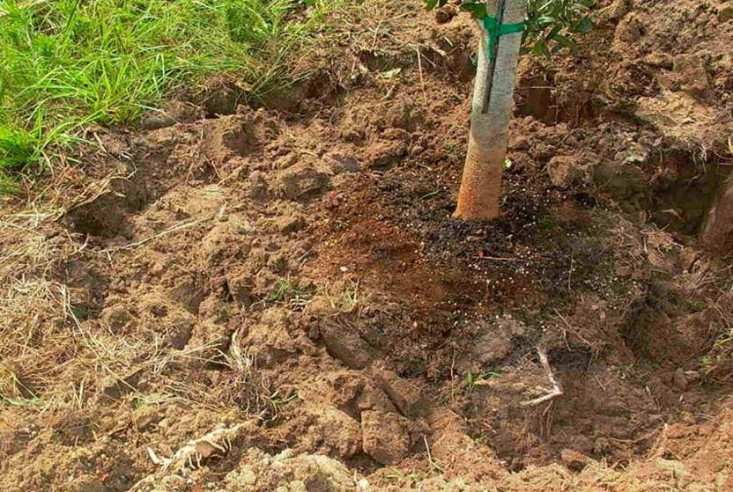
Moderately pack the backfill soil
Notes:
The root ball is now surrounded by about 18 inches of loose soil on all sides. No soil was placed over the root ball – you can clearly see the media of the container root ball near the trunk. Roots will grow freely into this loosened soil and help trees establish quickly. Moderately pack the backfill soil so root ball does not move. Do not over pack, especially when soil is wet.

Slide 38
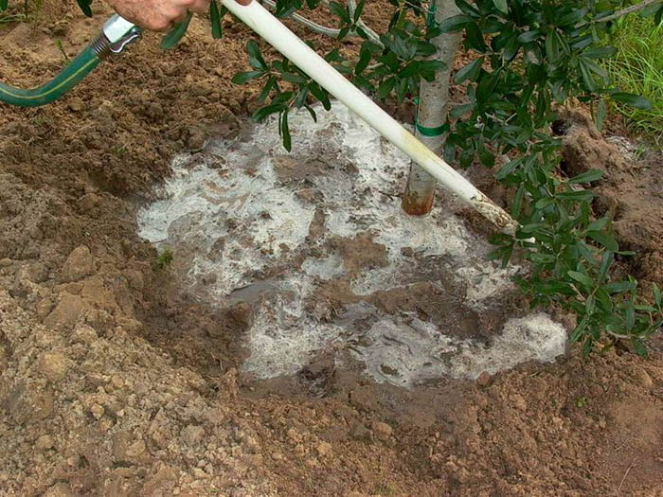
Water the backfill to settle
Notes:
Add water to the root ball and soil after adding the backfill soil. Here you see a one-inch pvc pipe being inserted into the backfill soil. This is an effective means of eliminating air pockets around the root ball. Add 10 to 20 gallons of water to the root ball and backfill on a small tree pictured here, more for larger trees. Fill in any holes or depressions with additional backfill soil. Do not firmly pack backfill soil in an attempt to eliminate air pockets because this could cause too much soil compaction. The water infiltrating the backfill soil will eliminate the large air pockets. The presence of small air pockets could even be of benefit because they could allow more air to reach the roots.

Slide 39
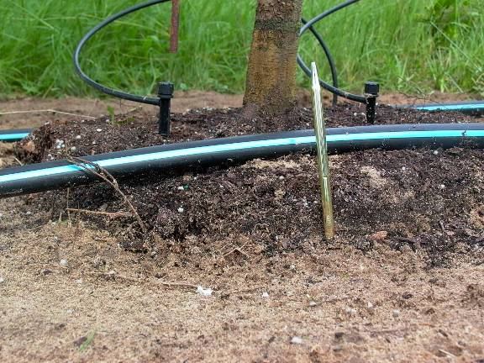
Ready for mulch
About two inches of the root ball should remain above ground after all the backfill soil is added.
This ensures the top-most root remains above ground, even if the root ball settles.
Notes:
Mulch will cover the sides of the ball but will not be placed on top. A thick layer of mulch placed on top of the ball could cut off oxygen and water to roots. Leave this open to the air. Recent research showed that mulch OVER the root ball provides NO BENEFIT to the tree, and it could hurt by reducing air exchange and reducing water infiltration into the root ball. Mulch over the root ball can also encourage growth of stem girdling roots next to the trunk. The root ball should not settle very much if the bottom of the hole is packed with your feet.

Slide 40
Steps for proper planting
Look up for wires/lights
Dig shallow/wide hole
Find the top-most root and treat root defects
Place tree in hole
Position top root 1-2 inches above landscape soil
Straighten tree
Remove synthetic materials
Add backfill soil and firm the root ball
Add mulch
Stake and prune if needed
Notes:
Ten simple steps to planting a tree.

Slide 41
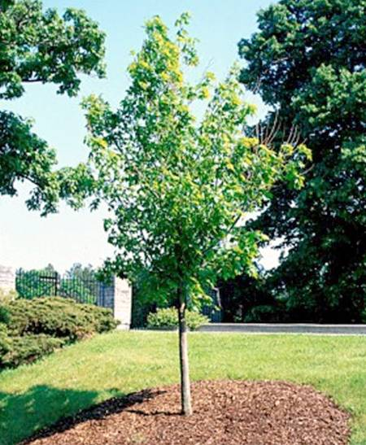
Mulching
Apply a 3-inch thick layer of mulch to at least an eight-foot diameter circle
Apply a thinner 1” layer of mulch over the root ball if necessar, but keep it at least 10” from the trunk
Notes:
Apply a 3-inch thick (after settling) layer of mulch to at least an eight-foot diameter circle around the plant, or maintain the area weed free with herbicides, to help discourage weeds and turf. This area should be maintained during the establishment period at least two feet in diameter (preferably three feet) for each inch of tree trunk diameter (to encourage rapid establishment. Minimum diameter should be eight feet for trees with a trunk diameter less than 3 inches. Apply a thinner layer of mulch over the root ball, for aesthetic reasons if you wish, but keep it at least 10 inches from the trunk (20-inch diameter mulch-free area) so the trunk bark can dry. This also allows rainwater, irrigation, and air to easily enter the root ball since it does not have to drain through the mulch. Mulch resting on the trunk and applying too thick a layer can kill the plant by holding water meant for the roots, oxygen starvation, death of bark, stem and root diseases, prevention of hardening off for winter, vole and other rodent damage to trunk, keeping the root ball too wet, encouraging stem girdling roots, and repelling water if the mulch dries out.

Slide 42
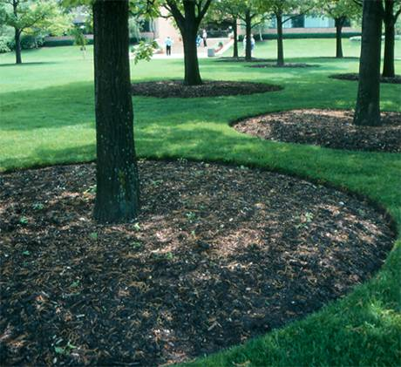
Mulching
Mulch as large an area as possible to allow the tree roots to expand without competition from turf roots.
Notes:
Turf roots are very competitive with tree roots. This competition can dramatically slow the rate of tree root growth and establishment into the landscape soil, and this can cause the tree to become unhealthy. Once the tree is established, the mulch area can shrink.

Slide 43
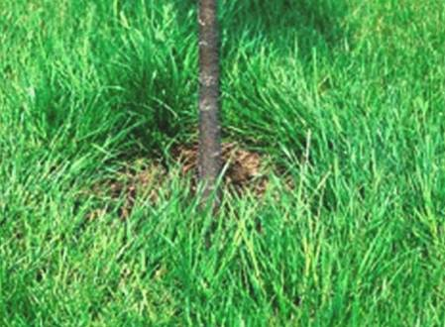
Improper mulching
If turfgrass grows up to the trunk, trees often perform poorly.
Turf and weeds rob trees of moisture and nutrients and some produce chemicals that inhibit tree growth.
Lawn mowing equipment damages trunk
Notes:
If turf grass grows up to the trunk, trees often perform poorly (Watson and Green, 1989; Gilman et al 2004). Turf and weeds rob trees of moisture and nutrients, and some produce chemicals that inhibit tree growth.

Slide 44
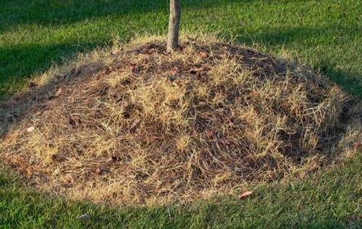
Improper mulching
Never pile mulch in a volcano-like manner against the trunk. This can rot the trunk, cut off oxygen to roots, keep vital irrigation and rain water out, and can keep roots too wet in poorly drained soils. Stem girdling roots form from this on some trees.
Notes:
Some rodents, such as voles, can also cause damage to the trunk easily if mulch is piled there. Trees could decline from this problem.

Slide 45
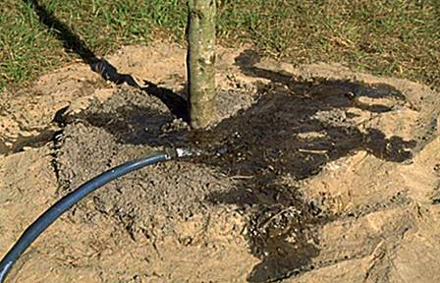
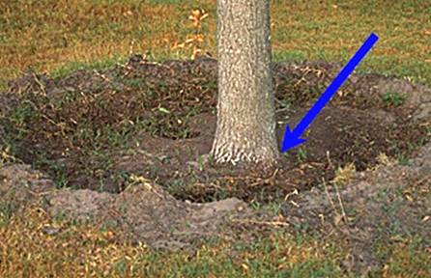
Adding a berm
A 3 to 4-inch berm could be constructed at the edge of the root ball to prevent water from running off as seen here.
Prevent soil from washing over the root ball by covering berm with a 3 to 4-inch layer of mulch, or by constructing the berm entirely from mulch.
Notes:
If you believe a berm is needed to hold water from a high volume delivery system such as a large hose or water trunk, use mulch, not soil to construct a berm. Soil can wash over the root ball with time burying the roots too deep. The berm will ensure that water penetrates to where it is needed most, i.e. in the root ball. If soil is sandy or very well drained, a berm may not be needed.

Slide 46
Steps for proper planting
Look up for wires/lights
Dig shallow/wide hole
Find the top-most root and treat root defects
Place tree in hole
Position top root 1-2 inches above landscape soil
Straighten tree
Remove synthetic materials
Add backfill soil and firm the root ball
Add mulch
Stake and prune if needed
Notes:
Ten simple steps to planting a tree.

Slide 47
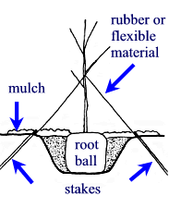
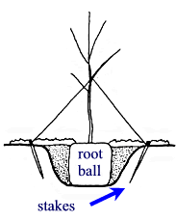
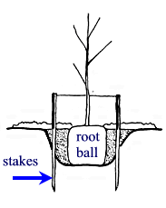
Traditional staking methods
Figure 1
Figure 2
Figure 3
All these systems require removal within one year of planting.
Notes:
Figure 1: Three short stakes (2 shown) attached to the trunk with straps, similar material. Stakes driven in as shown above may be better secured in the soil than those shown in Figure 2.
Figure 2: Three short stakes (2 shown) driven into soil in a traditional manner attached to the trunk with stretchable material.
Figure 3: Two or three (2 shown) 2 x 2 (or lodgepole pine) wood stakes driven through the backfill soil.
Recent research shows that stakes driven straight into the ground, not at an angle as shown in Figures 1 and 2 above, are most secure in the soil.

Slide 48
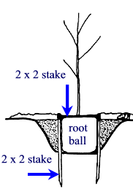
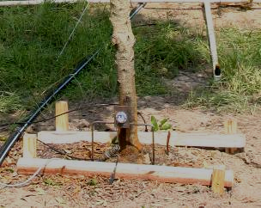
Alternative staking methods
Figure 4
Figure 5
This inexpensive alternative staking system does not need to be removed because they simply decay in a few years.
Notes:
Figure 4: Photo of the system shown in Figure 5.
Figure 5: One horizontal 2 in. x 2 in. screwed to two vertical 4 feet long 2 x 2s against the side of the root ball. This works for trees at least 3 inch caliper.

Slide 49
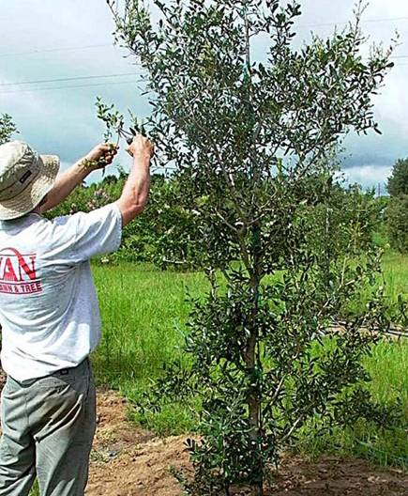
Prune to finish the job
Remove broken branches.
Perform structural pruning if needed.
Do not prune to compensate for root loss.
Notes:
Prune to remove or reduce codominant stems if no pruning is planned in the next couple years. Wait until later if there is pruning is planned in the next two years.

Slide 50
Fertilizer at planting?
Not necessary – fertilizing at planting time is not likely to improve survival or growth. A small benefit might occur in very poor soil.
Soluble fertilizers could burn roots if too much is applied, which could injure or kill the tree.
Notes:
Adding slow release fertilizer of any type at planting has never been associated with improved or reduced survival. Response to fertilizer applications at planting is most likely to occur in poor soils. Application of slow release fertilizer is not likely to hurt the plant provided it is applied according to the directions on the product. On the other hand, adding soluble fertilizer to a newly installed plant could burn roots if too much is applied. Burned roots will injure the plant and could kill it. Since survival will not be improved, growth increases are unlikely (except in very poor soils), and the potential for fertilizer burn is real, it might be best to make the first fertilizer application at least a few months after planting. Any nitrogen source can be applied to established trees with about the same effect on the tree.

Slide 51
Establishment
Establishment period: the time it takes for a tree to regenerate enough roots to stay alive without irrigation. In dry climates (western US), many trees will need supplemental irrigation well past the establishment period.
Roots grow to pre-transplanting length
Trunk and shoot growth match pre-transplant rate
Time: about 3 - 4 months/ inch trunk caliper in Florida
Notes:
In moist climates, by the end of the establishment period a tree has regenerated enough roots to keep it alive without supplemental irrigation in a landscape where roots can expand uninhibited by urban structures. In the drier parts of central and western US, the turf and landscape irrigation system may have to supplement rainfall to provide enough water for survival after establishment. Trees in unirrigated landscapes in dry climates may need supplemental irrigation beyond the end of the establishment period. This is especially important if the trees are not adapted to the dry climates.

Slide 52
Establishment rate is influenced by a variety of factors
Encourages growth | Limits growth | Little or no effect
Loose soil | Compacted soil | Peat or organic matter added
Proper irrigation | Little or no irrigation | Water absorbing gels
Mulch 8’ around planting hole | Grass and weeds close to trunk | Root stimulant products
Root flare above soil surface | Planting too deeply | Adding spores of mycorrhizae *
Leaving shoots intact | Pruning at planting | Fertilizing at planting
Notes:
Climate in another factor influencing establishment – in warm, wet climates the period will be much shorter than in dry, cold climates. The longer the growing season, the less time needed for establishment.
*can enhance growth on seedlings under certain circumstances

Slide 53
During establishment
Irrigate
- 2 – 3 times weekly until established
- 2 gallons per inch trunk caliper on root ball
Mulch
- Control weeds
- Increase mulch diameter over time to keep
pace with root growth
Minimize soil compaction
Remove stakes, protect lower trunk
Notes:
Trees provided with regular irrigation through the first growing season after transplanting require approximately 3 months (hardiness zones 9-11), 6 months (hardiness zones 7-8), or one year or more (hardiness zones 2-6) per inch of trunk diameter to fully establish roots in the landscape soil. Trees in desert climates may take longer to establish. Trees that are underirrigated during this establishment period are likely to require additional time to establish because roots grow more slowly. Most trees are underirrigated during the establishment period. Because roots are not fully established, be prepared to irrigate through the entire establishment period, especially in drought. Since most root growth occurs in summer, be sure soil moisture is appropriate during this crucial season.

Slide 54
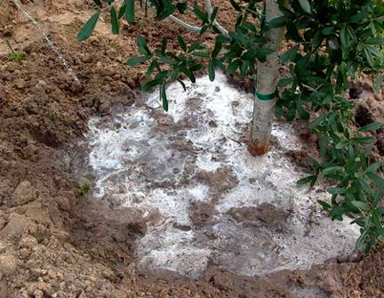
Irrigation: is it volume or frequency?
It’s frequency!
Experiment done on 4-inch hardened-off B&B trees where 1.5, 3, or 5 gallons of water were applied per inch trunk caliper.
Results show that volume did not matter but frequency did.
Notes:
Irrigating daily makes for healthier trees, but 2-3 times per week keep plants alive.

Slide 55
Frequency of irrigation based on tree size
Size of nursery stock | Irrigation schedule for vigor | Irrigation schedule for survival
< 2 inch caliper | Daily: 2 weeks Every other day: 2 months Weekly: until established | Twice weekly for 2-3 months
2 – 4 inch caliper | Daily: 1 month Every other day: 3 months Weekly: until established | Twice weekly for 3 – 4 months
> 4 inch caliper | Daily: 6 weeks Every other day: 5 months Weekly: until established | Twice weekly for 4 – 5 months
Notes:
Do not irrigate daily when planting in winter, cool climates, or during the rainy season. Irrigation frequency can be reduced to 2-3 times each week instead. Never apply irrigation if the soil is saturated.
Establishment takes 3 months (hardiness zones 10-11) to 4 (hardiness zones 8-9) to 8 (hardiness zones 6-8) to 12 (hardiness zones 2-5) per inch trunk caliper.
At each irrigation, apply 1-2 gallons (cool climates) or 2-3 gallons (warmest climates) per inch trunk caliper to the root ball. Apply it in a manner so all water soaks into the root ball. Do not water if root ball is wet/saturated on the irrigation day.

Slide 56
Months of irrigation to provide based on climate and tree size at planting
 | USDA Hardiness Zone
Max. trunk diameter at planting | 5 | 6 | 7 | 8 | 9 | 10
1 inch | 12 months | 10 months | 7 months | 5 months | 3 months | 3 months
2’’ | 24 | 20 | 15 | 10 | 6 | 6
3’’ | 36 | 30 | 23 | 16 | 9 | 9
4’’ | 48 | 39 | 30 | 21 | 12 | 12
Notes:
Maximum recommended tree size at planting depends on climate and how long trees can be irrigated after planting. For example, if irrigation can be provided for six months after planting in USDA hardiness zone 9, maximum trunk diameter at planting is two inches. Basically, this graph shows that areas with a longer growing season require less irrigation time for tree establishment. Also, the greater the size of the tree diameter at planting, the longer a period of time is needed for irrigation.

Slide 57

This tree is planted too deeply
By the way this tree is planted correctly
Notes:
Point out that the slide they have been seeing on each outline slide is planted too deeply (right photo). The tree on the left is positioned correctly.

Slide 58

Summary of proper planting
For more information on related topics…
Visit the website Trees and Hurricanes:
http://treesandhurricanes.ifas.ufl.edu
Notes:
This sums up the entire presentation. Proper hole depth and width, proper planting depth, a gently sloping 3 to 4 inch soil berm covered with mulch, mulch applied around ball but not applied on the root ball, and provisions for irrigation.

