Slide 1
Bank Marketing
Term Deposit Subscription Prediction
MBA Machine Learning Project
Only 11% of calls converted — Machine Learning identifies who to call next.
Dataset: UCI Bank Marketing | 41,188 calls | Portuguese bank | 2008–2010
Heena Kauser | 2527724
Slide 1 of 8

Slide 2
The Problem and the Data
Why the bank needed machine learning
THE BUSINESS PROBLEM
THE DATASET
• 89% of calls result in no subscription
• Agents call blind — no way to prioritise leads
• Same effort wasted on poor-fit customers
• Cost of calling 8 people to get 1 subscriber
➤ Goal: predict who will subscribe BEFORE calling
41,188
customer call records
21
features per record
11.3%
subscription rate (target)
2008–10
campaign period
0
true missing values (unknown kept as signal)
Bank Marketing ML Project
Slide 2 of 8

Slide 3
Methodology
8 stages from raw data to production-ready models
1
2
3
4
Data Exploration
Missing Value Treatment
Encoding
Feature Engineering
Identified class imbalance (11% yes) and hidden unknowns
Retained "unknown" as a category — it carries predictive signal
Ordinal for ordered fields; one-hot for nominal; label for target
Dropped call duration (leakage); engineered was_contacted_before flag
5
6
7
8
Scaling
Exploratory Analysis
Multicollinearity (VIF)
Train / Test Split
StandardScaler on continuous features for Logistic Regression only
Revealed month patterns, segment differences, macro correlations
Dropped emp.var.rate and nr.employed; retained euribor3m
80/20 stratified split; scaling fit on train only to prevent leakage
Bank Marketing ML Project
Slide 3 of 8

Slide 4
The Four Models
Increasing complexity — from transparent to powerful
Logistic Regression
01
Imbalance handling:
Linear baseline. Assigns each feature an influence score (odds ratio). Clearest model for explaining decisions to stakeholders.
class_weight="balanced"
Decision Tree
02
Imbalance handling:
A flow-chart of yes/no questions. Easy to visualise and interpret. Depth limited to prevent overfitting.
class_weight="balanced"
Random Forest
03
Imbalance handling:
300 decision trees, each on a random data sample. Majority vote reduces error and overfitting.
class_weight="balanced"
Gradient Boosting
04
Imbalance handling:
Trees built sequentially — each corrects the last. Typically the strongest performer on ranking metrics.
compute_sample_weight("balanced")
Bank Marketing ML Project
Slide 4 of 8

Slide 5
Results and Model Leaderboard
Ranked by ROC-AUC — the most reliable metric for imbalanced data
Model
Accuracy
Precision
Recall
F1
ROC-AUC
Gradient Boosting
0.898
0.614
0.244
0.349
0.813
WINNER
Decision Tree
0.847
0.389
0.623
0.479
0.797
Logistic Regression
0.782
0.296
0.677
0.412
0.785
Random Forest
0.873
0.439
0.457
0.448
0.783
Best Ranker
Best Recall
Key Trade-off
Gradient Boosting leads on ROC-AUC (0.813) and Precision. Best for efficient targeting.
Logistic Regression catches 68% of subscribers. Best when missing a customer is costly.
High precision = fewer wasted calls. High recall = fewer missed customers. Choose by campaign goal.
Bank Marketing ML Project
Slide 5 of 8

Slide 6
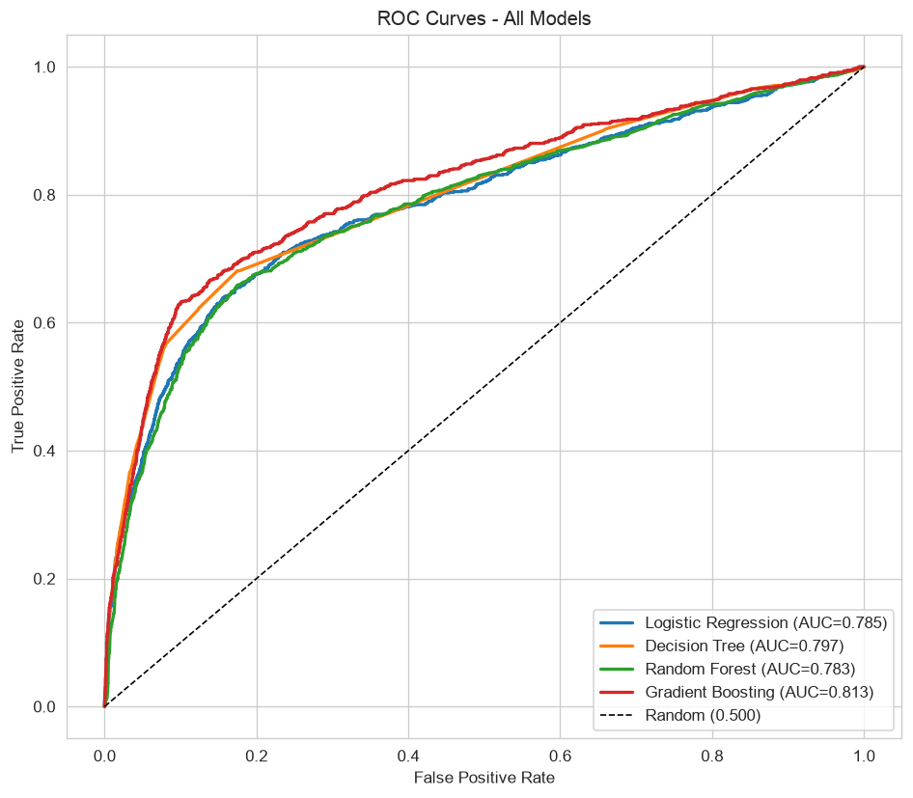
ROC Curves — Visualising Model Discrimination
How well each model separates subscribers from non-subscribers
READING THE ROC CURVE
What is it?
The ROC curve plots the True Positive Rate (subscribers correctly caught) against the False Positive Rate (non-subscribers wrongly flagged) at every possible decision threshold.
The diagonal line
Represents random guessing (AUC = 0.50). Any model above this line is doing better than chance.
Top-left is best
A curve that bows toward the top-left corner catches more subscribers while keeping false alarms low. AUC summarises this in one number.
Our results
Gradient Boosting leads at AUC 0.813, followed by Decision Tree (0.797), Logistic Regression (0.785) and Random Forest (0.783). All four substantially outperform random guessing.
Business meaning
AUC tells us how reliably the model ranks a real subscriber above a non-subscriber. At AUC 0.813, Gradient Boosting ranks correctly about 81% of the time — a strong foundation for lead prioritisation.
Bank Marketing ML Project
Slide 6 of 8

Slide 7
Key Findings and Strategic Recommendations
What the data revealed — and what the bank should do
WHAT THE DATA REVEALED
WHAT THE BANK SHOULD DO
Timing matters as much as targeting.
Score every lead before calling.
The interest-rate environment (euribor3m) is one of the strongest predictors.
Use Gradient Boosting to rank customers from most to least likely to subscribe.
Past subscribers convert at 65%.
Prioritise past subscribers.
A previous subscriber is the most reliable lead in the database.
Systematically re-contact customers who subscribed in previous campaigns.
May is the worst month — and gets the most calls.
Rebalance the campaign calendar.
March, September, October and December convert at 44–51% but receive very few calls.
Shift effort toward March, September, October and December — away from May.
Segments are clear.
Target the right segments.
Students (31%) and retirees (25%) subscribe far above average. Blue-collar workers (7%) far below.
Focus on students, retirees and customers reachable on mobile.
Missing data speaks.
Time campaigns to interest-rate conditions.
Customers who withhold credit-default status subscribe at less than half the usual rate.
Run campaigns when euribor3m signals a favourable savings environment.
Bank Marketing ML Project
Slide 7 of 8

Slide 8
Conclusion
The bank was converting only 11% of its calls because agents were calling without guidance. Using 41,188 records, we cleaned hidden data gaps, built leakage-free features, resolved multicollinearity, handled severe class imbalance, and compared four models on business-relevant metrics. Machine learning revealed that when you call matters as much as who you call, that past subscribers are six times more likely to convert than new contacts, and that the bank's heaviest calling month is its weakest. Gradient Boosting (ROC-AUC 0.813) ranks leads most accurately; Logistic Regression explains the decisions to stakeholders. Together they give the bank a system to achieve the same number of subscriptions from far fewer calls.
The Bottom Line
Let the model decide who to call. Lower cost, higher conversion, decisions grounded in evidence.
Bank Marketing ML Project
Slide 8 of 8

